Slide 1
Fingerprint login - for social networks
Edor kacerja
Academic advisor: prof. V. Karagiozov

Slide 2
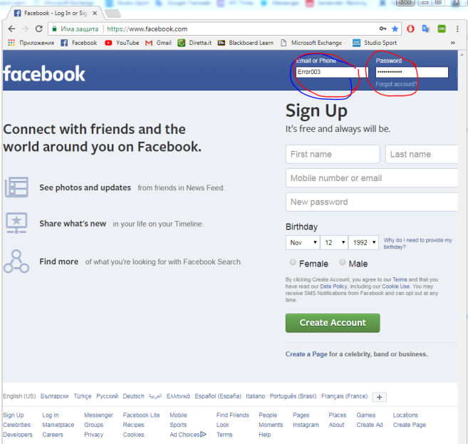
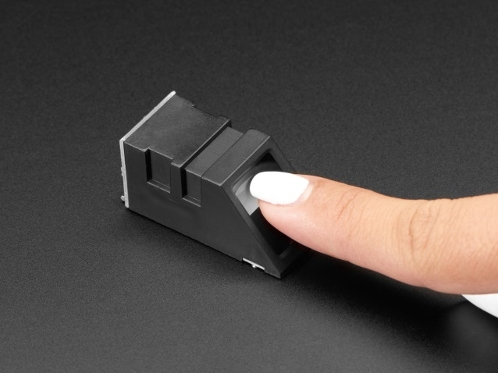
Project description
Just like today we unlock our phones using our fingerprints, I wanted to create a similar shortcut to log in social networks.
With my project, users will be able to login social networks just by placing their finger on the sensor, then they are going to get logged in automatically.

Slide 3
Functional & non-functional requirements
The user should be able to add his login credentials through the java GUI application while having the freedom to choose which Social Network between Facebook, Instagram and Twitter.
The user should be able to enroll fingerprints through the fingerprint sensor and store their images in the database.
The system should recognize a registered fingerprint when the user presses the finger onto the sensor.
The system should fire up a browser and feed the data from the database and log the user in the specified social network automatically.
- Reliability
The fingerprint should work without stopping while the java application is running and only if the user decides to terminate the application the Fingerprint sensor won’t work.
- Privacy
All the passwords that are registered from the users should be encrypted.
- Capacity
The project should be able to store up to 500 fingerprints without an issue.
- Response Time
The application should not take more than 2 seconds to open a browser and login the user to the system provided that there are no problems with the internet.

Slide 4
Software
Arduino Framework
Arduino IDE
C++
Adafruit Fingerprint Sensor Library.
JAVA 1.8
IntelliJ IDE
Serial Port Event Listener Library (RXTX Serial)
B Crypto library
Selenium
JavaFX framework
XAMPP Server
MySQL
Phpmyadmin

Slide 5
hardware
Arduino Uno – The piece of hardware which makes the connection to the fingerprint sensor and the computer. This is a smart device where the different applications for enrolling and detecting fingerprints are uploaded.
Adafruit Optical Fingerprint Sensor – This is where the fingerprint images are taken and processed.
Connecting wires - This is composed of two type of wires, thin ones which make the connection to the sensor and thicker ones which make better contact with the Arduino board.
Breadboard - A device used as a construction base in developing the electronic circuit. Breadboards can be solderless, which allows them to be reusable and easier to set up.
USB type A to USB type B cable - This cable makes the connection of the Arduino to the computer (laptop).

Slide 6

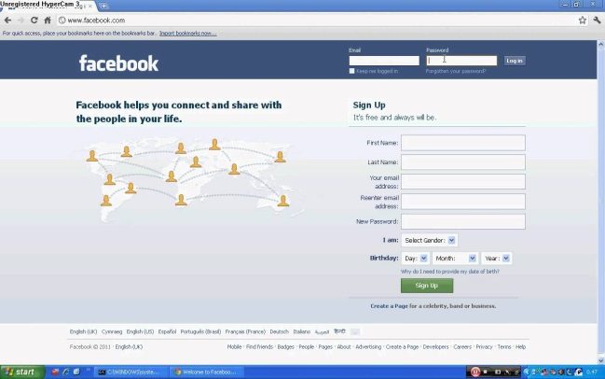
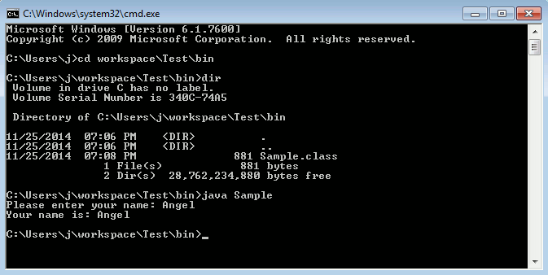
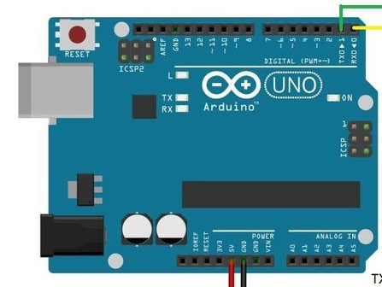

Architecture
JDBC
Selenium
RXTX
Adafruit library

Slide 7
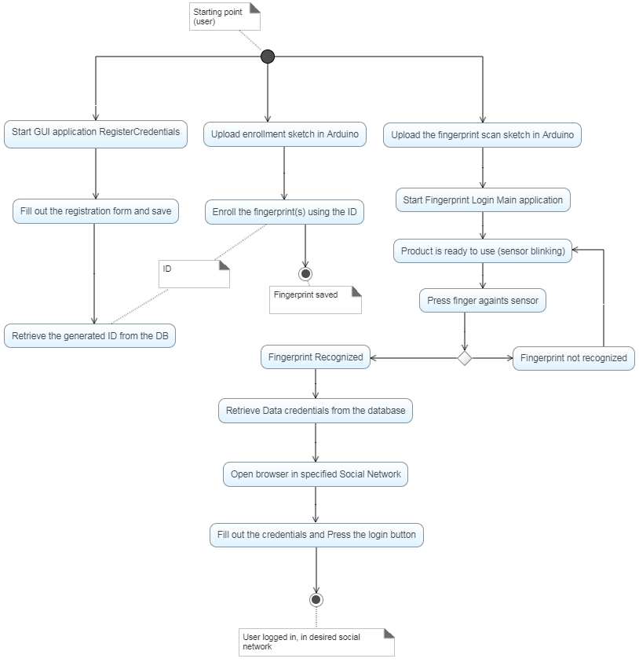

Slide 8
Fingerprint recognition
Fingerprint enrollment
Fingerprint verification
Fingerprint identification

Slide 9
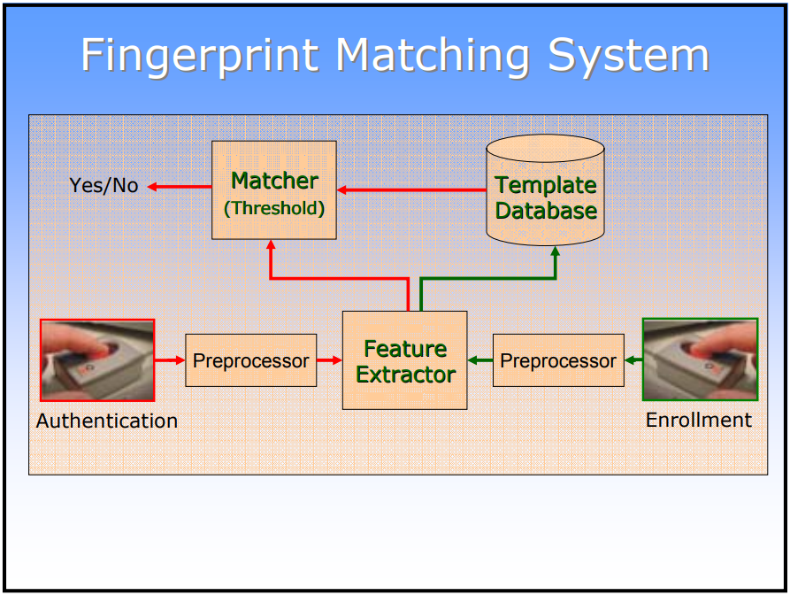
Fingerprint pattern recognition

Slide 10
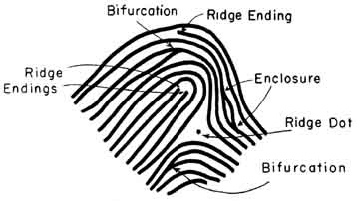
Minutiae fingerprint feature
Bifurcation
Ridge ending

Slide 11
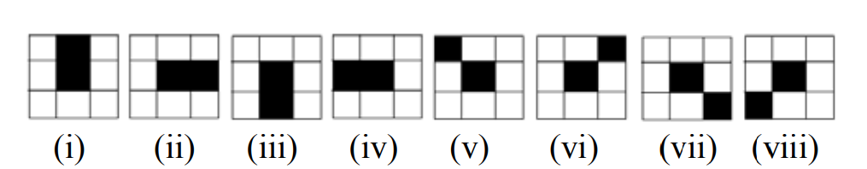
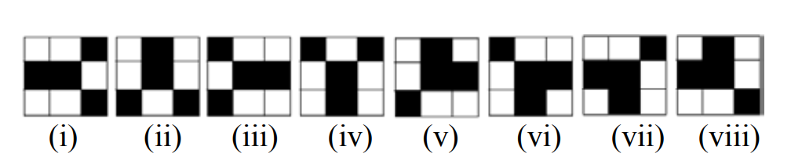
Minutiae extraction
Thinning the image for the ridges to be 1 pixel thick.
Loop through every black pixel
Ridge ending detection Bifurcation detection

Slide 12
Future plans
Reproduce the same sketches but using Java instead of the Arduino’s primary language which is C++. The reason behind this is to make the application more compact because in this I would create a GUI application in java for all the features and modularize the different sketches in different components without having two different java applications and also sketches which should be uploaded via the Arduino IDE.
Add a feature to log out from each platform automatically if someone else is logged in who is not the person registered with the fingerprint.

Slide 13

demo

