Slide 1
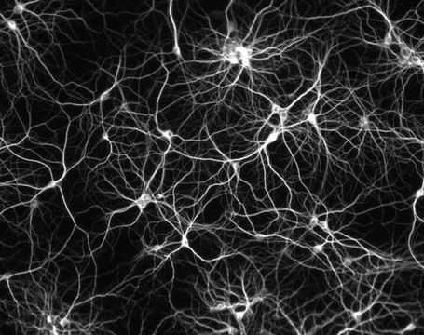



Mycelium: Large-Scale Distributed Graph Queries with Differential Privacy
Edo Roth, Karan Newatia, Yiping Ma, Ke Zhong, Sebastian Angel, and Andreas Haeberlen
Notes:
**Make sure to optimize Zoom for video!**
Hello everybody, my name is Edo Roth and I am going to be talking about Mycelium, which is joint work with Ka-run...

Slide 2
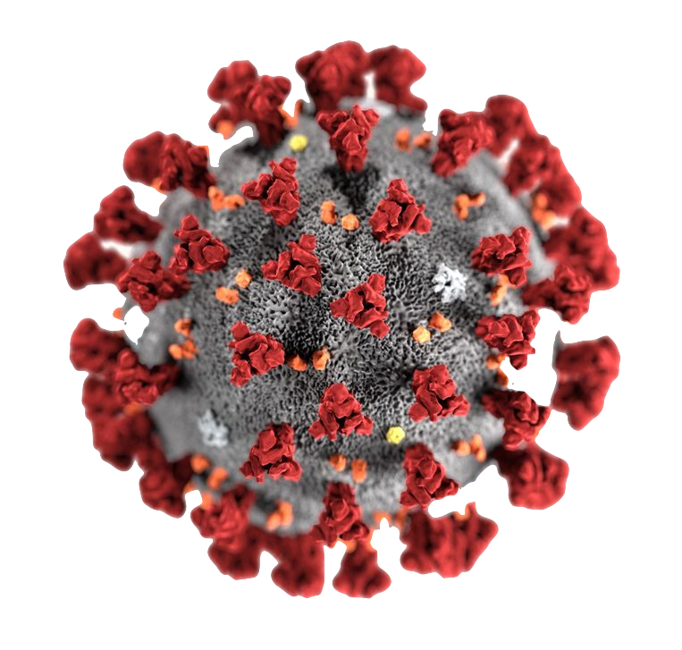

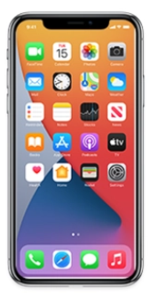

Scenario
🍕
🍔
rate
rate
# people infected
# people infected
0 1 2 3 4 5
0 1 2 3 4 5
If an infected person goes to a pizza place vs. a burger place, how many people become infected?
Example: tracking COVID-19 through a network of people
We want to study how and where it spreads:
E.g., Does it spread more on subways? At restaurants? What are risky behaviors?
Dealing with a massive scale (millions or billions of individuals!)
The necessary data does exist in distributed fashion, as part of GAEN contact tracing
We can’t analyze this data because it’s extremely sensitive:
1) individuals’ infection status and location
2) their connections to others
Notes:
medical community had LOTS of questions about exactly how this spreads, FOR INSTANCE the effect of certain locations or risky behaviors
One toy question we could ask:
answering this kind of question is hard to do in controlled studies, even at very small scales,
and in this case we are dealing with a MASSIVE scale
HOWEVER all of the necessary data happens to already be on our phones, if only we had a way to use it without creating a privacy nightmare!!

Slide 3
What to do?
We could do this with differential privacy (DP)
Guarantees that the output of queries doesn’t leak (too much) information about participating users
Leaks Bob’s input!
0 1 2 3 4 5
0 1 2 3 4 5
With Bob
Without Bob
Differentially Private
0 1 2 3 4 5
0 1 2 3 4 5
0 1 2 3 4 5
0 1 2 3 4 5
With Bob
Without Bob
3
Notes:
If we answer the same query twice, once with data that includes Bob and once
with data that doesn’t
DP protects against this scenario by adding a little bit of imprecision to the answer.
BUT dp does NOT tell us how to actually compute these outputs in a way that doesn't jeopardize privacy.
For instance, suppose we upload all the data in the clear to a central aggregator...

Slide 4



What to do?
We could do this with differential privacy (DP)
Guarantees that the output of queries doesn’t leak (too much) information about participating users
But doesn’t tell us how to compute this securely!
Aggregator
All relevant data
0 1 2 3 4 5
0 1 2 3 4 5
Users (millions or billions)
It’s hard to find any single entity that can be trusted with this sensitive data!
Notes:
DP protects against this scenario by adding a little bit of imprecision to the answer.
BUT dp does NOT tell us how to actually compute these outputs in a way that doesn't jeopardize privacy.
So let’s say we upload all the data in the clear to a central aggregator...
This would work, BUTT

Slide 5

What to do: Distributed Protocol
Previous work Orchard gives a decentralized solution without placing trust in any party
Do infections spread more at pizza places or burger places?
Can handle a variety of ML queries…
BUT…
Aggregator
10
If we try to apply it, Orchard has 3 major problems:
Doesn’t handle graph queries where data isn’t nicely broken down by user
2) We need to protect the adversary from learning the graph, which is sensitive too!
3) We need to make sure participants don’t learn their neighbors’ sensitive data in the process
1
Alice
2
If we wanted a complex computation over an entire graph….
🍕
3
4
Notes:
Fortunately, there already is a system that helps solve this problem
Orchard and Honeycrisp give a solution that doesn't force us to put trust in any party
These systems are good at answering queries that can be boiled down to adding vectors of per-user data, like the number of people who typed the word 'mycelium' today,
these systems support a wide variety of ML queries
but if we want to answer this Q about our pizza place, there are some issues
but here the data isn't nicely broken down by user;
to find the histogram for pizza places, we would have to find the other
users that our infected user Alice came close to while she was there,
and then figure out how many of them were diagnosed with COVID shortly
afterwards. this isn't something that Alice's phone can know by itself,
because the diagnosis would happen much later.
rather, we need to do a complex computation over an entire graph, and we also need to prevent the aggregator from learning that graph, which is sensitive too.

Slide 6
Problem 1: Graph Queries
Our example histogram query has a 2-part structure:
Compute some statistic for each user based on that immediate neighborhood
Aggregate that statistic across the entire user base
In our survey of the medical literature, we found that this [local + global] structure was quite common!
Orchard is good at sums!
Alice knows who she was close to, so if she could ask her contacts who was diagnosed LATER ON:
The final result is the sum of all local histograms!
2
Charlie
1
Alice
0 1 2 3 4 5
0 1 2 3 4 5
BUT 2 problems remain:
How can Alice do this without learning the infection status of her neighbors?
How can she even talk to them?
🍕
Dana
1
0
Bob
Key insight #1: Many queries fit a 2-step structure
Notes:
Our histogram query has a two-part structure: it computes some kind of statistic for each user, based on that user's immediate neighborhood in the graph and then aggregate that statistic across the entire user base
and these turn out to very often be the case in the literature
- which is good because Orchard is already good at sums!
hypothetically for now - Alice's phone knows who she was close to in the pizza place, so, if she could somehow ask those folks whether they were subsequently diagnosed with covid,
she could compute a 'local' histogram for herself, and if everyone did this, we could sum up the histograms and voila, we have the answer!
This immediately raises two problems though:
1)how can Alice do this without learning the infection status of her neighbors, which is private, and
2) how can she even talk to them - the exposure notification system uses pseudonyms and she won't be in communication range anymore by the time they're diagnosed. SO I'll get into this in a second.

Slide 7

Problem 2: Communication
How do nodes communicate with each other?
Infection is often revealed much after initial contact
GAEN (and similar) only provide pseudonyms to preserve privacy!
Devices don’t have the necessary information when they are still in range
When they have the info, they’re no longer able to exchange messages directly!
Strawman #1
456
123
X
Alice wants to send message X to Bob
X
Aggregator learns edge between Alice and Bob!
Alice
Bob
123
456
Notes:
devices can't just communicate when they're in range.
the reason is that infection status is discovered much later, when they're already far away again, and GAEN & don't want them to know specifically who they've been close to, to preserve privacy.
Aggregator learns who was close to whom, which is sensitive information

Slide 8
Problem 2: Communication
Still use aggregator as (untrusted) mediator
Strawman #2
Route through a chain of users using Tor-like onion encryption?
123
789
000
456
We still have to go through the aggregator, which can track the path!
X
X
X
X
X
Aggregator learns edge between Alice and Bob!
Alice
Charlie
Dana
Bob
123
789
000
456
8

Slide 9
Problem 2: Communication
Small set of participating devices act as intermediary mixes
We have many messages being sent at once
Each routing node:
Downloads all messages
Decrypts one layer
Uploads messages to next hops
Aggregator can’t see which input message corresponds to which output!
123
789
123
666
042
456
W
W
Z
Y
Z
Z
Z
Eliot
Francis
Y
666
042
Y
X
Y
X
W
W
X
Charlie
Dana
X
789
000
Alice
Bob
123
456
Key insight #2: We can route user communication using a semi-centralized mix network
Notes:
Not showing the mailboxes or the onion encryption, keep in mind this all happens through this!
this is basically a mixnet, except that we're using the aggregator as an intermediary, and that this leads some interesting technical challenges (e.g., during path setup) that we discuss in the paper.

Slide 10








Problem 3: Local Aggregation
Aggregator
We’ve figured out how to do the local part of each query: communication between nodes and their neighbors through mixnet
But Alice can still learn the infection status of her neighbors!
We fix this with fully homomorphic encryption (FHE) for node communication
This allows for local aggregation and binning (for histograms) in each neighborhood
Full details of the encoding are in the paper!
All the global aggregator must do is add up the ciphertexts (roughly analogous to Orchard)
$$2^{}$$
$$x^{2}$$
$$x^{1}$$
$$1^{}$$
Alice
0 1 2 3 4 5
$$x^{1}$$
$$1^{}$$
$$0^{}$$
$$x^{0}$$
Key insight #3: FHE encoding to protect neighbor data
Notes:
we fix this with FHE etc., which looks something like this
this is more subtle than it may sound, because of our need to support histograms, and limitations with current FHE schemes,
we had to come up with a special encoding to make this practical (in practice, these are polynomials), and more about that is in the paper

Slide 11

Putting it Together
Aggregator
0 1 2 3 4 5
0 1 2 3 4 5
0 1 2 3 4 5
0 1 2 3 4 5
0 1 2 3 4 5
0 1 2 3 4 5
0 1 2 3 4 5
0 1 2 3 4 5
0 1 2 3 4 5
0 1 2 3 4 5
Bob
Bella
Alice
Charlie
Agnes
Chris
0 1 2 3 4 5
0 1 2 3 4 5
0 1 2 3 4 5
0 1 2 3 4 5
0 1 2 3 4 5
0 1 2 3 4 5
0 1 2 3 4 5
0 1 2 3 4 5
0 1 2 3 4 5
0 1 2 3 4 5
🍕
🍔
0 1 2 3 4 5
0 1 2 3 4 5
0 1 2 3 4 5
Notes:
Alice gets 1, "because she has one infected neighbor"
So basically bc less infections spread there, this proves that pizza is far superior to burgers,
But also gives an overview of how the system functions as a whole. Now that I’ve told you how Mycelium works, I’m going to talk about how we evaluated it.

Slide 12
Evaluation
How many queries can Mycelium support?
What are the major costs, to normal users, to committee members, and to the aggregator?
How well does the onion routing protect topology privacy?
How well does Mycelium scale?

Slide 13
Evaluation
How many queries can Mycelium support?
What are the major costs, to normal users, to committee members, and to the aggregator?
How well does the onion routing protect topology privacy?
How well does Mycelium scale?
Full results in paper!

Slide 14
Evaluation - Generality
Surveyed the medical literature on queries about infectious disease
Eval | Query | Description
 | Q1 | Histogram of the number of infections in an infected participant’s two-hop neighborhood, within 14 days
 | Q2 | Histogram of the amount of time A has spent near B, if A is infected within 5-15 days of contact with B
 | Q3 | Histogram of the frequency of contact between A and B, if A infected B
 | Q4 | Secondary attack rate of infected participants if they travelled on the subway
 | Q5 | Histogram of the number of distinct contacts within the last 24 hours, for different age groups
 | Q6 | Histogram of secondary infections caused by infected participants in different age groups
 | Q7 | Histogram of secondary infections based on type of exposure (such as family, social, work)
 | Q8 | Secondary attack rates in household vs non-household contacts
 | Q9 | Secondary attack rates within case-contact pairs in the same age group vs different age groups
 | Q10 | Secondary attack rates at different stages of the disease (incubation period vs illness period)

Slide 15
Evaluation - Generality
Surveyed the medical literature on queries about infectious disease
Can support all but 1 query; not fundamentally incompatible but result of cryptographic parameters
Eval | Query | Description
 | Q1 | Histogram of the number of infections in an infected participant’s two-hop neighborhood, within 14 days
✅ | Q2 | Histogram of the amount of time A has spent near B, if A is infected within 5-15 days of contact with B
✅ | Q3 | Histogram of the frequency of contact between A and B, if A infected B
✅ | Q4 | Secondary attack rate of infected participants if they travelled on the subway
✅ | Q5 | Histogram of the number of distinct contacts within the last 24 hours, for different age groups
✅ | Q6 | Histogram of secondary infections caused by infected participants in different age groups
✅ | Q7 | Histogram of secondary infections based on type of exposure (such as family, social, work)
✅ | Q8 | Secondary attack rates in household vs non-household contacts
✅ | Q9 | Secondary attack rates within case-contact pairs in the same age group vs different age groups
✅ | Q10 | Secondary attack rates at different stages of the disease (incubation period vs illness period)
Notes:
we surveyed the literature, and we picked a collection of representative queries.
of the queries we’ve collected, we can support almost all, except one due to the limiations of the specific FHE scheme we used

Slide 16
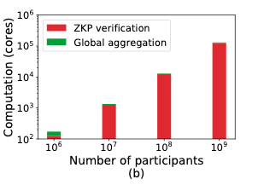
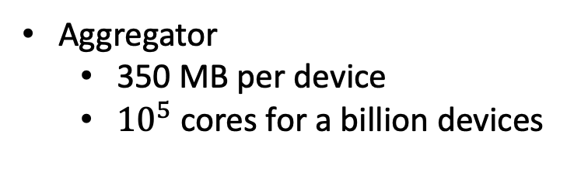
Evaluation - Scalability
Can’t simulate a billion devices; measured costs for individual components of the system
Scales roughly linearly in the number of total users!
For users there is essentially no dependency on participant total!
Average participants
430 MB of traffic
15 minutes of computation
Aggregator
350 MB per device
${10}^{5}$ cores for a billion devices
Scales to a billion devices!
Notes:
We estimated costs for up to a billion devices
most of the costs are roughly linear in the number of users, with a small logarithmic factor in the mix.
For users...
FOR INSTANCE, the amount of computation the aggregator would need is going to be shown here
# of participants up to a billion on x-axis
Computation in cores on the y-axis
The aggregator will have access to a data center, and so the costs should be within their capabilities
Some average costs are as follows:
The takeaway is that we can scale up to a billion!

Slide 17
Summary
Problem: graph queries at massive scale with an untrusted aggregator and need for privacy guarantees
Mycelium: first system to support differentially private analytics on graph queries on the scale of up to a billion users
Key Insights:
2-step process of local and global aggregation
Semi-centralized mix network for topology privacy
Using FHE encoding to support histograms
Supports many queries; scales roughly linearly in number of users
Questions?
Contact: edoroth@seas.upenn.edu

