Slide 1
FriendZone
Iteration 3

Slide 2
Team Members
Ed Orsini - Team Leader / Configuration Leader
Robert Gomez - Environment and Integration Leader
Arpita Vats - Requirement Leader
Ravi K Rajendran - Design Leader
Nick Hattabaugh - Implementation Leader
Cory Stone - QA Leader
Michael Eskowitz - Security Leader

Slide 3
Outline
Product (Rob)
Requirements (Arpita)
Design & Architecture (Arpita)
Implementation (Ravi)
Testing (Cory)
Deployment (Nick)
Management (Ed)
Risk & Metrics (Cory)
Process (Ed & Mike)
Our Iterations (Ed & Mike)
Improvements & Lessons (Rob)
Demo (everyone)

Slide 4
Product
FriendZone - Social Networking app
We made a website where you can interact with your friends by browsing/posting on their profiles as well as being able to chat with them.
Features
Friends network
Being able to add Friends into your friends list
Real time chat
Being able to communicate real time with other users of the website
Profiles/Wall posts
Being able to browse through different user’s profiles and being able to post on their wall as well as comment on a Post.
Picture upload
Being able to upload pictures onto your profile

Slide 5
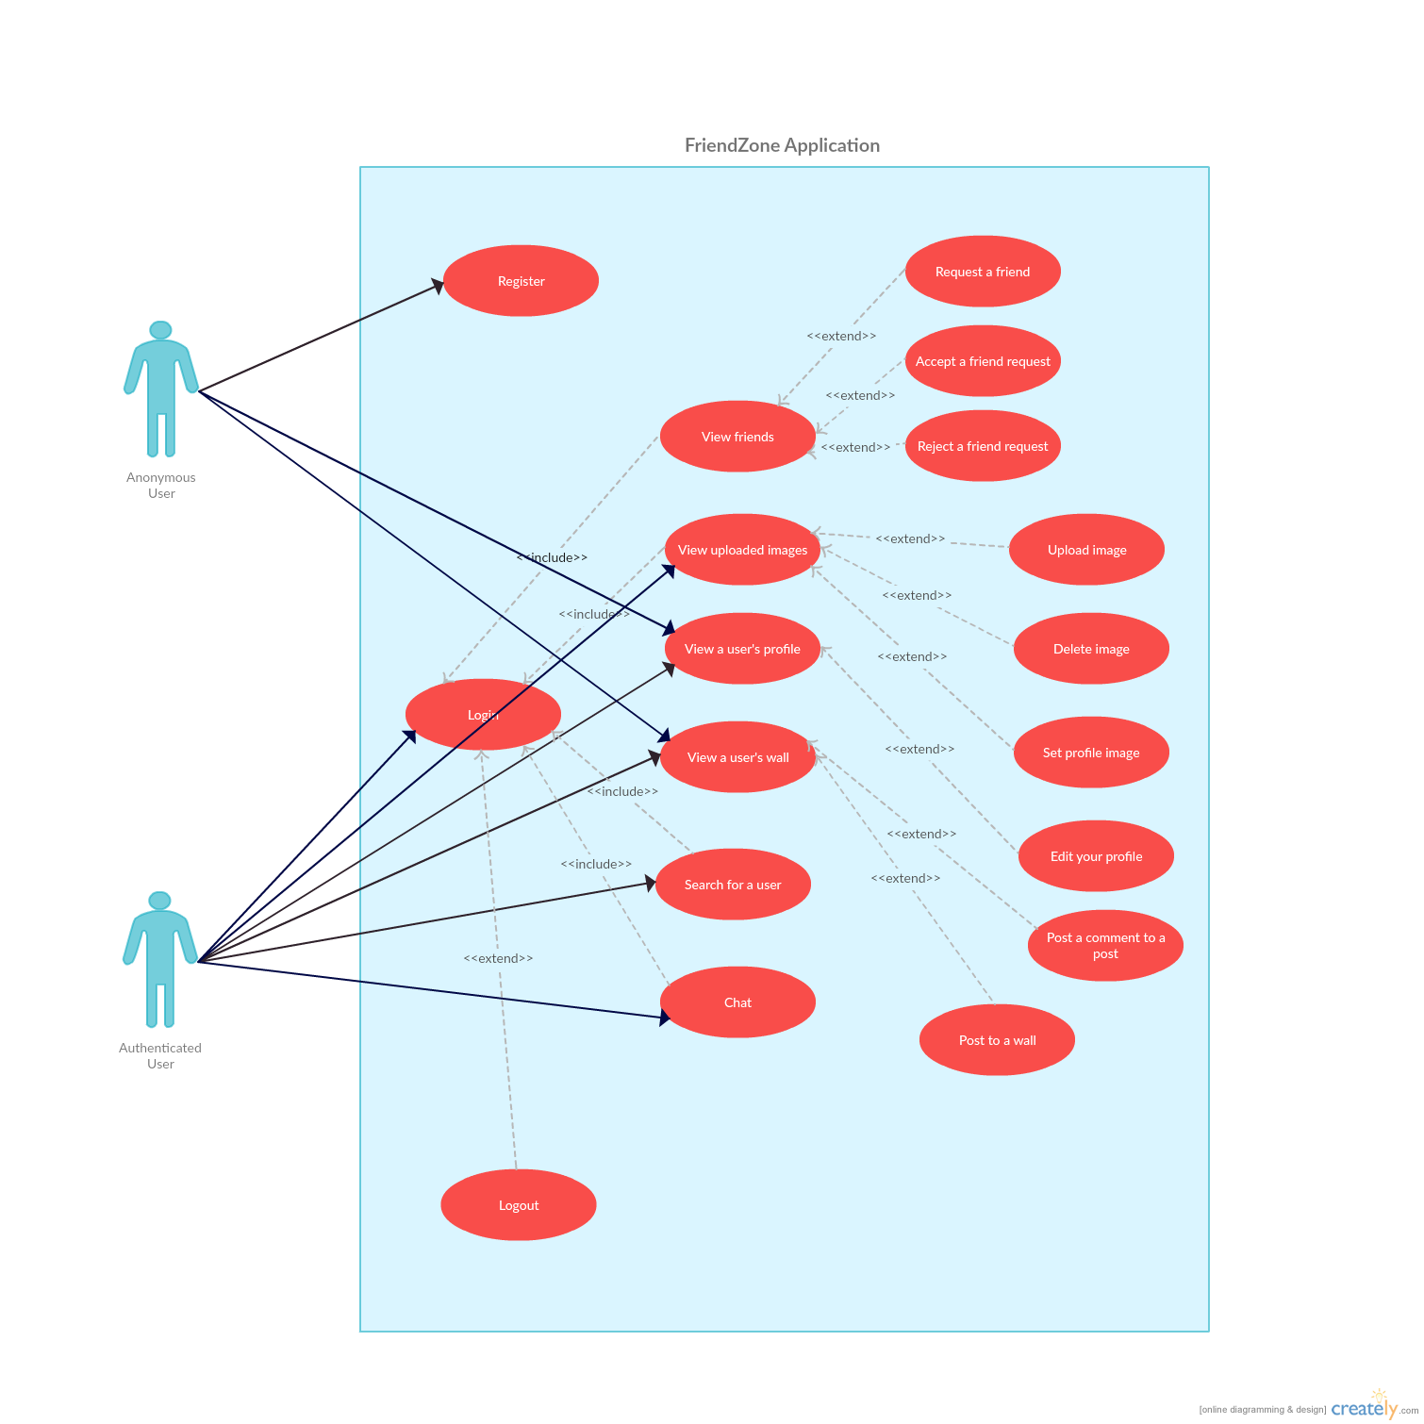
Use Case Diagram

Slide 6
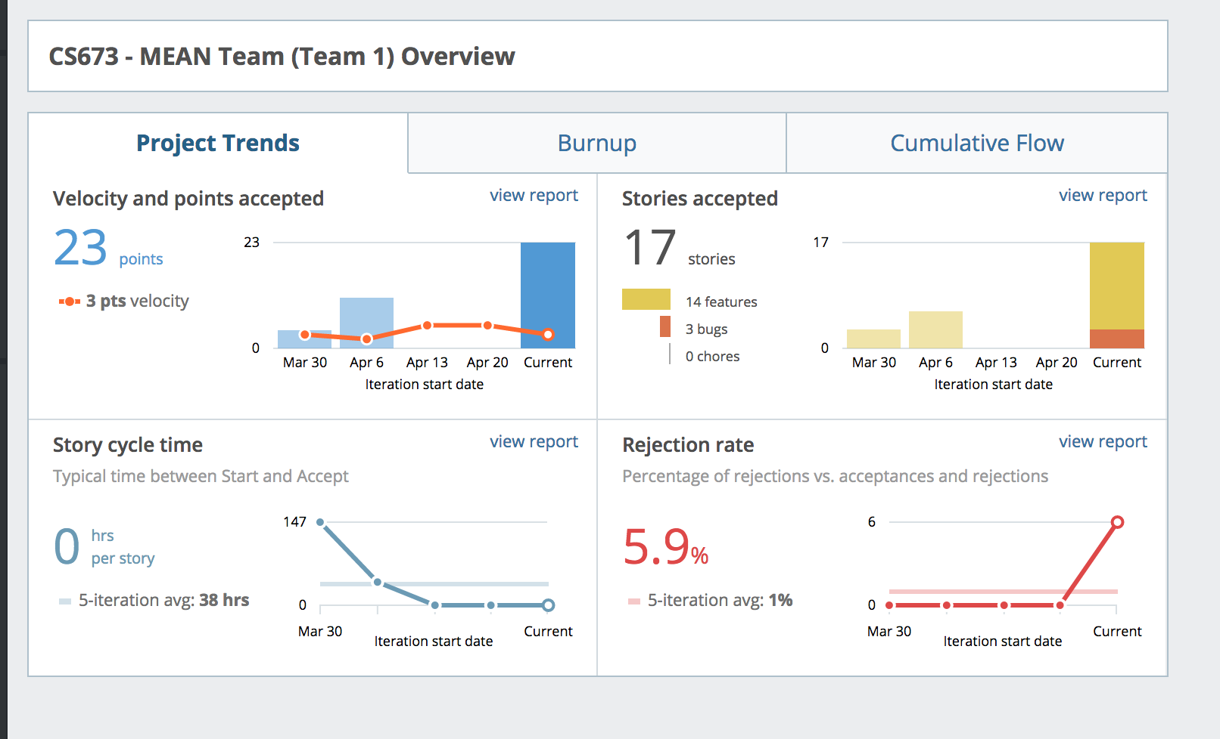
Stories Overview

Slide 7
Sample User Stories [1]
Story:
As a user, I want to login with my Google credentials, so that I don't have to remember another username and password
Acceptance:
Given I am not logged in
When I view the login page
Then I should see a button that says "Sign in with Google"
Given I am not logged in and I do not have a FriendZone account
When I click the "Sign in with Google" button on the login page and enter a valid Google username/password
Then a FriendZone account with my Google email address should be created for me and I should be logged in
Tasks:
Register app on Google
Configure FriendZone to use Google app for OAuth
Status: Acceptance criteria implemented.

Slide 8
Sample User Stories [2]
Story:
As a logged in user, when I look at my friends list, I want to see a list of my friends.
Acceptance:
Given I have no friends, when I view my friends list , then I should see no friends.
Given I have multiple friends, when I view my friends list , then I should see each friend's username and profile picture.
Tasks:
Create new route, controller, schema, and template responsible for this new feature
Test
Status: Acceptance criteria implemented.

Slide 9
Sample User Stories [3]
Story:
As a user, I want to see a user's profile information and wall posts on a single page, so that I have a more cohesive viewing experience.
Acceptance:
Given I am a logged in user,
When I view a user's profile page,
Then I should see that user's profile information on the left and their entire wall history on the right
Tasks:
Combine profile information and wall controllers into a single view
Status: Acceptance criteria implemented.

Slide 10
Sample User Stories [4]
Story:
As a logged in user, I want to chat with other users of the website in a public chat room, so that we could chat in real time.
Acceptance:
Given that I am logged in,
when I click on the chat room,
then I can begin communicating in real time with other Users in the general chatroom.
Given that I am logged in, when I click on the chat room, type a message and click submit , then I should see my message and other users should see my message as well.
Tasks:
Create server side socket for chatroom.
Create chat client to connect to the server side socket.
Upon connection messages sent to the server by any client will be then forwarded to all other users that are connected to the chat socket.
Enter directive to allow messages to be sent by pressing enter.
Automatically scroll chat window to latest message sent or received
Status: Acceptance criteria implemented.

Slide 11
Sample User Stories [5]
Story:
As a user I would like to make posts on my wall so that my friends know what I am doing at any given moment.
Acceptance:
Given a logged in user viewing a page, when I submit a post, then I should see my post pop up right away at the top of the wall
…
Tasks:
Create view and controller to submit a post
Create model and service for api call
Test
Status: Acceptance criteria implemented.

Slide 12
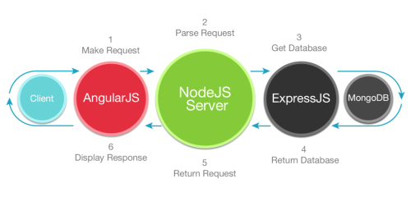
Architecture & Design

Slide 13
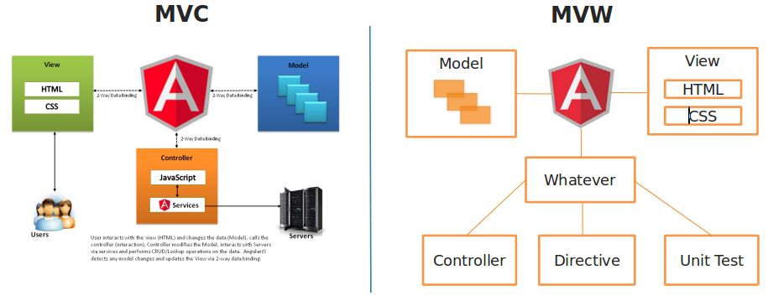
Angular’s MVW versus traditional MVC

Slide 14
Benefits of the MEAN stack
Reduces complexity
Increases maintainability
Organizes code
Core is JavaScript
JavaScript is a very popular language (top 10 according to Tiobe index)
JavaScript is used for the entire application (from front-end to back-end)
It supports the MVC architecture
The components are open source which get updated regularly
Great community and available resources

Slide 15



Implementation
Client
SEND
JSON
AJAX
Server
SEND
JSON
GET/POST
TO DB
Database

Slide 16
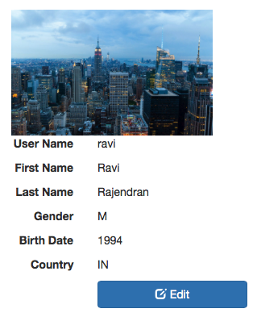
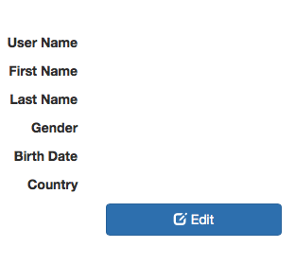
Implementation

Slide 17
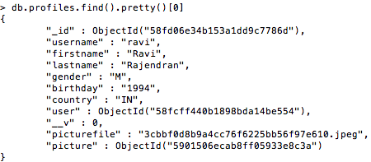
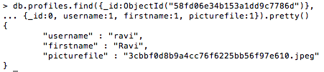
Implementation
SEND
JSON
GET/POST
TO DB
Database

Slide 18
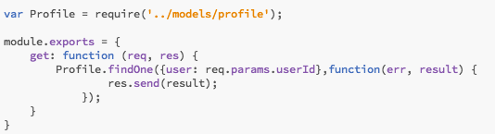
Implementation
SEND
JSON
GET/POST
TO DB
Database

Slide 19
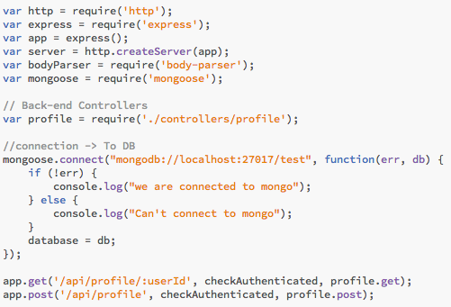
Implementation
SEND
JSON
AJAX
Server
SEND
JSON
GET/POST
TO DB

Slide 20
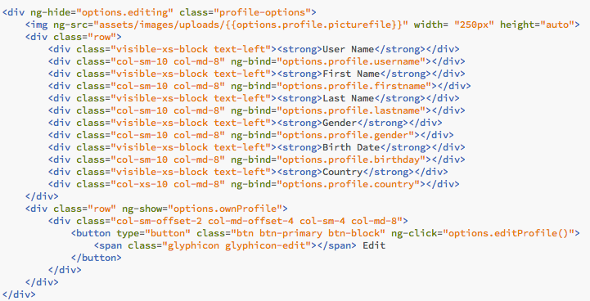
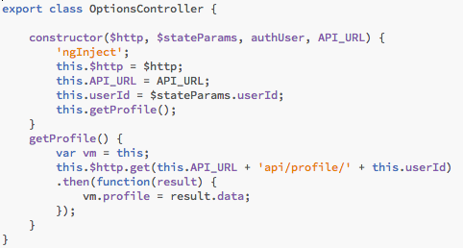
Implementation
Client
SEND
JSON
AJAX
{{options.profile.username}}
{{options.profile.firstname}}
{{options.profile.lastname}}
{{options.profile.gender}}
{{options.profile.birthday}}
{{options.profile.country}}

Slide 21
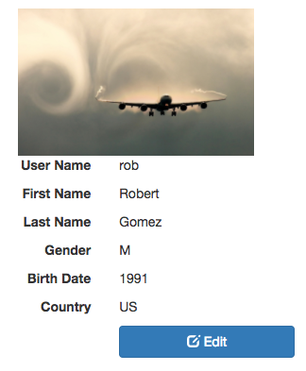
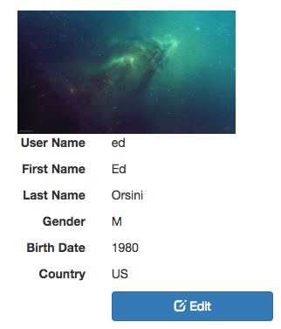
Implementation
Client
SEND
JSON
AJAX

Slide 22
Implementation
CONTROLLERS
BACK-END
MODELS
SERVER.JS
APPLICATION
INDEX.HTML
APP
INDEX.MODULE
FRONT-END
INDEX.ROUTES
ASSETS
HTML
FEATURES
CONTROLLERS

Slide 23
Implementation
CONTROLLERS
AUTHORIZATION
CHATMESSAGE
CHAT
MODELS
FRIEND REQUEST
FRIENDS
PICTURE
SERVER.JS
FRIEND REQUEST
POSTCOMMENT
PICTURE
PROFILE
POST COMMENT
USER
PROFILE
SEARCH
WALLPOST
WALLPOST

Slide 24
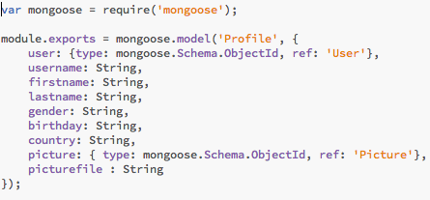
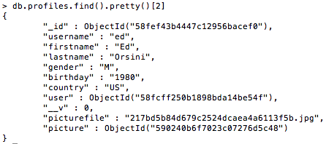
Implementation
PROFILE
Schema
Data (JSON)

Slide 25
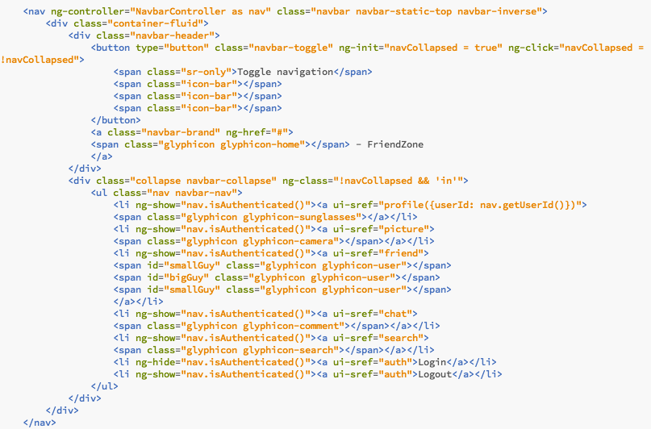
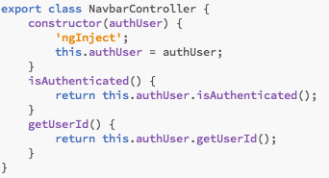
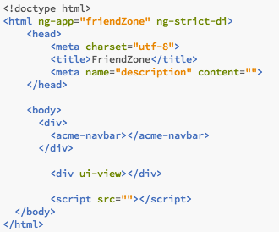
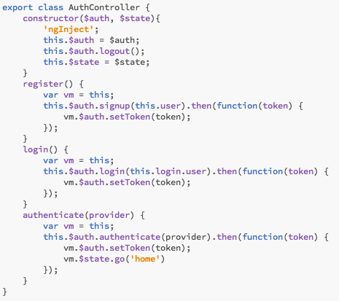
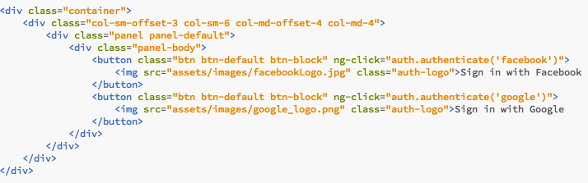
Implementation
Navigation
Controller.js
Given by index.route
(stateProviders)
HTML

Slide 26
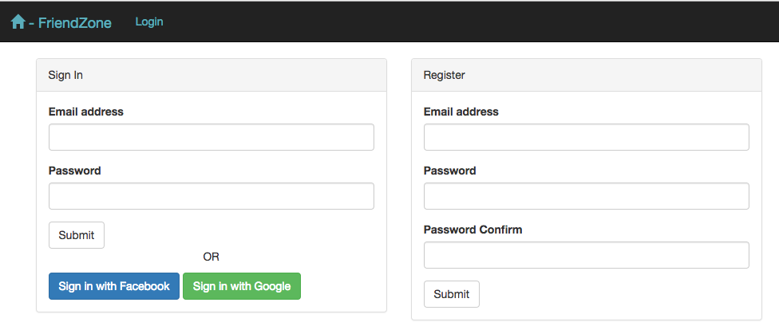
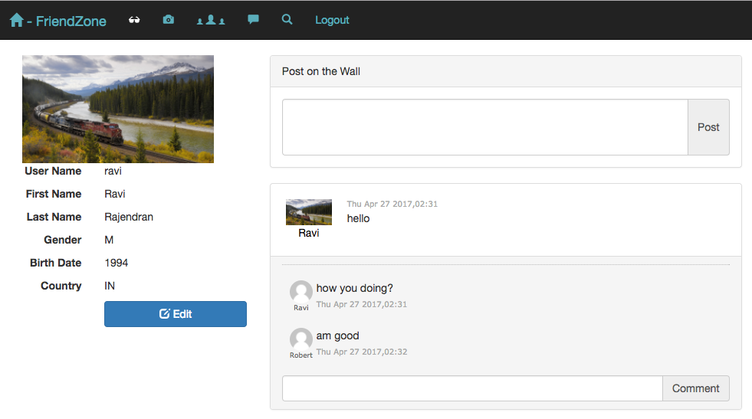
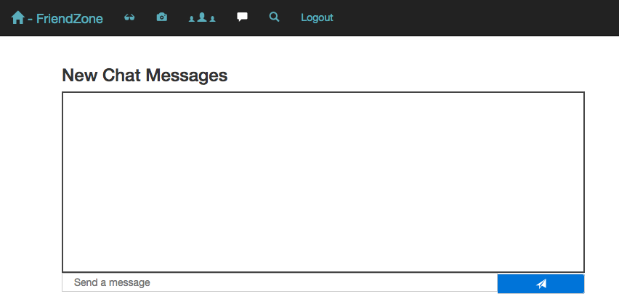
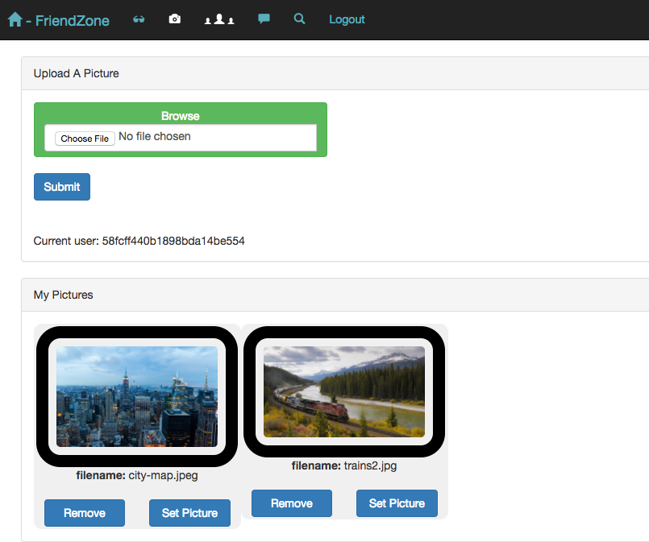
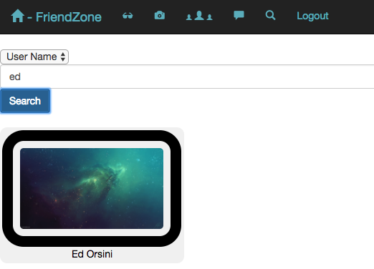
Implementation
ROUTES
stateProvider()

Slide 27
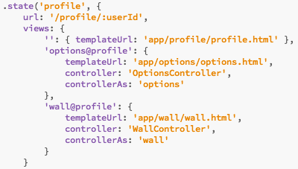






Implementation
ROUTES
stateProvider()

Slide 28
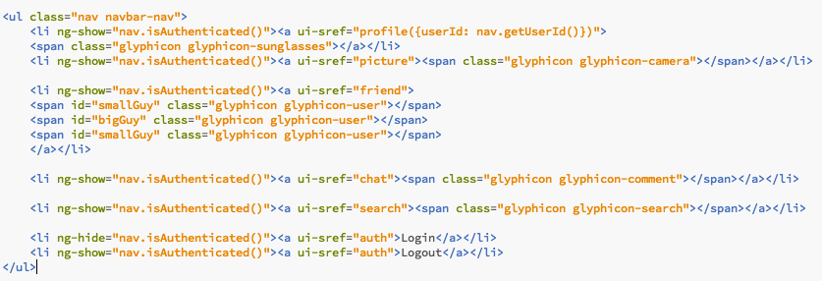
Implementation
PROFILE
PICTURE
FRIEND
CHAT
SEARCH
LOGIN / LOGOUT

Slide 29
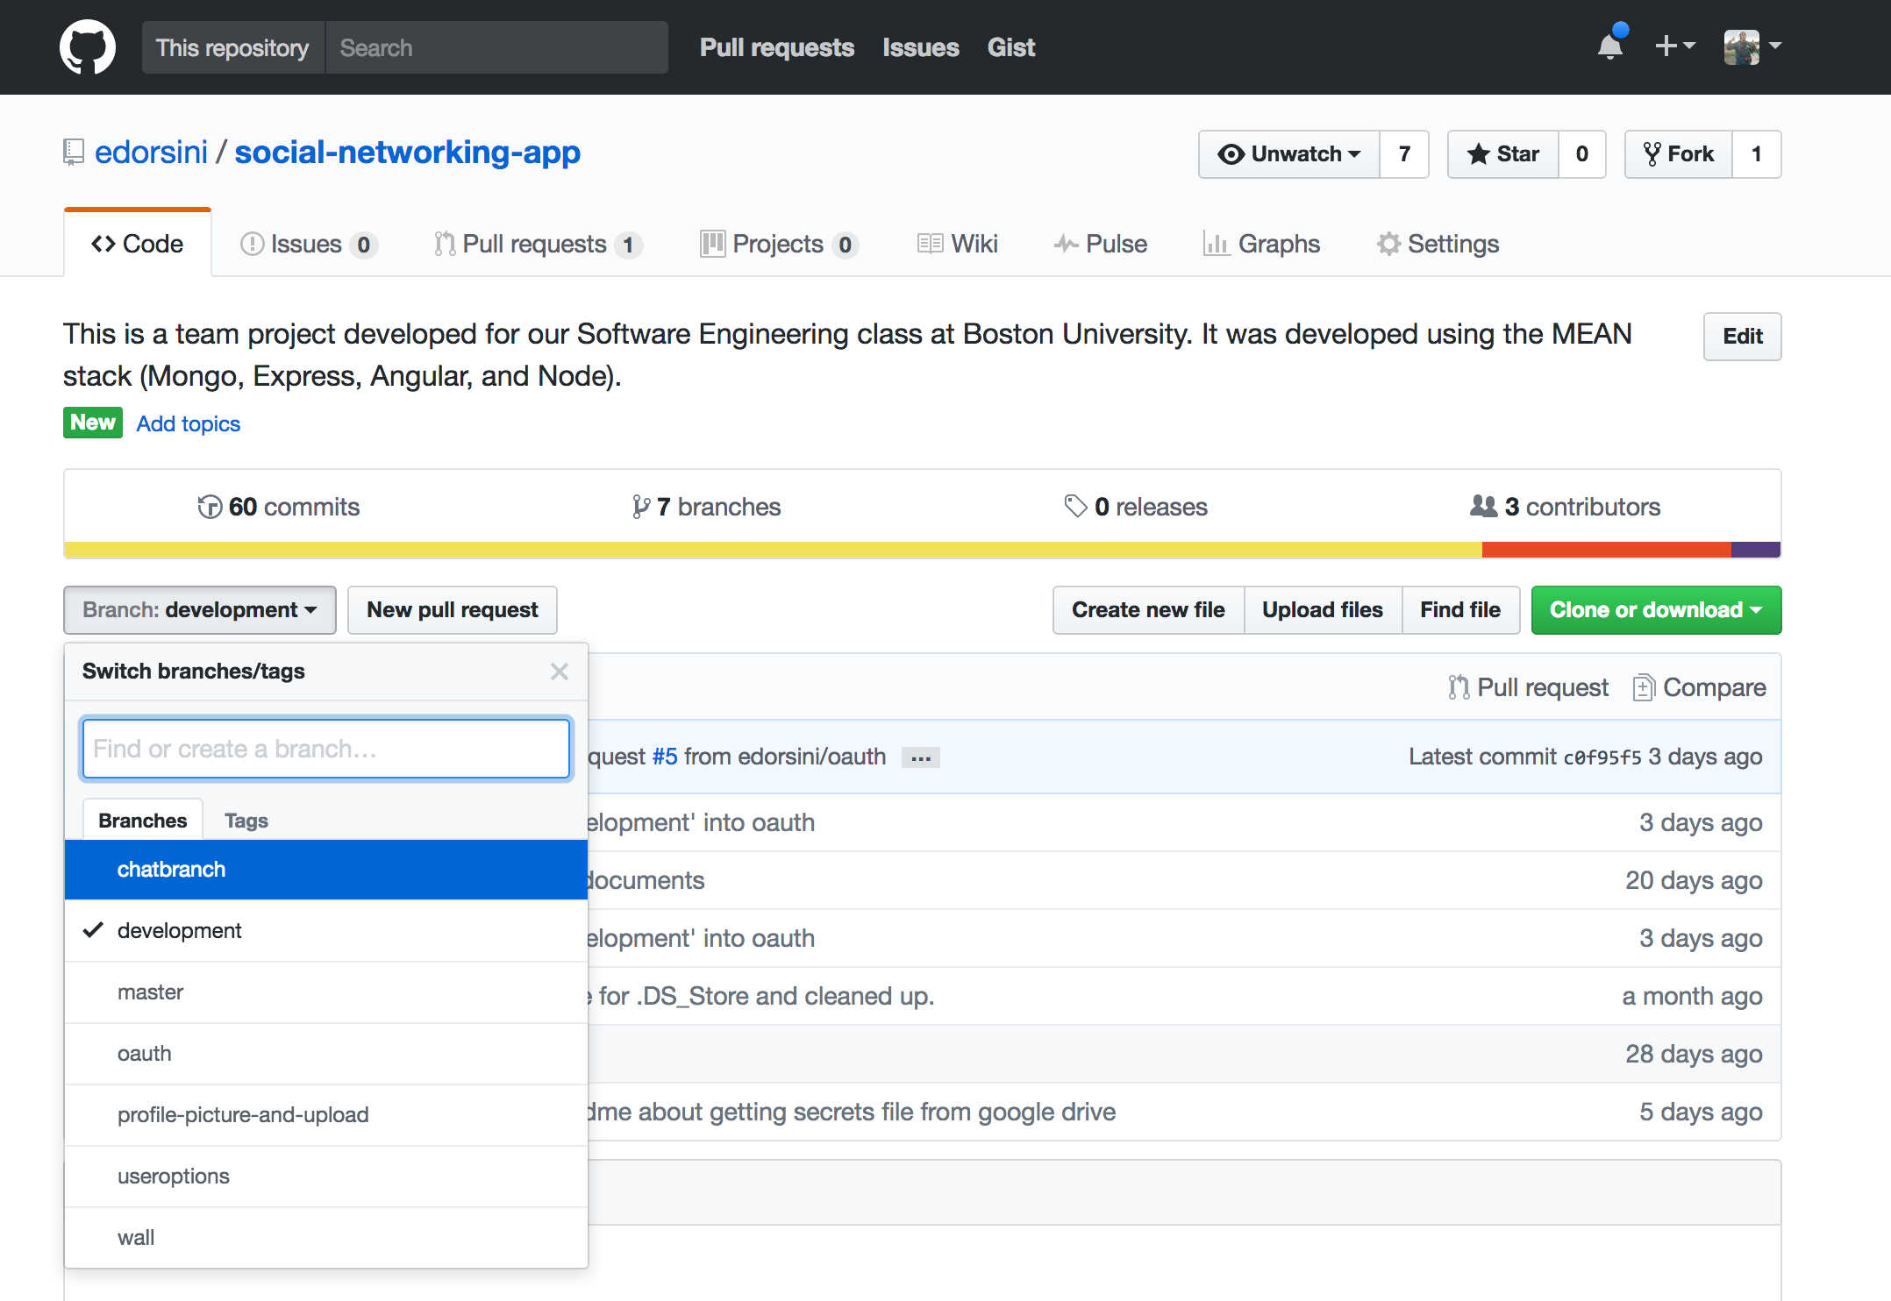
Configuration Management
Each feature received its own branch
When the feature was completed, the code was integrated into the development branch
After testing and validation of the development branch, the code was integrated into the master branch

Slide 30
Configuration Management
We continually attempted to optimize our development process throughout the project.
Worked directly on the development branch
Directly tested everyone’s work constantly while working on our own features
Resulted in much faster development cycles
Eliminated the time used to merge branches
Felt more like a truly continuous integration approach
https://softwareengineering.stackexchange.com/questions/107884/to-branch-or-not-to-branch

Slide 31
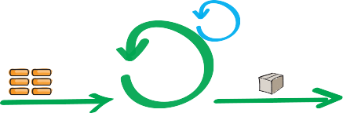
Our Process

Slide 32
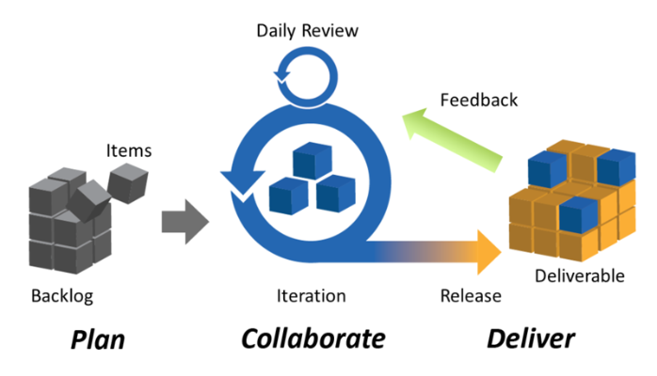
Agile Scrum

Slide 33
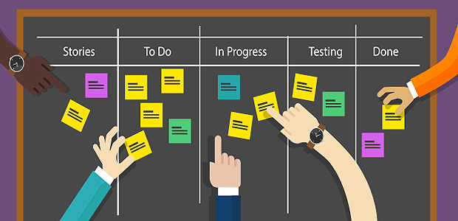
Our Scrum Board (Pivotal Tracker)

Slide 34

Iteration 0
What we accomplished:
As a group, we Brainstormed and decided what to design and create for the class project
Selected a technology stack
Gathered requirements for the application
Created a skeleton app for the team to start learning and playing with
Placed a skeleton code base on GitHub

Slide 35
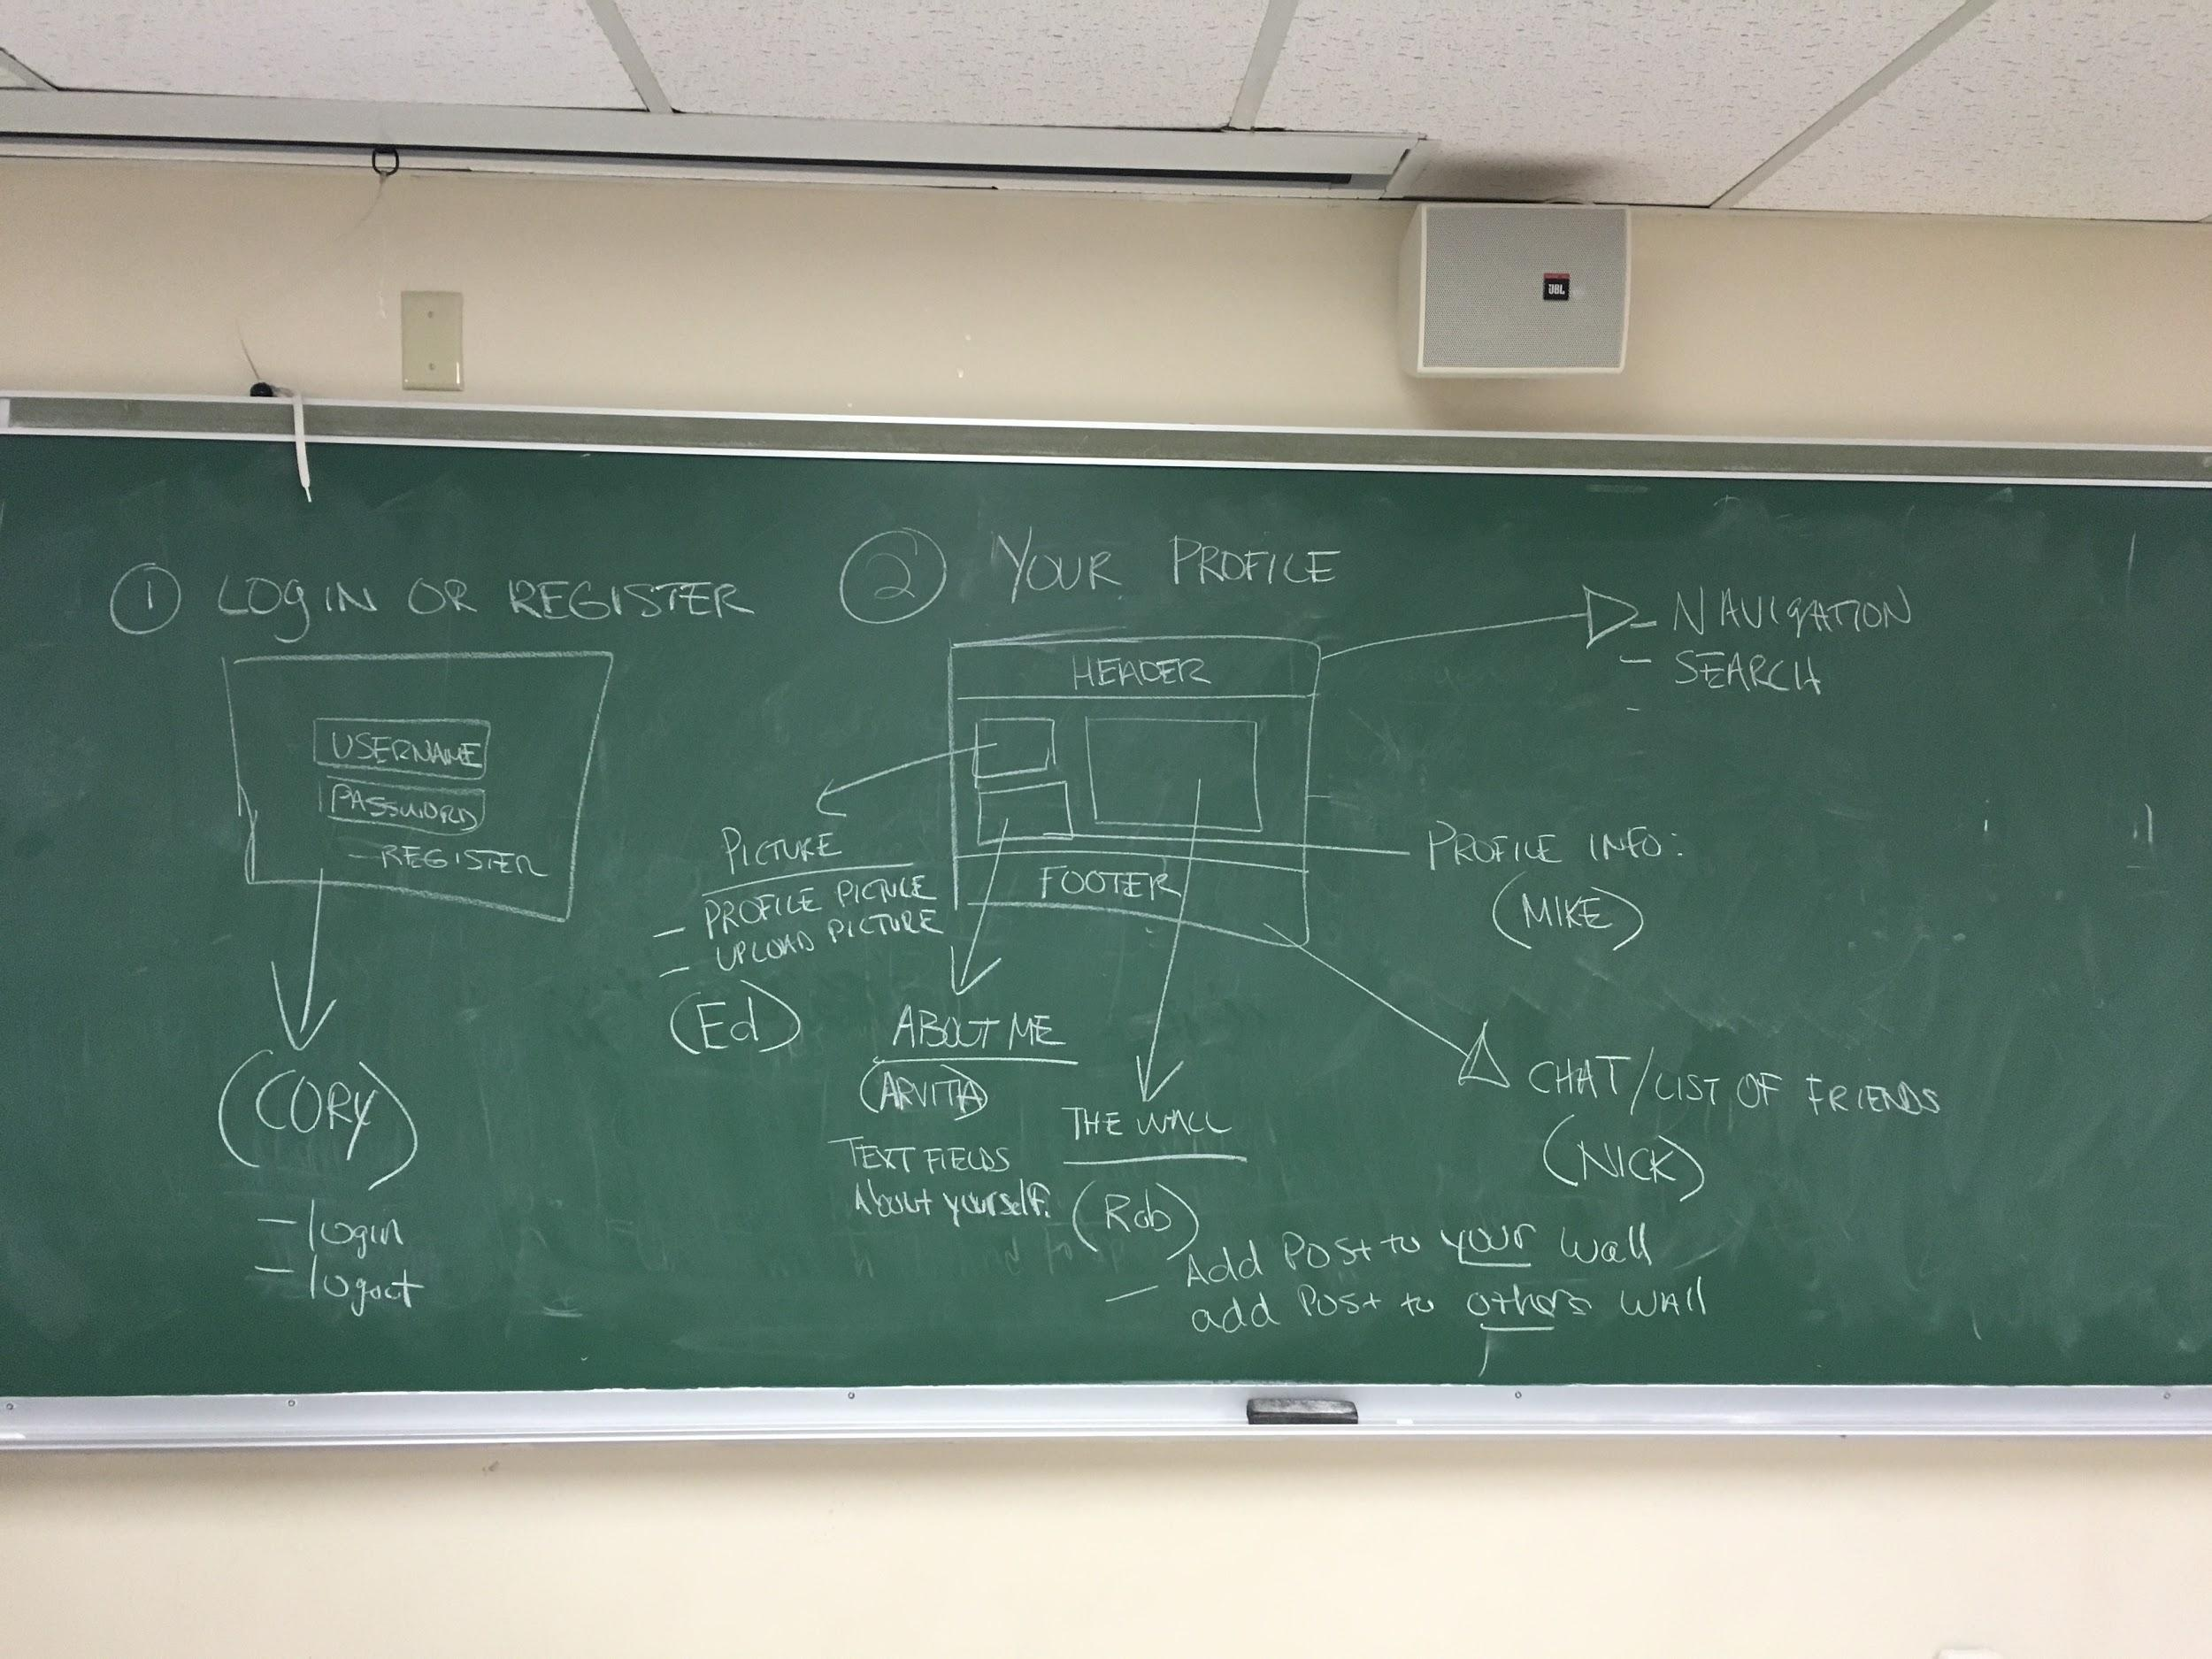
Iteration 1
What we accomplished:
Prioritized features for our application and selected those of highest priority to be implemented
Normal/local authentication
Authentication with Facebook
Wall posts and commenting
Profile image uploading
Assigned features to individual team members so that development could occur independently

Slide 36

Iteration 2
Based on the results of our previous iteration, we adjusted how we approached task delegation.
Again we selected the most important features/stories for our app
We elected to work more closely using a team-oriented approach (instead of everyone working on their own individual feature/branch)
We began working directly on the development branch
We made sub-teams so that we could share knowledge between members and also minimize communication between the entire team
Sub-teams were as follows:
Team 1 - Cory, Mike (wall, profile)
Team 2 - Nick, Arpita, Ravi (chat)
Team 3 - Ed, Rob (friends)

Slide 37
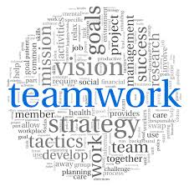
Iteration 3
Based on the results of our previous iteration, we further fine-tuned our workflow.
We continued the team-oriented approach from the previous iteration.
We reshuffled our sub-teams to encourage team collaboration with the goal of getting everyone involved.
We relied more heavily on in person meetings as they were more effective when attempting to integrate and debug our application.
Sub-teams were as follows:
Team 1 - Cory, Mike, Arpita (wall, profile, authentication cleanup)
Team 2 - Nick, Cory (deployment, chat clean up)
Team 3 - Ed, Rob, Ravi (friends, upload profile image clean up, set profile image)

Slide 38
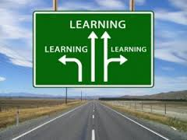
Lessons Learned
We found that in person meetings produced greater results
Meeting in person was difficult as we do not all physically work in the same location everyday
We also found that we could introduce/swap members to other sub-teams to increase productivity
As developers, we are always optimistic; reality is that everything takes time
Even improvement takes time
We can always improve as long as we are looking for those opportunities
Working out of one branch instead of feature branches
We are always learning!

Slide 39
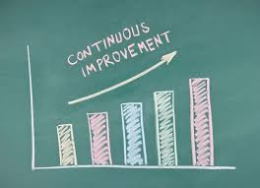
Improvements We Strived For
Created a supportive environment for everyone
Lead by example
Adapted and evolved
Learned to get out of the way
Listened to everyone
Recognized members’ contribution
Trusted our teammates
Persistence
Recognized that there is always room for improvements
Recognized mistakes
Pay attention to what works
Share what works with the team

Slide 40
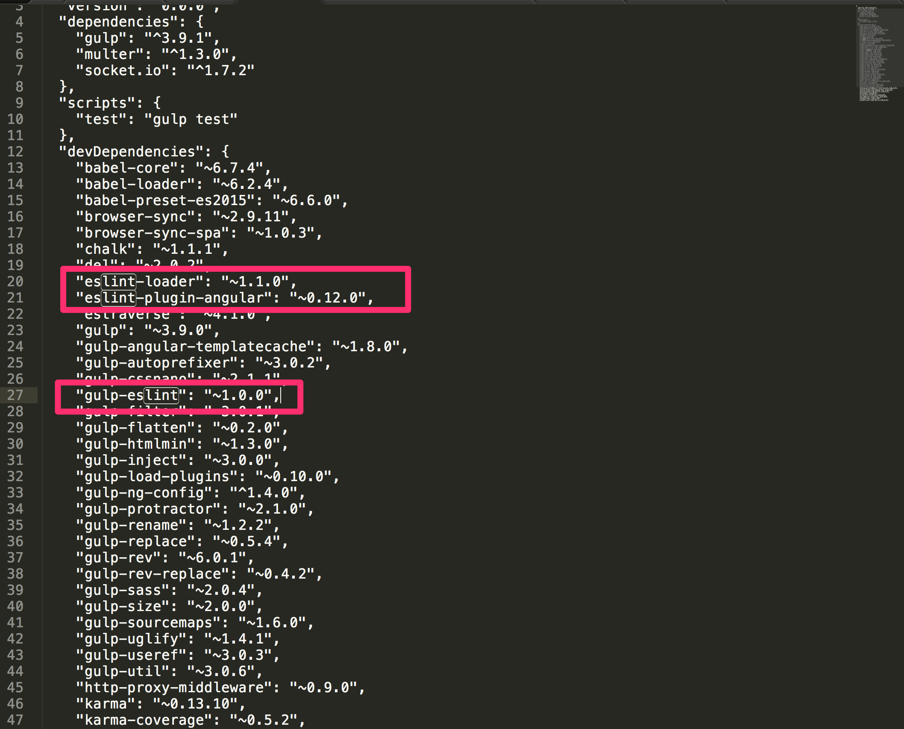
Static Analysis
eslint:
ESLint is an open source project originally created by Nicholas C. Zakas in June 2013. Its goal is to provide a pluggable linting utility for JavaScript.
eslint-loader:
es lint loader for Webpack.
eslint-plugin-angular:
ESLint rules for your angular project with checks for best-practices, conventions or potential errors.
gulp-eslint:
A Gulp plugin for identifying and reporting on patterns found in ECMAScript/JavaScript code.

Slide 41
Testing Summary
Unit tests
57 Passed
2 Failed
System testing
36 Passed
2 Failed
Acceptance testing
17 Passed
0 Failed

Slide 42
Metrics
Process
Size: 2615 lines of code
Defect density: 1 defect / 871.6 LOC
Product
Story points: 38 planned, 36 completed
Defects detected: 6
Defects resolved: 6
Cost: 15 man-hours testing vs 205 man-hours total

Slide 43
Demo
http://www.friend-zone.me

