Slide 1
FriendZone
Iteration 1

Slide 2
Team Members
Ed Orsini - Team Leader / Configuration Leader (presenting)
Robert Gomez - Environment and Integration Leader
Arpita Vats - Requirement Leader (presenting)
Ravi K Rajendran - Design Leader
Nick Hattabaugh - Implementation Leader
Cory Stone - QA Leader
Michael Eskowitz - Security Leader (presenting)

Slide 3
Outline
Requirements
Stories
Architecture/Design
Implementation
Configuration Management
Quality Assurance / Testing
Schedule / Roadmap
Demo

Slide 4
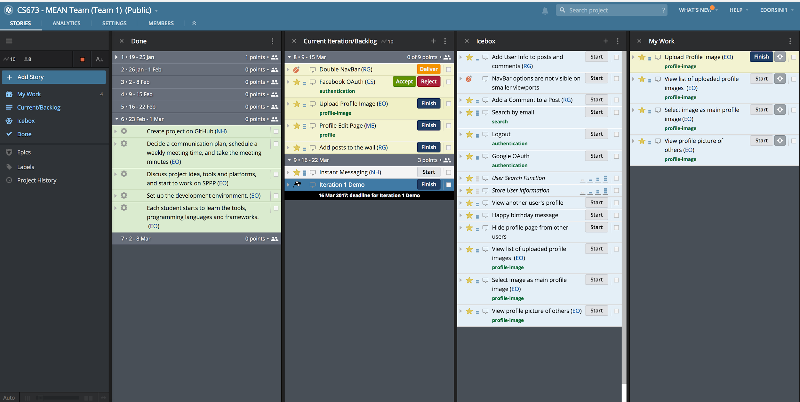
User Stories

Slide 5
Sample User Stories [1]
Story:
As a logged in user, I want to upload an image file so that I could see a list of all the files I’ve uploaded.
Acceptance:
Given that a user is logged in and on “profile image” page, when the user selects an image file and clicks the “upload” button, then the image will be uploaded to a specific directory on the server.
Tasks:
Learn about module that would allow upload functionality with the MEAN stack. May need to pick from a set of modules so I would need to research.
Install the module(s) that are desired for the upload.
Create new route, controller, schema, and template responsible for this new feature
Test
Status: Acceptance criteria implemented.

Slide 6
Sample User Stories [2]
Story:
As a logged in user, I want to view a list of all the image files that I’ve uploaded so that I could select or change my profile picture.
Acceptance:
Given a user is logged in, when the user clicks on “profile image”, then the list of all image files that have been uploaded will be displayed in thumbnail format.
Tasks:
Create query to retrieve all the image files that are associated with the user’s profile
In corresponding template, iterate through query results and display the image accordingly so that each row contains a new image file with a thumbnail
Test
Status: Acceptance criteria partially implemented.

Slide 7
Sample User Stories [3]
Story:
As a user, I want to login in with my Facebook credentials, so that I don't have to remember another username and password
Acceptance:
Given I am not logged in and I do not have a FriendZone account, when I click the "Sign in with Facebook" button on the login page and enter a valid Facebook username/password, then a FriendZone account with my Facebook email address should be created for me and I should be logged in
…
Tasks:
Register an application on Facebook (.5h)
Update our login page to have a button that triggers Facebook OAuth (.5h)
If no user is associated with the facebook ID, create a new account and save the facebook ID and facebook email address with that account (1h)
Create and return an authentication token for the user associated with the facebook ID (.5h)
Load properties from a secrets file for access within the app (1h)
Test
Status: Acceptance criteria implemented.

Slide 8
Sample User Stories [4]
Story:
As a user I would like to make posts on my wall so that my friends know what I am doing at any given moment.
Acceptance:
Given a logged in user viewing a page, when I submit a post, then I should see my post pop up right away at the top of the wall
…
Tasks:
Create view and controller to submit a post
Create model and service for api call
Test
Status: Acceptance criteria implemented.

Slide 9
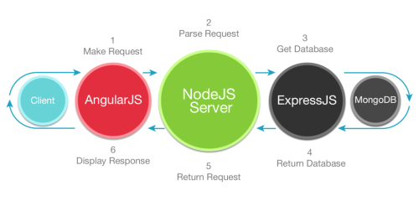
Architecture & Design

Slide 10
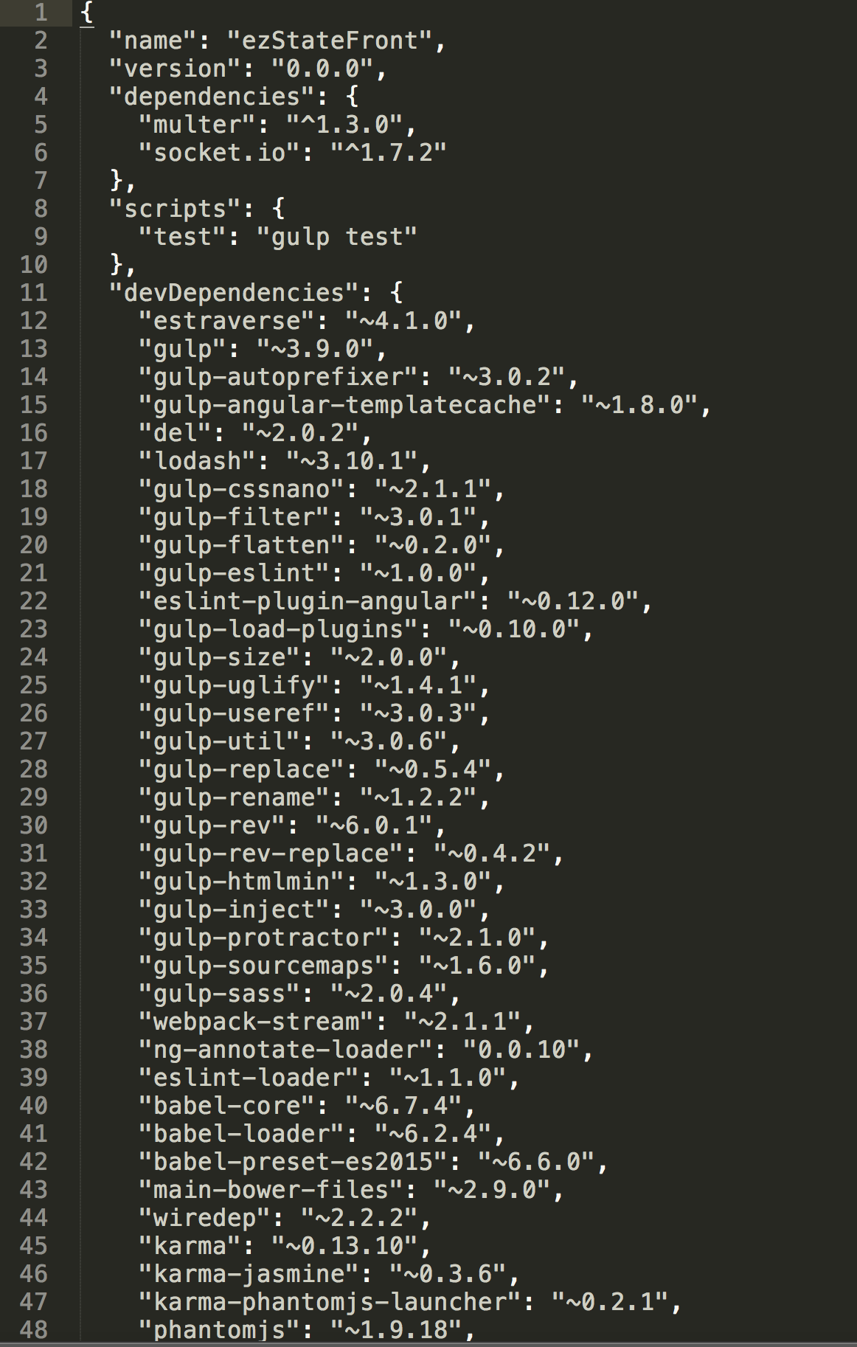
Node Package Manager
Gives us the ability to install packages and provides us with a useful interface. We manage our packages and dependencies via the package.json file.

Slide 11
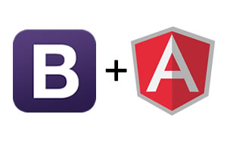
Bootstrap
Bootstrap is a popular HTML, CSS, and JS framework for developing responsive, mobile first projects on the web.

Slide 12

SASS
Sass is a mature, stable, and powerful professional grade CSS extension language in the world.
Benefits:
Ability to define variables
Nested syntax
Ability to define mixins
Create mathematical functions
Looping CSS
Joining multiple CSS files
Simplifies RWD implementation
Increases maintainability
Reduces complexity
Optimizes CSS output

Slide 13
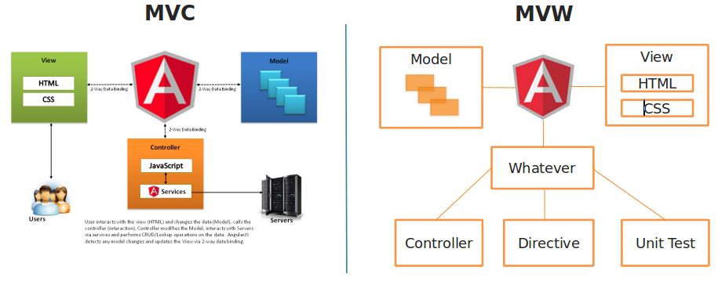
Angular’s MVW versus traditional MVC

Slide 14
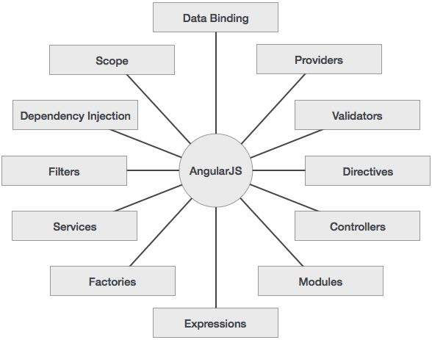
Benefits of using Angular.js

Slide 15
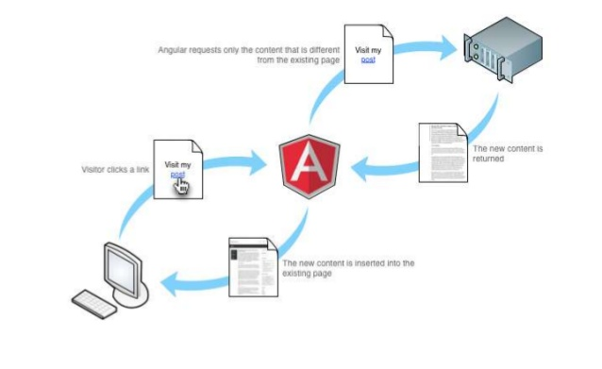
Basic Angular Request

Slide 16
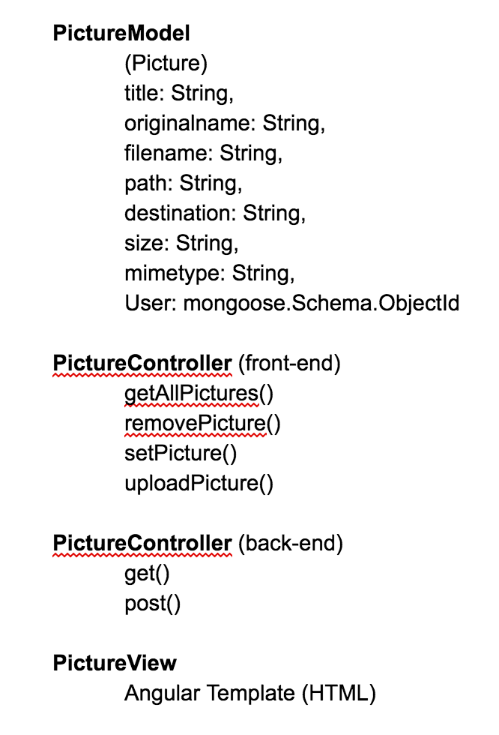
Implementation:
Each feature has its own Model View Controller

Slide 17
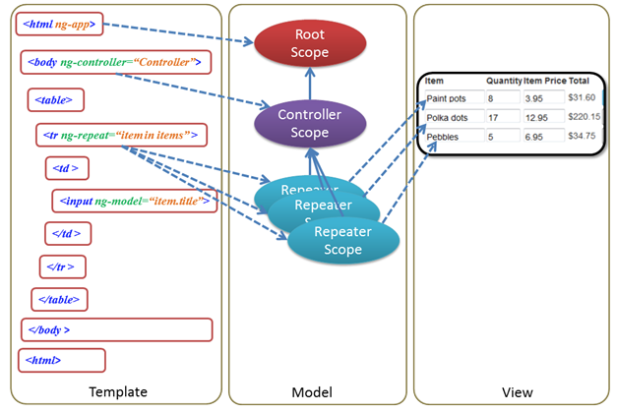
Implementation - Angular

Slide 18
Benefits of the MEAN stack
Reduces complexity
Increases maintainability
Organizes code
Core is JavaScript
JavaScript is a very popular language (top 10 according to Tiobe index)
JavaScript is used for the entire application (from front-end to back-end)
It supports the MVC architecture
The components are open source which get updated regularly
Great community and available resources

Slide 19
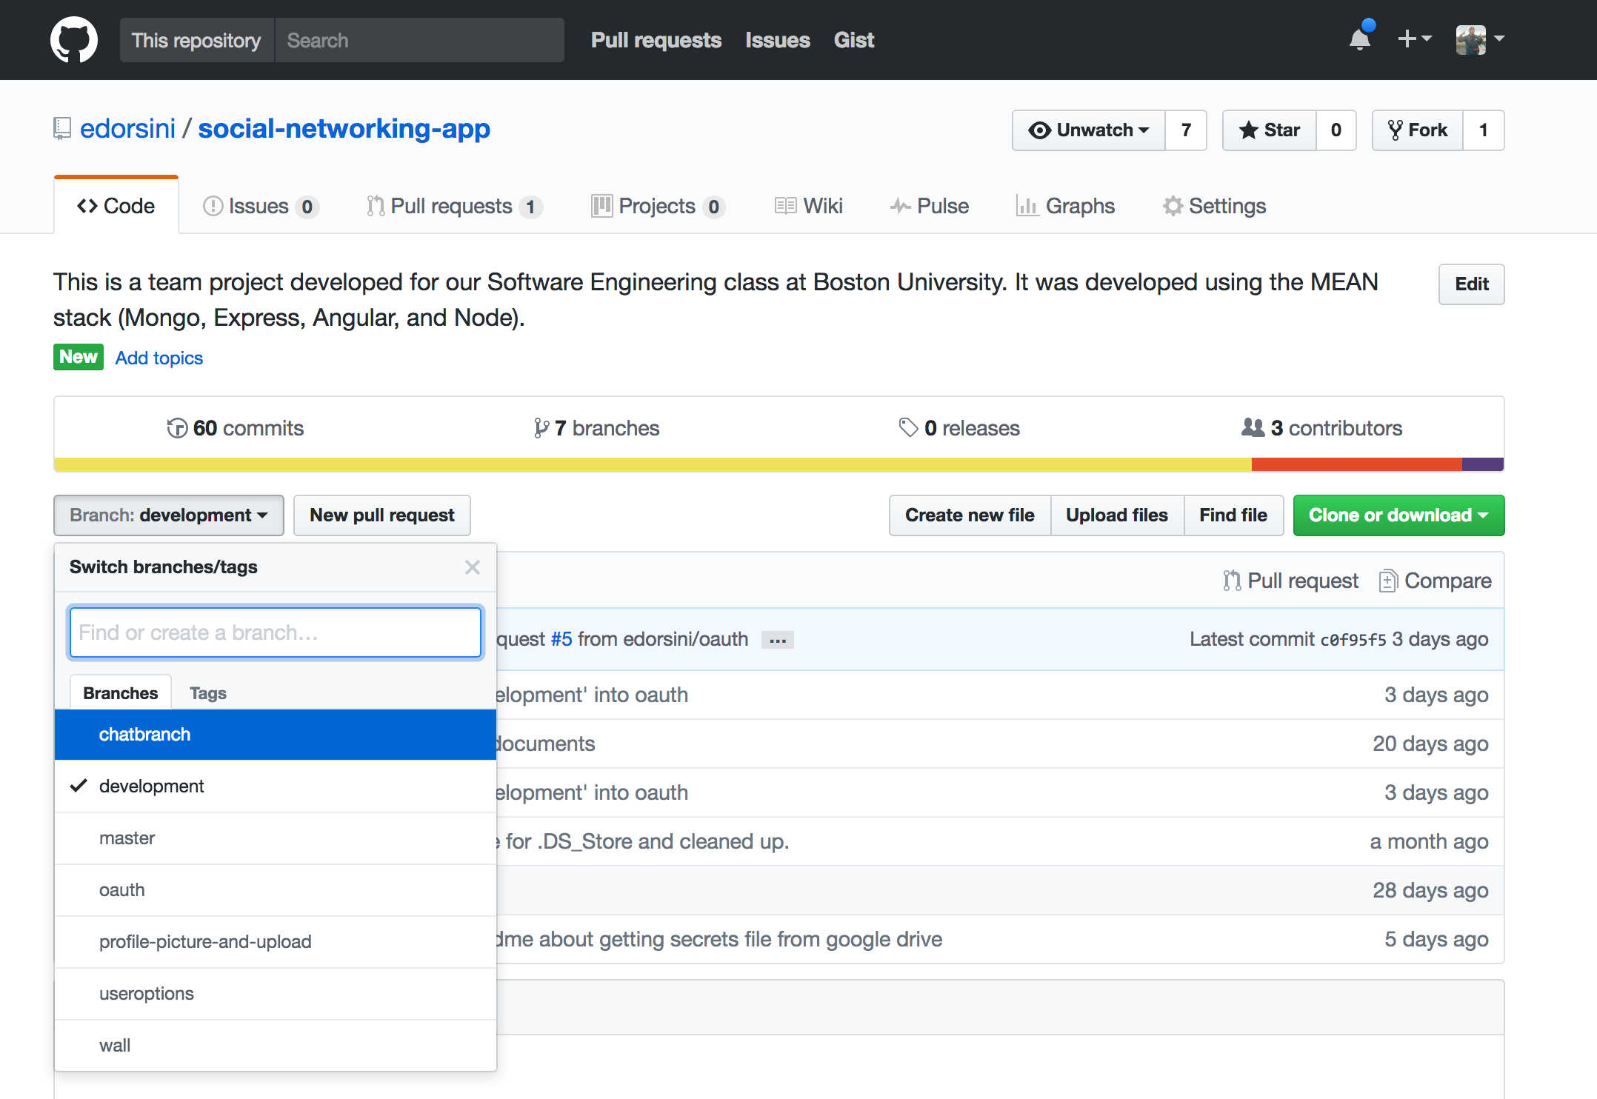
Configuration Management
Every feature gets its own branch
When feature is complete, code is integrated into development branch
Once development branch is tested and validated, code is integrated into master branch

Slide 20
Testing Summary
Unit tests
29 Passed
0 Failed
System testing
9 Passed
1 Failed
Acceptance testing
8 Passed
0 Failed

Slide 21
Metrics
Process
Size: 1059 lines of code (781 JS + 278 HTML)
Defect density: 1 defect / 176.5 LOC
Product
Story points: 12 planned, 9 completed
Defects detected: 6
Defects resolved: 4
Cost: 11 man-hours testing vs 157.5 man-hours total

Slide 22
Schedule / Roadmap
3/16
1/19
Iteration 0 complete
Iteration 1 complete
Iteration 2
5/4
Feature Integration and Verification
3/16
Feature Development
4/13
4/19
Nick, Ravi
Arpita
Chat
Prepare for Presentation and final exam
Ed, Nick
Ravi, Cory
Search
Cory, Rob
Arpita, Mike
Friend’s Features
Mike, Ed
Rob
Activity Feed and Profile

Slide 23
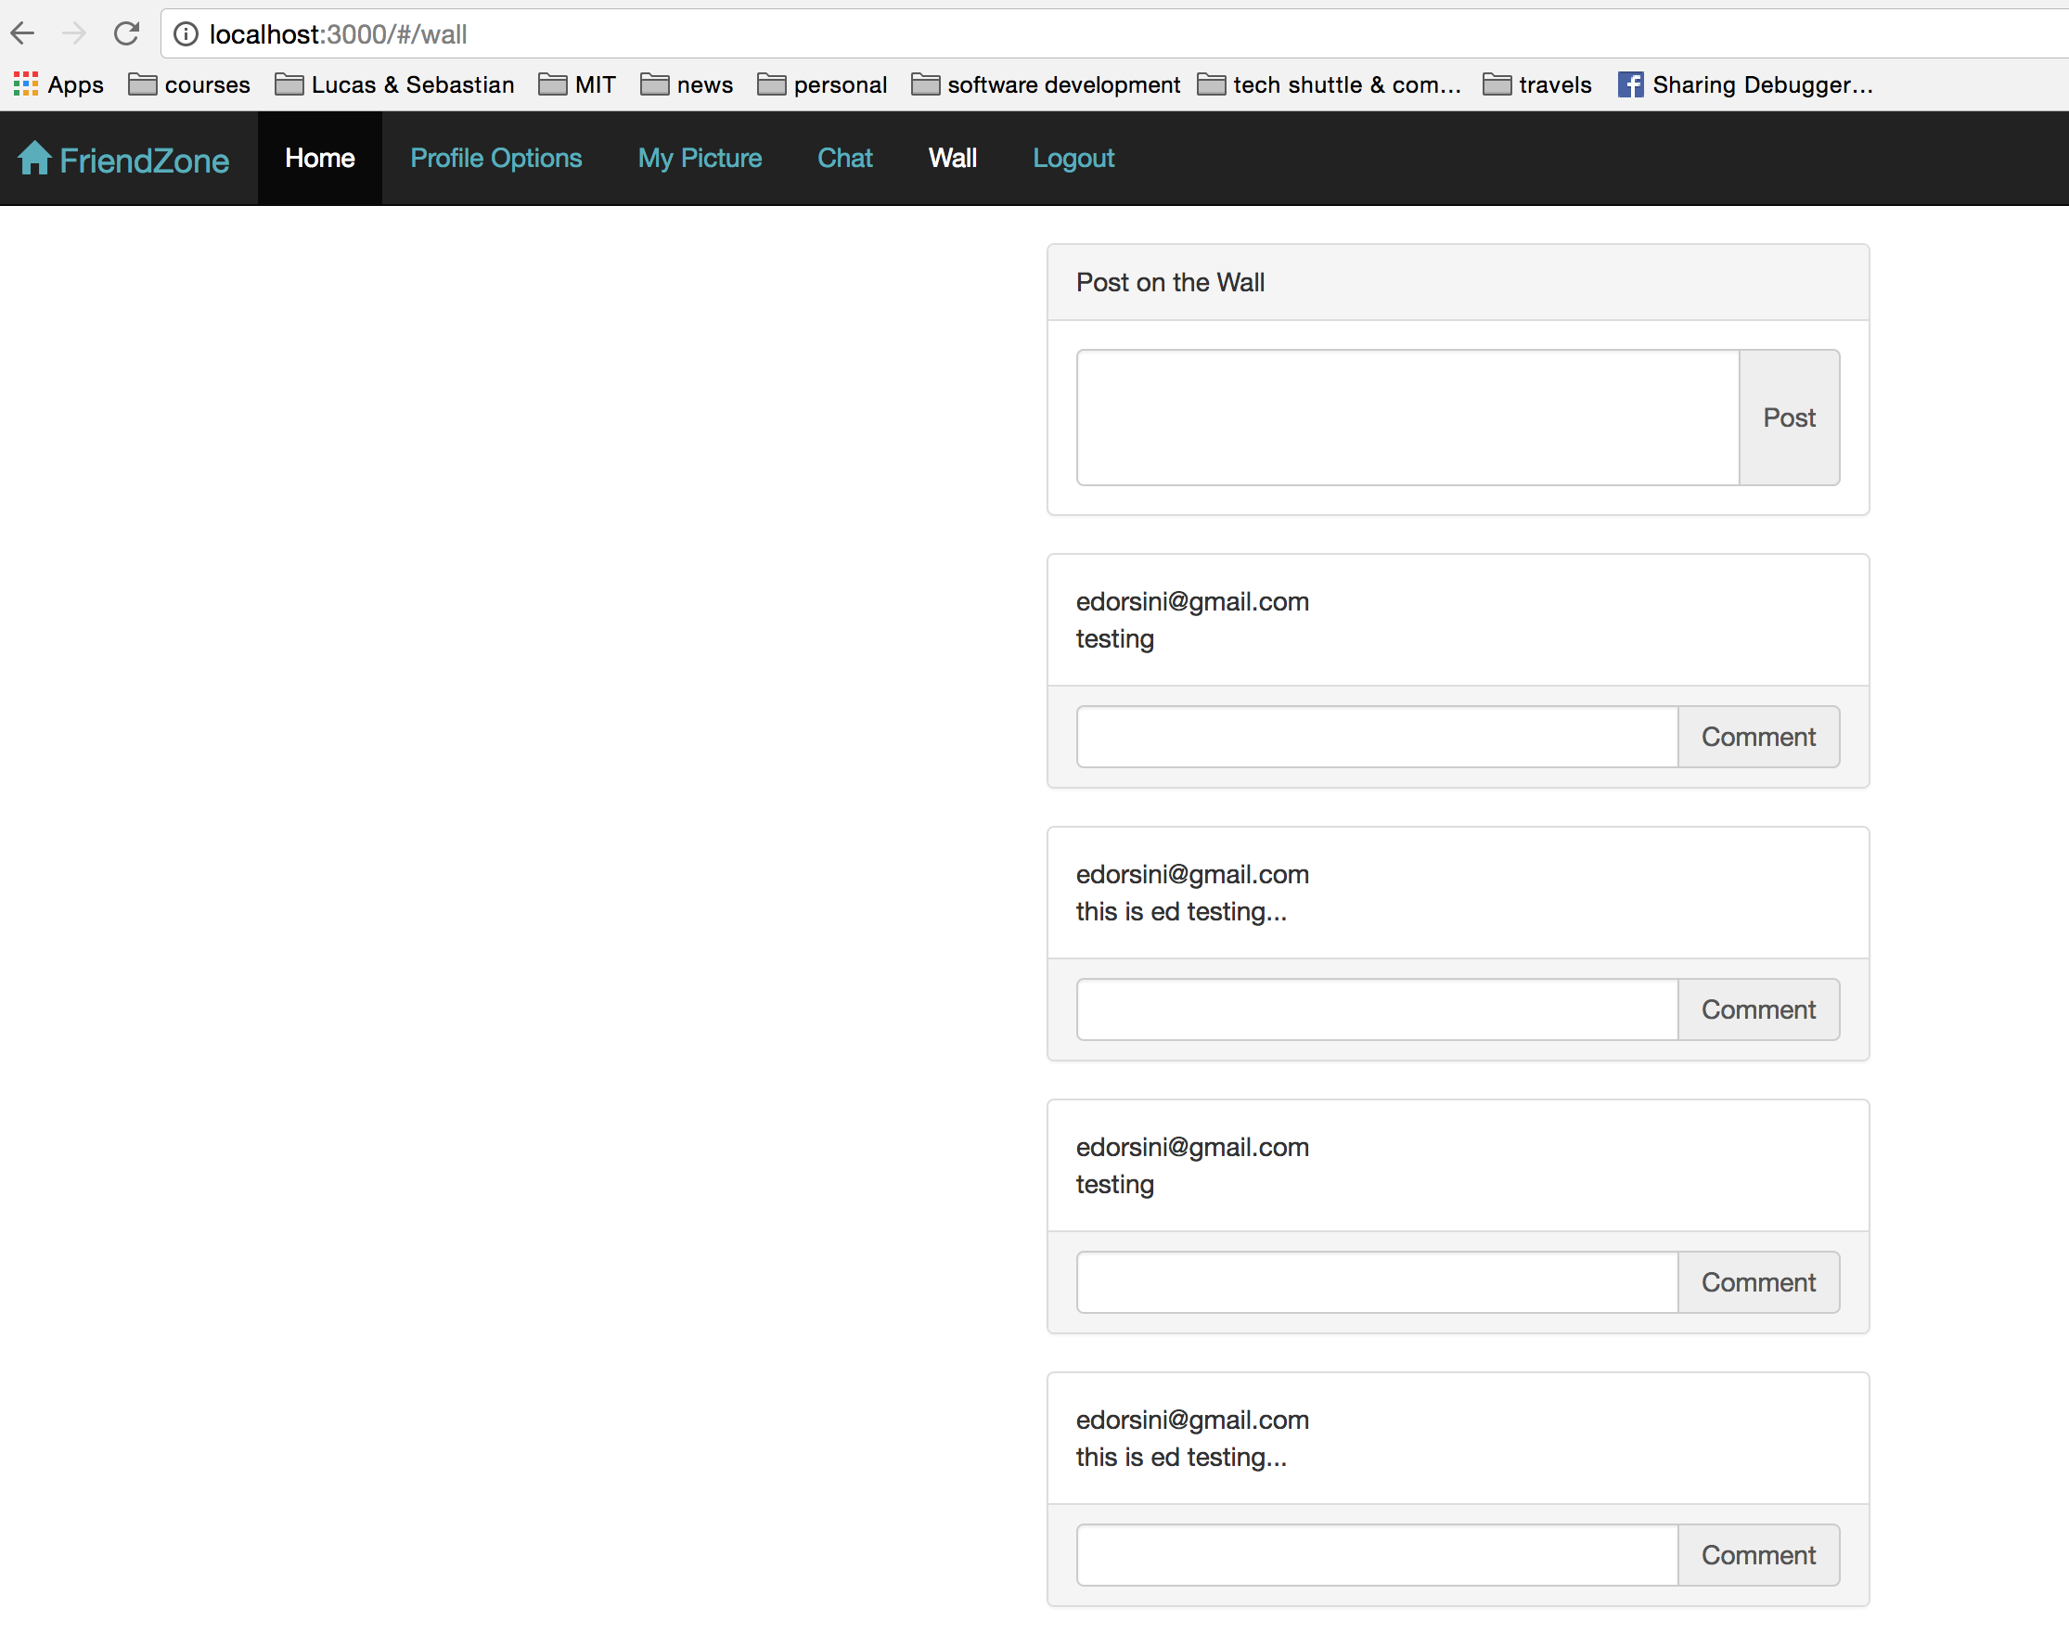
Demo

Slide 24
Appendix
https://www.sitepoint.com/introduction-to-mean-stack/
http://www.tiobe.com/tiobe-index/
https://github.com/mgechev/angularjs-in-patterns
http://searchmicroservices.techtarget.com/definition/OAuth
https://www.tutorialspoint.com/mongodb/mongodb_advantages.htm
http://stackoverflow.com/questions/28823253/what-are-the-benefits-of-express-over-plain-node-js
https://dzone.com/articles/what-are-benefits-nodejs
https://www.devsaran.com/blog/10-best-reasons-use-bootstrap-amazing-web-designs

