Slide 1
DoTA2 101
edos4

Slide 2
Bluemix DevOps
Para may time tayo makipagdate☺
Ed Salinas
edos4.github.io/bluemix-devops.pptx

Slide 3
Bluemix
Is an open standards, cloud platform for building, running, and managing apps and services.

Slide 4
DevOps //boring definition
The practice of operations and development engineers participating together in the entire service lifecycle, from design through the development process to production support.

Slide 5
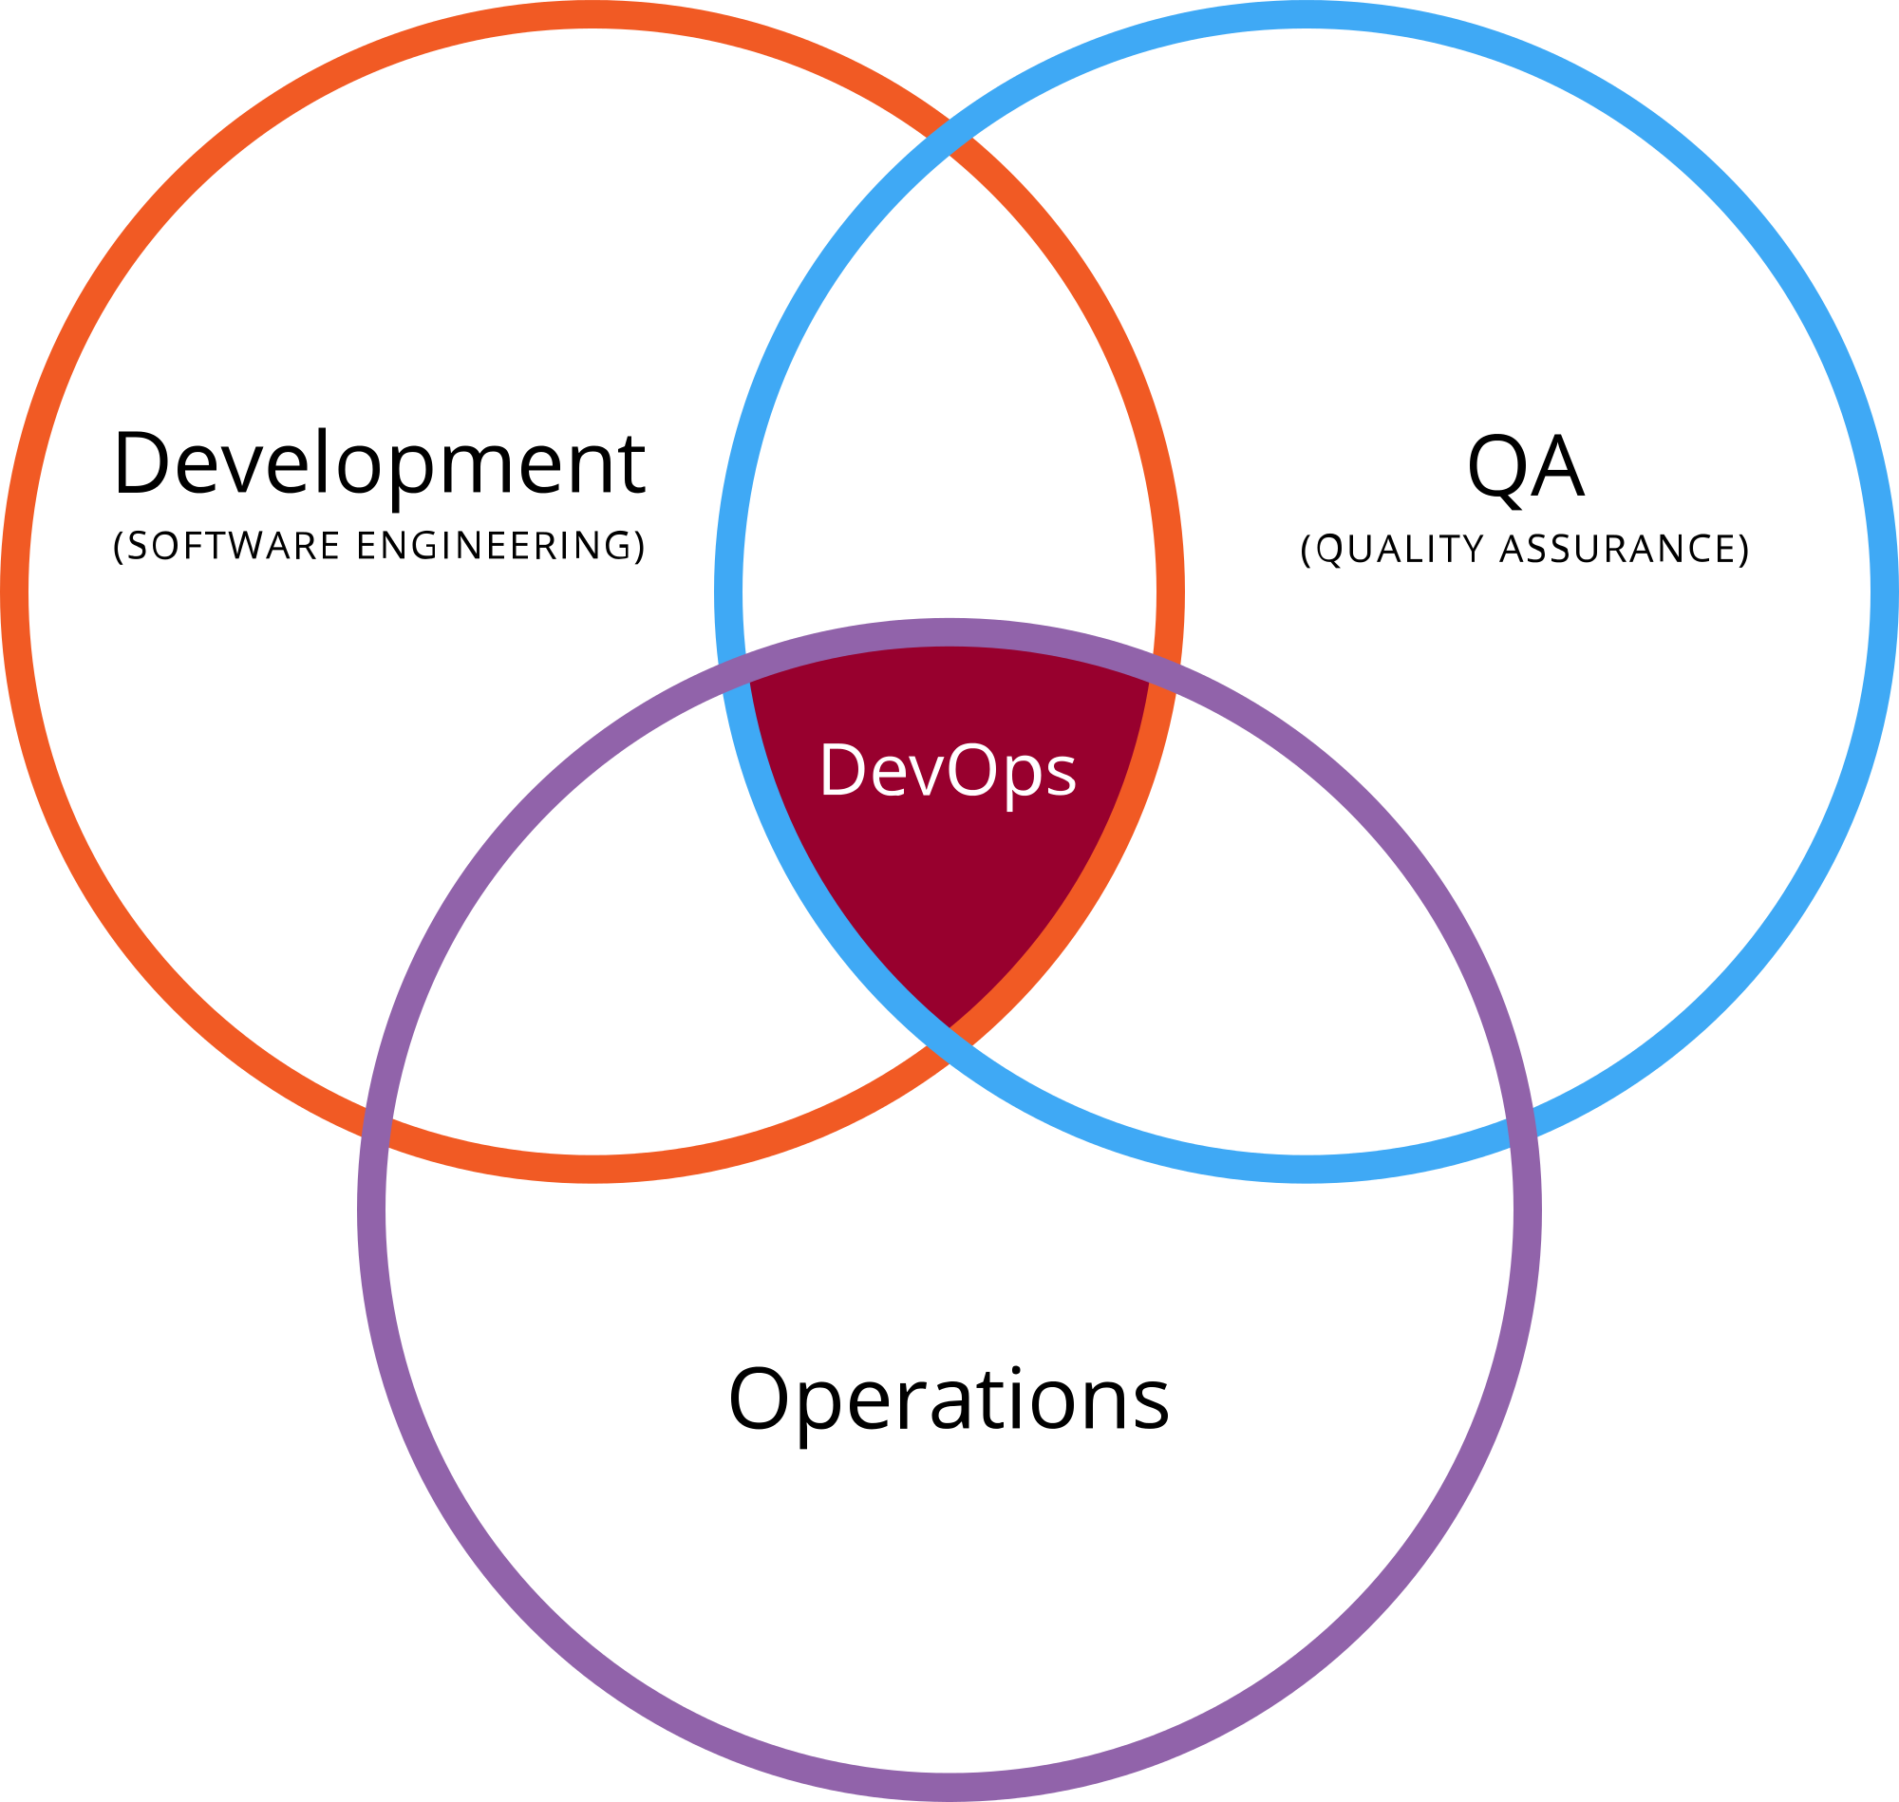
DevOps //#pichur //#love triangle

Slide 6
Dev
Developers and/or QA
// woohoo! (applause)
Ops
Systems Engineers, System Administrators, Operations Staff, Release Engineers, DBAs, Network Engineers, Security Professionals, and etc.
// yes, they also exist

Slide 7
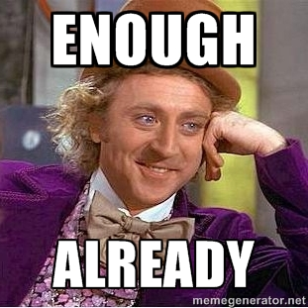

Slide 8
DevOps // last, pramis!
Overall service or software fully delivered to the customer instead of simply “working software.”
Sino ba may gusto ng pagmamahal na hindi buo? (Tagalog)
Who would want partial love? (English)

Slide 9
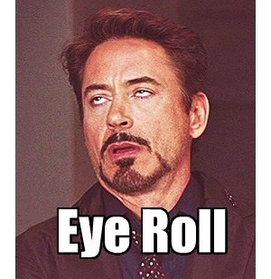

Slide 10
Features
Git hosting
Connect with your GitHub repository
Your work in one place
No installation, just code now
Integrated source code editor
Update a running app automatically with Bluemix Live Sync
Built-in source code management
Work items to track and plan project activities
Dashboard charts for project status

Slide 11
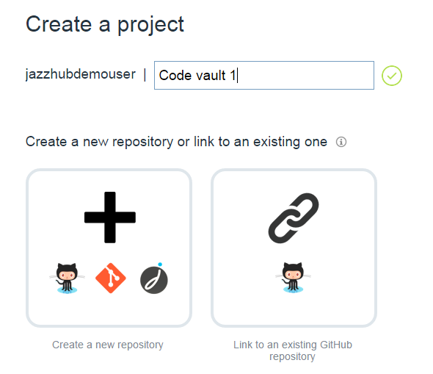
Git Hosting // no need to be forever alone
Track, plan, and develop your project
Use your SCM. //no need to break
Browser-based

Slide 12
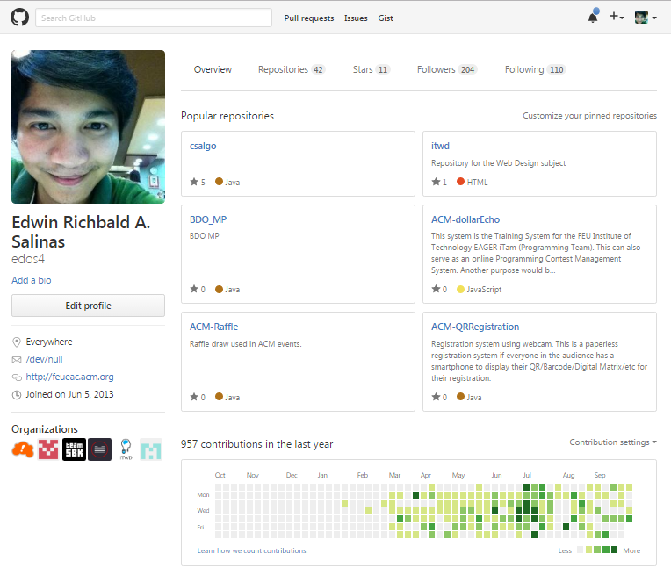
Connect to your GitHub Repository

Slide 13
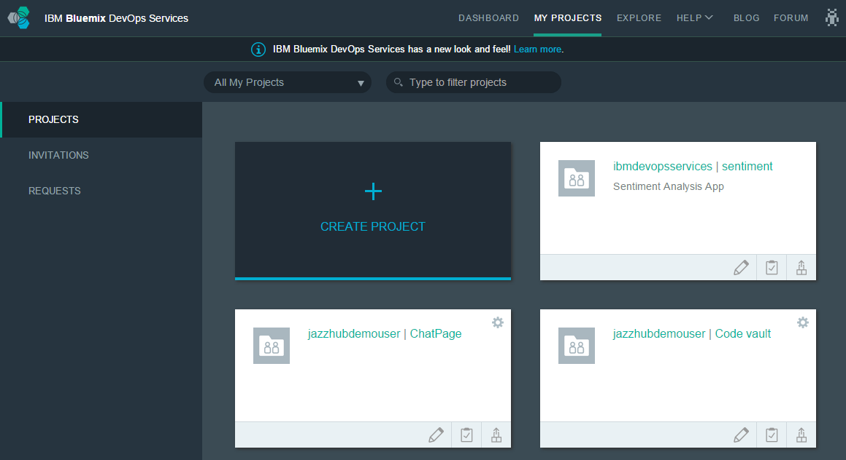
Your work in one place // stick to one

Slide 14
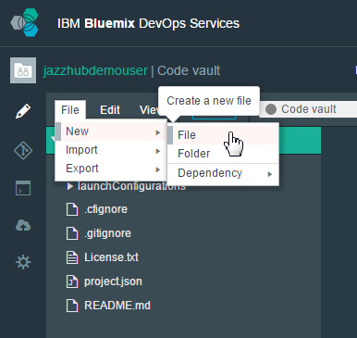
No installation, just code now // wag paligoy-ligoy
Start coding immediately after you create a project. Click Edit Code to get started.

Slide 15
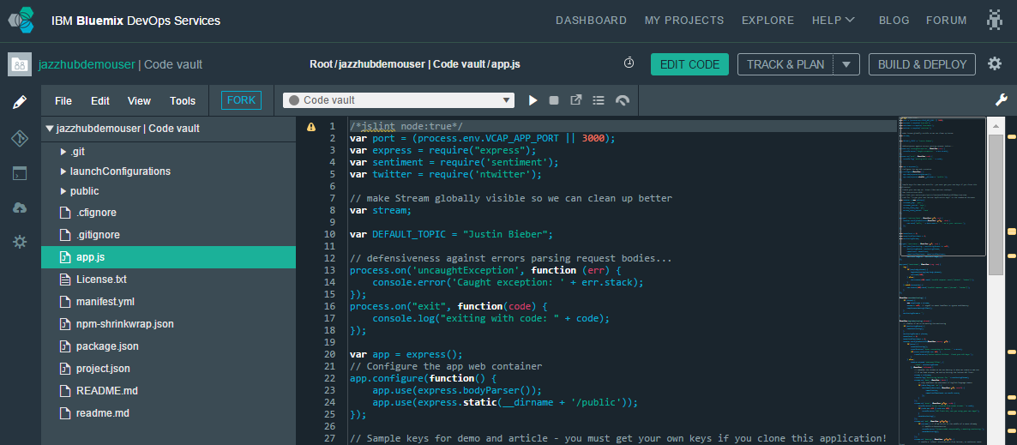
Integrated source code editor // wala kang hahanapin pang iba

Slide 16
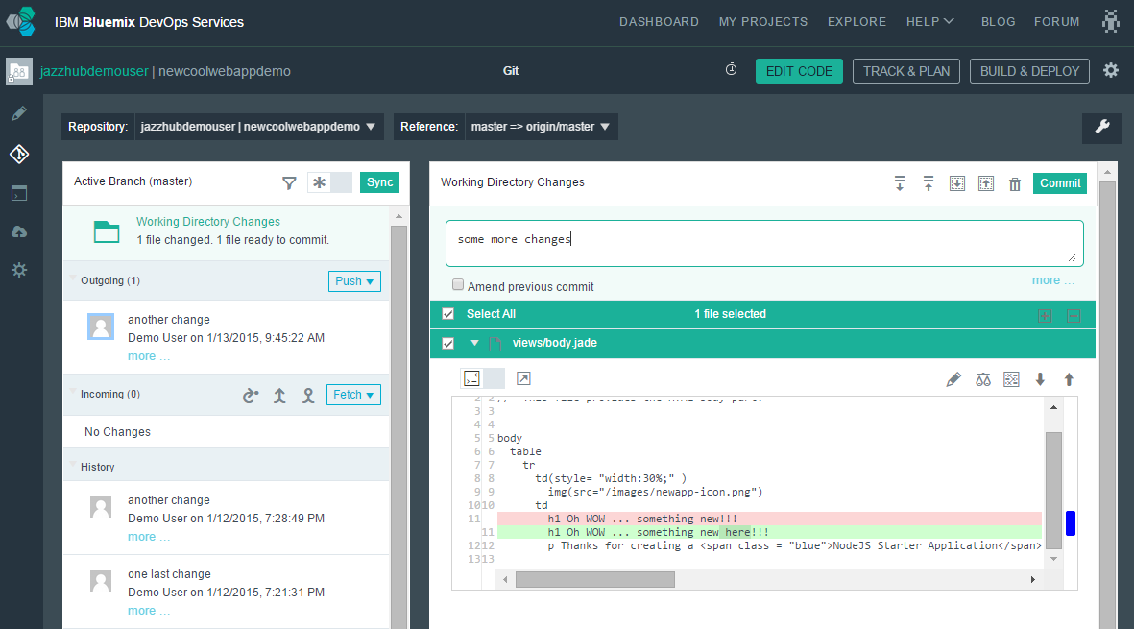
Built-in source code management // wala kang hahanapin pang iba part 2

Slide 17
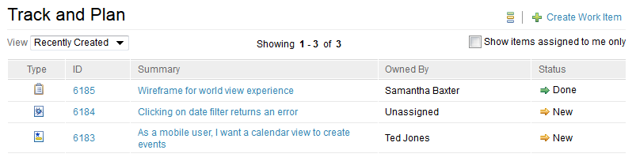
Work items to track and plan project activities // Alam mo ginagawa niya. #dontParanoid
Know who’s doing what and when it will be finished
Need a design? Open a task and assign it to a teammate.
Bug found? Open a defect.
Feel good when finishing a task and setting its status to Done ☺

Slide 18
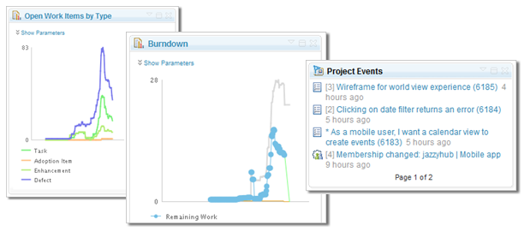
Dashboard charts for project status // Report to komander and make her happy

Slide 19
Development Support // Many fish in the sea
Arduino
C
C#
C++
CoffeeScript
CSHTML
Embedded JavaScript (ejs)
Erlang
Go
HTML abstraction markup language (Haml)
Jade
Java
JSON
Lua
Objective-C
PHP
Python
Ruby
Sass/SCSS
SQL
Swift
TypeScript
Visual Basic (vb)
VMHTML
XHTML
XML
XQuery
YAML
Launch file
Dockerfile
gitignore
git config
cfignore
properties

Slide 20
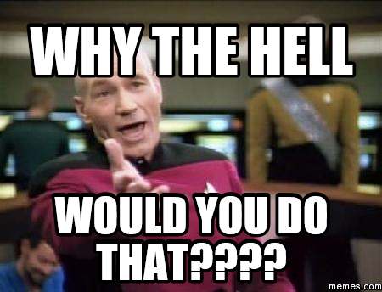

Slide 21
Why?
Working smart > working hard
So that everything is organized
Para may time makipagdate // So that there’s time for dating.
More productivity
It is cool!

Slide 22
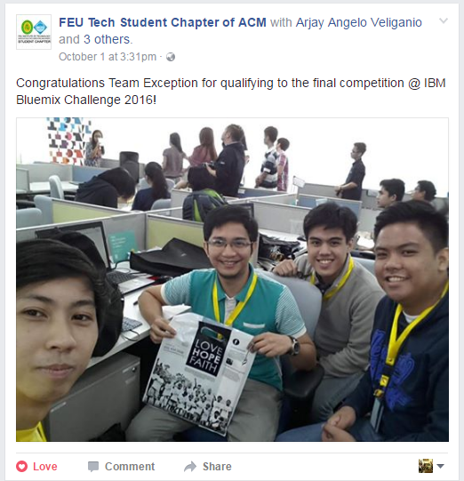
It is fun!

Slide 23
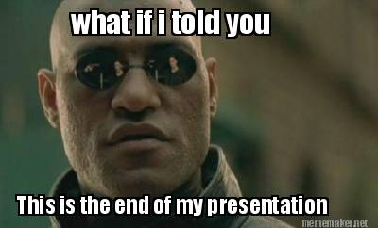
Thanks for listening!

