Slide 1
DoTA2 101
edos4

Slide 2
Bluemix DevOps
Para may time sa lablyf ☺
Ed Salinas
edos4.github.io/bluemix-devops.pptx

Slide 3
Bluemix
Is an open standards, cloud platform for building, running, and managing apps and services.

Slide 4
DevOps //boring definition
The practice of operations and development engineers participating together in the entire service lifecycle, from design through the development process to production support.

Slide 5
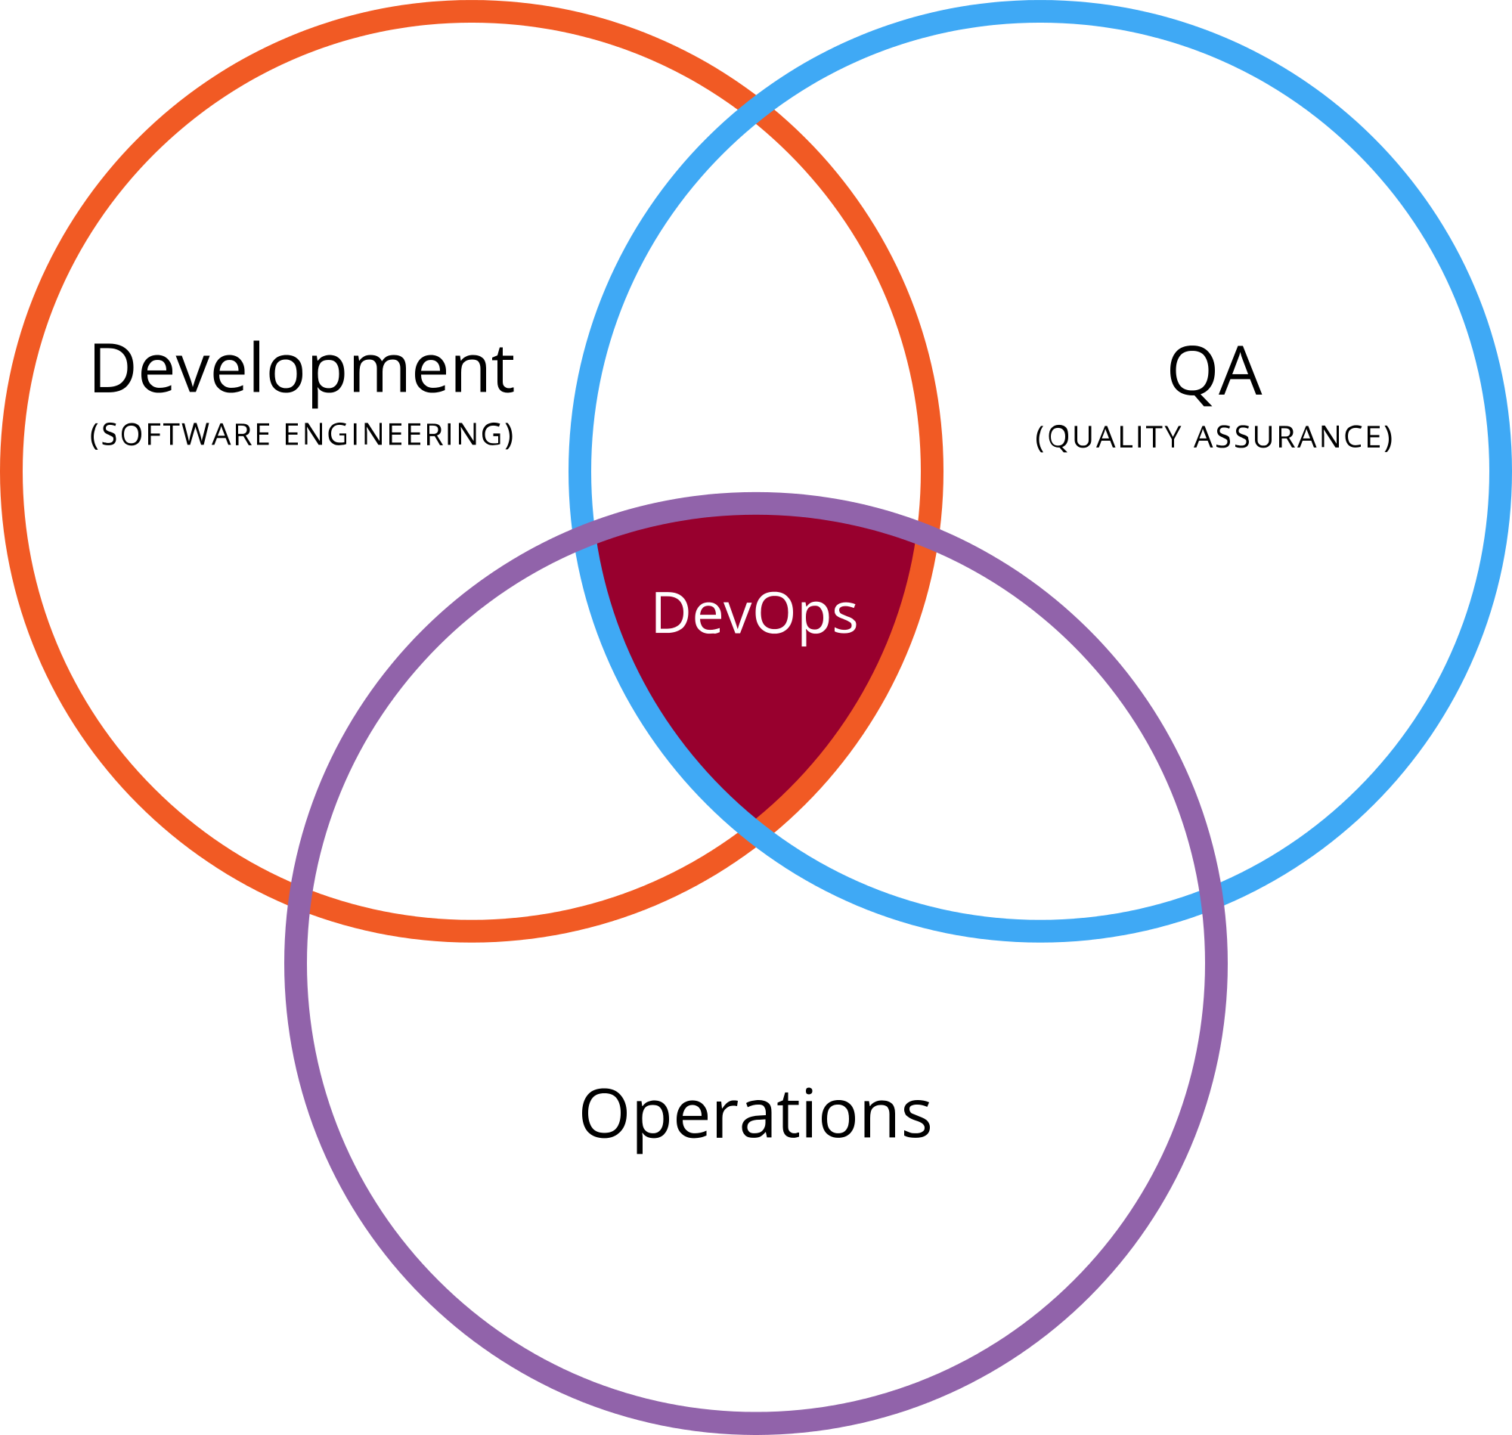
DevOps //#pichur //#love triangle

Slide 6
Dev
Developers and/or QA
// woohoo! (applause)
Ops
Systems Engineers, System Administrators, Operations Staff, Release Engineers, DBAs, Network Engineers, Security Professionals, and etc.
// yes, they also exist

Slide 7
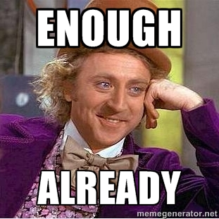

Slide 8
DevOps // last, pramis!
Overall service or software fully delivered to the customer instead of simply “working software.”
Sino ba may gusto ng pagmamahal na hindi buo? (Tagalog)
Who would want a love that is partial? (English)

Slide 9
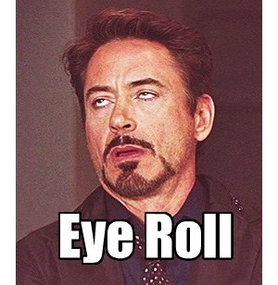

Slide 10
Features
Git hosting
Connect with your GitHub repository
Your work in one place
No installation, just code now
Integrated source code editor
Built-in source code management
Work items to track and plan project activities
Dashboard charts for project status

Slide 11
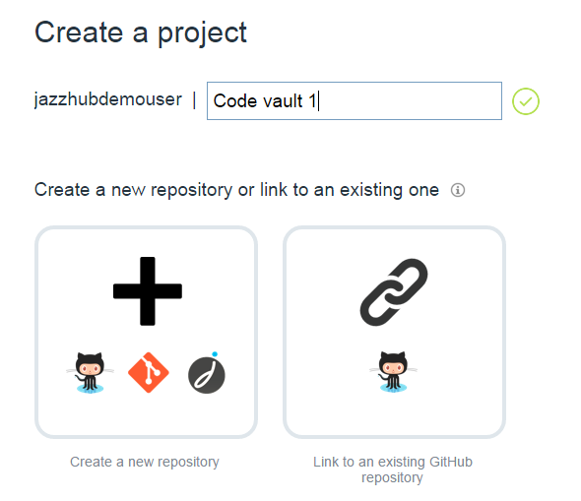
Git Hosting // no need to be forever alone
Track, plan, and develop your project
Use your SCM. //no need to break
Browser-based

Slide 12
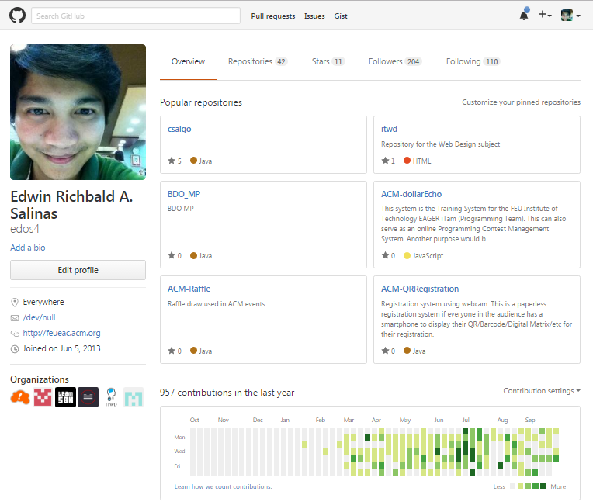
Connect to your GitHub Repository

Slide 13
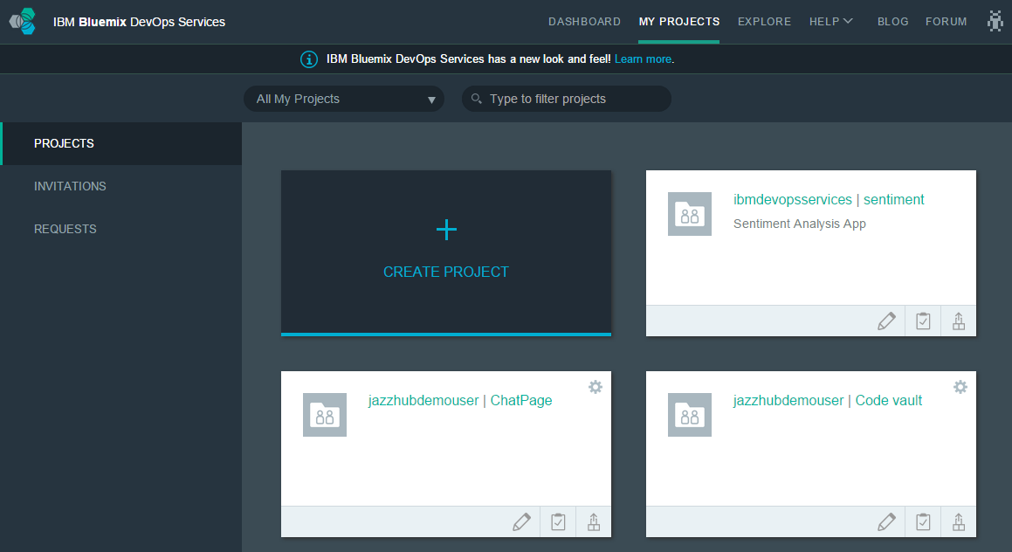
Your work in one place // stick to one

Slide 14
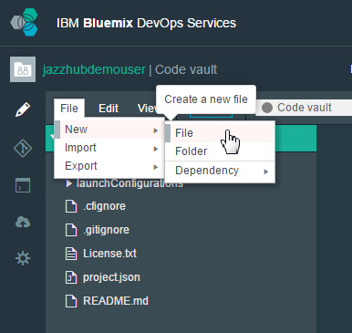
No installation, just code now // wag paligoy-ligoy
Start coding immediately after you create a project. Click Edit Code to get started.

Slide 15
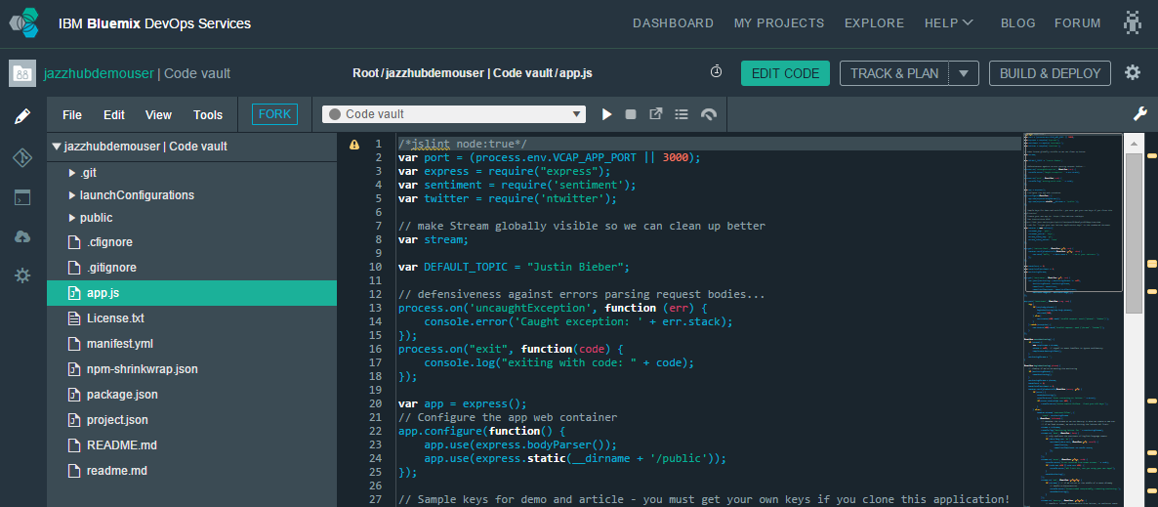
Integrated source code editor // wala kang hahanapin pang iba

Slide 16
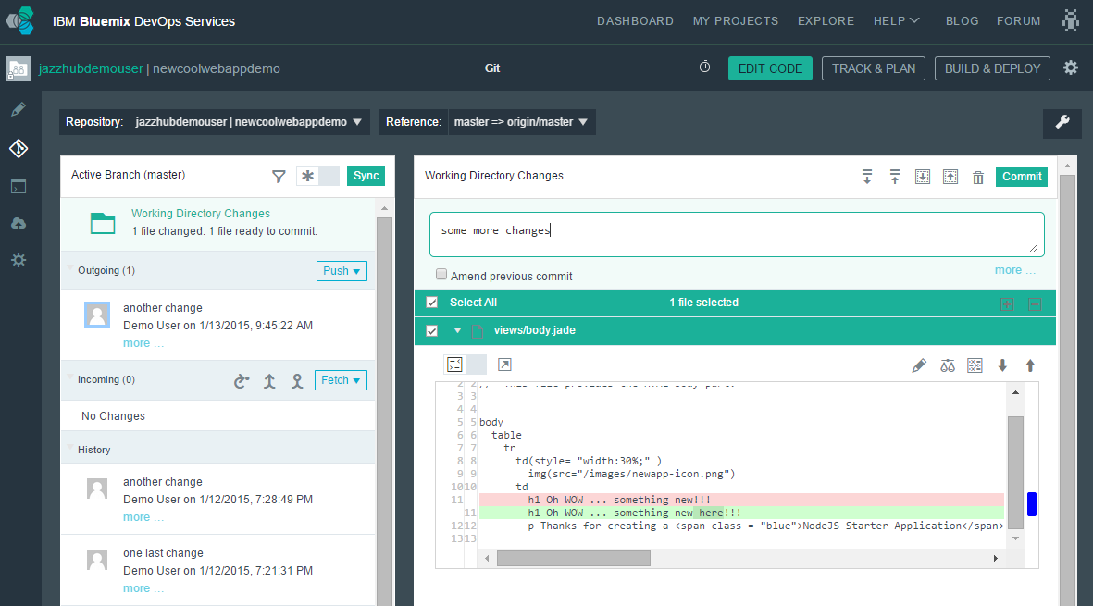
Built-in source code management // wala kang hahanapin pang iba part 2

Slide 17
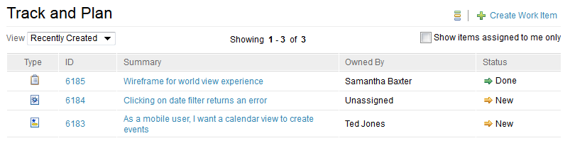
Work items to track and plan project activities // Alam mo ginagawa niya. #dontParanoid
Know who’s doing what and when it will be finished
Need a design? Open a task and assign it to a teammate.
Bug found? Open a defect.
Feel good when finishing a task and setting its status to Done ☺

Slide 18
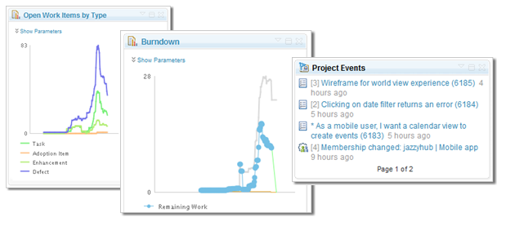
Dashboard charts for project status // Report to komander and make her happy

Slide 19
Development Support // Many fish in the sea
Arduino
C
C#
C++
CoffeeScript
CSHTML
Embedded JavaScript (ejs)
Erlang
Go
HTML abstraction markup language (Haml)
Jade
Java
JSON
Lua
Objective-C
PHP
Python
Ruby
Sass/SCSS
SQL
Swift
TypeScript
Visual Basic (vb)
VMHTML
XHTML
XML
XQuery
YAML
Launch file
Dockerfile
gitignore
git config
cfignore
properties

Slide 20
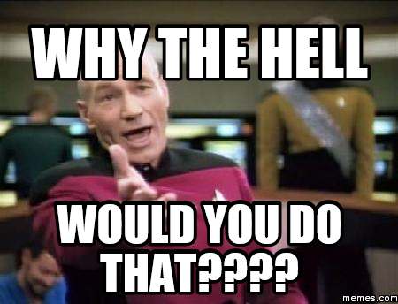

Slide 21
Why?
Working smart > working hard
So that everything is organized
Para may time makipagdate // So that there’s time for dating.
More productivity
It is cool!

Slide 22
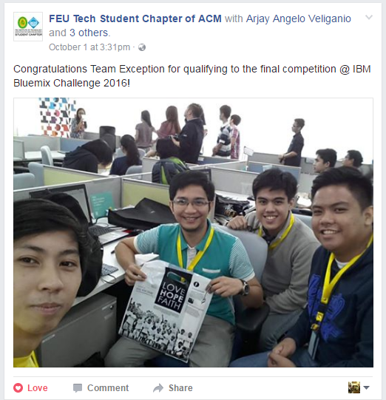
It is fun!

Slide 23
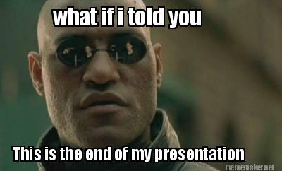
Thanks for listening!

