Slide 1
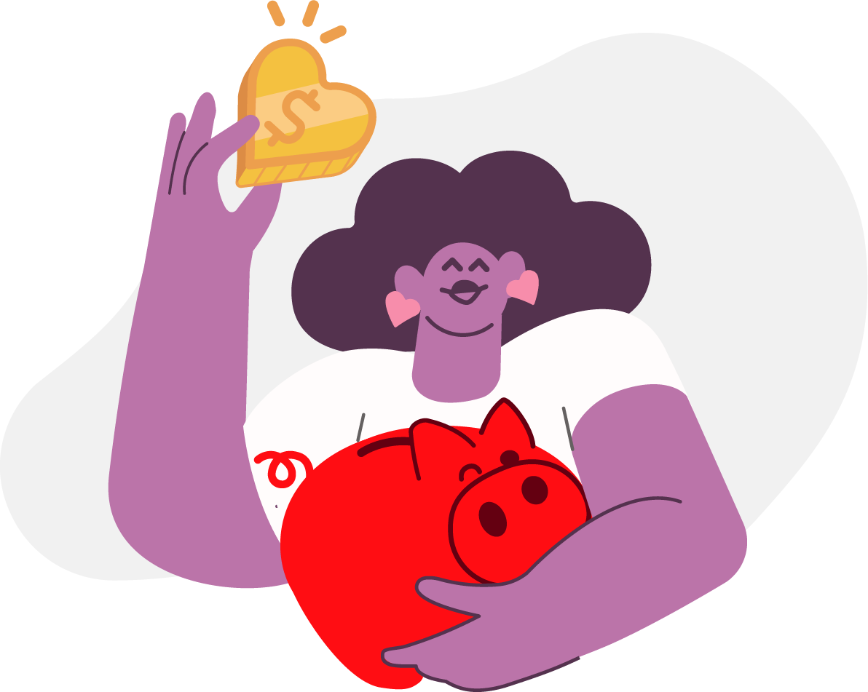

Hi, I'm Eddy
Product Specialist · Toqan

Slide 2





About Me
Eddy — Product Specialist & PM at Toqan
Building Toqan & ToqanClaw — Prosus's AI platform
Joined Prosus on 1 May 2026
Day split between meetings, product strategy & ticket management

