Slide 1
Java User Group
Edouard Swiac – Antoine Diligent
SUPINFO San Francisco
2010/2011

Slide 2
Java User Group
Presentation
Members
Objectives
Talks
Lessons learned

Slide 3
Presentation of the SF JUG
Created in October 2010 by Edouard Swiac and Antoine Diligent
For SUPINFO students, by SUPINFO students
Talks about Java and software development methodologies opened to every student
10 regular members

Slide 4
Members
Edouard Swiac
Antoine Diligent
Laurent Quillerou
Nyana Veeraragoo
Olivier Tavard
Remy Loubradou
Thomas Guieu
Thomas Hilaire
Rocj Grondin
Benjamin Monjoie
Notes:
Mostly M2 students, except Remy Loubradou
4 students stayed in the US ed – antoine – laurent - thomas

Slide 5
Objectives
Sharing the Java passion between SUPINFO students
Helping other students in their class of Java
Speaking of Java and software development methodologies to anyone interested on the campus through talks
Notes:
Students enthusiasts about Java and software development methodologies
Sharing the passion every Wednesday between 1pm and 2pm around a pizza !
We proposed our help but nobody wanted to take it ☹
Presentations on Java topics by a each member of the group

Slide 6
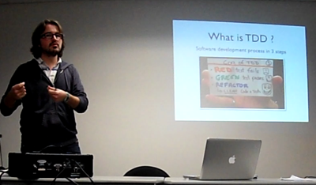
Talks
Given by a member on a Java topic
Announced to the campus (thanks Anna)
Open to anyone interested

Slide 7
Why talks?
Getting students excited about the Java world
Improving speaking and teaching capacities of our members in a conference environment
Associating people and their name to the SUPINFO Java community, because it’s real!
Notes:
Trying to get people excited about Java and software developnent
Improving public speaking and teaching capacities and of the members
> members choose their subjectm create their slides, manage their talk and answer questions

Slide 8
Talks subjects
Test-driven development with Java (ES)
Deployment of JEE applications (AD)
Development of Android applications (BM, RL)
Google App Engine & GWT (TH)
…
The slides are available on Internet, associated with SUPINFO.

Slide 9
Lessons learned
Managing a user group is challenging
Java scares most of SUPINFO students
Attracting people from the outside is hard
Time is of the essence, and M2 year is short
Notes:
Managing a user group is a challenge
Scheduling meetings, gathering people, finding good topics of discussion, sustaining the activity, meeting everyone expectations
People not interested : not a lot of people outside the Jug, even on not only Java talks\
People not interested are not interested
Need MOAR time, M2 is short, something serious needs time to be build and sustained

Slide 10
Thank you
http://javalabsf.net/
javalabsf@googlegroups.com
http://www.slideshare.net/javalabsf/presentations

