Slide 1


Systems Architecture and Trajectory Optimization for High Thrust Interplanetary Spacecraft
Erik Payton and Prof. Mason Peck
Cornell University
AIAA Region 1 Student Conference
March 2023
Notes:
Name and Introduction...you got this!!!

Slide 2
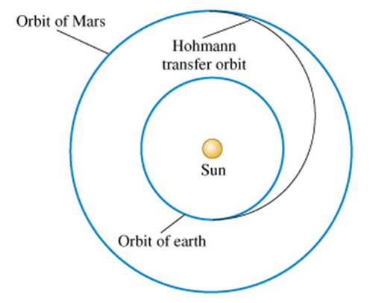
Turn and Burn: Research Question
Current Interplanetary Travel
Hohmann Transfer
Minimum Fuel Trajectory
170-200 day trip to Mars
Image Credit: SatNow
Conclusions and Further Research
Trajectory with Different Thrust
Earth to Mars Case Study
Presentation Overview

Slide 3

Turn and Burn: Research Question
Current Interplanetary Travel
Hohmann Transfer
Minimum Fuel Trajectory
170-200 day trip to Mars
What about Minimum Time Trajectory?
Not Practical with current technologies
Trying to find what this looks like
?
Image Credit: SatNow
Conclusions and Further Research
Trajectory with Different Thrust
Earth to Mars Case Study
Presentation Overview

Slide 4
Turn and Burn: Research Question
Current Interplanetary Travel
Hohmann Transfer
Minimum Fuel Trajectory
170-200 day trip to Mars
What about Minimum Time Trajectory?
Not Practical with current technologies
Trying to find what this looks like
?
What does an Interplanetary Minimum-Time Trajectory look like?
Image Credit: SatNow
Conclusions and Further Research
Trajectory with Different Thrust
Earth to Mars Case Study
Presentation Overview

Slide 5
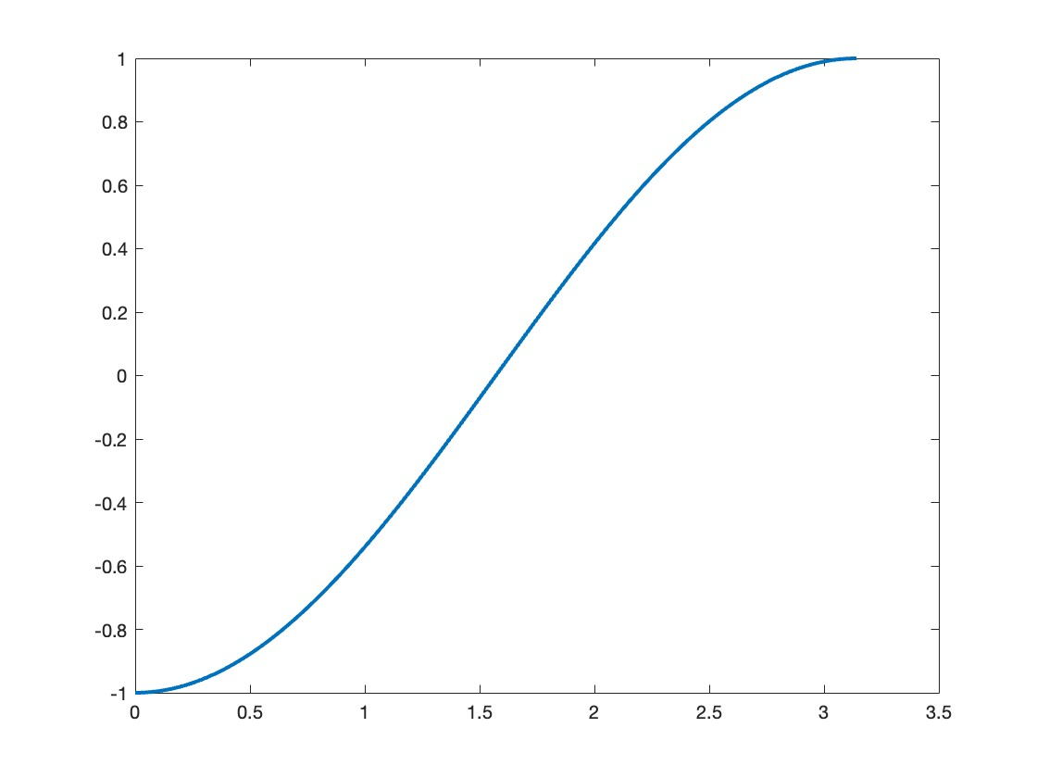
Turn and Burn: Maneuver Basics
Goal: Continuous High-Thrust Maneuver for Interplanetary Travel
Hamilton-Jacobi-Bellman time optimality
Future Propulsion Technologies
Positron Induced Fusion Space Propulsion [3]
Specific Impulse: 82,000 seconds
Half Period of Cosine Function as Motivation for the Maneuver
Conclusions and Further Research
Trajectory with Different Thrust
Earth to Mars Case Study
Presentation Overview

Slide 6
Turn and Burn: Maneuver Basics
Goal: Continuous High-Thrust Maneuver for Interplanetary Travel
Hamilton-Jacobi-Bellman time optimality
Future Propulsion Technologies
Positron Induced Fusion Space Propulsion [3]
Specific Impulse: 82,000 seconds
Assume Futuristic Propulsion to achieve Hamilton-Jacobi-Bellman time optimality.
Half Period of Cosine Function as Motivation for the Maneuver
Conclusions and Further Research
Trajectory with Different Thrust
Earth to Mars Case Study
Presentation Overview

Slide 7
Further Considerations
This Paper: Orbital Mechanics and Mission Planning
Other areas of interest
Structure: loads during maneuver
Thermal: performance limitations
Communications: Doppler Shift
Relativistic Effects: 5% speed of light
Conclusions and Further Research
Trajectory with Different Thrust
Earth to Mars Case Study
Presentation Overview

Slide 8
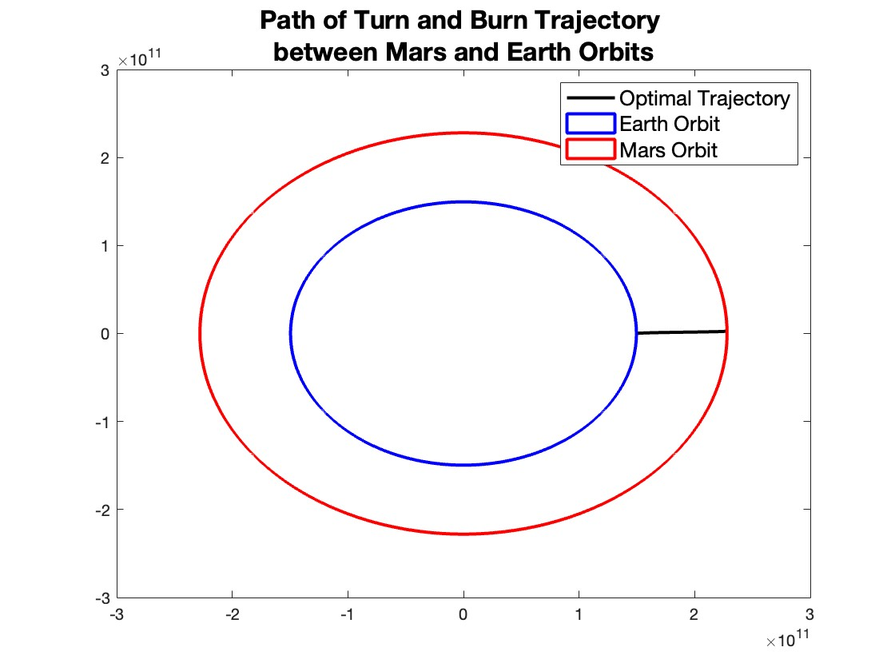
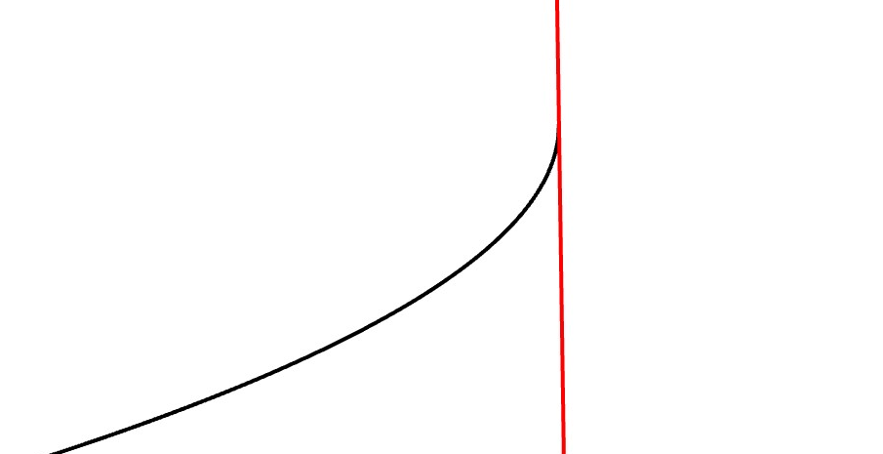
Research Overview
Earth to Mars Case Study Results
Methods of Simulation
Results with differing thrust levels
3 different thrust levels
Mars Orbit
Earth Orbit
Close up of Mars Orbit Approach
Conclusions and Further Research
Trajectory with Different Thrust
Earth to Mars Case Study
Presentation Overview

Slide 9
Research Overview
Earth to Mars Case Study Results
Methods of Simulation
Results with differing thrust levels
3 different thrust levels
Mars Orbit
Earth Orbit
Examine a Case Study from Earth to Mars under 3 different Thrust levels.
Close up of Mars Orbit Approach
Conclusions and Further Research
Trajectory with Different Thrust
Earth to Mars Case Study
Presentation Overview

Slide 10
Overview of Assumptions
Spacecraft has 15000kg mass
1/3 devoted to propellant
Orbit Eccentricities of 0
Destination is orbit rather than Planet
Very good approximation
Conclusions and Further Research
Trajectory with Different Thrust
Earth to Mars Case Study
Presentation Overview

Slide 11
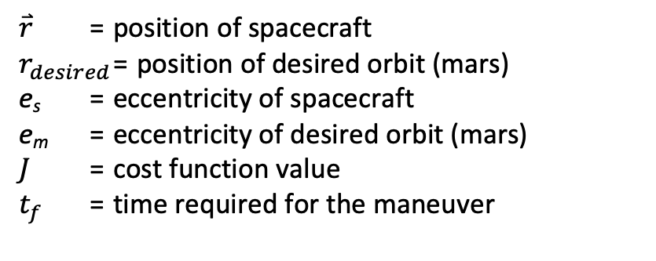
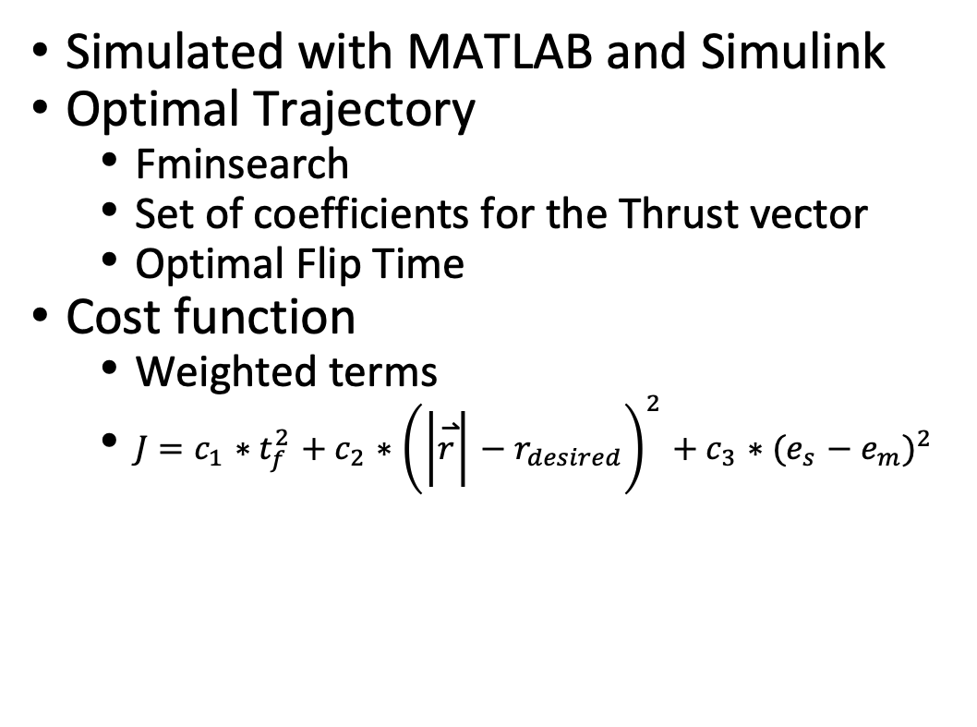
Earth to Mars Case Study: Simulation
Simulated with MATLAB and Simulink
Optimal Trajectory
Fminsearch
Set of coefficients for the Thrust vector
Optimal Flip Time
Cost function
Weighted terms
$J=c_{1}∗t_{f}^{2}+c_{2}∗{\left(\left|\overset{⃑}{r}\right|−r_{desired}\right)}^{2}+c_{3}∗{(e_{s}−e_{m})}^{2}$
$\overset{⃑}{r}$ = position of spacecraft
$r_{desired}$ = position of desired orbit (mars)
e_{s} = eccentricity of spacecraft
e_{m} = eccentricity of desired orbit (mars)
$J$ = cost function value
$t_{f}$ = time required for the maneuver
Conclusions and Further Research
Trajectory with Different Thrust
Earth to Mars Case Study
Presentation Overview

Slide 12
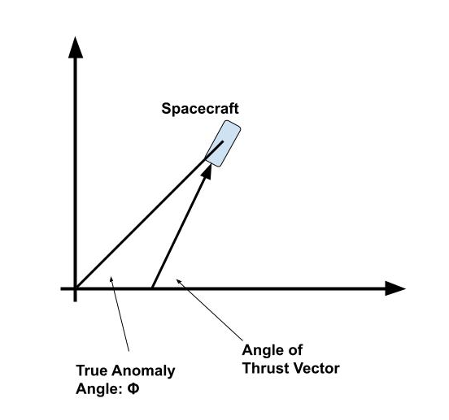
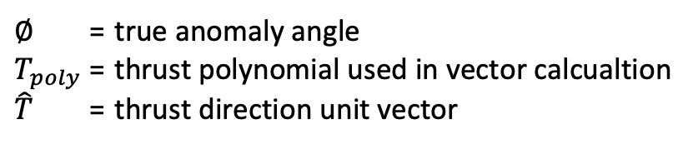

Earth to Mars Case Study: Simulation
Simulated with MATLAB and Simulink
Optimal Trajectory
Fminsearch
Set of coefficients for the Thrust vector
Optimal Flip Time
Thrust Vector
$T_{poly}=a_{1}+a_{2}∗∅+a_{3}∗∅^{2}+…a_{n+1}∗∅^{n}$
$\hat{T}=cos\left(T_{poly}\right)\hat{i}+sin\left(T_{poly}\right)\hat{j}$
$∅$ = true anomaly angle
$T_{poly}$ = thrust polynomial used in vector calcualtion
$\hat{T}$ = thrust direction unit vector
Conclusions and Further Research
Trajectory with Different Thrust
Earth to Mars Case Study
Presentation Overview

Slide 13
Earth to Mars Case Study: Simulation
Simulated with MATLAB and Simulink
Optimal Trajectory
Fminsearch
Set of coefficients for the Thrust vector
Optimal Flip Time
Thrust Vector
$T_{poly}=a_{1}+a_{2}∗∅+a_{3}∗∅^{2}+…a_{n+1}∗∅^{n}$
$\hat{T}=cos\left(T_{poly}\right)\hat{i}+sin\left(T_{poly}\right)\hat{j}$
$∅$ = true anomaly angle
$T_{poly}$ = thrust polynomial used in vector calcualtion
$\hat{T}$ = thrust direction unit vector
Use Simulation to evaluate and Optimize Trajectory
Conclusions and Further Research
Trajectory with Different Thrust
Earth to Mars Case Study
Presentation Overview

Slide 14
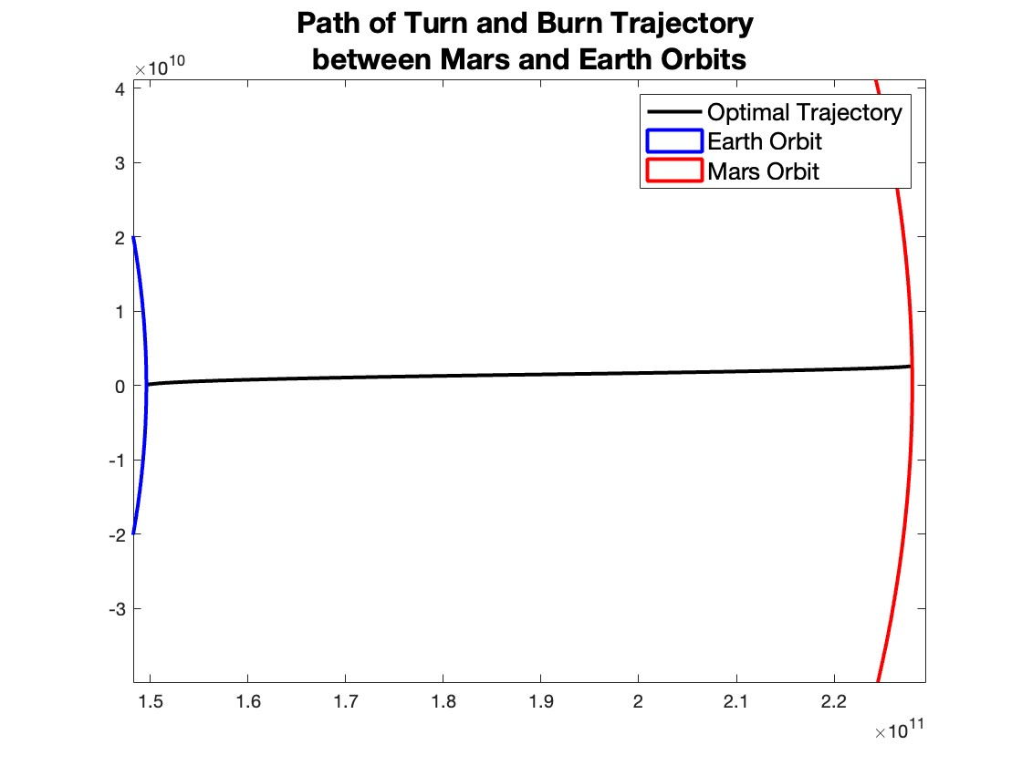
Earth to Mars Case Study: Results
Thrust to Provide 3g initial acceleration
Key Numbers
Max Speed: 1680000m/s
Thrust 441,000 N
Total Maneuver Duration: 26.1 hours
Flip Time: 14.3 hours (55%)
Range of Thruster Angle: 0.0076 Rad
Earth Orbit
Mars Orbit
Conclusions and Further Research
Trajectory with Different Thrust
Earth to Mars Case Study
Presentation Overview

Slide 15
Earth to Mars Case Study: Results
Thrust to Provide 3g initial acceleration
Key Numbers
Max Speed: 1680000m/s
Thrust 441,000 N
Total Maneuver Duration: 26.1 hours
Flip Time: 14.3 hours (55%)
Range of Thruster Angle: 0.0076 Rad
Earth Orbit
Mars Orbit
Turn and Burn Trajectory provides much faster travel times.
Conclusions and Further Research
Trajectory with Different Thrust
Earth to Mars Case Study
Presentation Overview

Slide 16
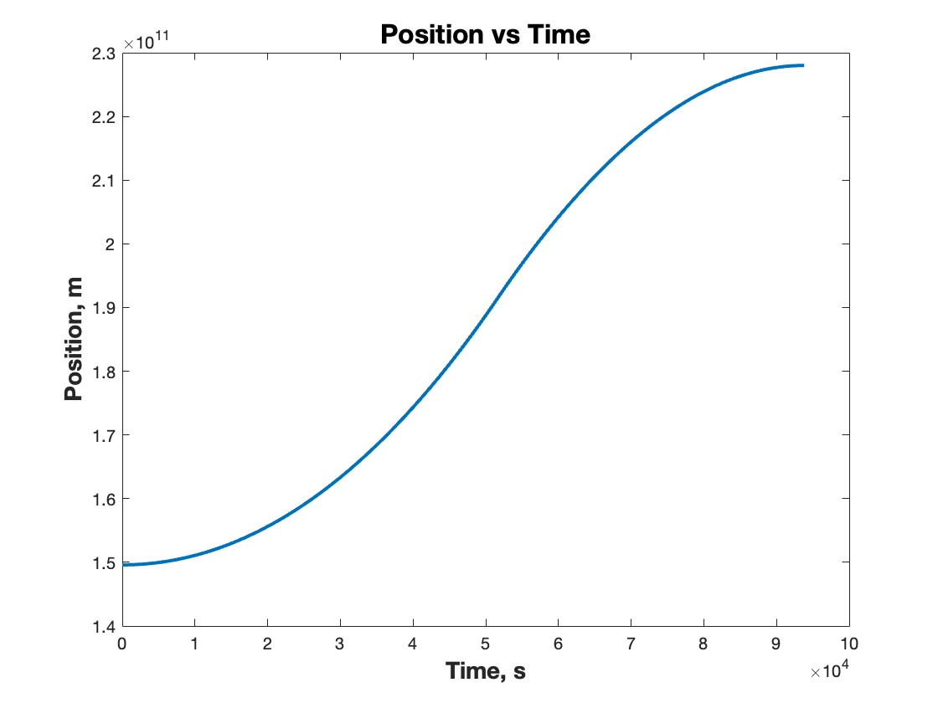
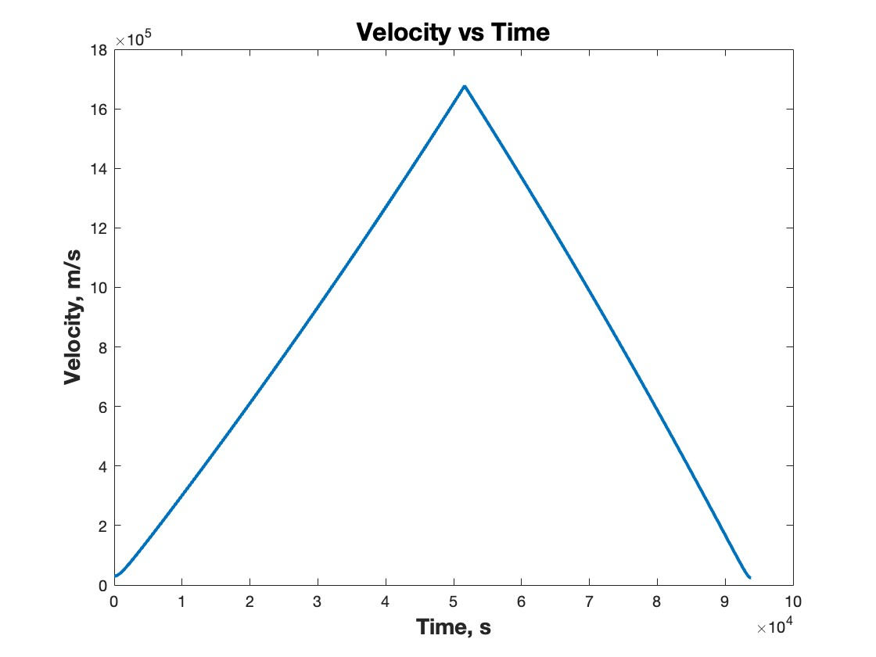
Earth to Mars Case Study: Results
Conclusions and Further Research
Trajectory with Different Thrust
Earth to Mars Case Study
Presentation Overview

Slide 17
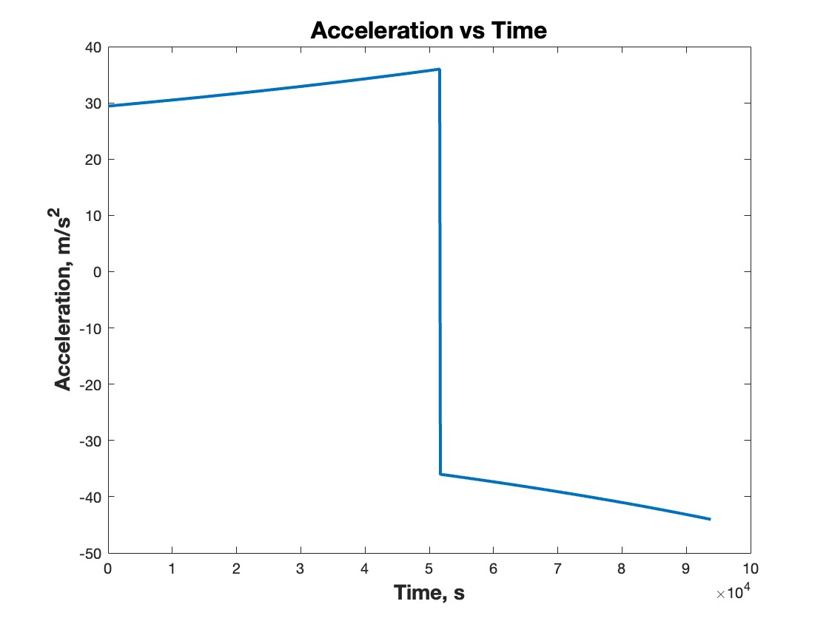
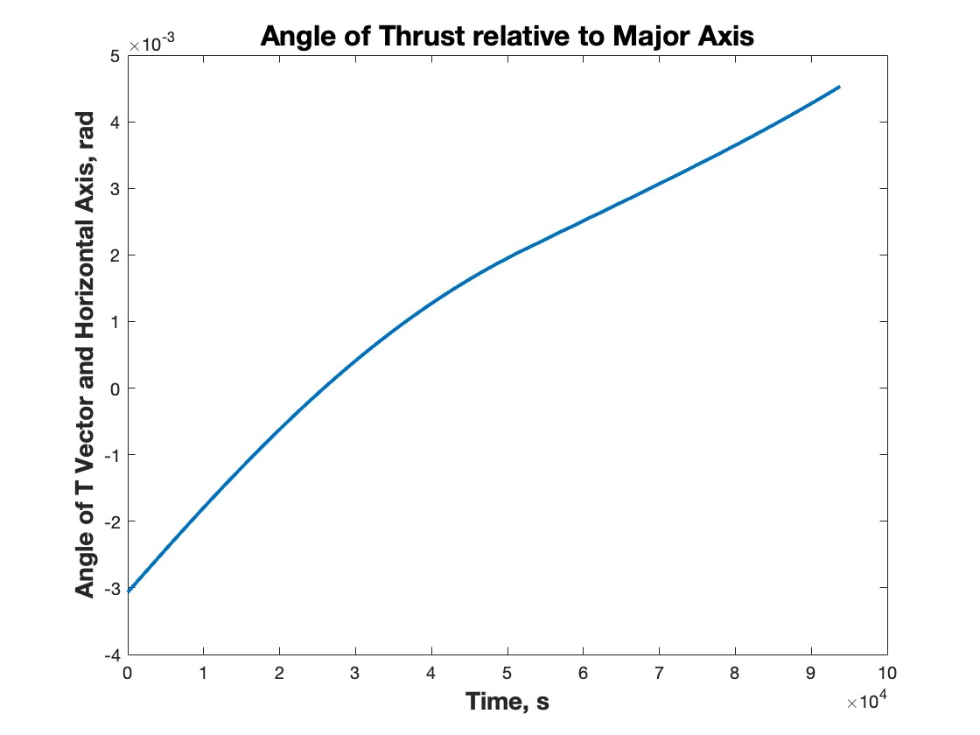
Earth to Mars Case Study: Results
Conclusions and Further Research
Trajectory with Different Thrust
Earth to Mars Case Study
Presentation Overview

Slide 18
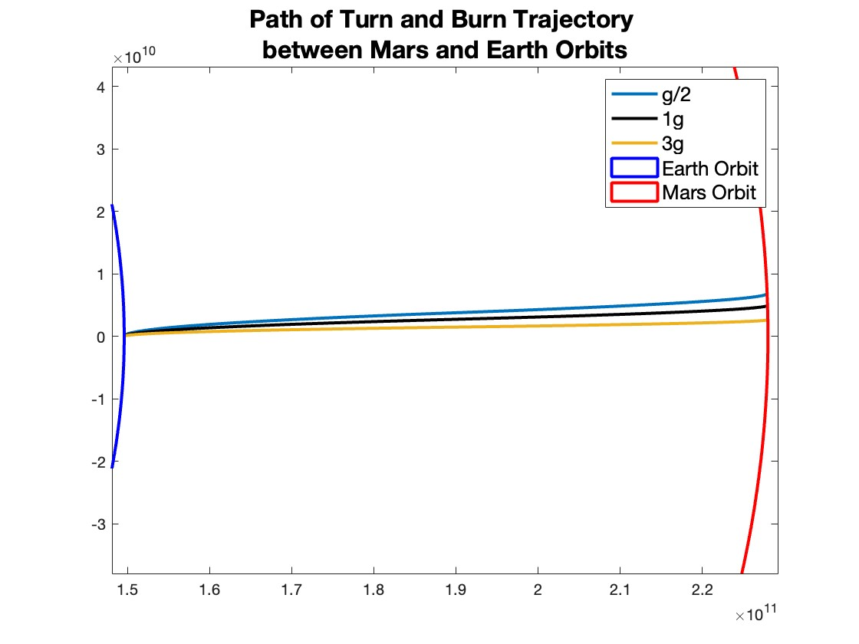
Earth to Mars Case Study: Other Thrusts
Examine Turn and Burn Maneuver under different Thrust levels
3g initial acceleration
1g initial acceleration
0.5g initial acceleration
Earth Orbit
Mars Orbit
Conclusions and Further Research
Trajectory with Different Thrust
Earth to Mars Case Study
Presentation Overview

Slide 19
Earth to Mars Case Study: Other Thrusts
Examine Turn and Burn Maneuver under different Thrust levels
3g initial acceleration
1g initial acceleration
0.5g initial acceleration
Earth Orbit
Mars Orbit
Test validity of Turn and Burn in different conditions.
Conclusions and Further Research
Trajectory with Different Thrust
Earth to Mars Case Study
Presentation Overview

Slide 20
Earth to Mars Case Study: Other Thrusts
 | 0.5 g Initial Accel | 1 g Initial Accel | 3 g Initial Accel
Max Speed | 679,000 m/s | 960,000 m/s | 1,680,000 m/s
Thrust | 74,000 N | 147,000 N | 441,000 N
Mission Duration | 64.3 hours | 45.5 hours | 26.1 hours
Flip Time | 35.1 hours | 24.83 hours | 14.34 hours
Range of Thruster Angle | 0.018 rad | 0.013 rad | 0.0076 rad
Conclusions and Further Research
Trajectory with Different Thrust
Earth to Mars Case Study
Presentation Overview

Slide 21
Earth to Mars Case Study: Other Thrusts
 | 0.5 g Initial Accel | 1 g Initial Accel | 3 g Initial Accel
Max Speed | 679,000 m/s | 960,000 m/s | 1,680,000 m/s
Thrust | 74,000 N | 147,000 N | 441,000 N
Mission Duration | 64.3 hours | 45.5 hours | 26.1 hours
Flip Time | 35.1 hours | 24.83 hours | 14.34 hours
Range of Thruster Angle | 0.018 rad | 0.013 rad | 0.0076 rad
Turn and Burn still has significant benefits at lower thrust.
Conclusions and Further Research
Trajectory with Different Thrust
Earth to Mars Case Study
Presentation Overview

Slide 22
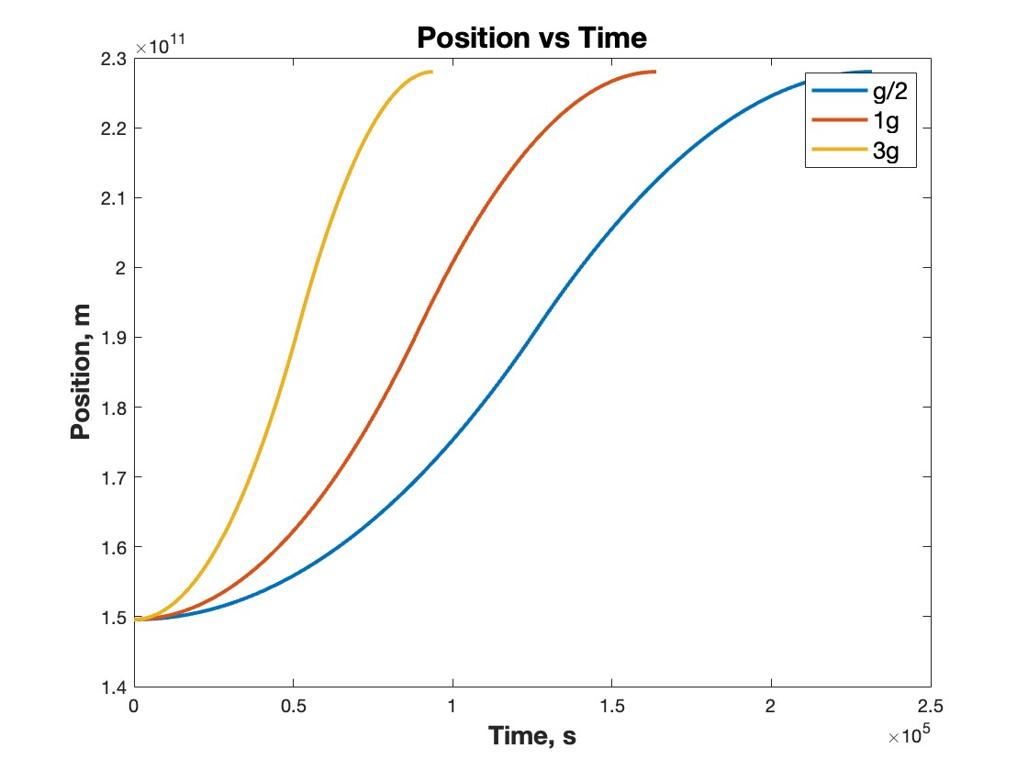
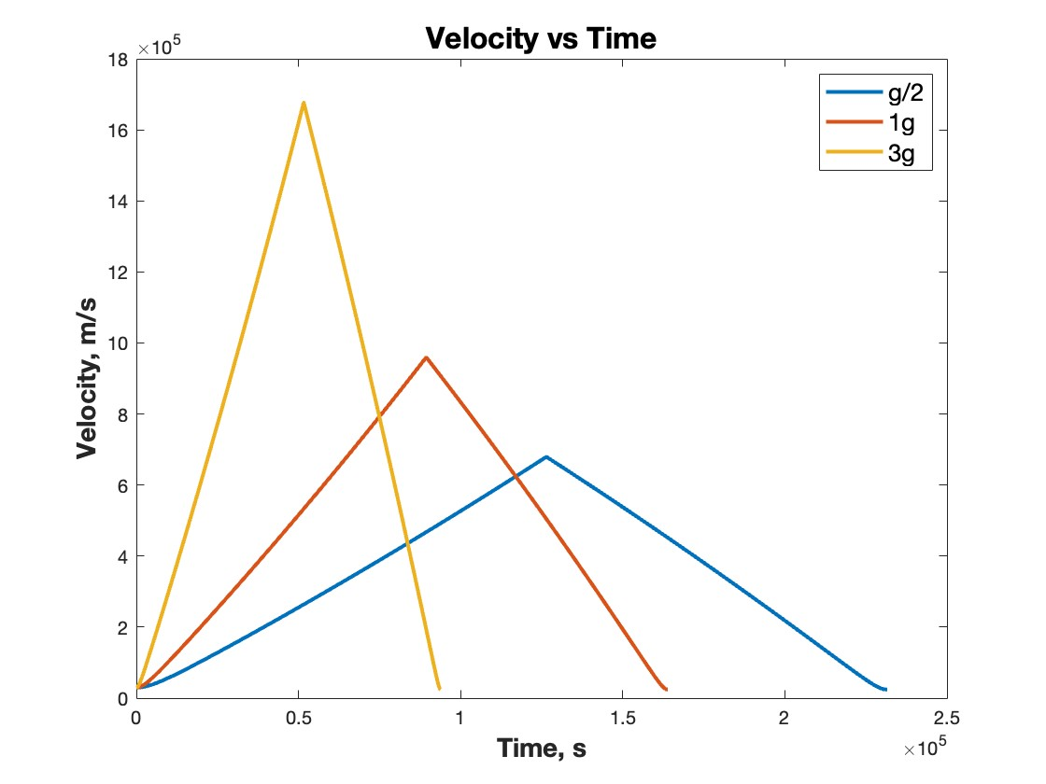
Earth to Mars Case Study: Other Thrusts
Conclusions and Further Research
Trajectory with Different Thrust
Earth to Mars Case Study
Presentation Overview

Slide 23
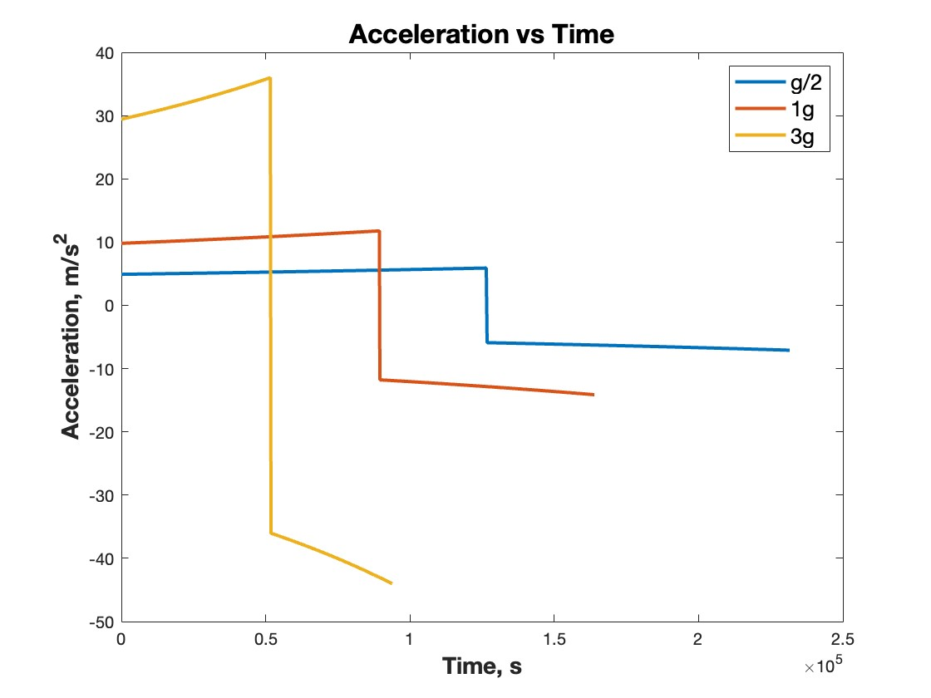
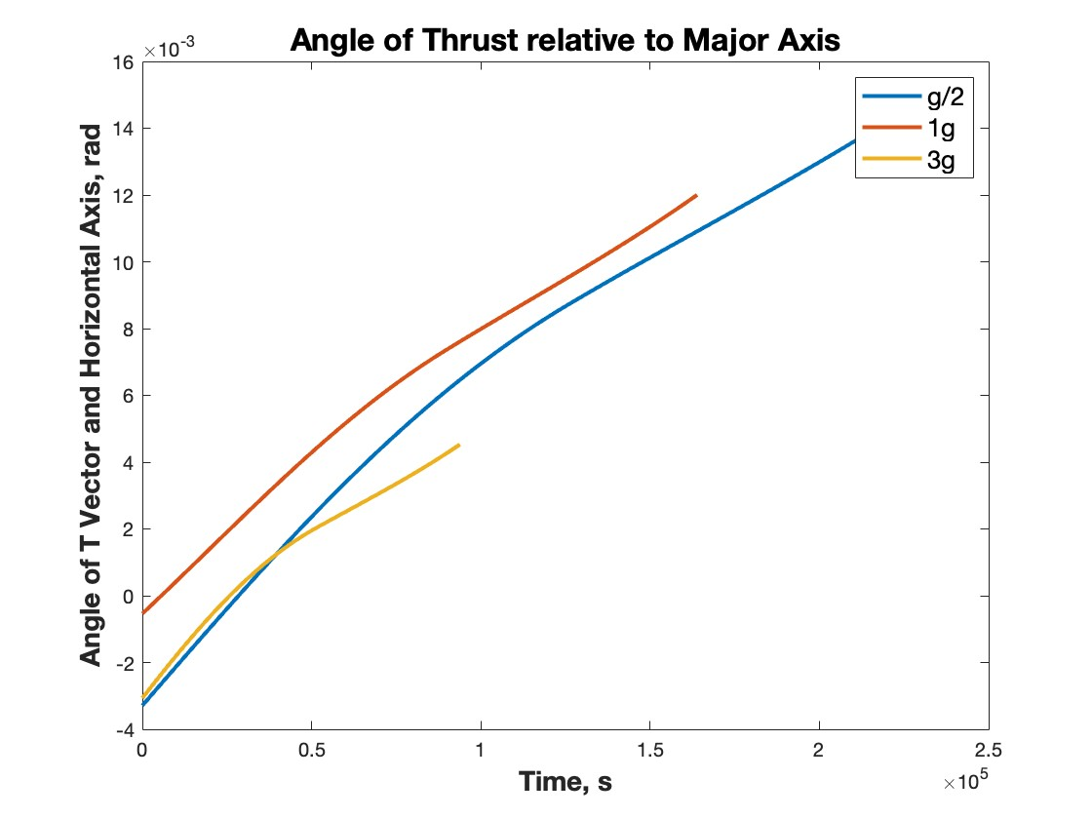
Earth to Mars Case Study: Other Thrusts
Conclusions and Further Research
Trajectory with Different Thrust
Earth to Mars Case Study
Presentation Overview

Slide 24
Conclusions and Current Status
Lay out framework for future technologies
Shorter Travel Times
Less living requirements onboard
Further Research
Subsystems of the Spacecraft
Lunar Case with Nuclear Thermal Propulsion
Mars Orbit
Earth Orbit
Conclusions and Further Research
Trajectory with Different Thrust
Earth to Mars Case Study
Presentation Overview

Slide 25
Acknowledgments and References
Acknowledgments
The research presented in this paper was conducted at Cornell University as a part of the Space Systems Design Studio. We would like to acknowledge Tina Daniel and Isaac Beaton for their work on other aspects of the Turn-and-Burn Project. Their work has helped confirm and expand upon the work presented in this paper.
References
[1] Drake, B. G. et al. “Human Exploration of Mars, Design Reference Architecture 5.0.” NASA Johnson Space Center 2009. [2] Kirk D. E., Optimal Control Theory An Introduction, Dover Publications, Inc. New York, 1998, Parts, I, IV [3] LeMoyne, R. “Positron Induced Fusion Pulsed Space Propulsion through an Ultra-Intense Laser.” Journal of Applied Mathematics and Physics, Vol.5, No.4, 2017. [4] “Space Shuttle News Reference” NASA 1981. [5] Daniel T, “Turn and Burn End of Semester Report (Cornell University Internal Document)” Cornell University, Ithaca, New York, 2022. (unpublished) [6] MATLAB and Simulink, Ver R2022b, Math Works, Natick, MA, 2022.

Slide 26
Turn and Burn Interplanetary Maneuver
Questions?

