Slide 1






“ENRICHING WORD VECTORS WITH SUBWORD INFORMATION”
Lucas Whitmire
Edgardo Panza

Slide 2
Who is it? Where was it published?
Why is it relevant? Why did it write it?
Main contribution
Background, Why is it novel?
Datasets
Tasks
Approach, Baselines, Methods
Notable tricks
Measurability
Quantitative / Qualitative Results
Is there an error analysis?
What’s next?
Do you believe it? Do i see problems?
Where do they cheat?
Can you apply it? Is code and data available?
What are weakness?
Impactful? Are there any Enterprise solutions that apply it?
Who cited it? Semantic scholar
2

Slide 3
Tasks
Word Representation
Transforming words into a vector format which can be more easily processed by computers.
Text Classification (hate speech detection, etc.)
Assigning a set of predefined categories to free-text. Text classifiers can be used to organize, structure, and categorize
3
Notes:
[Pull definitions from class presentations and make sure we understand these tasks.]

Slide 4
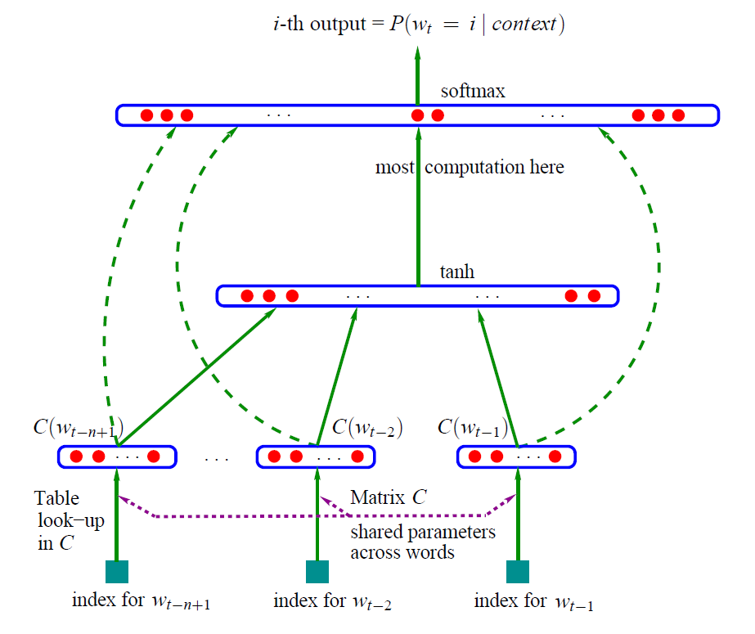
Background (Neural Probabilistic Model, 2003)
Bengio et al., A Neural Probabilistic Language Model: http://www.jmlr.org/papers/volume3/bengio03a/bengio03a.pdf
4

Slide 5
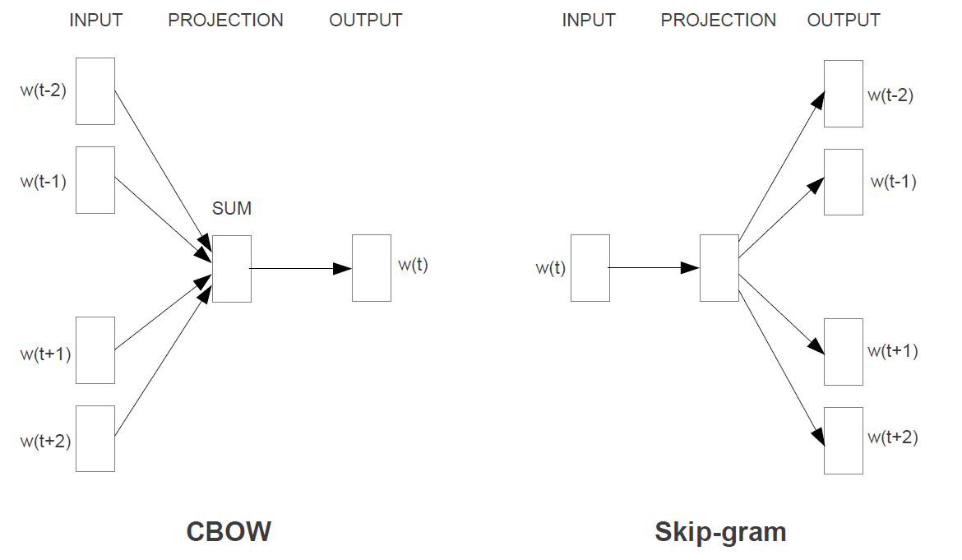
Background (Word2Vec, 2013)
Mikolov et al., Word2Vec: Efficient Estimation of Word Representations in Vector Space: https://arxiv.org/pdf/1301.3781.pdf
5
Notes:
Neural Network Training (Inputs in both models are just one-hot encoded vocabulary vectors):
The CBOW model architecture predict the target word (the center word) based on the source context words (surrounding words).
Skip-gram model the context is predicted based on the source word
In both architectures, after training, the output layer is “thrown away” and the hidden layer is used as the vector representation of the words.
Additional Note: Later this same year, “Distributed Representations of Words and Phrases and their Compositionality” was published which introduced improvements to the Skip-gram model such as Negative Sampling and Subsampling of Frequent Words.
[Mikolov et al., Distributed Representations of Words and Phrases and their Compositionality: https://arxiv.org/abs/1310.4546]

Slide 6
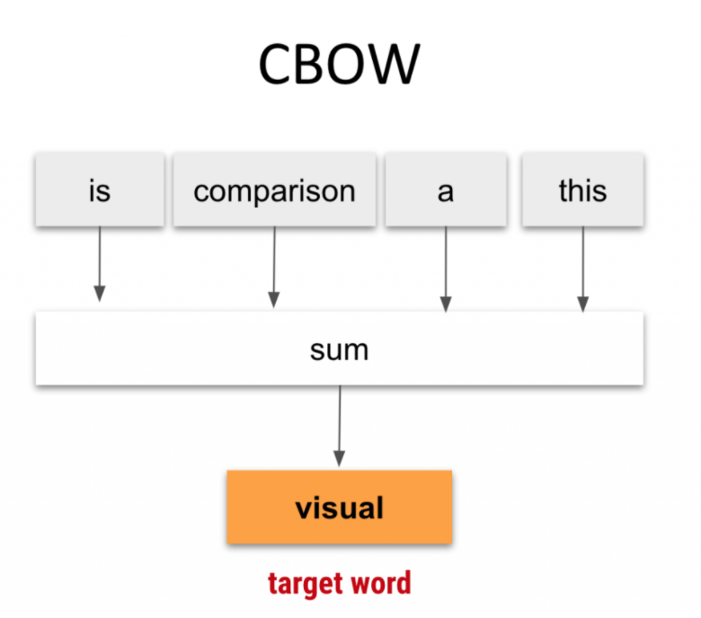
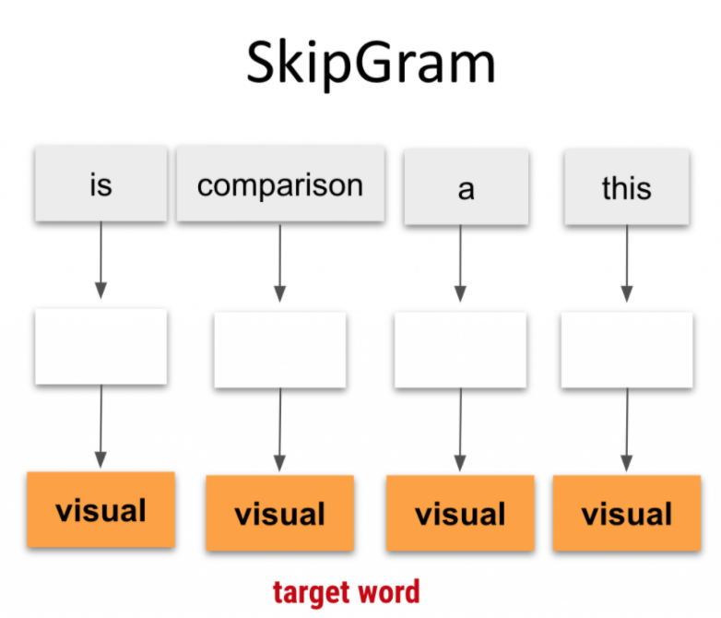
Background (Word2Vec)
6
Notes:
[Also reference papers here (maybe with timeline?) 3 papers – CBOW, continuous skipgram, and character-level neural networks (RNN and CNN)]
Network Training:
The CBOW model architecture predict the target word (the center word) based on the source context words (surrounding words).
Skip-gram model the context is predicted based on the source word

Slide 7
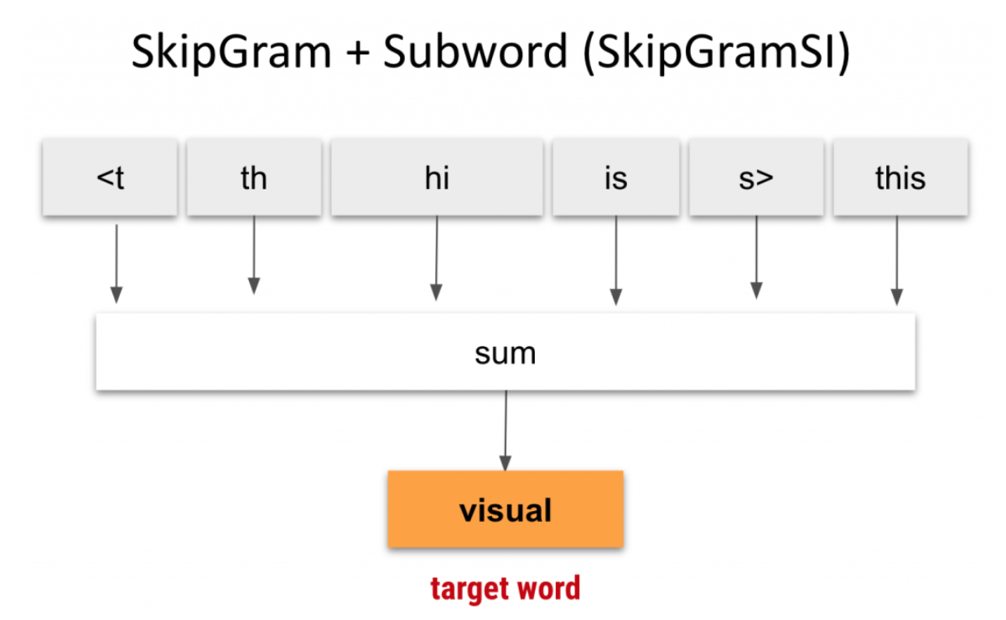
Skip-gram Model with Subword Information (2017)
[Put skipgram eqn. or scoring functions from presentation here, per BW]
Bojanowski, Grave et al., Enriching Word Vectors with Subword Information: https://arxiv.org/pdf/1607.04606.pdf
7
Notes:
More recently, building on the SkipGram idea, a more granular approach was introduced where a bag of character n-grams (also known as subwords) are used to represent a word. As shown in Figure, each word is represented by the sum of it’s n-gram vectors.

Slide 8
Advantages
Grammatical variations in words have similar n-gram vectors
Examples: verb conjugation, plurals, declensions (accusative, nominative, etc.)
Out-of-Vocabulary Word encoding
N-gram vectors can be built for words that were not present in training
These words will have similar n-gram vectors to similar words used in training
 | Singular | Plural
Nominative | uniwersytet | uniwersytety
Genetive | uniwersytetu | uniwersytetów
Dative | uniwersytetowi | uniwersytetom
Accusative | uniwersytet | uniwersytety
Instrumental | uniwersytetem | uniwersytetami
Locative | uniwersytecie | uniwersytetach
Vocative | uniwersytecie | uniwersytety
Polish declension
Piotr Bojanowski, fastText - a library for efficient text classification and word representation: https://nlpparis.files.wordpress.com/2016/11/fasttext-nlpmeetup-23112016.pptx
8

Slide 9
Data Sets
Word Representation
Dataset
Structure
Dataset 2
Structure
Text Classification (hate speech detection,etc)
Dataset
Structure
Dataset 2
Structure
9

Slide 10
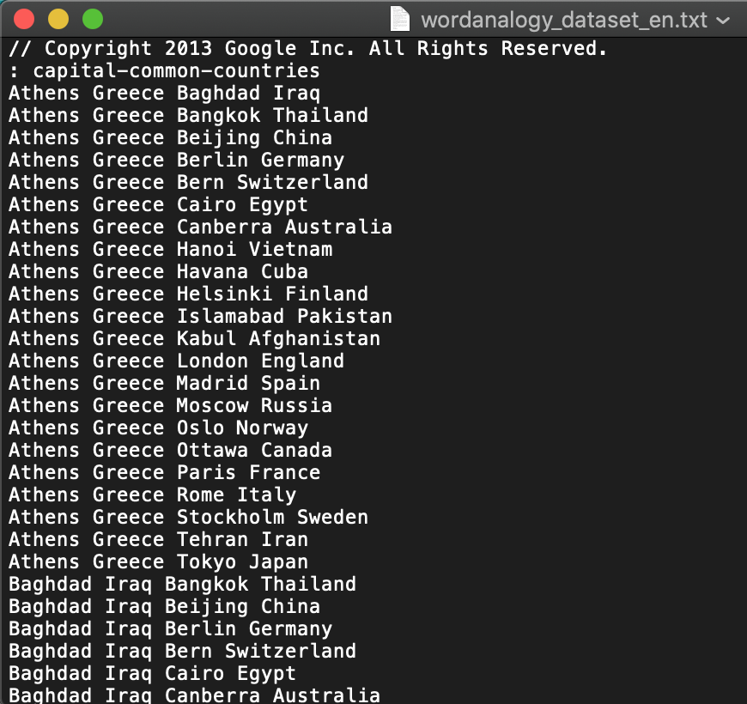
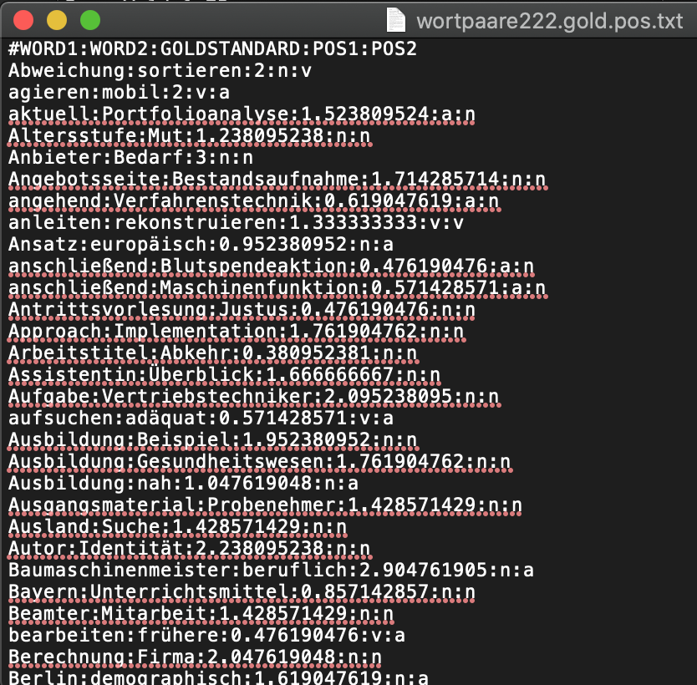
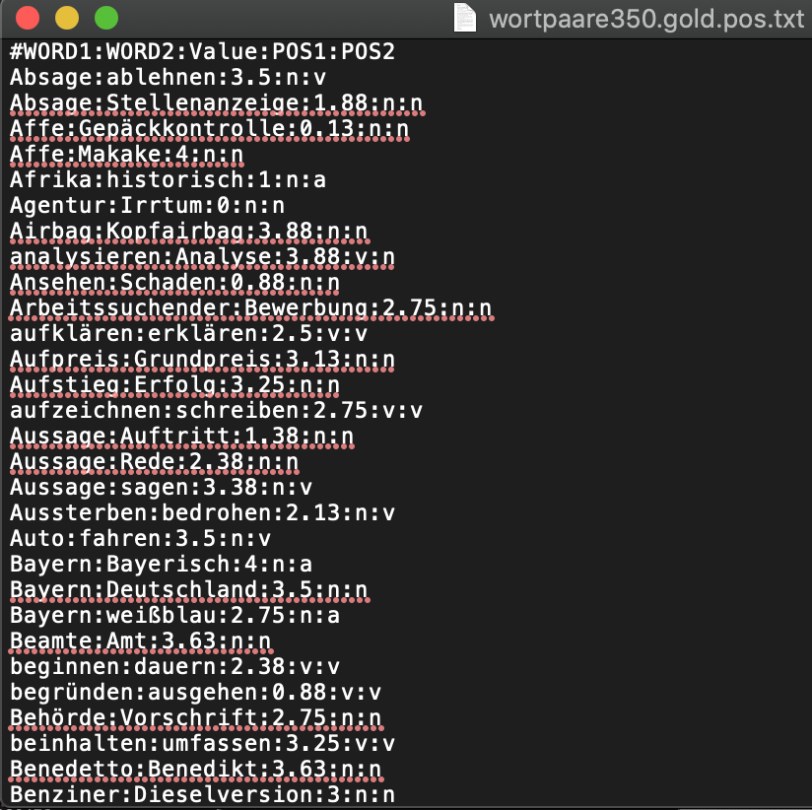
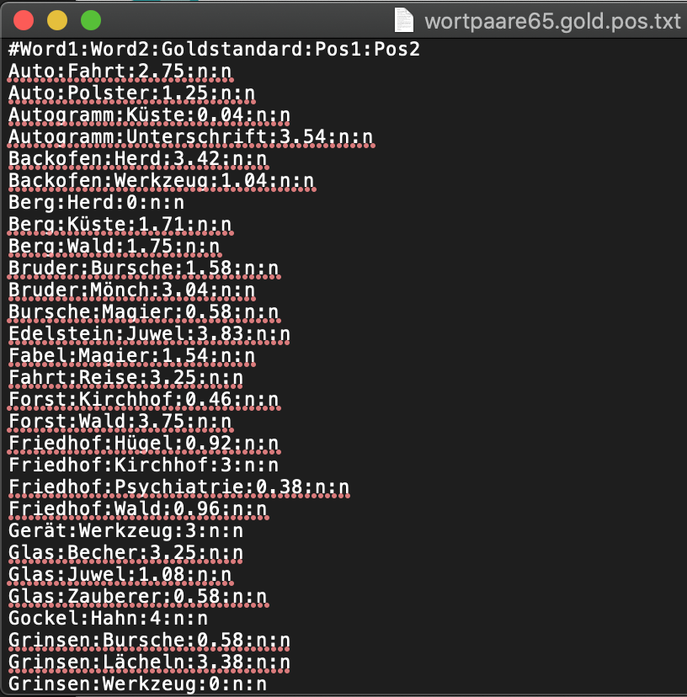
Data Sets
10

Slide 11
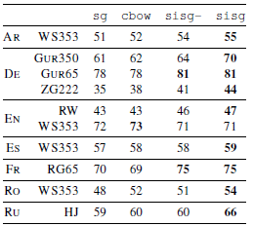
Quantitative / Qualitative Results
In most experiments (except in Sec. 5.3), we compare our model to the C implementation of the skipgram and cbow models from the word2vec2 package.
5.3 Comparison with morphological representations
We also compare our approach to previous work on word vectors incorporating subword information on word similarity tasks. The methods used are: the recursive neural network of Luong et al. (2013), the morpheme cbow of Qiu et al. (2014) and the morphological transformations of Soricut and Och (2015).
We evaluate our model in five experiments: an eval- uation of word similarity and word analogies, a com- parison to state-of-the-art methods, an analysis of the effect of the size of training data and of the size of character n-grams that we consider. We will de- scribe these experiments in detail in the following sections.
11

Slide 12
Why is it relevant? Why did they write it?
Continuous word representations, trained on large unlabeled corpora are useful for many natural language processing tasks. Popular models that learn such representations ignore the morphology of words, by assigning a distinct vector to each word. This is a limitation, especially for languages with large vocabularies and many rare words. In this paper, we propose a new approach based on the skipgram model, where each word is represented as a bag of character n-grams. A vector representation is associated to each character n-gram; words being represented as the sum of these representations. Our method is fast, allowing to train models on large corpora quickly and allows us to compute word representations for words that did not appear in the training data. We evaluate our word representations on nine different languages, both on word similarity and analogy tasks. By comparing to recently proposed morphological word representations, we show that our vectors achieve state-of-the-art performance on these tasks.
12

Slide 13
Main Contribution
-Morphological languages.
-Good word representations with smaller datasets (Ref. Sect. 5.4)
-Good rare word representations
13

Slide 14
Is there an error analysis?
NOUP
Do you believe it? Do I see problems?
YES / there is no error
Where do they cheat?
With the error
“Hand picked examples”
What are the weaknesses?
This method lacks the contextual information gathered in the RNN or Transformer models
14

Slide 15
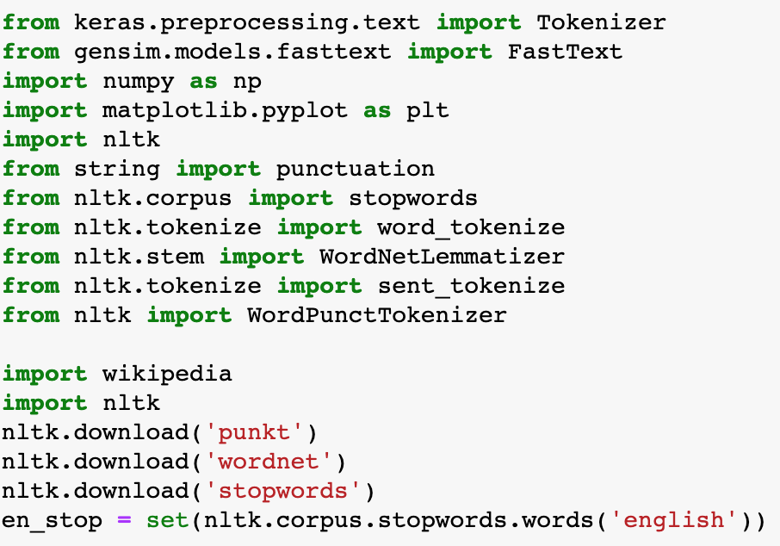
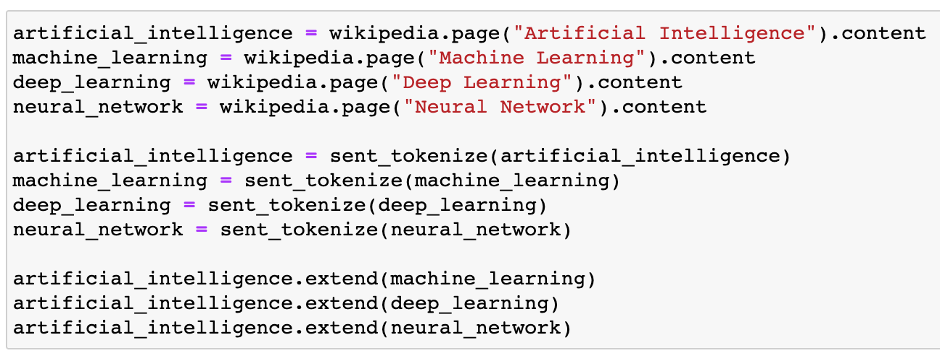
Fasttext Examples
The libraries used are:
Gensim.models.fastext
Nltk → natural language toolkit
Wikipedia
Scrape some Wikipedia pages
https://github.com/facebookresearch/fastText
15
Notes:
[Potentially download and run some simple fasttext code and show the results]

Slide 16
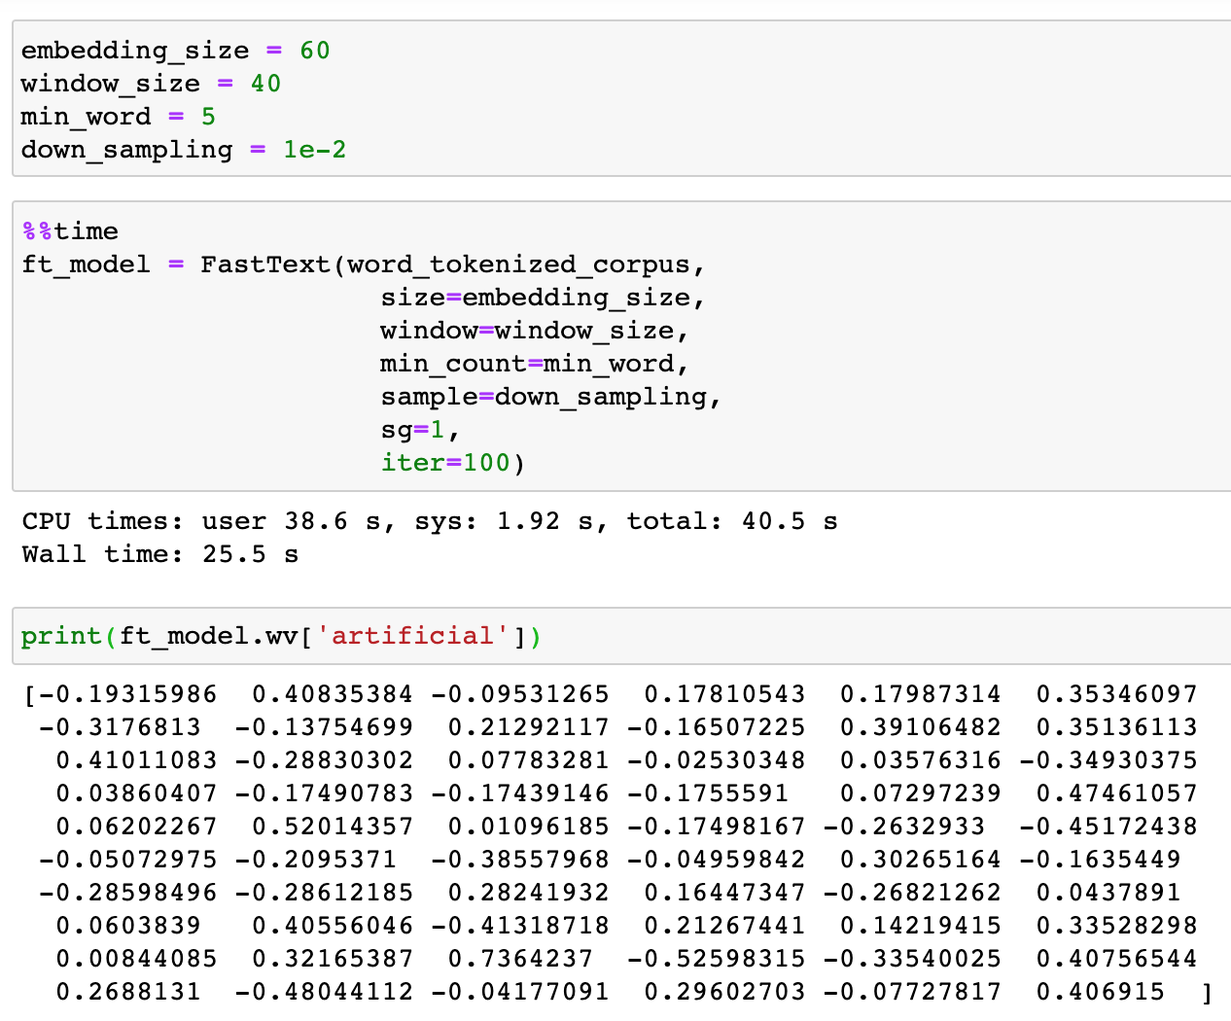
Fasttext Examples
Preprocessing:
All to lower case
All to root form
Remove stop words
Embedding_size is the size of the embedding vector.
In other words, each word in our corpus will be represented as a 60-dimensional vector.
16
Notes:
[Potentially download and run some simple fasttext code and show the results]
The window_size is the size of the number of words occurring before and after the word based on which the word representations will be learned for the word.
The next hyper-parameter is the min_word, which specifies the minimum frequency of a word in the corpus for which the word representations will be generated. Finally, the most frequently occurring word will be down-sampled by a number specified by the down_sampling attribute.

Slide 17
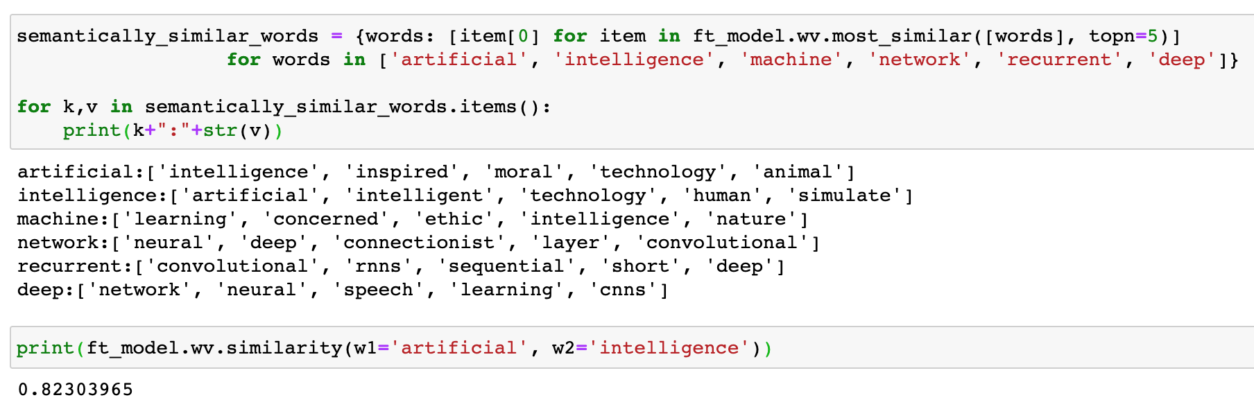
Fasttext Examples
The value can be anywhere between 0 and 1. A higher value means higher similarity.
17
Notes:
[Potentially download and run some simple fasttext code and show the results]

Slide 18
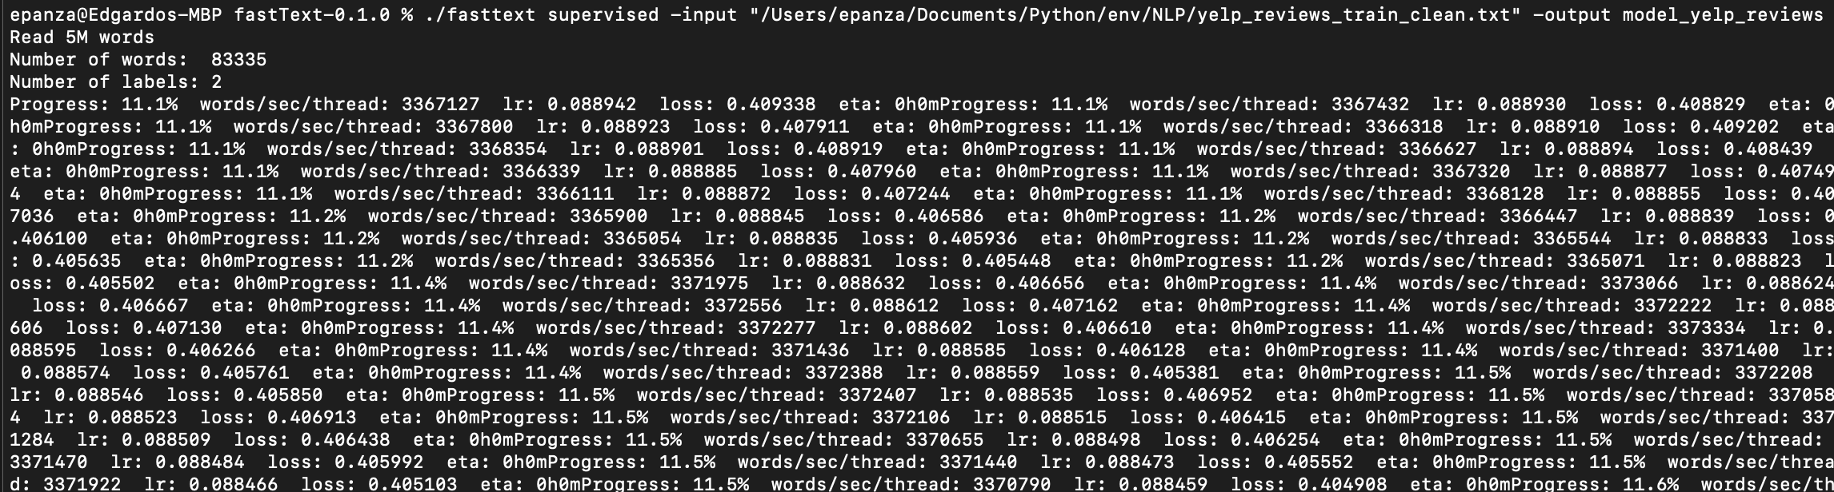
Fasttext Examples
P@1 → Precision.
R@1 → Recall
18
Notes:
[Potentially download and run some simple fasttext code and show the results]

Slide 19
Impactful? Are there any Enterprise solutions that apply it?
And
Who cited it? Semantic Scholar
https://pypi.org/project/fasttext/
[Figure out what papers followed this, and also make sure we know if fasttext is used for the state of the art methods (BERT and ELMO, and other transformer methods]
19

Slide 20
References
https://towardsdatascience.com/skip-gram-nlp-context-words-prediction-algorithm-5bbf34f84e0c
https://kavita-ganesan.com/comparison-between-cbow-skipgram-subword/#.XvHfR5P7RDU
https://stackabuse.com/python-for-nlp-working-with-facebook-fasttext-library/
20

