Slide 1





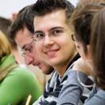
Analysis of “Enriching Word Vectors With Subword Information”^{[1]}
Lucas Whitmire
Edgardo Panza
^{[1]}Bojanowski, Grave et al., Enriching Word Vectors with Subword Information: https://arxiv.org/pdf/1607.04606.pdf

Slide 2
Agenda
Introduction
Background
New Model with Subword Information
Advantages
Datasets
Results
Main Contributions
Shortcomings / Cheats
Next Steps
Examples
References
2

Slide 3
Introduction
“Enriching Word Vectors with Subword Information”
Written by Piotr Bojanowski, Edouard Grave, Armand Joulin, and Tomas Mikolov (all employees of Facebook at the time of writing)
Published in 2017
Presents a novel approach for word representation based on the Skip-gram model
3
Notes:
[Pull definitions from class presentations and make sure we understand these tasks.]
Most of popular techniques represent each word of the vocabulary by a distinct vector, without parameter sharing. In particular, they ignore the internal structure of words, which is an important limitation for morphologically rich languages, such as Turkish or Finnish.

Slide 4
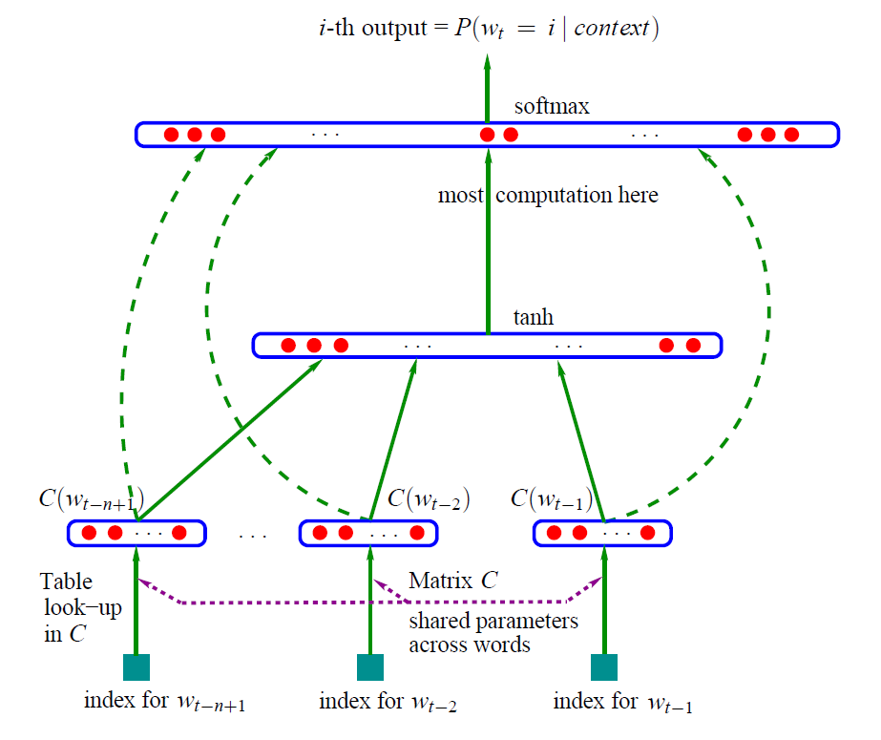
Background (Neural Probabilistic Model, 2003)
Bengio et al., A Neural Probabilistic Language Model: http://www.jmlr.org/papers/volume3/bengio03a/bengio03a.pdf
4
Notes:
Introduced a model to predict the next word based on ‘n’ previous words. This seems to be the first half of the CBOW type model.

Slide 5
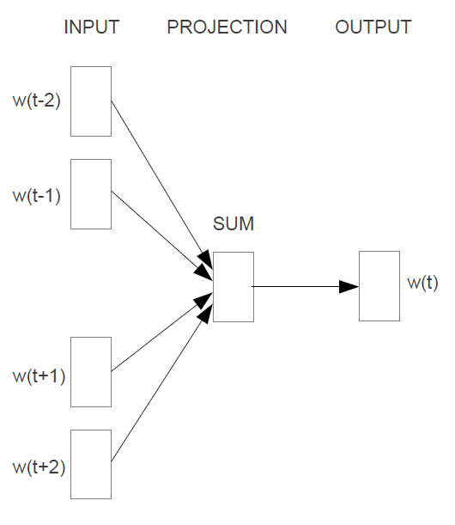
Background (Word2Vec, 2013) - CBOW
The
mighty
knight
Lancelot
fought
bravely.
Mikolov et al., Word2Vec: Efficient Estimation of Word Representations in Vector Space: https://arxiv.org/pdf/1301.3781.pdf
5
Notes:
Neural Network Training (Inputs in both models are just one-hot encoded vocabulary vectors):
The CBOW model architecture predict the target word (the center word) based on the source context words (surrounding words).
Quicker to train, better accuracy on frequent words.
In both architectures, after training, the output layer is “thrown away” and the hidden layer is used as the vector representation of the words.

Slide 6
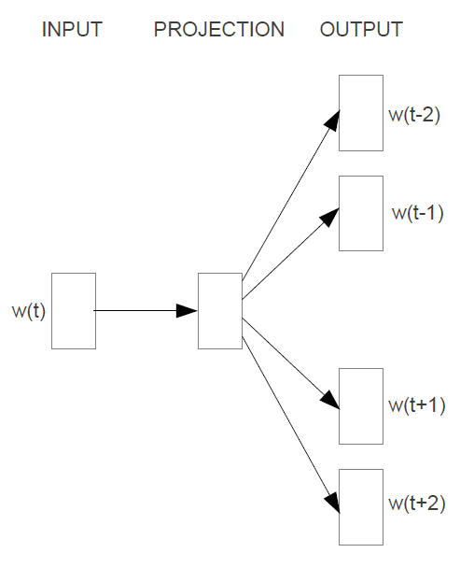
Background (Word2Vec, 2013) – Skip-gram
The
mighty
knight
Lancelot
fought
bravely.
Mikolov et al., Word2Vec: Efficient Estimation of Word Representations in Vector Space: https://arxiv.org/pdf/1301.3781.pdf
6
Notes:
Neural Network Training (Inputs in both models are just one-hot encoded vocabulary vectors):
Skip-gram model the context is predicted based on the source word. This method performs better on rare words, but is slower to train than CBOW.
In both architectures, after training, the output layer is “thrown away” and the hidden layer is used as the vector representation of the words.
Additional Note: Later this same year, “Distributed Representations of Words and Phrases and their Compositionality” was published which introduced improvements to the Skip-gram model such as Negative Sampling and Subsampling of Frequent Words and
[Mikolov et al., Distributed Representations of Words and Phrases and their Compositionality: https://arxiv.org/abs/1310.4546]

Slide 7
Skip-gram Model with Subword Information (2017)
visual
<vi
vis
isu
sua
ual
al>
<vi
vis
isu
sua
Generate one-hot encoded vectors for n-grams
Sum
Feature Vector for input to Skip-gram model
Bojanowski, Grave et al., Enriching Word Vectors with Subword Information: https://arxiv.org/pdf/1607.04606.pdf
7
Notes:
More recently, building on the SkipGram idea, a more granular approach was introduced where a bag of character n-grams (also known as subwords) are used to represent a word. As shown in Figure, each word is represented by the sum of it’s n-gram vectors.

Slide 8
Advantages
Grammatical variations in words have similar n-gram vectors
Examples: verb conjugation, plurals, declensions (accusative, nominative, etc.)
Out-of-Vocabulary Word features
N-gram feature vectors can be built for words that were not present in training
These words will have similar n-gram feature vectors to similar words used in training
 | Singular | Plural
Nominative | uniwersytet | uniwersytety
Genetive | uniwersytetu | uniwersytetów
Dative | uniwersytetowi | uniwersytetom
Accusative | uniwersytet | uniwersytety
Instrumental | uniwersytetem | uniwersytetami
Locative | uniwersytecie | uniwersytetach
Vocative | uniwersytecie | uniwersytety
Polish declension
Piotr Bojanowski, fastText - a library for efficient text classification and word representation: https://nlpparis.files.wordpress.com/2016/11/fasttext-nlpmeetup-23112016.pptx
8

Slide 9
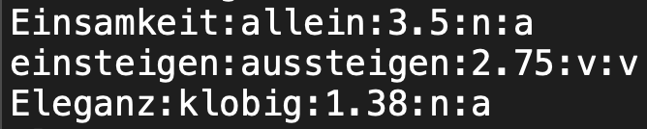
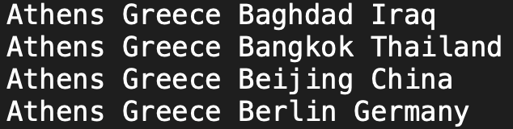
Datasets
Training Datasets are Wikipedia dumps in different languages: Arabic, Czech, German, English, Spanish, French, Italian, Romanian, Russian.
Baselining Datasets
Given pairs of words, determine similarity and compare to human judgement of similarity
Example:
Given triplets of words, predict the analogy
Example:
9

Slide 10
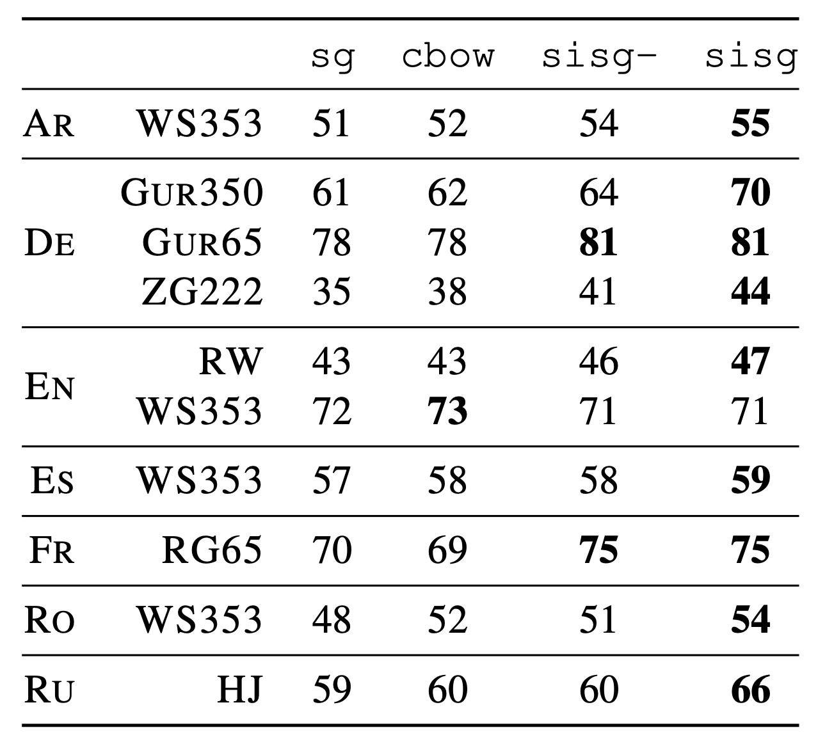
Results – Word Similarity
10
Notes:
Sisg- uses null vectors for unseen words, sisg creates feature vectors by summing n-gram vectors
Poorer performance on WS353: This is due to the fact that words in the English WS353 dataset are common words for which good vectors can be obtained without exploiting subword information.

Slide 11
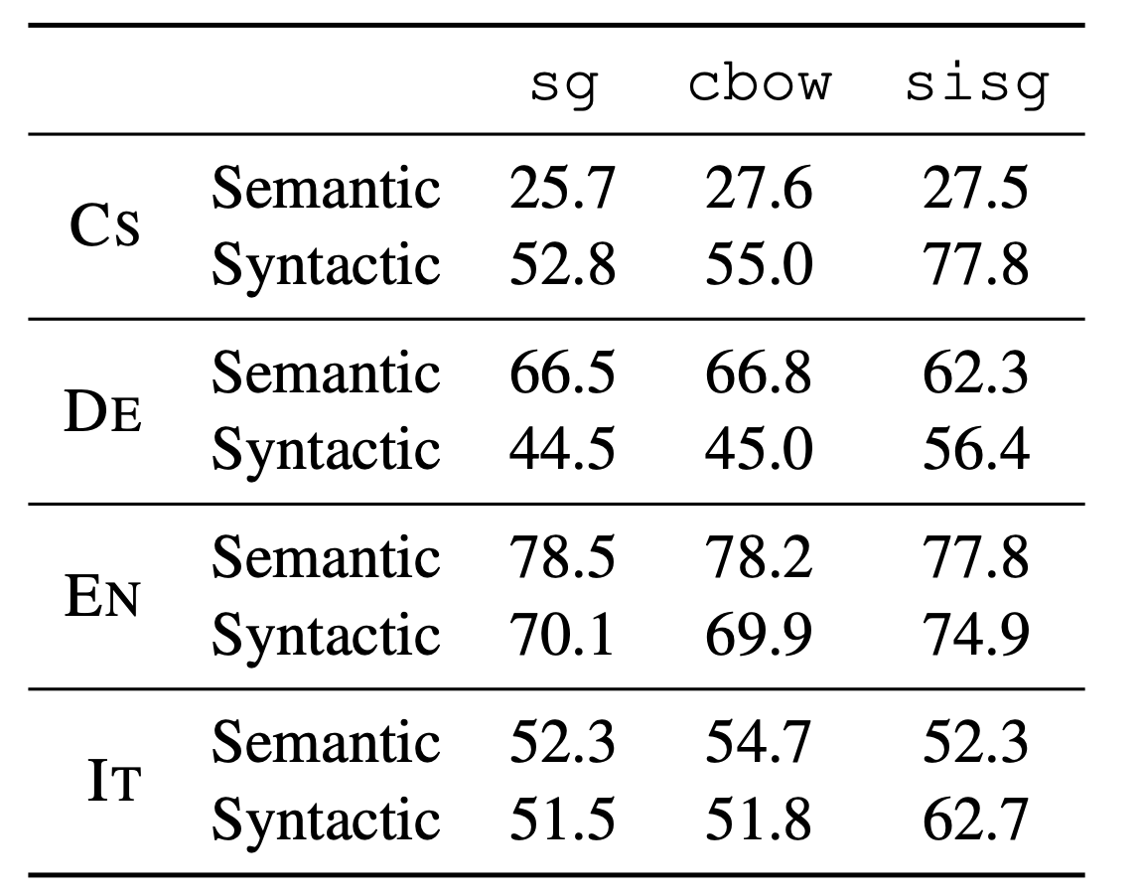
Results - Analogies
11
Notes:
"The task consists of analogies such as "Germany" : "Berlin" :: "France" : ?, which are solved by finding a vector x such that vec(x) is closest to vec("Berlin") - vec("Germany") + vec("France") according to the cosine distance (we discard the input words from the search). This specific example is considered to have been answered correctly if x is "Paris". The task has two broad categories: the syntactic analogies (such as "quick" : "quickly" :: "slow" : "slowly") and the semantic analogies, such as the country to capital city relationship.“
[Mikolov et al., Distributed Representations of Words and Phrases and their Compositionality: https://arxiv.org/abs/1310.4546]

Slide 12
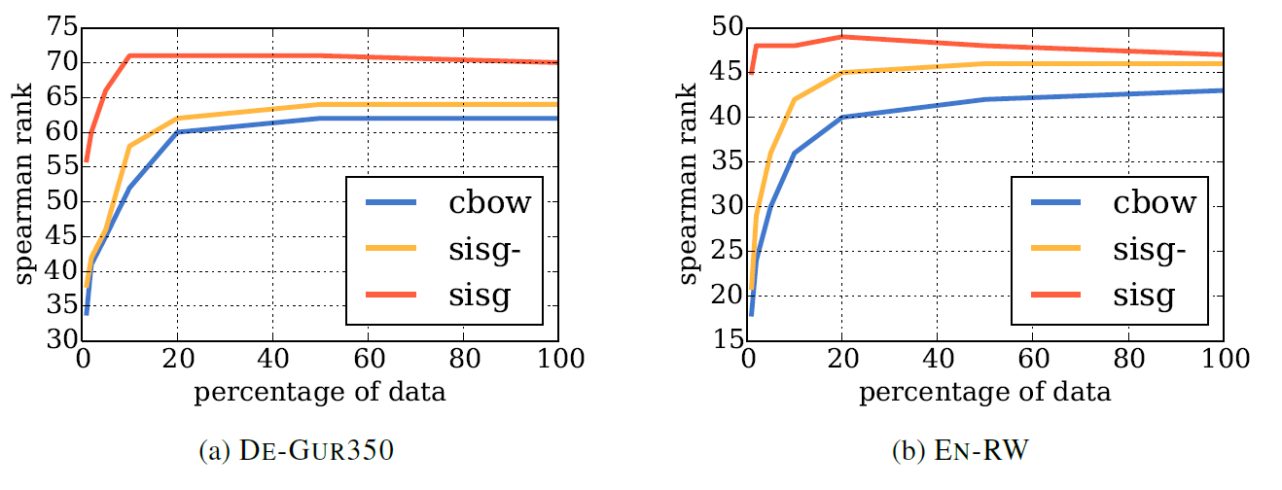
Results – Training Set Sizes
12
Notes:
First, we notice that for all datasets, and all sizes, the proposed approach (sisg) performs better than
the baseline. However, the performance of the base- line cbow model gets better as more and more data is available. Our model, on the other hand, seems to quickly saturate and adding more data does not always lead to improved results.
Second, and most importantly, we notice that the proposed approach provides very good word vectors even when using very small training datasets

Slide 13
Main Contributions
Works well for rare/OOV words and for morphologically rich languages (like German).
Works well for syntactic analogies and does not degrade semantic analogies much.
Good word representation with smaller datasets.
13

Slide 14
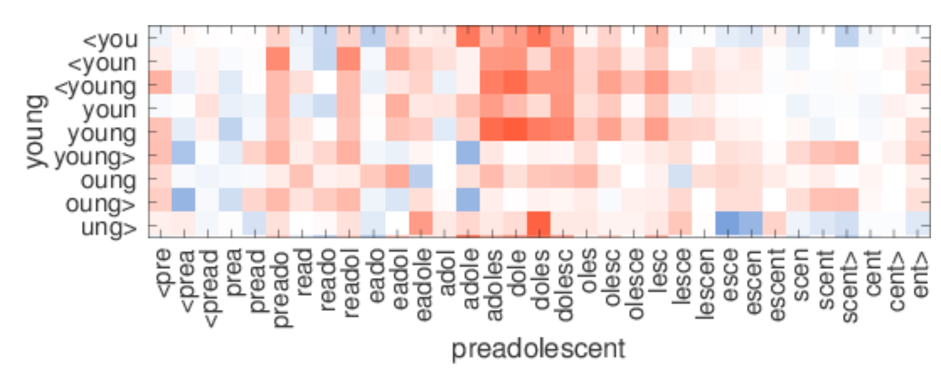
Shortcomings/Cheats
The paper lacks an error analysis.
An investigation into the errors made during the word similarity task would be helpful to identify systemic gaps in the performance of the model.
The hand-picked OOV examples presented at the end of the paper seem to be a weak argument for the effectiveness of the new model.
A more comprehensive analysis of the English Rare Words dataset would be more informative.
14
Notes:
Figure 2: Illustration of the similarity between character n-grams in out-of-vocabulary words. For each pair, only one word is OOV, and is shown on the x axis. Red indicates positive cosine, while blue negative.

Slide 15
Next Steps
This paper, as well as the others listed below, were combined into one library called FastText, this is a unified framework for Word Representation and Text Classification.
A. Joulin, E. Grave, P. Bojanowski, T. Mikolov, Bag of Tricks for Efficient Text Classification
A. Joulin, E. Grave, P. Bojanowski, M. Douze, H. Jégou, T. Mikolov, FastText.zip: Compressing text classification models
Jacob Devlin, Ming-Wei Chang, Kenton Lee, Kristina Toutanova, BERT: Pre-training of Deep Bidirectional Transformers for Language Understanding
15
Notes:
[Introduce FastText (and other papers which fed into this, see github)]
https://pypi.org/project/fasttext/
Text Classification is the process of categorizing text into organized groups. first automatically analyzing the text and then assigning a set of pre-defined tags or categories based on its content.
[ELMO]
[BERT]
This method uses Subword information for its own tokenization.

Slide 16
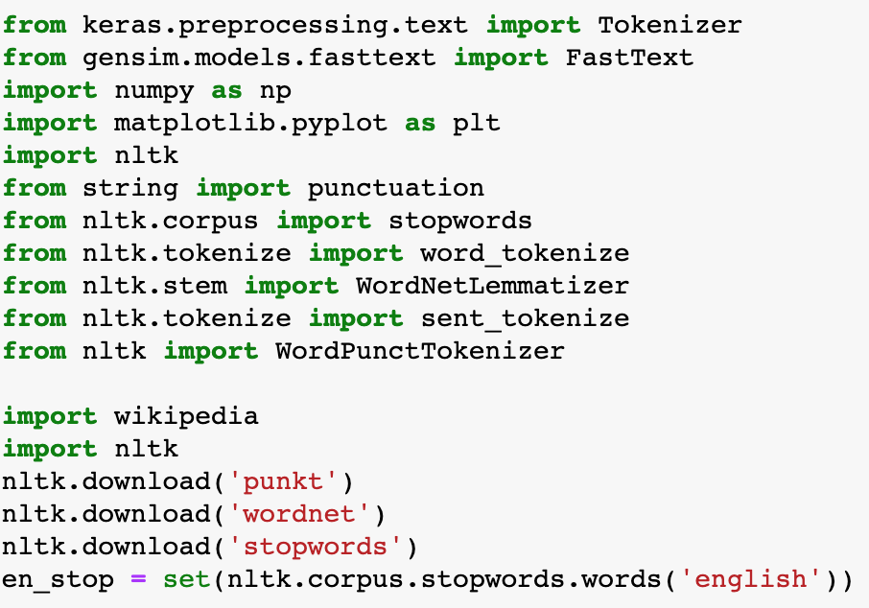
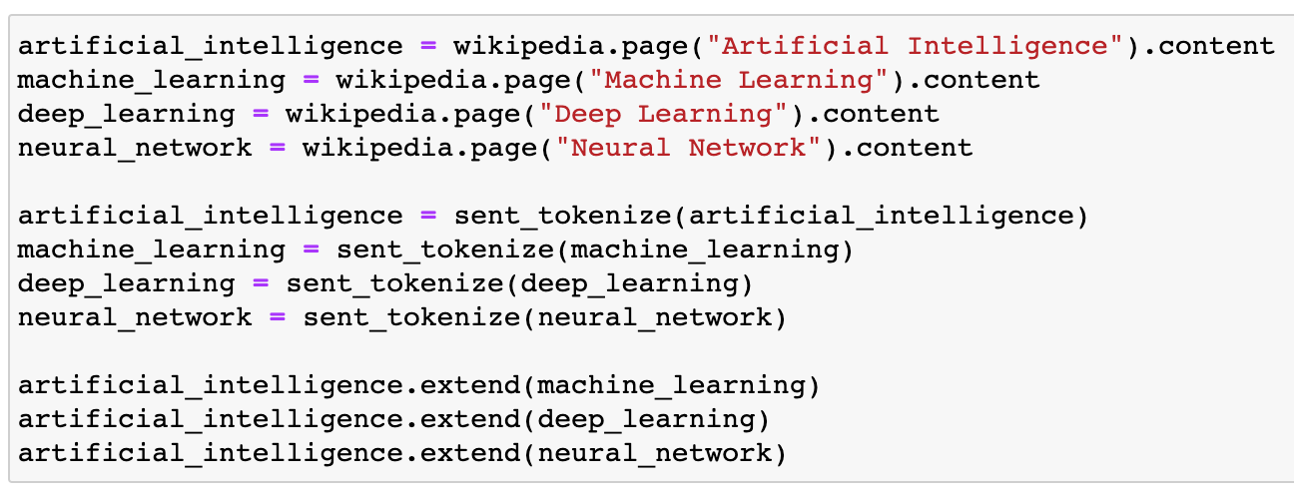
FastText Example
Importing Libraries
Reading Data
PreProcessing Data
https://github.com/facebookresearch/fastText
16
Notes:
Gensim.models.fastext
Nltk → natural language toolkit
Wikipedia
Text Classification (hate speech detection, etc.)
Assigning a set of predefined categories to free-text. Text classifiers can be used to organize, structure, and categorize

Slide 17
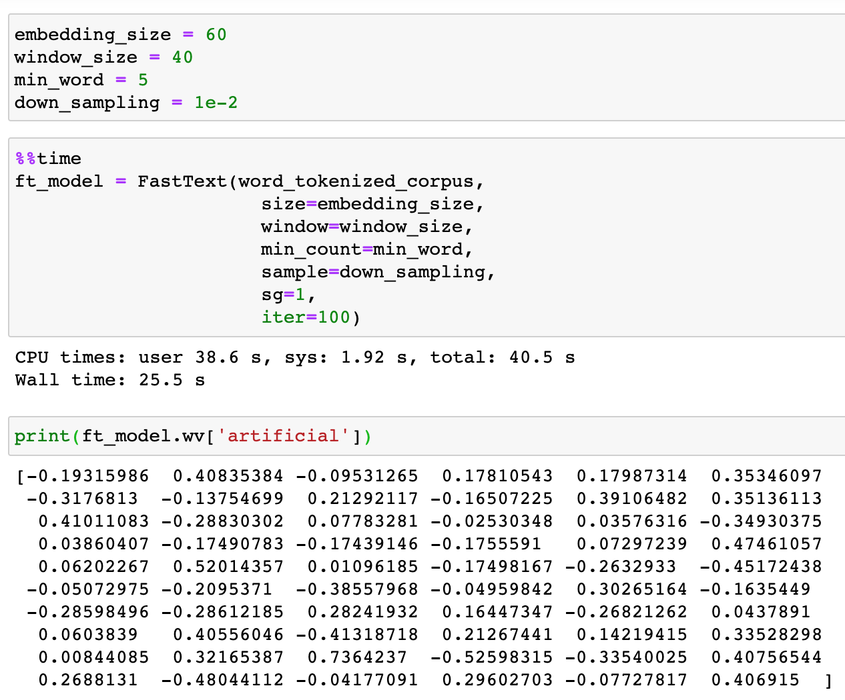
FastText Example
Model
Results
17
Notes:
[Potentially download and run some simple fasttext code and show the results]
The window_size is the size of the number of words occurring before and after the word based on which the word representations will be learned for the word.
The next hyper-parameter is the min_word, which specifies the minimum frequency of a word in the corpus for which the word representations will be generated. Finally, the most frequently occurring word will be down-sampled by a number specified by the down_sampling attribute.
Preprocessing:
All to lower case
All to root form
Remove stop words
Embedding_size is the size of the embedding vector.
In other words, each word in our corpus will be represented as a 60-dimensional vector.

Slide 18
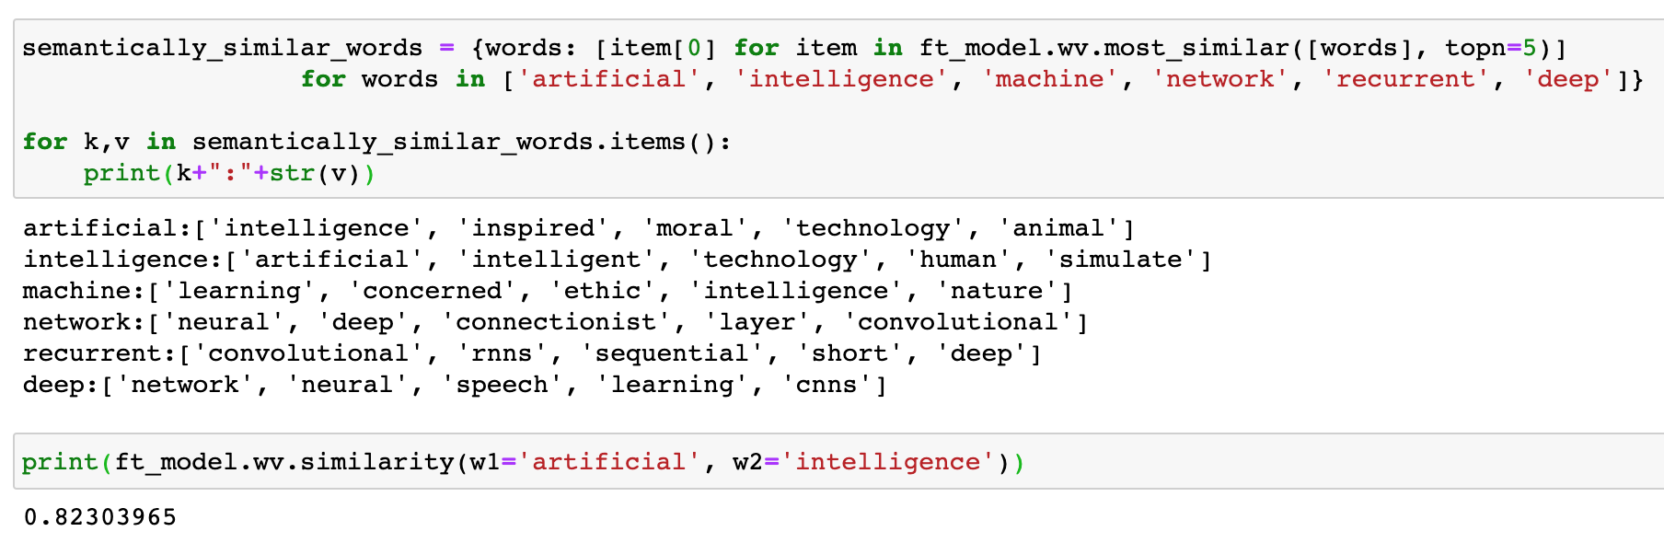
FastText Example
The value ranges from 0 and 1. A higher value means higher similarity.
18
Notes:
[Potentially download and run some simple fasttext code and show the results]

Slide 19
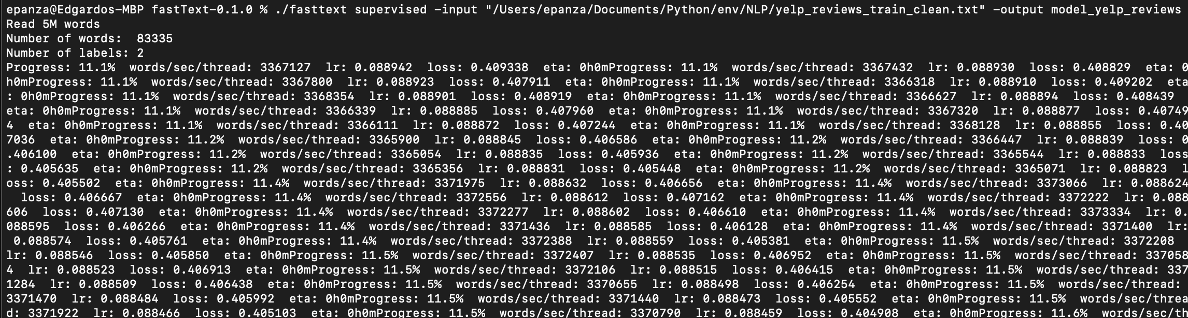
FastText Command Line Example
A second example using FastText command line utility.
19
Notes:
[Potentially download and run some simple fasttext code and show the results]
P@1 → Precision.
R@1 → Recall
Preprocessing the same as in the pdf with the perl script https://gist.github.com/kylemcdonald/49c483c61798a952e36e

Slide 20
References
https://towardsdatascience.com/skip-gram-nlp-context-words-prediction-algorithm-5bbf34f84e0c
https://kavita-ganesan.com/comparison-between-cbow-skipgram-subword/#.XvHfR5P7RDU
https://stackabuse.com/python-for-nlp-working-with-facebook-fasttext-library/
20

