Slide 1






THE CHALLENGE
SMEs are asked to report emissions they can't easily measure
No in-house know-how
OUR SOLUTION
SMEScope
GHG accounting expertise sits outside most small companies.
An AI-assisted tool that turns the documents an SME already has into a screening-grade Scope 1, 2 & 3 carbon footprint.
No time or resource
There is rarely a dedicated person to run a carbon inventory.
Upload the bills & ledgers you already have
The data is scattered
The numbers live in bills, fuel logs and ledgers — not a system.
Guided questionnaire — no carbon know-how needed
Rising pressure
Transparent, traceable results, ready for review
Banks, large customers and regulators now expect a footprint.
Built and demo-ready.

Slide 2






WHAT SMEScope DOES
Everything an SME needs to measure and own its footprint
SMEScope turns the documents an SME already has — energy bills, fuel logs, spend ledgers — into a screening-grade Scope 1, 2 and 3 carbon footprint. A guided questionnaire asks every question in plain language, an LLM reads the uploads, and a deterministic engine does the maths — so each number stays transparent and traceable.
Guided assessment
Dashboard & benchmarking
Plain-language Scope 1·2·3 questions — no carbon expertise needed.
See your footprint by scope and compare against peers.
AI document reading
Reports & export
Upload bills and ledgers; the data is extracted automatically.
Factor register and per-line Excel, ready to share.
SMEScope
Trusted calculation
carbon engine
Carbon upskilling & advisory
Transparent, traceable emission factors behind every number.
Guided learning and expert support to act on the results.
Potential add-on
Core features are live and demo-ready; upskilling & advisory are a potential add-on.

Slide 3
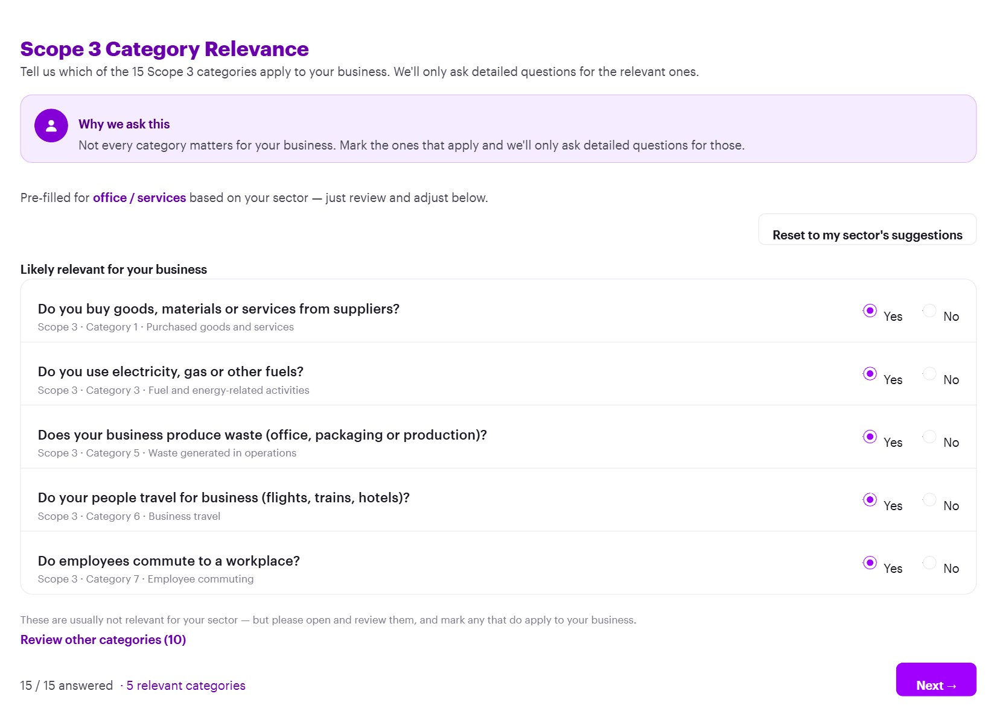
THE TOOL IN ACTION
A guided assessment anyone can complete
smescope.app · guided assessment
1
Plain-language guidance
Every step explains what counts — no GHG jargon or accounting terms.
2
Only what applies
Multi-select questions adapt to the business; the SME skips the rest.
3
Upload & auto-read
Add bills, ledgers or a photo — the AI extracts the data for review.
Result: a screening-grade Scope 1·2·3 footprint from data the SME already has.
Scope 1 shown — Scope 2 and Scope 3 follow the same guided pattern.

Slide 4
THE TOOL IN ACTION
Scope 3 — only the categories that matter
smescope.app · scope 3 relevance
1
Only where it applies
The SME answers just the categories that matter — no trudging through all 15.
2
Prefiltered per industry / NACE code
Relevant Scope 3 categories are pre-selected from the company’s sector — then reviewed and adjusted.
Here: 5 relevant categories pre-selected for an office/services SME.
The 10 categories that rarely apply stay collapsed under “Review other categories”.

