Slide 1
Christmas Presentation
Happy Holidays!

Slide 2
Winter Facts
Snow is white
It's cold
People build snowmen

Slide 3
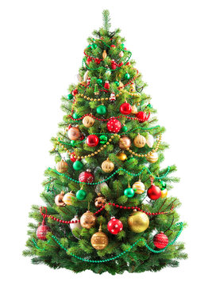
Christmas Tree

