Slide 1





Welcome to the Open Science Grid &
Our participation in the International Summer School
Ruth Pordes, OSG Executive Director, Fermilab
Project supported by the Department of Energy Office of Science SciDAC-2 program from the High Energy Physics, Nuclear Physics and Advanced Software and Computing Research programs, and the National Science Foundation Math and Physical Sciences, Office of CyberInfrastructure and Office of International Science and Engineering Directorates.

Slide 2
Students:
Derek Weitzel <dweitzel@cse.unl.edu>,
Andrew J Younge <ajy4490@rit.edu>,
Kristen Hardwick <hardwic@g.clemson.edu>,
Lawrence Meyer <codpilot@bellsouth.net>,
Malina Kirn <m.a.kirn@gmail.com>,
Ai Niwaer <anwar@cse.unl.edu>,
Cole Brand drachenstern@gmail.com,
chrismiceli@gmail.com,
michael.miceli88@gmail.com,
“Katherine C. Hegewisch" khegewis@mail.wsu.edu,
Sarah Caudill scaudill83@gmail.com,
yindengpan@gmail.com

Slide 3
What is the OSG?
Lots of groups of people working together to:
make their clusters, disk caches, storage systems accessible remotely
using these computational resources to do research, to learn things,
sharing their ideas, their software, their knowledge
helping each other do this

Slide 4
Key :
Preparing for and worrying about the future.
Ensuring there are new people – you! – who learn and understand and fold use of cyberinfrastructure into your work.
Making things better - you! – who give us feedback and help us – and you - make good use of what is provided.

Slide 5
Our hope..
To talk to you before, during and after the summer school to help get the most of out it for all of us.
Understand what OSG can offer you and what you are interested in “offering” for OSG.

Slide 6
Where is the OSG?
The clusters and storage are mainly in the US – OSG is “a US National Grid”.
The users are anywhere. In particular, since the OSG is used by the large physics experiments at CERN physics users come from all over the world.
e.g. more than 2500 people used OSG last year.
e.g. more than 80 clusters are accessible through the OSG.
Note: OSG does not own the hardware nor develop the software

Slide 7
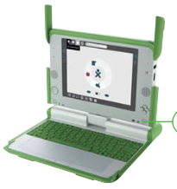

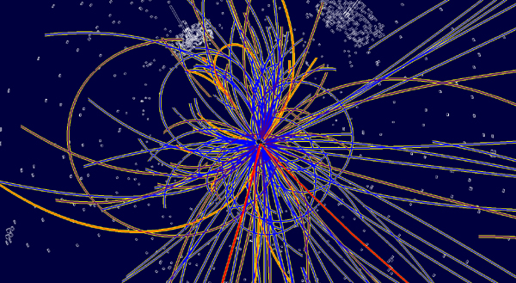
The Overall Picture
Acknowledgement:
http://www.laptop.org/en/laptop/start/

Slide 8
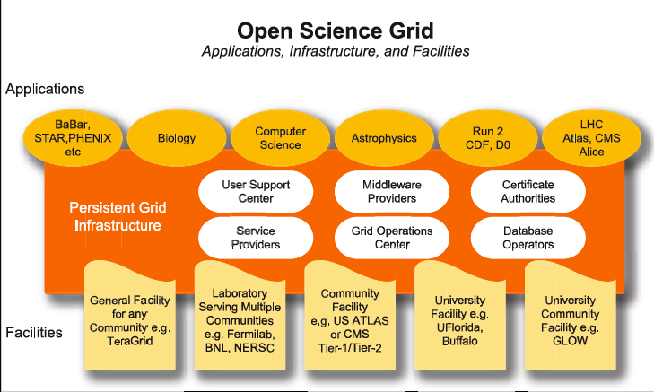
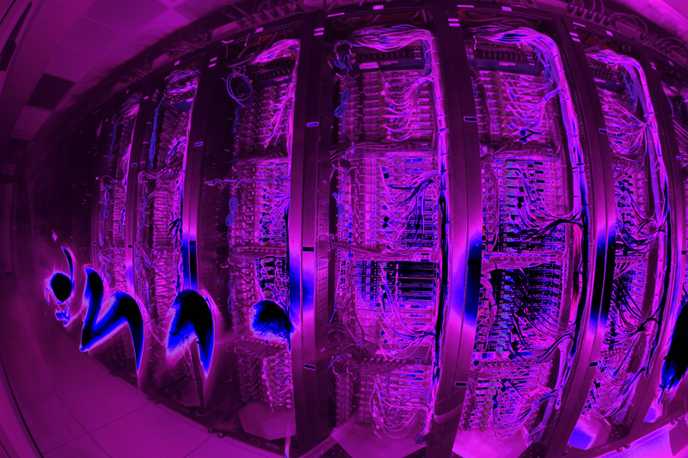
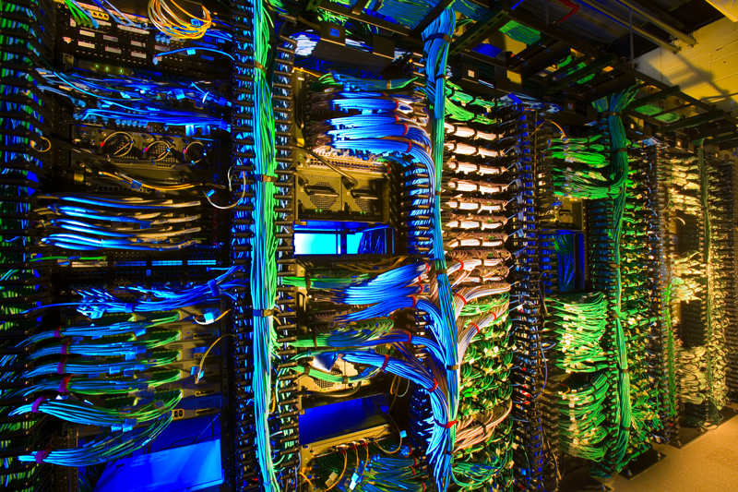

The OSG Architecture – in the summer school you learn about the concepts, principles and ideas as well as the technologies.
Virtual Organizations
Common Services
Resources and Sites

Slide 9
Integrate into “vertical”Community Systems
End-to-end System for Each community & group.
Structure hidden from end users.
Hide end users from resource admins

Slide 10
There are Many Grids
Communities can be international, so operating across multiple sets of services

Slide 11
Computer Science in Action
Open Science Grid work based on CS concepts and ideas.
Principles guide our daily work.
  Autonomy
  Openness
  Middleman
  Integrated Security Management
  Just in time decisions
  Symmetric relationships
Recursive relationships
Minimum impact
Self protection
Phased deployment
Local rules

