Slide 1
Dealing with real resources
Wednesday Afternoon, 3:00 pm
Derek Weitzel dweitzel@cse.unl.edu
OSG Campus Grids
University of Nebraska – Lincoln

Slide 2
What have we seen?
If you do a condor_status on submit:
glidein_18928@red- LINUX X86_64 Unclaimed Benchmar 0.880 7933 0+00:00:04
monitor_15002@red- LINUX X86_64 Owner Idle 0.880 793 0+00:01:06
monitor_18449@red- LINUX X86_64 Owner Idle 0.880 793 0+00:00:04
monitor_18928@red- LINUX X86_64 Owner Idle 0.880 793 0+00:00:04
Total Owner Claimed Unclaimed Matched Preempting Backfill
INTEL/LINUX 15 8 0 7 0 0 0
X86_64/LINUX 27 14 2 11 0 0 0
Total 42 22 2 18 0 0 0

Slide 3
What have we seen?
If you do a condor_status on submit:
glidein_18928@red- LINUX X86_64 Unclaimed Benchmar 0.880 7933 0+00:00:04
monitor_15002@red- LINUX X86_64 Owner Idle 0.880 793 0+00:01:06
monitor_18449@red- LINUX X86_64 Owner Idle 0.880 793 0+00:00:04
monitor_18928@red- LINUX X86_64 Owner Idle 0.880 793 0+00:00:04
Total Owner Claimed Unclaimed Matched Preempting Backfill
INTEL/LINUX 15 8 0 7 0 0 0
X86_64/LINUX 27 14 2 11 0 0 0
Total 42 22 2 18 0 0 0

Slide 4
What have we seen?
What does this mean?
15 nodes what are 32bit
27 nodes that are 64bit
INTEL/LINUX 15 8 0 7 0 0 0
X86_64/LINUX 27 14 2 11 0 0 0

Slide 5
Different Architectures
OSG computers come in 2 major architectures:
  X86_64 – Dominant, 64 bit platform
  32bit – Very few, but
Executables have problems on the different architectures.

Slide 6
Different Architectures
32bit application -> 32 bit architecture
32bit application -> 64 bit architecture
64bit application -> 64 bit architecture
64bit application -> 32 bit architecture
Be smart when you compile and run executables (more in exercise)

Slide 7
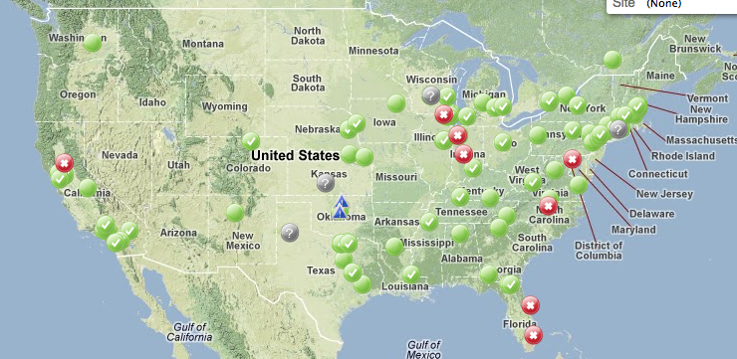
Sites that preempt
Remember we had all these sites

Slide 8
Sites that preempt
What happens if 1 kills your job?

Slide 9
Sites that preempt
What if a site goes away?
!

Slide 10

Sites that preempt
What if a site goes away?
!

Slide 11
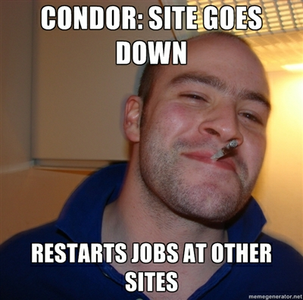
What happens in GlideinWMS?
With GlideinWMS, the jobs stick around.
Condor will send the jobs to other remaining sites.
GGC
(Good Guy Condor?)

Slide 12
Troubleshooting Resources
Wednesday Afternoon, 4:00 pm
Derek Weitzel dweitzel@cse.unl.edu
OSG Campus Grids
University of Nebraska – Lincoln

Slide 13
Goals
For this section, I want to cover some common troubleshooting techniques
These techniques are widely used by grid users and administrators.

Slide 14
What has happened?
Jobs stay idle?
Jobs go on hold?
Jobs fail on worker nodes?

Slide 15
Jobs on Idle
There are some tools to help with finding why jobs are not running.
First, check if any available resources are available:
$ condor_status

Slide 16
Jobs on Idle
There are some tools to help with finding why jobs are not running.
Next, check if the condor knows why your job isn’t running
$ condor_q –better-analyze 10.0

Slide 17
Jobs on Idle
There are some tools to help with finding why jobs are not running.
Hum… so your jobs should run, ok now what?
Look in the job’s log file, has it ran already? Failing?

Slide 18
Jobs on Hold
You see your job on hold in the queue
$ condor_q
-- Submitter: osg-ss-glidein.chtc.wisc.edu : <128.104.100.57:53209> : osg-ss-glidein.chtc.wisc.edu
ID OWNER SUBMITTED RUN_TIME ST PRI SIZE CMD
347.0 mhaytmyr 6/26 11:01 0+00:00:06 H 0 0.0 run-blast.sh yeast
404.0 wliu 6/26 13:32 0+00:00:36 I 0 0.0 blast.sh
2 jobs; 1 idle, 0 running, 1 held

Slide 19
Jobs on Hold
What is the hold reason?
$ condor_q 347 -format '%s\n' 'HoldReason'
Error from glidein_8812@iut2-c159.iu.edu: STARTER at 149.165.225.159 failed to receive file /var/lib/condor/execute/dir_7087/glide_fZ7141/execute/dir_18801/query1: FILETRANSFER:1:No plugin table defined (request was https://twiki.grid.iu.edu/twiki/bin/viewfile/Education/OSGSS2012CondorBLAST/query1)

Slide 20
Jobs on Hold
Each case is different
In this case, the user put in their submit file:
The Glidein at IU cannot download from http
$ condor_q 347 -format '%s\n' 'HoldReason'
Error from glidein_8812@iut2-c159.iu.edu: STARTER at 149.165.225.159 failed to receive file /var/lib/condor/execute/dir_7087/glide_fZ7141/execute/dir_18801/query1: FILETRANSFER:1:No plugin table defined (request was https://twiki.grid.iu.edu/twiki/bin/viewfile/Education/OSGSS2012CondorBLAST/query1)
transfer_input_files = https://twiki.grid.iu.edu/twiki/bin/viewfile/Education/OSGSS2012CondorBLAST/query1

Slide 21
Jobs failing on Worker Nodes
How to find jobs are failing on worker nodes?
  If the output does not match what you expect.
  If the jobs seem to be running ‘too fast’

Slide 22
Jobs failing on Worker Nodes
First, can you see anything useful in the output/error:
Next, we have to try some further debugging
universe = vanilla
...
output = out
error = err
...
queue

Slide 23
Jobs failing on Worker Nodes
If you are running a wrapper script, can force output on every step
It then outputs every step to the stderr, or ‘error’ in your submit file.
#!/bin/sh
#!/bin/sh -x

Slide 24
Jobs failing on Worker Nodes
Condor can also send you to the worker node using condor_ssh_to_job
HUGE!!!!
Will see in exercises

Slide 25
Questions?
Questions? Comments?
  Feel free to ask me questions later:
  Derek Weitzel <dweitzel@cse.unl.edu>
Upcoming sessions
  4:30 – 5:00
    Hands-on exercises
  5:00 – 7:00
    Dinner
  7:00 – 9:00
    Optional Evening Session

