Slide 1
Research projects run on OSG

Slide 2
Introduction
the Grid development has been motivated by scientific research
What will the Grid be used for?
  Just about anything!
  If you can do it on a computer, you could also do it on the Grid.
Categories:
  computation-centric,
  data centric
  community-centric.
Notes:
The first big-time users of the Grid will probably be scientists with challenging applications that are simply too difficult to do on just one set of computers. After all, the Grid was originally conceived for these types of users, and is being built by them, too. What kind of applications will there be?You can categorize applications by their general computational nature, or by whether they are computation-centric, data centric or community-centric.You can also look at applications in science.Or you can look at the broader areas of application in industry, finance, government and civil society.

Slide 3
Computational problems
Parallel calculations
Fine-grained calculations
Coarse-grained calculations (or embarrassingly parallel calculations)
High-performance vs. high-throughput
And the Grid...?
Notes:
There are many words used to describe computational problems. Here are a few that are important to Grid technology.
Let’s describe computational problems from a grid technology point of view.

Slide 4
Parallel computations
Your problem can be split into many smaller sub-problems.
This means that each sub-problem can be worked on by a different processor, so that many sub-problems can be worked on "in parallel".
This means you can speed up your computation.

Slide 5
Fine-grained calculations
Each sub-problem is dependent on the result of other sub-problems.
For example, when calculating the weather, each calculation in one volume of atmosphere is affected by surrounding volumes.
Fine-grained parallel calculations require very clever programming to make the most of their parallelism, so that the right information is available to processors at the right time.

Slide 6
Coarse-grained
Each sub-problem is independent of all the other problems.
For example:
the analysis of a large databank of medical images is embarrassingly parallel, since each image is independent of all the others.
"Monte Carlo simulations", where you vary the parameters in a model of a real system and study the results, are also coarse-grained calculations.

Slide 7
High-performance HPC vs. high-throughput HTC
Fine-grained calculations are better suited to high-performance computing: big, monolithic supercomputers, or very tightly coupled computer clusters with lots of identical processors and an extremely fast, reliable network between the processors.
Embarrassingly parallel calculations are ideal for high-throughput computing: more loosely-coupled networks of computers where delays in getting results from one processor will not affect the work of the others.

Slide 8
And the Grid …
Many interesting problems in science require a combination of fine- and coarse-grained calculations, and this is where the Grid can be particularly powerful
For example,
in the case of complex climate modeling, researchers launch many similar calculations to see how different parameters affect their models. Each calculation is a fine-grained parallel calculation that needs to run on a single cluster or supercomputer. Using the Grid, these many independent calculations can be distributed over many different clusters on the Grid, thus adding coarse-grained parallelism and saving a lot of time.

Slide 9
High-throughput applications
HTC suits problems divisible into many independent tasks. The Grid can be used to schedule these tasks, with the goal of putting unused processor cycles to work.
SETI@home: the search for signs of extraterrestrial intelligence, the mother of all @home applications
Folding@home: a protein folding simulation that sifts for potential drugs
Xpulsar@home: filters astronomical data looking for pulsars.
Evolutionary@home: tackles problems in population dynamics
FightAIDS@home: models the evolution of drug resistance and designs anti-HIV drugs.
Rosetta@home: Molecular modeling
Notes:
One example is the "@home" applications that many people use as screen savers. The tasks involved are totally independent, so it doesn't matter whether some tasks take a long time or never return. After a "time-out" period, unfinished tasks are simply sent elsewhere to be processed.

Slide 10
High-performance applications
Typical supercomputing or high performance computing (HPC) applications include:
  astrophysics (e.g., simulations of a supernova explosion or black hole collision)
  automotive/aerospace industry (e.g., simulations of a car crash or a new airplane design)
  climate modeling (e.g., simulations of a tornado or climate prediction)
  economics (e.g., modeling the world economy)
The models used for these simulations must often be simplified so they can run using the computing power available. This usually means leaving out important effects, so capturing the true complexity of a problem is often beyond reach.
Notes:
For example, the Distributed Interactive Simulation application is used for training and planning in the military field, and is also applicable to air traffic control systems, for example. Realistic scenarios may involve 200,000 entities, but today's largest supercomputers can handle 20,000 entities at most .

Slide 11
Computer-centric problems
are the domain of HPC
keyword: "teraflops”
  as many as possible.
Computer-centric applications can benefit from the Grid because it combines large computational resources allowing scientists to tackle problems that cannot be solved on a single system, or to solve problems much more quickly.

Slide 12
Data-centric problems
are also called data-intensive problems
are the primary driving force behind the Grid.
  Huge amounts of scientific data are being created and the Grid will be used to collect, store and analyze this data in geographically distributed libraries and databases.
  Examples :
    Searching the terabytes of data generated every day by future high-energy physics experiments. The Grid will give thousands of physicists from hundreds of research institutes access to this data and power to analyze it.
    Studying the terabytes of astronomical photographic data collected by sky surveys and available in numerous network-accessible databases.
    Forecasting future climate using modern meteorological forecasting systems that move, process and assimilate gigabytes of data including remote satellite observations.

Slide 13
Community-centric problems
aka collaborative applications
  concerned primarily with bringing people together to collaborate.
They often comprise a "virtual shared space" where community members can share computational resources using the Grid.
Examples:
  interactive video conferencing
  distributed musical concerts
  collaborations of researchers trying to perform complex simulations using detectors from all over the world

Slide 14
Our applications
Biology
Chemistry

Slide 15
Rosetta*
Molecular modeling program
Identify novel protein sequences that fold into specific structures
    Because a protein’s structure is directly related to its function, most research in the area of protein design has focused on the problem of creating well defined structures.
Problem: create well defined structure
*) Engagement team -- John McGee, Mats Rynge
Notes:
Because a protein’s structure is directly related to its function, most research in the area of protein design has focused on the problem of creating well defined structures.
The strategy used by Rosetta to search these multi-dimensional spaces is to perform thousands of independent simulations that sample different regions of structure space. Fortunately, these simulations do not need to be run in parallel but rather can be farmed out to large numbers of independent processors.ﾊ For this reason, the distributed framework of OSG is ideal for performing protein design simulations.

Slide 16
Rosetta strategy
search multi-dimensional spaces by performing thousands of independent simulations that sample different regions of structure space
For this reason, the distributed framework of OSG is ideal for performing protein design simulations

Slide 17
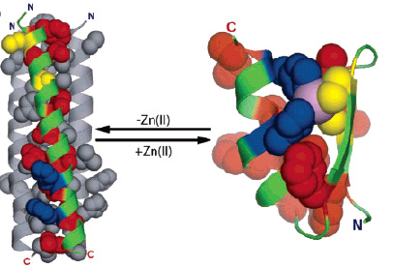
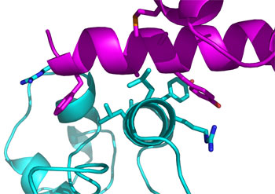
Rosetta
Using OSG to design proteins that adopt specific 3D structures and bind and regulate target proteins important in cell biology and pathogenesis. These designed proteins are used in experiments with living cells to detect when and where the target proteins are activated in the cells
  Sr. Rosetta Researcher and his team, little CS/IT expertise, no grid expertise. Quickly up and running with large scale jobs across OSG, >250k CPU hours
  1 run takes about 3 days
Notes:
Here is an example of a successful engagement. Kuhlman lab at UNC is a small research team concentrating on protein folding. The results of the research could lead to new treatments, and eventually cures, for serious diseases such as diabetes, Alzheimers, HIV/AIDS and many cancers.
The problem with smaller teams like this is that they lack CS/IT expertise. Protein folding: 1 run takes about 3 days. Then spend 4 weeks in wet lab, using the results from the run. If you only spend 3 days out of a month using the grid, you can’t maintain a full VO and infrastructure. And you do not want to spend a lot of times debugging your jobs.
We deployed one of our CI persons with the team, and within a couple of days, the Kuhlman lab was up and running large scale jobs on OSG. The lab has today used up more than 250.000 CPU hours.

Slide 18
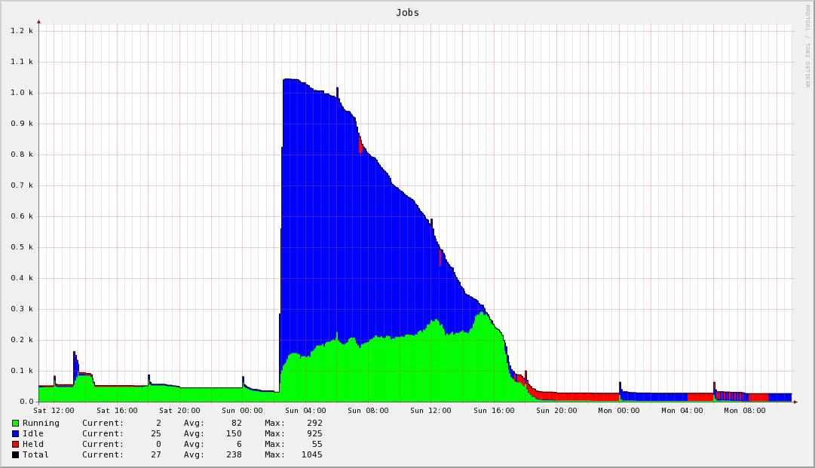
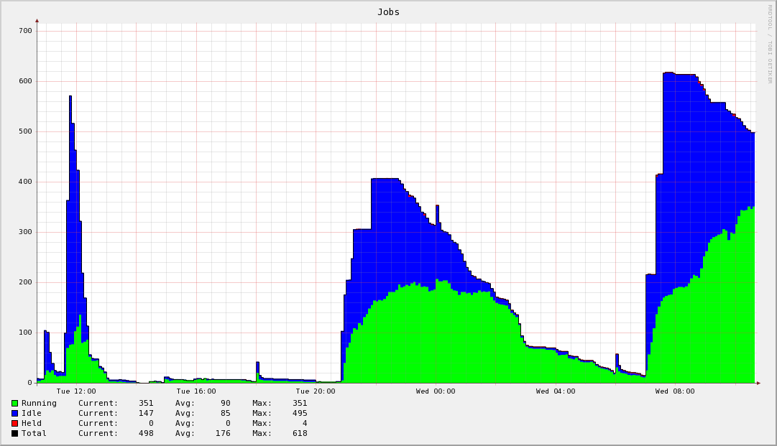
Rosetta on OSG
Good example on why resources selection is important
  A typical Kuhlman job run consists of 1000 jobs, which uses up approximate 3000 CPU hours in total.
  Each protein design requires about 5,000 CPU hours, distributed across 1,000 individual compute jobs
Notes:
A typical Kuhlman job run consists of 1000 jobs, which uses up approximate 3000 CPU hours in total.
It is important that the scientist do not end up babysitting the job run. They should be able to submit, walk away and do their research, and then come back later for results. Engagement is using a resource selection system to make job management easy. The user only have to provide a job requirements description, and the resource selection system will place the jobs on appropriate grid resources, and handle failures and job resubmits automatically.
The graphs on this slide shows the Kuhlman scientists submitting a 1,000 jobs, and a day later, the system has completed them all.

Slide 19
Resource Selection
Job submission and management for small labs/experiments
Based on existing OSG infrastructure
  ReSS (Resource Selection Service), Condor-G
Component of a hosted VO infrastructure provided for users
Easy to use meta-scheduling and fault avoidance
  Site verification: sites are verified every 4 hours
  Recent performance of job throughput and job success rate per site enables:
    Job load re-balancing
    More intelligent scheduling
    As a site services Engage jobs well, it matches more, as it slows in servicing Engage jobs, it matches less
Notes:
Engagement hosts a VO infrastructure for VO members who do not want to run their own. Some members are small labs / experiments, and do not have the resources to host/maintain their own infrastructure. Resource selection is one piece of that infrastructure.
Important point is that most of the Engagement resource selection is only added a thin layer on top of existing OSG infrastructure, such as ReSS (Resource Selection Service from FNAL, and Condor-G from UWisc).
Point out that the bottom screen shows a visualization of the resource selection during a real Kuhlman job run.
First layer of defense against job failures: sites are verified every 4 hours. Things like environment and file system availability / free space is checked. Only sites which passes the verification tests are available in the resource selection system.
Site / job performance is monitored, stats are added to a database, and sites can be upgraded or downgraded depending on recent history. For example, if a site starts failing a lot of jobs, the site rank will be downgraded and fewer (0 for a while) jobs will match the site until it starts behaving well again.
You can also see site being downgraded because the just queue the jobs, and not run any.
Sites which starts running jobs immediately gets upgraded, and will hence receive more jobs.

Slide 20
CHARMM
Johns Hopkins Team
  Ana Damianovic

Slide 21
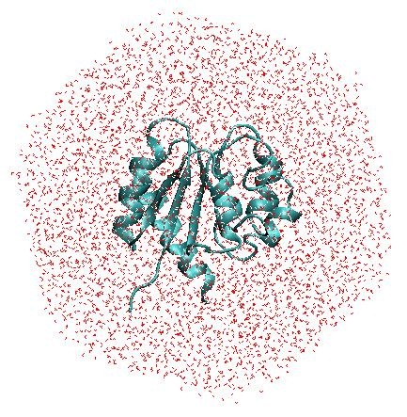
CHARMM and MD simulations
CHARMM is one of the most widely used programs for computational modeling, simulations and analysis of biological (macro)molecules
The widest use of CHARMM is for molecular dynamics (MD) simulations:
Atoms are described explicitly
interactions between atoms are described with an empirical force-field * electrostatic, van der Waals
  * bond vibrations, angle bending, dihedrals …
Newton’s equations are solved to describe
time evolution of the system: timestep 1-2 fs
typical simulation times: 10-100 ns
CHARMM has a variety of tools for analysis of MD
trajectories
Notes:
Molecular dynamics aims to better understand these jiggles and wiggles, using numerical methods to simulate the ways in which atoms and molecules move.
One tool facilitating this work is CHARMM or Chemistry at HARvard Macromolecular Mechanics a software application developed at Harvard University for modeling the structure and behavior of molecular systems. CHARMM has multiple applications, but for Ana Damjanovic of the National Institutes of Health and Johns Hopkins University in Baltimore, Maryland, U.S., molecular dynamics simulations are the name of the game.
Damjanovic is using CHARMM to help her learn more about the interactions between proteins and water, an understanding of which can ultimately aid the design of medicinal drugs.

Slide 22
Why OSG?
Many biological processes are statistical in nature.
Simulations of such processes parallelize naturally.
One of the bottlenecks in simulating how proteins function is that many functionally important motions occur on timescales of microseconds and longer, but molecular dynamics simulations can only sample real-time in nanoseconds
Performance of multiple simulations on OSG will help with:
Accuracy
  Sampling necessary for calculation of experimental observables
  Simulate mutants, compare their behavior and compare with experiments
  Test several force-fields - different force-fields may produce different results
Describe long timescale processes (μs and longer)
  Run large number of simulations (increase probability of observation of
  important events)
  Test different “alternative” methods
Notes:
One of the bottlenecks in simulating how proteins function is that many functionally important motions occur on timescales of microseconds and longer, but molecular dynamics simulations can only sample real-time in nanoseconds, Damjanovic says. Sometimes even the processes that occur on nanosecond timescales, such as water penetration in some proteins, are not sampled properly with only a few simulations. To get better statistics, one needs to run many, many different simulations. This is where it pays to have access to grid computing, which provides the large number of processors necessary to obtain meaningful sampling.

Slide 23
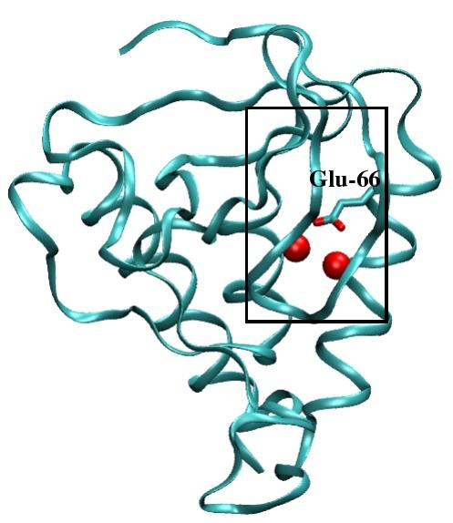
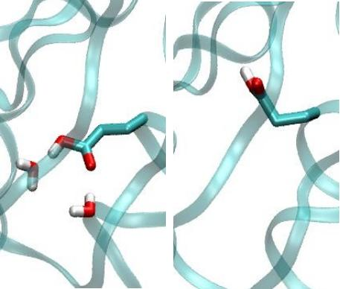
Hydration of the protein interior
Interior water molecules can play key roles in many biochemical processes such as
proton transfer, or catalysis.
Precise location and numbers of water molecules in protein interiors is not always
known from experiments.
Knowing their location is important for understanding how proteins work, but also
for drug design
Crystallographic structures obtained at different temperatures
disagree in the number of observed water molecules.
How many water molecules are in the protein interior?
staphylococcal nuclease
Using traditional HPC resources
we performed 10 X 10 ns
long MD simulations.
Not enough statistics!
Two conformations, each different
hydration pattern
Use OSG to run lots of simulations with different initial velocities.

Slide 24
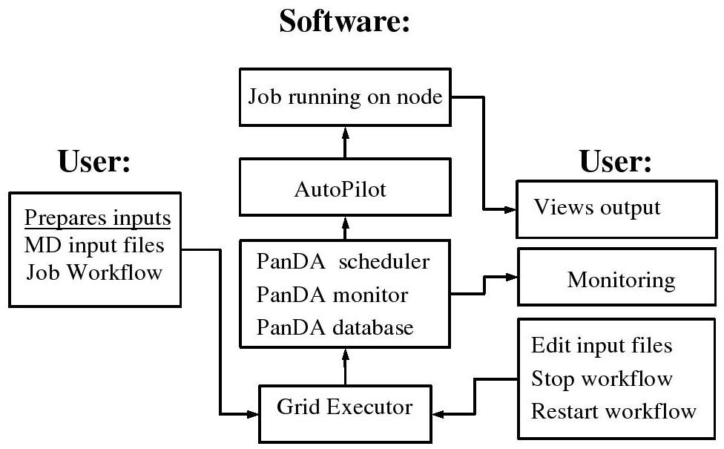
It is easy to run jobs on the OSG
Manual submission and running of a large number of jobs can be
time-consuming and can sometimes lead to errors
- use workflow software to submit to compatible OSG sites
Notes:
“We have developed workflow management software for submitting and babysitting the jobs,” Miller explains. “Since molecular dynamics jobs usually take days to complete, and Open Science Grid sites are optimized for shorter jobs, each long job is split into many, many little jobs.” The workflow uses customized PanDA software, developed at Brookhaven National Laboratory for the US ATLAS high energy physics experiment, to submit jobs to compatible Open Science Grid sites. Now our workflow software can keep track of the rather large number of jobs what is submitted and what is left to be done and it can then automatically submit the work that is to be done,” Miller says. “If a job fails, this is detected and the job is then resubmitted. There are multiple threads running as well, and they can branch out and run two different types of analysis on the same structure.”

Slide 25
Accomplishments with use of OSG
staphylococcal nuclease
2 initial structures X 2 methods
each 40 X 2 ns long simulations
Total: 160 X 2ns.
Total usage: 120K cpu hours
Interior water molecules can
influence protein conformations
Different answers obtained if simulations started with and
without interior water molecules
Longer runs are needed to answer “how many water molecule are in the protein?”
Parallel CHARMM is key to running longer simulations (as simulation time is reduced).
OSG has set up a queue for an MPI version of CHARMM, and this queue is
currently being tested.

Slide 26
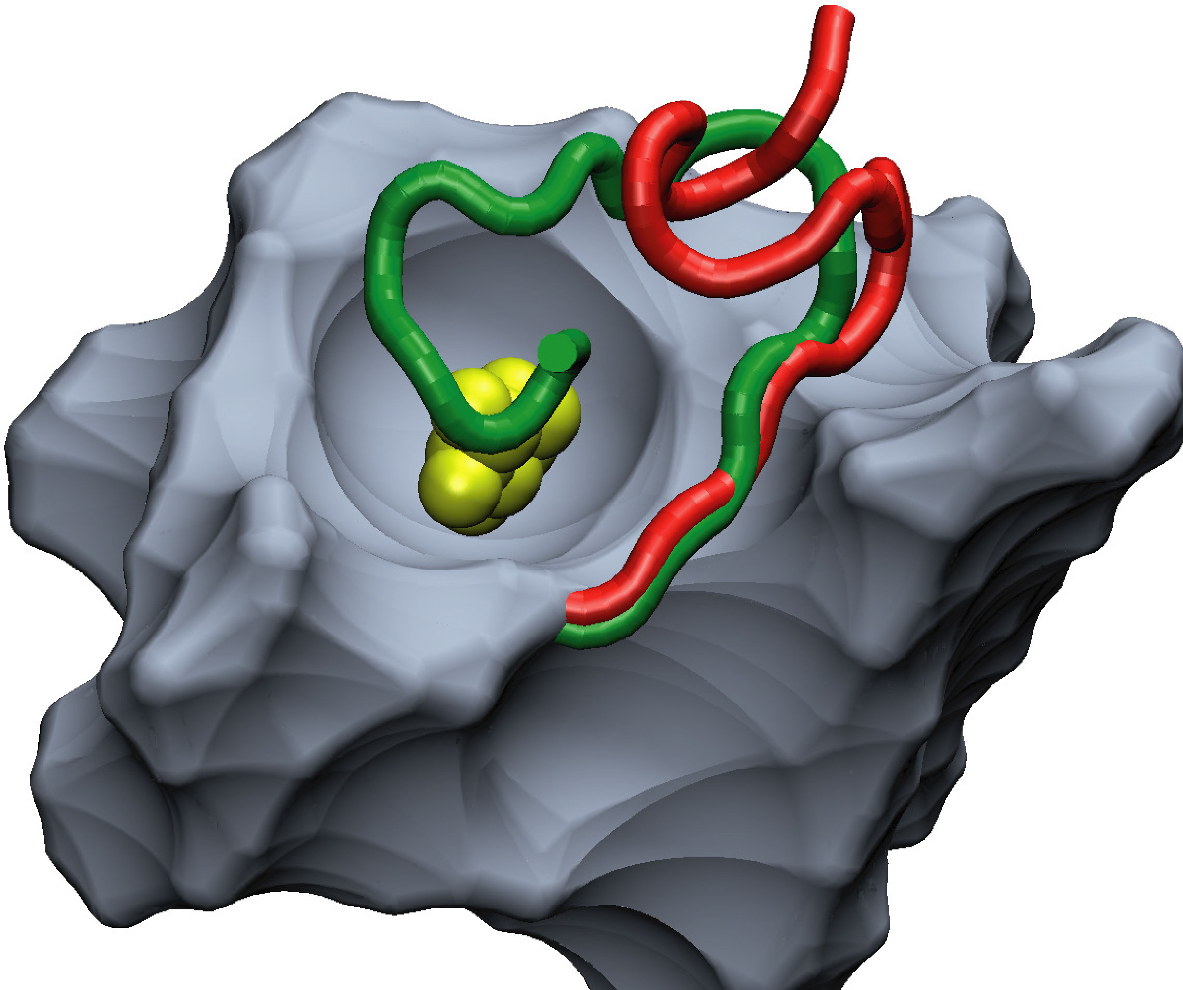
Plans for near term future
Hydration of interior of staphylococcal nuclease:
  answer previous question: (80 X 8 ns = 153K cpu hours)
  test new method for conformational search, SGLD (80 X 8 ns = 153K cpu hours)
Conformational rearrangements and effects of mutations in AraC protein.
    when sugar arabinose is present, “arm”, gene expression on
    when sugar arabinose is absent, “arm”, gene expression off
Computational requirements:
Wild type with and without arabinose (50 X 10 ns)
F15V with and without arabinose (50 X 10 ns)
Total: 100 X 10 ns = 240K cpu hours
Additional test simulations (100 X 25 X 1 ns)
Total: 2500 X 1ns = 600K cpu hours
Provide feedback to experiments

Slide 27
Long term needs
Study conformational rearrangements in other proteins
Conformational rearrangements are at the core of key biochemical processes such as regulation of enzymatic and genetic activity.
Understanding of such processes is pharmaceutically relevant.
Such processes usually occur on timescales of μs and longer, are not readily sampled in MD simulations.
Experimentally little is known about the mechanisms of these processes.
Poorly explored territory, will be “hot” for the next 10 years
    Use brute force approach
    Test performance of different methods
    Test different force fields
    Study effects of mutations -> provide feedback to experiments

Slide 28
Impact on scientific community
CHARMM on OSG is still in testing and development stage so
the user pool is small
Potential is great - there are 1,800 registered CHARMM users
bring OSG computing to hundreds of other CHARMM users
  give resources to small groups
  do more science by harvesting unused OSG cycles
  provide job management software
“Recipe” used here developed for CHARMM, but can be easily extended to
other MD programs (AMBER, NAMD, GROMACS...)‏

Slide 29
Questions
Ideas for your projects, research …

