Slide 1
The OSG Stakeholders’ Request System Oct 9, 2012
Gabriele Garzoglio
for the Project Office

Slide 2
Goals of the System
Record and track requests from the OSG stakeholders (communities, internal offices, etc.) and provide updates to the requesters.
Provide vital input to the project – all requests are being followed up by the OSG project teams
Provide the process framework for the OSG project teams to follow up on requests
Help flagging of upcoming issues like delays, conflicts, priorities, … for the project office and the ET
Provide statistics and insight on community interests
Council members are encouraged to create requests for their communities / sites / projects on the web or via a GOC ticket.

Slide 3
Request Handling Process
Any new request is discussed among area coordinates and project office (weekly meeting)
Requests are being assigned to areas and the status of requests is being tracked in the system
The ET is kept in the loop for new and completed requests
In case of requests being rejected, the decision can be appealed to the ET
New requests generally spawn additional linked work items for the area coordinators’ project tracking systems

Slide 4
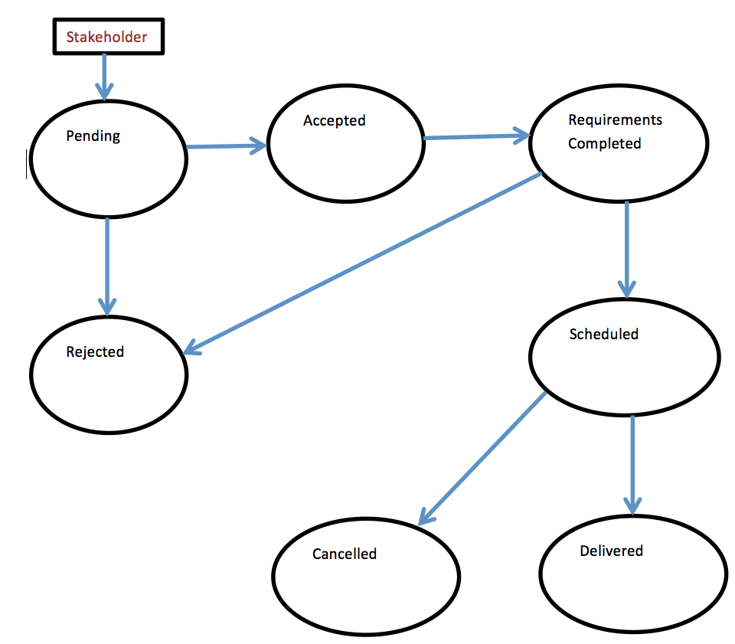
Request attributes and workflow
REQUEST ATTRIBUTES
Summary / Description
Requester / Requester VO(s)
Responsible OSG member / Assignee
OSG Functional Area (Software, Tech., …)
Requirement URL
Schedule URL / Due date
Status / Workflow

Slide 5
Implementation: OSG JIRA
JIRA Project: “Stakeholder Requests”
Requests are tickets
Requester can “watch” them
Provide automatic triggers / filters to generate the agenda for the AC meeting
Allows creation of a dashboard to keep track of request status (“Accepted older then 8 wks”, “’Complete Requirements’ unchanged for 1 month”, “Due in 4 wks / past due”, “Pending”, …)
To create a request…
Open a GOC ticket to get a JIRA account
Email: goc@opensciencegrid.org | Wed: http://ticket.grid.iu.edu/goc/submit
Log on JIRA at http://jira.opensciencegrid.org/browse/REQUESTS
Click create “Request” (top-right)
Definitions: https://osg-docdb.opensciencegrid.org:440/cgi-bin/ShowDocument?docid=1061
Request system: http://jira.opensciencegrid.org/secure/Dashboard.jspa?selectPageId=10030

Slide 6
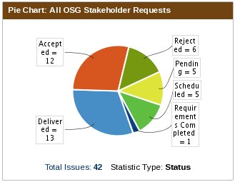
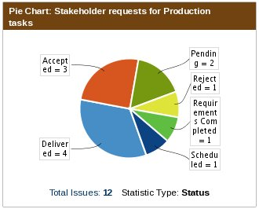
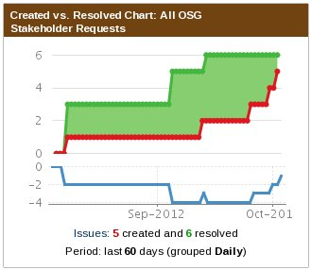
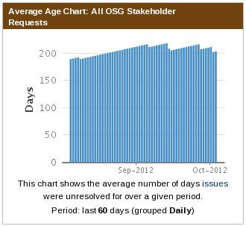
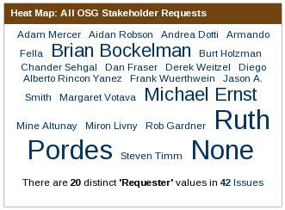
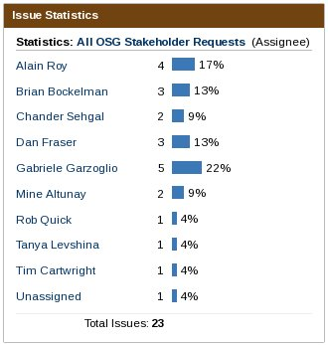
Statistics
Acknowledgments: Rob Gardner – Stakeholders Request Assessment http://jira.opensciencegrid.org/secure/Dashboard.jspa?selectPageId=10340

