Slide 1
Grid Data Management
Notes:
An Introduction to Grids / SC '07
Data comes from different media: sensors, analytic equipment, and ever-finer measuring tools. Patterns in these could point to new medicines and therapies, new forms of clean energy. They could help predict earthquakes. But most scientists lacked the machinery to store and sift through these digital “El Dorados”. Therefore we need mechanisms to deal with large quantities of data. In this lecture will see what tools are available for data management on the grid.

Slide 2
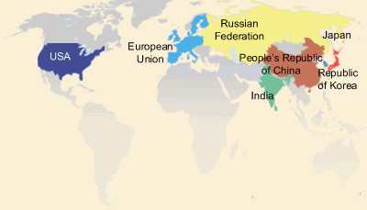
Data Management
Distributed community of users need to access and analyze large amounts of data
Requirement arises in both simulation and experimental science
Fusion community’s International ITER project
Notes:
An Introduction to Grids / SC '07

Slide 3
Data Management
Huge raw volume of data
  Measured in terabytes, petabytes, and further …
  Data sets can be partitioned as small number of large files or large number of small files
  Store it long term in appropriate places (e.g., tape silos)
  Move input to where your job is running
  Move output data from where your job ran to where you need it (eg. your workstation, long term storage)
Notes:
An Introduction to Grids / SC '07
What we have covered so far relates to jobs and execution.
One of the other very big areas in using the grid is dealing with large amounts of data.
We need to deal with things such as moving data around, storing it somewhere long term, keeping track of where we've stored it, for large amounts (terabytes, and heading towards petabytes) and large numbers of files.
So, like the GRAM case, we have some grid software to do this. For data movement, he standard is GridFTP.
There are various other pieces of software to deal with storing data within a site (similar to an LRM but designed for data) such as dCache, and for keeping track of where data is places (such as the Globus Replica Location Service).
The source of this large volume of data is either supercomputer simulations or experimental facilities.
DOE-funded climate modeling groups generate large reference simulations at supercomputer centers
Experimental program based upon the LHC at the CERN will produce petabytes of data per year for approximately 15 years.
Raw simulation or observational data is just a starting point for most investigations
Understanding comes from further analysis, reduction, visualization, and exploration

Slide 4
Data Management on the Grid
How to move data/files to where I want?
  GridFTP
Data sets replicated for reliability and faster access
Files have logical names
Service that maps logical file names to physical locations
  Replica Location Service (RLS)
  Where are the files I want?
Notes:
An Introduction to Grids / SC '07
GridFTP is the defacto standard for moving data on the Grid
First, you need to find the location of the data.

Slide 5
GridFTP
High performance, secure, and reliable data transfer protocol based on the standard FTP
  http://www.ogf.org/documents/GFD.20.pdf\
  Multiple implementations exist, we’ll focus on Globus GridFTP
Globus GridFTP Features include
  Strong authentication, encryption via Globus GSI
  Multiple transport protocols - TCP, UDT
  Parallel transport streams for faster transfer
  Cluster-to-cluster or striped data movement
  Multicasting and overlay routing
  Support for reliable and restartable transfers
Notes:
An Introduction to Grids / SC '07
GridFTP: a high performance, secure, and reliable data transfer protocol based on the standard FTP. GridFTP enhances FTP with GSI security, multiple data channels for parallel transfers, third party transfers, and authenticated reusable channels.

Slide 6
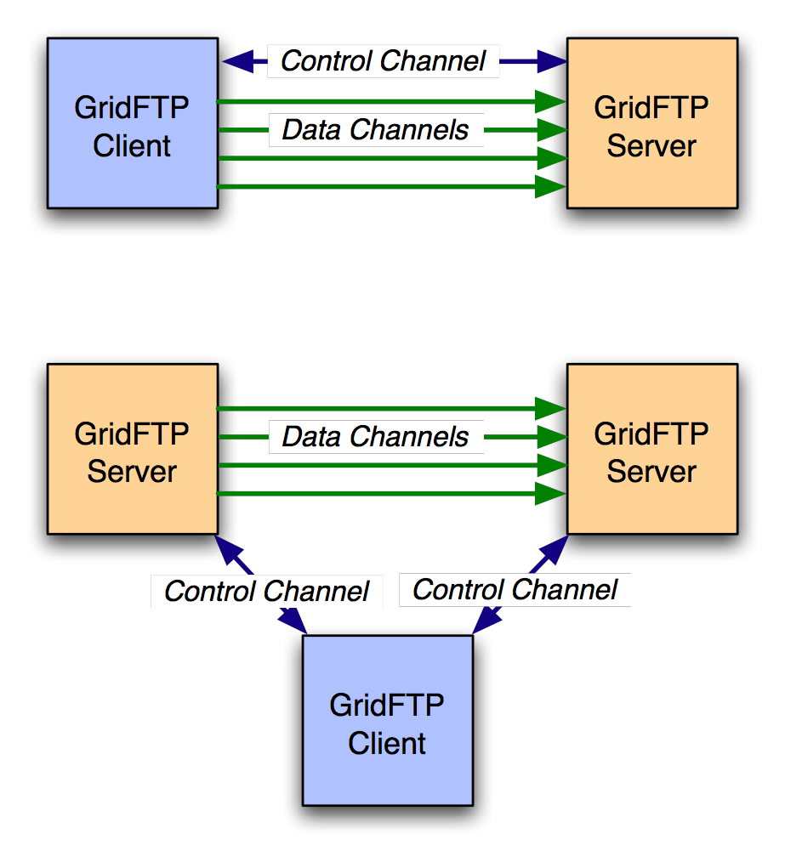
Basic Definitions
Control Channel
  TCP link over which commands and responses flow
  Low bandwidth; encrypted and integrity protected by default
Data Channel
  Communication link(s) over which the actual data of interest flows
  High Bandwidth; authenticated by default; encryption and integrity protection optional
Notes:
An Introduction to Grids / SC '07
GridFTP is a two-channel protocol like FTP. GridFTP supports both client/server transfer and third-party transfer

Slide 7
Control Channel Establishment
Server listens on a well-known port (2811)
Client form a TCP Connection to server
Authentication
  Anonymous
  Clear text USER <username>/PASS <pw>
  Base 64 encoded GSI handshake
Notes:
An Introduction to Grids / SC '07

Slide 8




Data Channel Establishment
227 <IP:PORT>
GridFTP Server
PASV
AUTH
GridFTP
Client
PORT <IP:PORT>
AUTH
GridFTP Server
Notes:
An Introduction to Grids / SC '07

Slide 9
Going fast – parallel streams
Use several data channels
TCP - default transport protocol used by GridFTP
TCP has limitations on high bandwidth wide area networks
Control channel
Server
Site B
Site A
Data channels
Notes:
An Introduction to Grids / SC '07
GridFTP has various other modes for increasing speeds.
For example, it can do 'parallel streams'. With parallel streams, we establish several data channels, and send the file in pieces across all of the connections. There are a few advantages here. The underlying network protocol, TCP, that most data transfers on the internet use, tries to share bandwidth equally between each stream. By using more streams, we can get more shares.
Some people think this is cheating, though and some people will get upset about it as a form of network abuse.
Another advantage is that if one or more of the channels do not run at full speed (for example, a single lost packet can cause massive slow down), this slowdown is ameliorated.

Slide 10
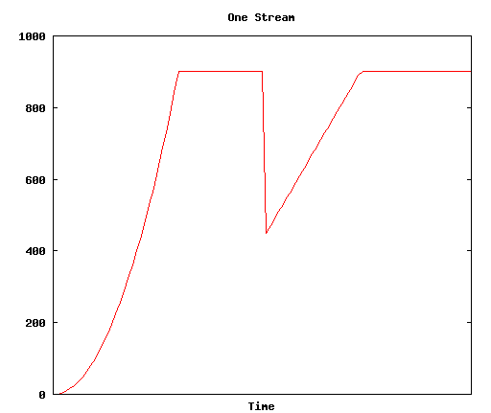
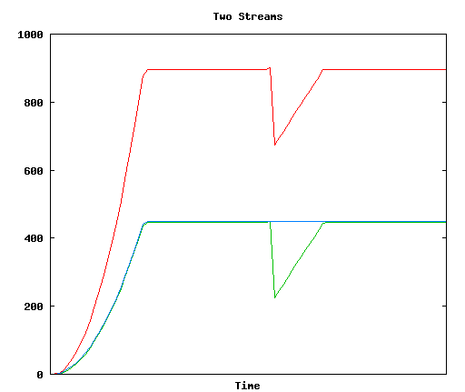
Parallel Streams
Notes:
An Introduction to Grids / SC '07

Slide 11
Cluster-to-cluster data transfer
GridFTP can do coordinated data transfer utilizing multiple computer nodes at source and destination
Node 1
Node 1
GridFTP
Control
node
GridFTP
Control
node
10x Gb/s
1 Gbit/s
1 Gbit/s
Node 2
Node 2
1 Gbit/s
1 Gbit/s
GridFTP
Data node
GridFTP
Data node
1 Gbit/s
1 Gbit/s
1 Gbit/s
1 Gbit/s
Node M
Node N
GridFTP
Data node
GridFTP
Data node
Cluster A
Cluster B
Notes:
An Introduction to Grids / SC '07
If the network capacity between the source and destination clusters is greater than the data rate supported by each
computer at the clusters, GridFTP can be configured to use multiple computers at each end to drive data transfers

Slide 12
GridFTP usage
globus-url-copy - commonly used GridFTP client
  Usage: globus-url-copy [options] srcurl dsturl
Conventions on URL formats:
  file:///home/YOURLOGIN/dataex/largefile
    a file called largefile on the local file system, in directory /home/YOURLOGIN/dataex/
  gsiftp://osg-edu.cs.wisc.edu/scratch/YOURLOGIN/
    a directory accessible via gsiftp on the host called osg-edu.cs.wisc.edu in directory /scratch/YOURLOGIN.
Notes:
An Introduction to Grids / SC '07
Please note the triple slash: file:///home/etc…

Slide 13
GridFTP transfers using globus-url-copy
globus-url-copy
file:///home/YOURLOGIN/dataex/myfile
gsiftp://osg-edu.cs.wisc.edu/nfs/osgedu/YOURLOGIN/ex1
globus-url-copy
gsiftp://osg-edu.cs.wisc.edu/nfs/osgedu/YOURLOGIN/ex2
gsiftp://tp-osg.ci.uchicago.edu/YOURLOGIN/ex3
Notes:
An Introduction to Grids / SC '07
First command will transfer the local file “myfile” to file “ex1” on the osg-edu.cs.wisc.edu machine.
The second command is an example of 3rd party tranfer (let’s assume that the user issues this command from workshop1.ci.uchicago.edu machine).
For more exercises, see the Data Management part of the lab http://www.ci.uchicago.edu/osgedu/schools/gridlab/data.html

Slide 14
Handling failures
GridFTP server sends restart and performance markers periodically
  Restart markers are helpful if there is any failure
  No need to transfer the entire file again
  Use restart markers and transfer only the missing pieces_x000c_
GridFTP supports partial file transfers
  Globus-url-copy has a retry option
  Recover from transient server and network failures
  What if the client (globus-url-copy) fails in the middle of a transfer?
Notes:
An Introduction to Grids / SC '07

Slide 15
RFT = Reliable file transfer
GridFTP client that provides more reliability and fault tolerance for file transfers
  Part of the Globus Toolkit
RFT acts as a client to GridFTP, providing management of a large number of transfer jobs (same as Condor to GRAM)
RFT can
  keep track of the state of each job
  run several transfers at once
  deal with connection failure, network failure, failure of any of the servers involved.
Notes:
An Introduction to Grids / SC '07
RFT: GridFTP client that provides more reliability and fault tolerance for file transfers.
Just as in the job submission section, we mentioned a facility, GRAM, for submitting jobs , and then another program, Condor, sitting on top of that that provides reliability. A similar situation in the data transfer context.
We have a component called RFT, the Reliable File Transfer service, which comes as part of the Globus Toolkit.
http://www.globus.org/toolkit/docs/4.0/data/rft/
RFT acts as a client to GridFTP, providing management of a large number of transfer jobs – RFT can keep track of the state of each job, run several transfers at once, deal with connection failure, network failure, failure of any of the servers involved.

Slide 16
RFT
Client
SOAP
Messages
Notifications
(Optional)
RFT
Persistent Store
Site A
Site B
Server
Server
Control channels
Data channel
Notes:
An Introduction to Grids / SC '07
WS-RF compliant High Performance data transfer service
Soft state
Notifications/Query
Reliability on top of high performance provided by GridFTP
Fire and Forget
Integrated Automatic Failure Recovery
Network level failures
System level failures, etc.

Slide 17
RLS - Replica Location Service
RLS
  Component of the data grid architecture (Globus component)
  It provides access to mapping information from logical names to physical names of items
  Its goal is to reduce access latency, improve data locality, improve robustness, scalability and performance for distributed applications
Logical Filenames (LFN)
  Names a file with interesting data in it
  Doesn’t refer to location (which host, or where in a host)‏
Physical Filenames (PFN)
  Refers to a file on some filesystem somewhere
  Often use gsiftp:// URLs to specify
Two RLS catalogs:
  Local Replica Catalog (LRC) and
  Replica Location Index (RLI)
Notes:
An Introduction to Grids / SC '07
RLS produces replica catalogs (LRCs), which represent mappings between logical and physical files scattered across the storage system.
For better performance, the LRC can be indexed.

Slide 18
Local Replica Catalog (LRC)‏
Stores mappings from LFNs to PFNs.
Interaction:
  Q: Where can I get filename ‘experiment_result_1’?
  A: You can get it from
  gsiftp://gridlab1.ci.uchicago.edu/home/benc/r.txt
Undesirable to have one of these for whole grid
  Lots of data
  Single point of failure
Index LRCs
Notes:
An Introduction to Grids / SC '07

Slide 19
Replica Location Index (RLI)‏
Stores mappings from LFNs to LRCs.
Interaction:
  Q: Who can tell me about filename ‘experiment_result_1’.
  A: You can get more info from the LRC at gridlab1
  (Then go to ask that LRC for more info)‏
Failure of one RLI or LRC doesn’t break everything
RLI stores reduced set of information, so can handle many more mappings.
Notes:
An Introduction to Grids / SC '07

Slide 20
Globus RLS
site A
rls://serverA:39281
LRC
file1
file2
file1→ gsiftp://serverA/file1
file2→ gsiftp://serverA/file2
RLI
file3→ rls://serverB/file3
file4→ rls://serverB/file4
site B
rls://serverB:39281
LRC
file3
file4
file3→ gsiftp://serverB/file3
file4→ gsiftp://serverB/file4
RLI
file1→ rls://serverA/file1
file2→ rls://serverA/file2
Notes:
An Introduction to Grids / SC '07

Slide 21
Globus RLS
Quick Review
  LFN → logical filename (think of as simple filename)
  PFN → physical filename (think of as a URL)
  LRC → your local catalog of maps from LFNs to PFNs
    H-R-792845521-16.gwf → gsiftp://dataserver.phys.uwm.edu/LIGO/H-R-792845521-16.gwf
  RLI → your local catalog of maps from LFNs to LRCs
    H-R-792845521-16.gwf → LRCs at MIT, PSU, Caltech, and UW-M
  LRCs inform RLIs about mappings known
Can query for files is a 2-step process: find files on your Grid by
  querying RLI(s) to get LRC(s)
  then query LRC(s) to get URL(s)
Notes:
An Introduction to Grids / SC '07
So querying for files is a 2-step process

Slide 22
Globus RLS: Server Perspective
Mappings LFNs → PFNs kept in database
Mappings LFNs → LRCs stored in 1 of 2 ways
Table in database
  full, complete listing from LRCs that update your RLI
  requires each LRC to send your RLI full, complete list
    as number of LFNs in catalog grows, this becomes substantial
    10⁸ filenames at 64 bytes per filename ~ 6 GB
In memory in a special hash called Bloom filter
  10⁸ filenames stored in as little as 256 MB
    easy for LRC to create Bloom filter and send over network to RLIs
  can cause RLI to lie when asked if knows about a LFN
    only false-positives
    acceptable in many contexts
  Wild carding not possible with Bloom Filters
Notes:
An Introduction to Grids / SC '07

Slide 23
Bloom filters
LRC-to-RLI flow can happen in two ways:
  LRC sends list of all its LFNs (but not PFNs) to the RLI. RLI stores whole list.
    Answer accurately: “Yes I know” / “No I don’t know”
    Expensive to move and store large list
  Bloom filters
    LRC generates a Bloom filter of all of its LFNs
    Bloom filter is a bitmap that is much smaller than whole list of LFNs
    Answers less accurately: “Maybe I know” / “No I don’t know”. Might end up querying LRCs unnecessarily (but we won’t ever get wrong answers)
    can’t do a wildcard search
Notes:
An Introduction to Grids / SC '07

Slide 24
Globus-rls-cli
Simple query to RLI to locate a LFN -> LRC mapping
  then query that LRC for the PFN
$ globus-rls-cli query rli lfn example-file.gwf rls://dataserver
example-file.gwf: rls://ldas-cit.ligo.caltech.edu:39281
$ globus-rls-cli query lrc lfn example-file.gwf rls://ldas-cit.ligo.caltech.edu:39281
example-file: gsiftp://ldas-cit.ligo.caltech.edu:15000/archive/S1/L0/LHO/H-R-7140/H-R-714024224-16.gwf
Notes:
An Introduction to Grids / SC '07
Example of the 2-step protocol to locate a file … pay attention to the arguments and results
First query gets the catalog that contains information about the specific fie name, and the second query goes to that catalog to retrieve the physical information (URL) of the file. (the output of the first query is used as input to the second query)

Slide 25
Storage and Grid
Storage resources are shared on the Grid
  Layered storage on Grid systems (memory, disk and tape)
  Need to make sure that the file is not swapped off of the disk to tape while the file is being transferred
  Data receiving end can run out of space in the middle of a transfer
  Reserve space on the destination end
Notes:
An Introduction to Grids / SC '07

Slide 26
Storage and Grid
  Unlike compute/network resources, storage resources are not available when jobs are done
  Release resource usage when done, unreleased resource need to be garbage collected
  Need to enforce quotas
  Need to ensure fairness of space allocation and scheduling
Notes:
An Introduction to Grids / SC '07

Slide 27
What is SRM?
Storage Resource Managers (SRMs) are middleware components
  whose function is to provide
    dynamic space allocation
    file management on shared storage resources on the Grid
  Different implementations for underlying storage systems are based on the same SRM specification
Notes:
An Introduction to Grids / SC '07
Brief history will follow after this slide

Slide 28
Managing spaces
Negotiation
  Client asks for space: Guaranteed_C, MaxDesired
  SRM return: Guaranteed_S <= Guaranteed_C,
  best effort <= MaxDesired
Types of spaces
  Access Latency (Online, Nearline)
  Retention Policy (Replica, Output, Custodial)
  Subject to limits per client (SRM or VO policies)
Lifetime
  Negotiated: Lifetime_C requested
  SRM return: Lifetime_S <= Lifetime_C
Reference handle
  SRM returns space reference handle (space token)
Updating space
  Resize for more space or release unused space
  Extend or shorten the lifetime of a space
Notes:
An Introduction to Grids / SC '07

Slide 29
File Management
Assignment of files to spaces
  Files can be assigned to any space, provided that their lifetime is shorter than the remaining lifetime of the space
  Files can be put into an SRM without explicit reservation
  Default spaces are not visible to client
Files already in the SRM can be moved to other spaces
  By srmChangeSpaceForFiles
Files already in the SRM can be pinned in spaces
  By requesting specific files (srmPrepareToGet)
  By pre-loading them into online space (srmBringOnline)
Releasing files from space by a user
  Release all files that user brought into the space whose lifetime has not expired
Notes:
An Introduction to Grids / SC '07

Slide 30
Transfer protocol negotiation
Negotiation
  Client provides an ordered list of preferred transfer protocols
  SRM returns first protocol from the list it supports
  Example
    Client provided protocols list: bbftp, gridftp, ftp
    SRM returns: gridftp
Advantages
  Easy to introduce new protocols
  User controls which transfer protocol to use
How it is returned?
  Transfer URL (TURL)
  Example: bbftp://dm.slac.edu//temp/run11/File678.txt
Notes:
An Introduction to Grids / SC '07

Slide 31
Site URL and Transfer URL
Provide: Site URL (SURL)
  URL known externally – e.g. in Replica Catalogs
  e.g. srm://ibm.cnaf.infn.it:8444/dteam/test.10193
Get back: Transfer URL (TURL)
  Path can be different from SURL – SRM internal mapping
  Protocol chosen by SRM based on request protocol preference
  e.g. gsiftp://ibm139.cnaf.infn.it:2811//gpfs/sto1/dteam/test.10193
One SURL can have many TURLs
  Files can be replicated in multiple storage components
  Files may be in near-line and/or on-line storage
  In a light-weight SRM (a single file system on disk)
    SURL may be the same as TURL except protocol
Notes:
An Introduction to Grids / SC '07

Slide 32
Directory management
Usual unix semantics
  srmLs, srmMkdir, srmMv, srmRm, srmRmdir
A single directory for all spaces
  No directories for each file type
  File assignment to spaces is virtual
Notes:
An Introduction to Grids / SC '07

Slide 33
OSG & Data management
OSG relies on GridFTP protocol for the raw transport of the data using Globus GridFTP in all cases except where interfaces to storage management systems (rather than file systems) dictate individual implementations.
OSG supports the SRM interface to storage resources to enable management of space and data transfers to prevent unexpected errors due to running out of space, to prevent overload of the GridFTP services, and to provide capabilities for pre-staging, pinning and retention of the data files. OSG currently provides reference implementations of two storage systems the (BeStMan) and dCache
Notes:
An Introduction to Grids / SC '07

Slide 34
Storage Software used on OSG
dCache
Bestman with various backends (Lustre, Xrootd, hdfs, cluster file system)

Slide 35
dCache
Allows space on nodes to be aggregated into a single namespace
Does not present a posix compliant file system yet
Supports tape backup systems for migrating infrequently used data to tape for nearline storage

Slide 36
Bestman
Bestman provides a srm gateway on top of a posix file system
Commonly used backends include (xrootd, hdfs, lustre, gpfs)
Simpler to configure and maintain then dCache
Doesn’t have all of the flexibility that dCache has

Slide 37

Credits
Bill Allcock allcock@mcs.anl.gov
Ben Clifford benc@ci.uchicago.edu
Scott Koranda skoranda@uwm.edu
Alex Sim asim@lbl.gov
Notes:
An Introduction to Grids / SC '07

