Slide 1
Building a Real Workflow
Thursday morning, 9:00 am
Greg Thain <gthain@cs.wisc.edu>
University of Wisconsin - Madison

Slide 2
Overview
From script…
  Pragmatics
  Estimation
To production

Slide 3
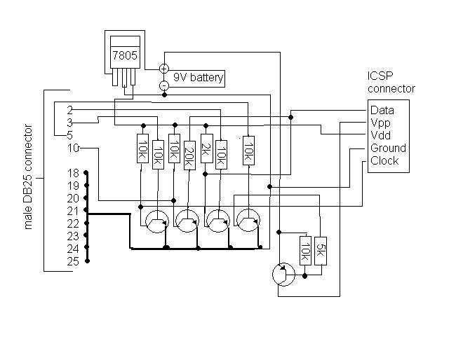
From schematics…

Slide 4
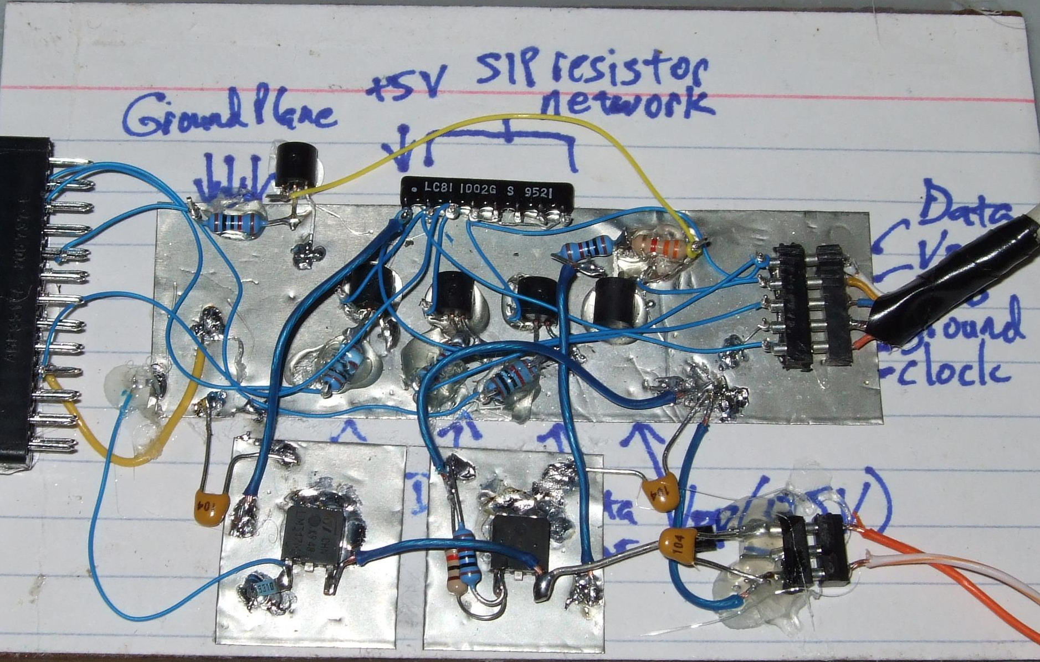
… to the real world

Slide 5

It starts with a script..
#!/bin/sh
# Comment
while read n
do
md5sum $n
done > output

Slide 6
Scriptify as much as possible
What is the minimal number of manual steps?
Even 1 might be too many.
Zero is perfect!

Slide 7
First run locally:
To measure usage
Did you get all the inputs?
Did it run correctly?
    Are you sure?
Run once remotely
  NOT ON SUBMIT MACHINE!
  Might be surprised
Once working, run a couple of times
If big variance, should you take the…
  Average? Median? Worst case?

Slide 8
Estimations:
Orders of Magnitude
Don’t sweat the small stuff
  AMD == Intel == 2.4 Ghz == 3.6 Ghz
But pay attention to the big stuff:
What makes this hard?
  From nanoseconds to terabytes
Powers of Ten, by the Eames

Slide 9
Resources Jobs Need
CPU
  Wall Clock vs. CPU cycles
Disk
  Working (execute side)
  Total (submit side)
  Bandwidth
    File transfer queue time
Network bandwidth
  Usually for file transfer only

Slide 10
User Log shows all
005 (2576205.000.000) 06/07 14:12:55 Job terminated.
(1) Normal termination (return value 0)
Usr 0 00:00:00, Sys 0 00:00:00 - Run Remote Usage
Usr 0 00:00:00, Sys 0 00:00:00 - Run Local Usage
Usr 0 00:00:00, Sys 0 00:00:00 - Total RemoteUsage
Usr 0 00:00:00, Sys 0 00:00:00 - Total Local Usage
5 - Run Bytes Sent By Job
104857640 - Run Bytes Received By Job
5 - Total Bytes Sent By Job
104857640 - Total Bytes Received By Job
Partitionable Resources : Usage Request
Cpus : 1
Disk (KB) : 125000 125000
Memory (MB) : 30 100

Slide 11
High Throughput
What Isn’t High Throughput?
  Quick starting jobs
  Very short job runtimes
  Micro optimizations
What is?
  Constant job pressure
  Many jobs
  Long total workflow times

Slide 12
Rules of Thumb for OSG Jobs
CPU (single-threaded)
  Use between 5 minutes and 2 hours wall
        Upper limit somewhat soft
Disk
  Keep scratch working space < 20 Gb
  Minimize OSG_APP_DATA usage
  Submit disk usage depends on machine
  Intermediate needs vs Sinks/Sources

Slide 13
Rules of Thumb (cont.)
Network
  Primarily file I/O
  Fill in FILE SIZE / RUN TIME HERE
Use squid caching where appropriate

Slide 14
How to apply rules of Thumb
Not always clear cut
Need to keep rules of thumb in mind
May need to join many short processes
  Easy with shell wrapper
  But careful with error conditions
Or break up one big one…

Slide 15
Golden Rules for DAGs
Beware of the shish kabob!
Use a single user log
Use PRE and POST script
RETRY is your friend
DAGs of DAGs are good

Slide 16
Do you have the full DAG
Are there manual steps (esp. at beginning and end) that could be automated?

Slide 17
Start with “Conceptual DAG”
A
B1
B2
B3
C1
C2
C3
D

Slide 18
Map to Actual workflow based on resource usage
A
B1
B2
B3
C1
C2
C3
D

Slide 19
Two transforms
Merging nodes
Splitting nodes

Slide 20
Merging is easy
Scripting
  Avoids transfer of intermediate files
  Careful with error conditions
  Debugging can be a bit tricky

Slide 21
Breaking up is hard to do…
Ideally into parallel jobs
not always possible
Often need to checkpoint
Standard universe can help
User-defined checkpointing
Checkpoint images can be hard to manage

Slide 22
Putting it all together
Should have one functional dag
With appropriate run times

Slide 23
Questions?
Questions? Comments?
  Feel free to ask me questions later:
  Upcoming sessions

