Slide 1
Campus Grids & Campus Infrastructures Community
Rob Gardner
Computation Institute / University of Chicago
July 17, 2013
(updates from June 26 Area Coordinator’s meeting)

Slide 2
OSG CONNECTION SERVICES
PLATFORM OF SERVICES FOR CAMPUS-BASED RESEARCHERS

Slide 3
Recasting Campus Grids as Platform of Services
“OSG Connect”
Accelerate engagement
Suite of services for campuses
Connecting science to resources with increasing capability
Task Launch
Cycle Share
Software Share
Data Share
Data
Local access
Anywhere access
Transfer services
Advanced analytics
Software
Campus access
Anywhere access
Tasks
Resource access
Campus
Grid
Cloud
HPC
Connected Science Shared Capabilities

Slide 4
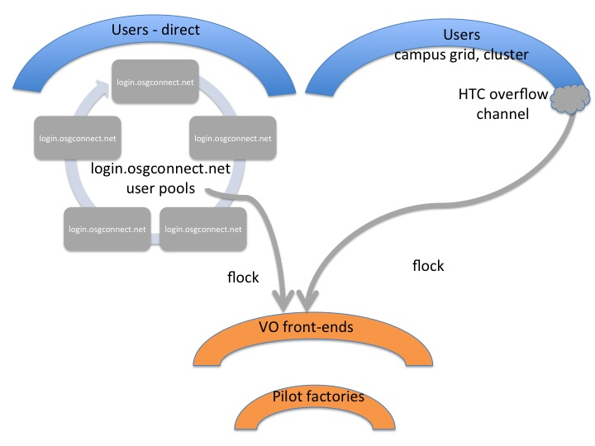
Updated to be a distributed picture

Slide 6
We’ve been working on the registration service workflow

Slide 7
OSG Connect via Certificate

Slide 9
OSG Campus infrastructures community
SHARING CAMPUS-CENTRIC DHTC EXPERTISE AND BEST PRACTICES

Slide 10
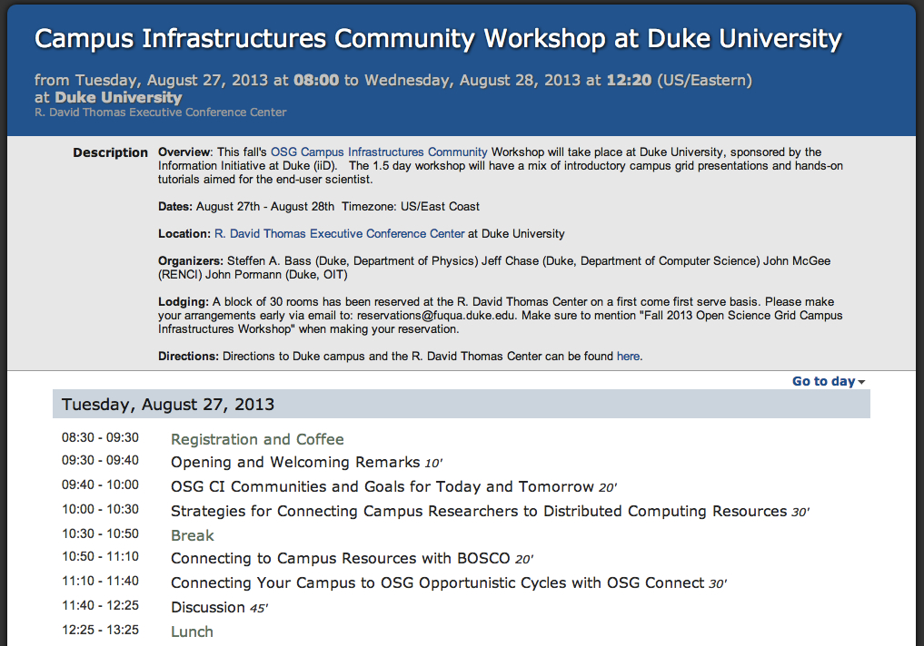
August 27-28 Workshop at Duke
WORKSHOP USER METRICS: TARGET = 50
# USERS REGISTERED TO OSGCONNECT
# USERS SUCESSFULLY COMPLETING QUICKSTART
# USERS BOSCO TO CAMPUS
# USERS OSGCONNECT:DIRECT TO OSG
# USERS OSGCONNECT:BOSCO TO OSG
# USERS > 1000 JOBS ON OSG
WORKSHOP CAMPUS RESEARCHER METRICS: TARGET = 5
# NEW REGISTERED CAMPUSES
# NEW RESEARCH PROJECTS
# NEW APPLICATIONS
WORKSHOP CAPABILITY METRICS: TARGET = 5
# ABLE TO USE OASIS
# ABLE TO USE DISTRIBUTED DATA
18 registered

