Slide 1




Lecture 1 - Part 1
Grid Intro and Fundamentals Review
Gabrielle Allen
Center for Computation & Technology
Louisiana State University
gallen@cct.lsu.edu
Grid Summer Workshop
June 21-25, 2004

Slide 2


Who am I?
Gabrielle Allen
  (Former) Black Hole Physicist
  One author of Cactus Code: http://www.cactuscode.org
  Grid Projects:
    GriKSL: http://www.griksl.org
    GridLab: http://www.gridlab.org
    Grid Application Toolkit: http://www.gridlab.org/GAT
    GridSphere Portal Framework: http://www.gridsphere.org
    UCoMS: http://www.ucoms.org
  CS Professor at Louisiana State University:
    Grid Computing Course: http://bit.csc.lsu.edu/~allen/Teaching/7700.html

Slide 3
Astrophysics and Astronomy
Driving Applications for HPC and Grid Computing:
  Cosmology
  Black Hole and Neutron Star Models
  Supernovae
  Astronomical Databases
  Gravitational Wave Data Analysis

Slide 4
Black Hole Simulations

Slide 5

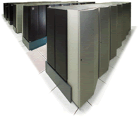
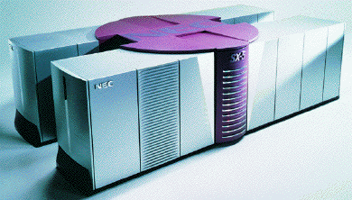
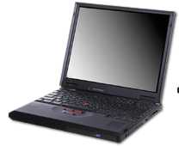

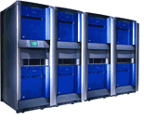

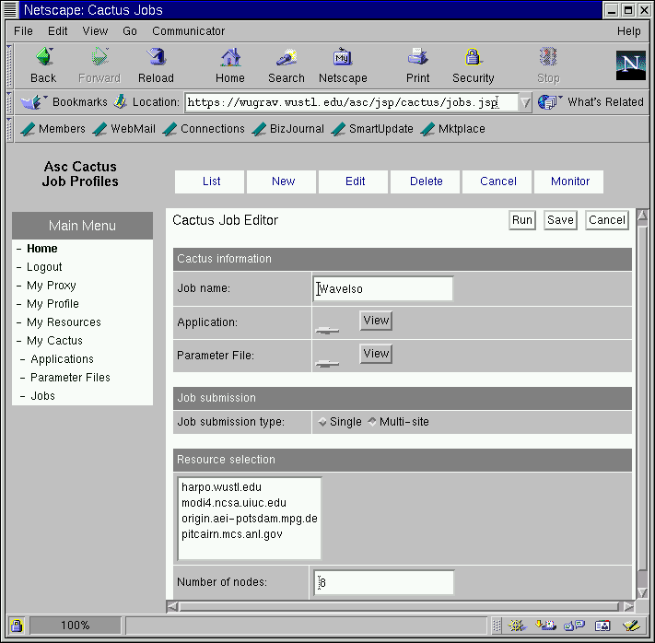
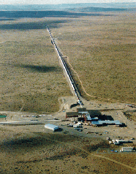
Grid Application Types
Minimal communication (embarrassingly parallel)
Staged/linked/workflow
Access to Resources
Fast throughput
Large scale
Adaptive
Data Tools
Real-time on demand
Speculative
More interesting: New dynamic scenarios
RZG
SDSC
SDSC
LRZ
AEI
NCSA

Slide 6
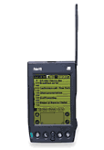
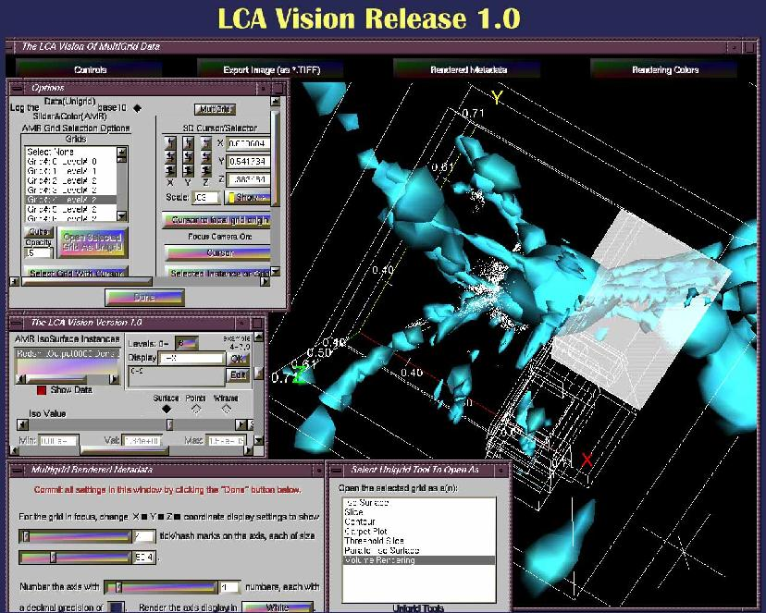
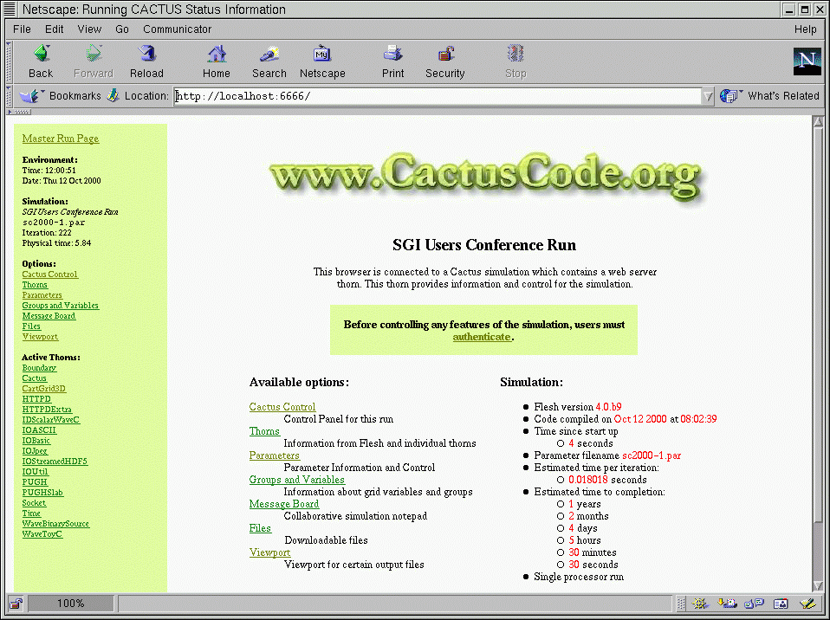
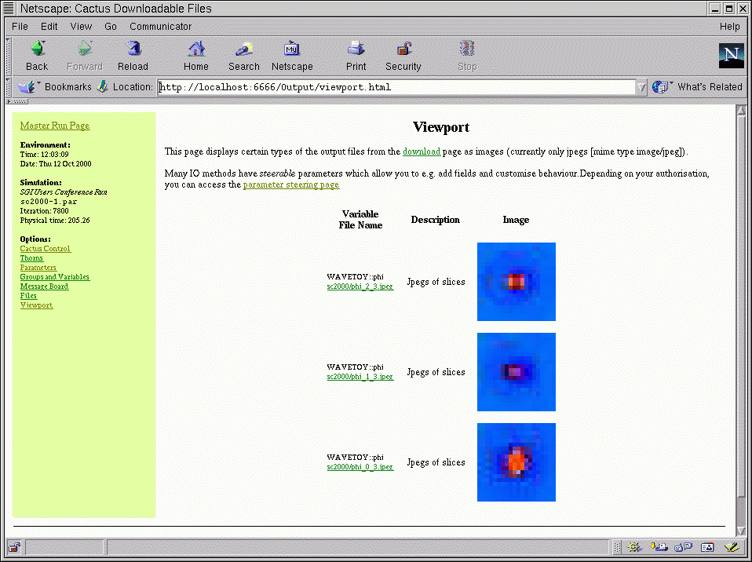
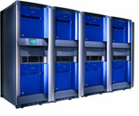

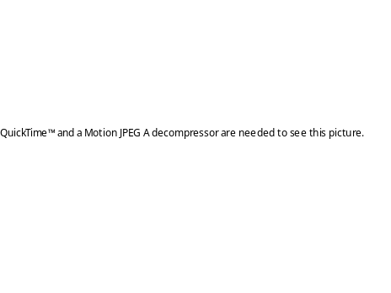
Remote Viz and Steering
HTTP
Any Viz Client
Changing any steerable parameter
Parameters
Physics, algorithms
Performance
Remote Viz data
Streaming HDF5
Autodownsample
Remote Viz data

Slide 7
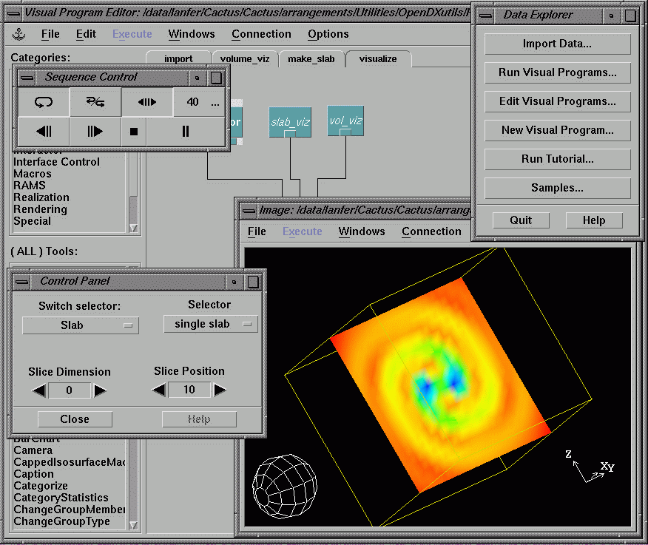
Remote File Access
Baltimore (US)
HDF5 VFD/
GridFTP:
Clients use file URL
(downsampling,hyperslabbing)
Visualization
Remote
Data
Storage
More Bandwidth
Available
Lapse for r<1, every other point
Network Monitoring Service
grr,psi on timestep 2
TB Data File
Analysis of Simulation Data
AEI (Germany)
NCSA (USA)

Slide 8
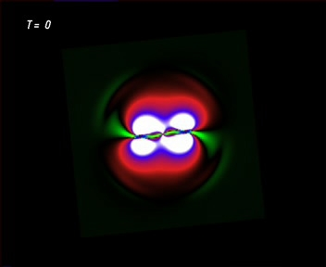
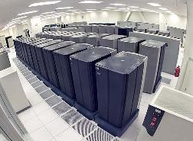

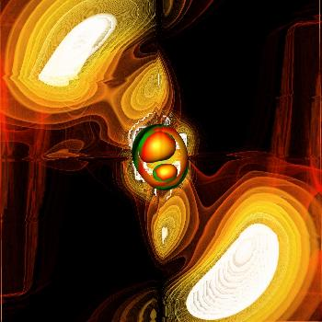
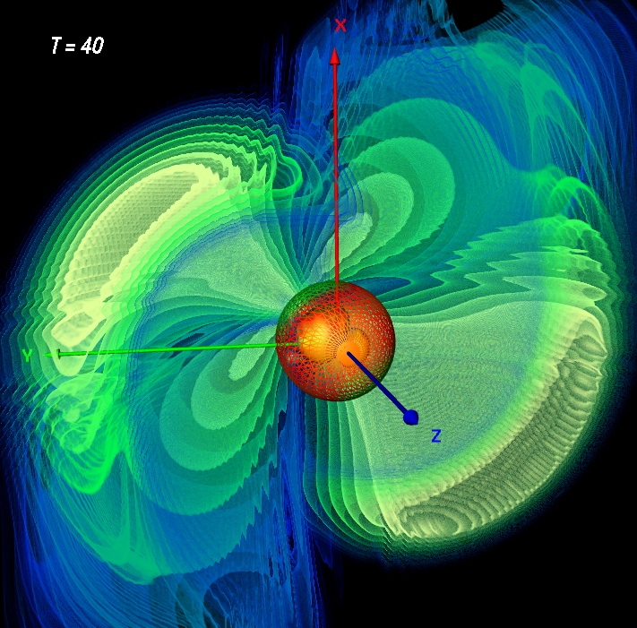
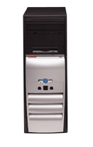
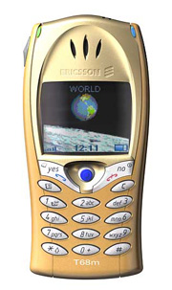
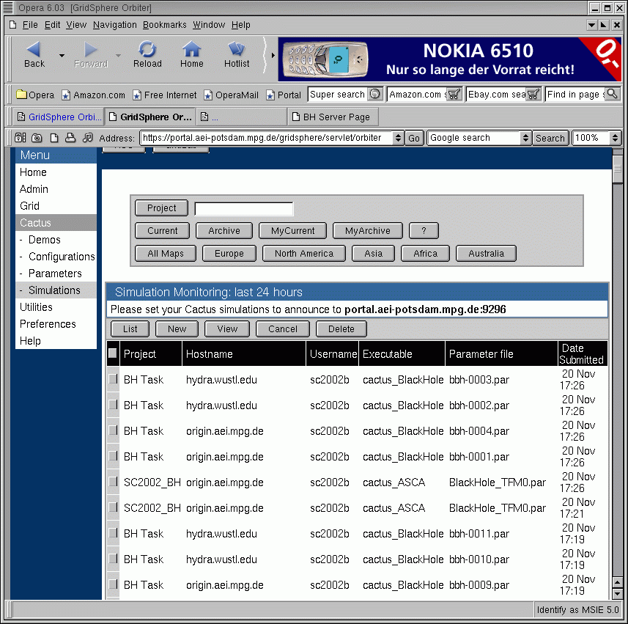

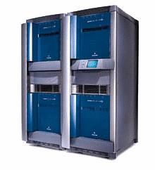
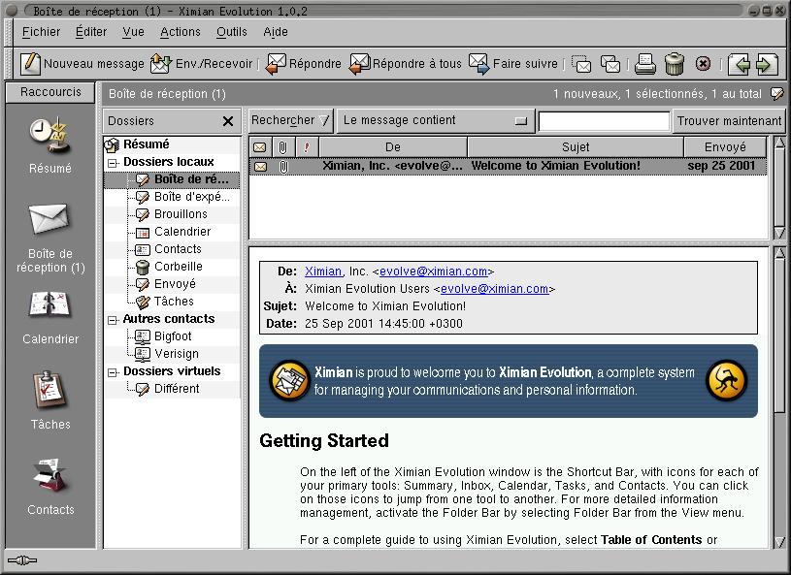
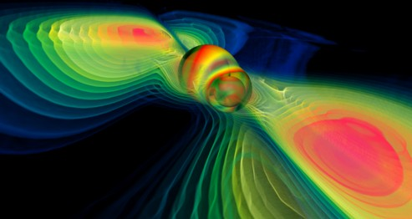
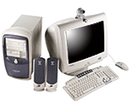
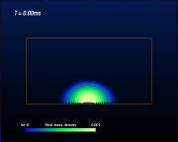
Notification
“TestBed”
Running
Appli cations
SMS Server
Portal Server
Mail Server

Slide 9
New Grid Scenarios
Intelligent Parameter Surveys, speculative computing
Dynamic Staging: move to faster/cheaper/bigger machine
Multiple Universe: create clone to investigate steered parameter
Automatic Component Loading: needs of process change, discover/load/execute new calc. component on approp.machine
Automatic Convergence Testing
Look Ahead: spawn off and run coarser resolution to predict likely future
Spawn Independent/Asynchronous Tasks: send to cheaper machine, main simulation carries on
Routine Profiling: best machine/queue, choose resolution parameters based on queue
Dynamic Load Balancing: inhomogeneous loads, multiple grids

Slide 10
Dynamic Adaptive Distributed Computing
GigE:100MB/sec
17
4
2
2
12
OC-12 line
(But only 2.5MB/sec)
12
5
5
SDSC IBM SP
1024 procs
5x12x17 =1020
NCSA Origin Array
256+128+128
5x12x(4+2+2) =480
These experiments (2001):
Black Holes with Cactus Code
First runs: 15% scaling
With new techniques: 70-85% scaling, ~ 250GF
Dynamic Adaptation: Number of ghostzones, compression, …
“Gordon Bell Prize” (Supercomputing 2001, Denver)

Slide 11

Future Dynamic Grid Computing
Physicist has new idea !
S
Brill Wave
S₁
S₂
P₁
P₂
S₁
S₂
P₁
P₂

Slide 12
Future Dynamic Grid Computing
Add more
resources
Queue time over,
find new machine
Free CPUs!!
RZG
SDSC
LRZ
SDSC
Archive data
Clone job with
steered parameter
Calculate/Output
Invariants
Further
Calculations
Found a black hole,
Load new component
Look for
horizon
Calculate/Output
Grav. Waves
AEI
Archive to LIGO
experiment
Find best
resources
NCSA

Slide 13
Learning Grid Computing
There is no “textbook” on Grid Computing!!!
  Good general overview …
    The Grid 2: Blueprint for a New Computing Infrastructure. Edited by Ian Foster and Carl Kesselmann
  More technical …
    Grid Computing, Making the Global Infrastructure a Reality. Edited by Fran Berman, Geoffrey C. Fox and Anthony J.G. Hey
  More suggestions and reference material …
    http://bit.csc.lsu.edu/~allen/Teaching/7700.html

Slide 14
Learning Grid Computing
It is still a rapidly moving research area
  We are starting here teaching Globus V.2 but towards Globus V.4 soon to be released!
  Follow news at
    http://www.globus.org,
    http://www.gridtoday.com,
    http://www.gridforum.org
    use Google!
Best way to learn is by trying it out yourself

Slide 15
Basic Networking Skills
We apologize if you already know these concepts.
We want to make sure that there is a certain basic level of understanding for all students.
Remember:
  Find out about Unix commands or tools using “man”
    > man nslookup
  There is lots of information on the web
    “what is” with Google, www.wikipedia.org, www.webopedia.com

Slide 16
IP Addresses
All computers on the Internet use TCP/IP.
  IP: responsible for moving packets of data from node to node
  TCP: responsible for correct delivery of data
TCP/IP assigns a unique number or “IP address” to every computer on the Internet
  32-bit number
  Written as four numbers, like: 128.105.3.61
An IP Address identifies a network interface, not a computer.
  A computer can have multiple IP addresses.
Notes:
Explain that TCP/IP is a network protocol … what is a protocol?

Slide 17
Domain Name Server (DNS)
DNS maps IP addresses to names, and vice-versa
  www.amazon.com ⬅➔ 207.171.163.30
  Discover this with “host” or “nslookup” or “dig”
  Try all three—how do they differ?
Notes:
Add some example output

Slide 18
DNS
> host www.amazon.com
www.amazon.com has address 207.171.163.90
> nslookup -sil www.amazon.com
Server: 10.0.1.1
Address: 10.0.1.1#53
Non-authoritative answer:
Name: www.amazon.com
Address: 207.171.166.48

Slide 19
DNS
> dig www.amazon.com
; <<>> DiG 9.2.2 <<>> www.amazon.com
;; global options: printcmd
;; Got answer:
;; ->>HEADER<<- opcode: QUERY, status: NOERROR, id: 1077
;; flags: qr rd ra; QUERY: 1, ANSWER: 1, AUTHORITY: 0, ADDITIONAL: 0
;; QUESTION SECTION:
;www.amazon.com. IN A
;; ANSWER SECTION:
www.amazon.com. 26 IN A 207.171.166.48
;; Query time: 15 msec
;; SERVER: 10.0.1.1#53(10.0.1.1)
;; WHEN: Sun Jun 20 12:39:35 2004
;; MSG SIZE rcvd: 48

Slide 20
Whois
Who owns or runs a domain?
Amazon.com:
  Amazon.com, Inc. (HOS276-ORG) hostmaster@AMAZON.COM
  PO BOX 81226
  SEATTLE, WA 98108-1300
  US
  +1 206 266 4064 fax: +1 206 266 7010
Discover this with “whois”.

Slide 21
Ping! Are you awake?
Note that a computer
can have multiple names
Is a computer on the network?
Use ping to find out
% ping www.cs.wisc.edu
PING marzipan.cs.wisc.edu (128.105.7.11) 56(84) bytes of data.
64 bytes from marzipan.cs.wisc.edu (128.105.7.11): icmp_seq=1 ttl=63 time=0.327 ms
64 bytes from marzipan.cs.wisc.edu (128.105.7.11): icmp_seq=2 ttl=63 time=0.241 ms
--- marzipan.cs.wisc.edu ping statistics ---
2 packets transmitted, 2 received, 0% packet loss, time 2611ms
rtt min/avg/max/mdev = 0.241/0.276/0.327/0.036 ms

Slide 22
Internet routes
Between you and a computer on the network, there is an often complex route.
% traceroute www.cs.uwm.edu
traceroute to miller.cs.uwm.edu (129.89.143.24), 30 hops max, 40 byte packets
1 svi-121.cisco1.cs.wisc.edu.105.128.in-addr.arpa (128.105.121.248) 0.423 ms 0.242 ms 0.227 ms
2 rh-cssc-b280c-2-core-vlan-492.net.wisc.edu (144.92.128.186) 0.404 ms 4.985 ms 0.489 ms
… snip…
6 r-uwmilwaukee-isp-atm1-0-1.wiscnet.net (140.189.8.2) 2.730 ms 2.603 ms 2.689 ms
7 space-needle-mke.csd.uwm.edu (216.56.1.194) 2.836 ms 2.718 ms 2.748 ms
8 miller.cs.uwm.edu (129.89.38.24) 2.754 ms * 2.796 ms
Notes:
Add that a number of sites block “ping” requests, such firewalls are a problem for grid computing …

Slide 23
Port numbers
A port number indicates which program to talk to on a computer.
Some port numbers are standard:
  HTTP (web): port 80
  SMTP (mail): port 25
  Ping: port 7
Some port numbers are assigned dynamically when you run a server.

Slide 24
Netstat
Netstat can answer the question: is a program running on a port on the local computer.
netstat --protocol=inet –l
tcp 0 0 *:finger *:* LISTEN
-l meant “listening for connections”. Look for active connections:
netstat --protocol=inet | grep ssh
% netstat --protocol=inet | grep ssh
tcp 0 0 chopin.cs.wisc.edu:ssh ppp-67-38-160-108:20715 ESTABLISHED
tcp 0 0 chopin.cs.wisc.edu:ssh 68.185.181.47:1176 ESTABLISHED
…

Slide 25
Telnet
Telnet isn’t just for remote access to a computer
Telnet can tell you if remote services are running correctly.
Is ssh running?
  Find ssh port number in /etc/services. It’s 22.
  telnet <host> 22. Example:
  telnet beak.cs.wisc.edu 22
  Trying 128.105.146.14...
  Connected to beak.cs.wisc.edu (128.105.146.14).
  Escape character is '^]'.
  SSH-1.99-OpenSSH_3.6.1p2
  ^] (That is control-right bracket)
  telnet> quit

Slide 26
Telnet & HTTP (Just for fun)
% telnet www.cs.wisc.edu 80
Trying 128.105.7.31...
Connected to www.cs.wisc.edu (128.105.7.31).
Escape character is '^]'.
GET http://www.cs.wisc.edu/~roy/index.html
<!DOCTYPE html PUBLIC "-//W3C//DTD HTML 4.01//EN">
<html>
<head>
<title>Alain Roy</title>
… snip …
Type the lines in red, and get back a web page.

Slide 27
Why are we telling you this?
Setting up and maintaining a grid can be hard work. Things break. You will get involved in debugging them.
You may to use all of these commands, and others, to figure out where a problem lies.
E.g. The Globus gatekeeper isn’t running, even though the computer is up.
  Is the computer really up? Use ping
  Is the computer accessible on the network? Use traceroute
  Can you telnet to the gatekeeper?

Slide 28
Example
Bad complaint:
  Waaah!!! My grid server-thingy is down
Good complaint:

Slide 29
Network Protocol
A formal description of message formats and a set of rules for exchanging messages
Good protocols are designed to do just one thing
  Protocols can be layered
Examples of protocols
  IP, TCP, TLS (SSL), HTTP, Kerberos

Slide 30
Network Enabled Services
Implementation of a protocol that defines a set of capabilities
  Protocol defines interaction with service
  All services require protocols
  Not all protocols are used to provide services (e.g. IP, TLS)
Examples: FTP and Web servers
FTP Server
Web Server
FTP Protocol
Telnet Protocol
HTTP Protocol
TLS Protocol
TCP Protocol
TCP Protocol
IP Protocol
IP Protocol

Slide 31
Application Programming Interface
A specification for a set of routines to help application development
  Refers to definition, not implementation
  E.g., there are many implementations of MPI
Spec often language-specific (or IDL)
  Routine name, number, order and type of arguments; mapping to language constructs
  Behavior or function of routine
Examples
  GSS API (security), MPI (message passing)

Slide 32
Software Development Kit
A particular instantiation of an API
SDK consists of libraries and tools
  Provides implementation of API specification
Can have multiple SDKs for an API
Examples of SDKs
  MPICH, Motif Widgets

Slide 33
Syntax
Rules for encoding information, e.g.
  XML, Condor ClassAds, Globus RSL
  X.509 certificate format (RFC 2459)
  Cryptographic Message Syntax (RFC 2630)
Distinct from protocols
  One syntax may be used by many protocols (e.g., XML); & useful for other purposes
Syntaxes may be layered
  E.g., Condor ClassAds -> XML -> ASCII

Slide 34
A Protocol can have Multiple APIs
TCP/IP APIs include BSD sockets, Winsock, System V streams, …
The protocol provides interoperability: programs using different APIs can exchange information
I don’t need to know remote user’s API
Application
Application
WinSock API
Berkeley Sockets API
TCP/IP Protocol: Reliable byte streams

Slide 35
An API can have Multiple Protocols
MPI provides portability: any correct program compiles & runs on a platform
Does not provide interoperability: all processes must link against same SDK
  E.g., MPICH and LAM versions of MPI
Application
Application
MPI API
MPI API
LAM SDK
MPICH-P4 SDK
LAM protocol
MPICH-P4 protocol
Different message formats, exchange sequences, etc.
TCP/IP
TCP/IP

Slide 36
APIs and Protocols are Both Important
Standard APIs/SDKs are important
  They enable application portability
  But w/o standard protocols, interoperability is hard (every SDK speaks every protocol?)
Standard protocols are important
  Enable cross-site interoperability
  Enable shared infrastructure
  But w/o standard APIs/SDKs, application portability is hard (different platforms access protocols in different ways)

Slide 37
Secure Sockets Layer: SSL (TLS)
Protocol that transmits communications over the Internet in an encrypted form
  SSL ensures that the information is sent, unchanged, only to the server you intended to send it to.
SSL uses a private key to encrypt data
  Netscape and Internet Explorer support SSL
  Web sites use SSL to obtain confidential user information, such as credit card numbers.
  By convention, URLs that require an SSL connection start with https: instead of http:.
Newest version of SSL is called Transport Later Security (TLS)
HTTP
FTP
Secure Socket Layer
(SSL)
TCP
IP

Slide 38
OpenSSL
An Open Source implementation of the SSL (Secure Sockets Layer) and TLS (Transport Layer Security) protocols
OpenSSL is used by Apache HTTP Server for https support and by MySQL to provide secure database access.

Slide 39
OpenSSH
OpenSSH is an implementation of the SSH protocol suite of tools
OpenSSH encrypts all traffic (including passwords)
OpenSSH provides a variety of authentication methods.
The OpenSSH suite includes
  ssh program which replaces rlogin and telnet,
  scp which replaces rcp,
  sftp which replaces ftp.
  Also other basic utilities like ssh-add, ssh-agent, ssh-keygen

Slide 40
Before The Grid (BTG) …
Now we’re going to see how we did “grid” work before there was “grid technology”.
What is grid technology? We’ll tell you more about this in the afternoon. For now:
  Run jobs on other computers
  Transfer data
  Discover information
  Do it all securely

Slide 41
Before The Grid: Example
Lets just try and run a program remotely …
HelloWorld.c
    int main()
    {
    printf("Hello World!\n");
  }
gcc HelloWorld.c -o HelloWorld

Slide 42
BTG: Job submission
ssh can run jobs remotely:
  ssh roy@beak.cs.wisc.edu ls
  ssh roy@beak.cs.wisc.edu HelloWorld
This expects a few things:
  Your program (here “HelloWorld”) already exists on the remote computer
  A shell is invoked to set up your environment, so you can find the program
  Note there is no scheduling here …

Slide 43
BTG: File Transfer
How do you transfer the program to be executed?
scp HelloWorld roy@beak.cs.wisc.edu:
  Note the final colon at the end of that line
How do you transfer the output back?
scp roy@beak.cs.wisc.edu:output .
Submitting your job here takes a minimum of three commands, at each command need to type your password.

Slide 44
BTG: Simplifying with Public Keys
We can simplify this by removing the need to use passwords
Use instead public keys cryptography
  Create a public/private key pair (ssh-keygen)
    keep the private key on your machine
    put the public key on the machines you want to use
  Start an agent to hold your private keys for this session (ssh-agent)
  Authenticate once to add your private keys to the agent (ssh-add)

Slide 45
BTG …
No scheduling or other high level functionality
No information about which machines you should use
No trust associated with the certificates (public keys)
  You distribute your own public key …

Slide 46
BTG: Issues
Issues you will find:
  How do you run three jobs sequentially that require data transfer? You just run each command in a row.
  How do you run three jobs in parallel that require data transfer?
    Make each transfer/job/transfer a script. Run the scripts in parallel from the command line
  How do you deal with failures?
    What if scp or ssh returns an error?
    What if scp or ssh never returns? (It hangs)
  How do you keep track of everything?
    In an ad-hoc way?

Slide 47
BTG: Dealing With the Issues
We will talk about grid solutions to these problems
Keep an eye out for:
  GSI for security
  GRAM or Condor-G for transfer of input/output files
  Condor-G for job reliability
  DAGMan for running sets of jobs

Slide 48
Lecture 1 – Part 2
Basic Grid Skills
Gabrielle Allen
Center for Computation & Technology
Louisiana State University
gallen@cct.lsu.edu
Grid Summer Workshop
June 21-25, 2004

Slide 49
Credits
A few of these slides were copied, in whole or in part, from past Globus presentations.
  http://www.globus.org/about/presentations/
One slide was copied from Miron Livny

Slide 50
What is a Grid?
1969, Len Kleinrock:
  “We will probably see the spread of ‘computer utilities’, which, like present electric and telephone utilities, will service individual homes and offices across the country.”
1998, Kesselman & Foster:
  “A computational grid is a hardware and software infrastructure that provides dependable, consistent, pervasive, and inexpensive access to high-end computational capabilities.”
2000, Kesselman, Foster, Tuecke:
  “…coordinated resource sharing and problem solving in dynamic, multi-institutional virtual organizations.”
Notes:
Grid computing has also been called metacomputing, scalable
global computing, internet computing
Originally very closely tied to scientific parallel computing, now more about loosely coupled applications

Slide 51
Ian Foster’s Grid Checklist (2002)
A Grid is a system that:
  Coordinates resources that are not subject to centralized control
  Uses standard, open, general-purpose protocols and interfaces
  Delivers non-trivial qualities of service

Slide 52
Bill Johnston’s Definition (2002)
A Grid is an environment that provides access and management for the whole range of computing resources needed to solve complex computing and data handling problems… a Grid is a well understood and standardized set of services that provide uniform access to a large number of diverse and distributed resources, together with several critical auxiliary services for resource discovery and secure communication based on authenticated, global identity.
  Resource discovery
  Resource scheduling
  Uniform computing access
  Uniform data access
  Asynchronous information sources
  Authentication, delegation, and secure communication
  Identify certificate management
  System management and access

Slide 53
Our Definition of a Grid
A distributed computing environment that coordinates:
  Computational jobs
  Data placement
  Information management
Scales from one computer to thousands
Capable of working across many administrative domains
That is: Get lots of work done, securely

Slide 54
Components for Grid Computing
Distributed People
  Research communities who need to share data, or codes, or computers, or equipment to work on and understand common problems
  Astrophysics Network: relativists, astrophysicists, computer scientists, mathematicians, experimentalists, data analysts
Distributed Resources
  Computers: supercomputers, clusters, workstations, PDAs
  Storage devices, databases, networks
  Experimental equipment: telescopes/interferometers
Machine Network
CPU
CPU
CPU
CPU
DISK
Wide Area Network
Campus Network (LAN)
Machine Network
CPU
CPU
CPU
CPU
DISK
Campus Network (LAN)
Notes:
3

Slide 55

Components for Grid Computing
Software infrastructure
  Links all these together
  Low level: security, information, communication, …
  Middleware: data management, resource brokers, portlets, monitoring, workflow, …
Examples
  Globus (low level)
  Condor (higher level)

Slide 56

Virtual Organizations
Groups of organizations that use the Grid to share resources for specific purposes
  EU DataGrid, Alliance, TeraGrid, SC02 Global Grid Testbed, etc
Support a single community or multiple communities
Deploy compatible technology and agree on working policies
Deploy different network accessible services:
  Grid Information
  Grid Resource Brokering
  Grid Monitoring
  Grid Accounting
Authentication and Authorization

Slide 57
Components for Grid Computing
Don’t forget applications !
Application Level Utilities
  Standard toolkits
  SDKs
  Libraries
  User portals
Applications themselves
  What properties do they need to run on a Grid?
  Need to be highly portable and machine independent
Development tools (debuggers, profilers, …)
Examples: Grid Application Toolkit: http://www.gridlab.org/GAT

Slide 58
Example Grid:
You can set up a Grid and try everything described in this lecture with just one machine (and no network)

Slide 59
Example Grid:
But more interesting to use two machines …don’t need to start off more complicated than this (building and maintaining a grid is hard work!)

Slide 60
Example Grid: Grid2003
Built by iVDGL (one of the sponsors of this school)
At its peak:
  Spanned 27 grid sites across the US and Korea
  Included 2000+ CPUs
  Ran 7 different scientific applications
  100 users had access to Grid2003
    Users were divided into distinct virtual organizations
  Ran up to 500-700 concurrent jobs, with 75% efficiency

Slide 61
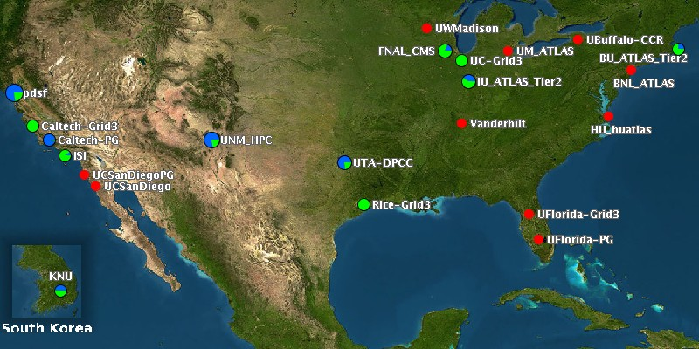
Grid2003

Slide 62
TeraGrid: teragrid.org

Slide 63
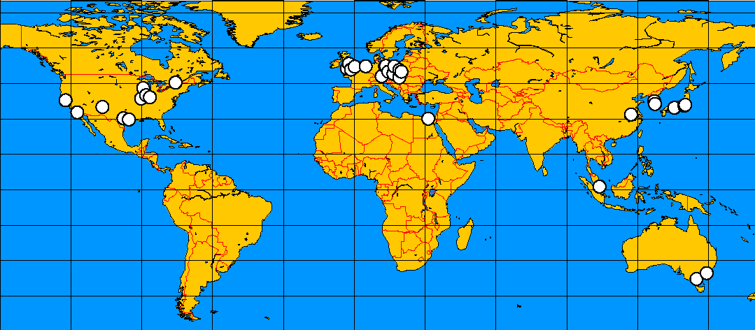
Global Grid Testbed Collaboration

Slide 64
Before The Grid …
Recall this morning’s lecture …
  Security infrastructure: ssh/https
  Running jobs: ssh
  Transferring data: FTP, HTTP, scp
  Discovering information: Google, LDAP
How does this change with grid technology?

Slide 65
Which Grid Technology?
There are lots of grid technologies
  Globus
  Condor
  Unicore
We will focus on Globus, Condor, and related software.
  Avaki (Legion)
  SETI@home

Slide 66
Grid with a Grid
Now we will use:
  Security infrastructure: GSI
  Running jobs: GRAM/Condor-G
  Transferring data: GridFTP & friends
  Discovering information: MDS

Slide 67
Why Grid Security is Hard
Resources may be valuable & the problems being solved sensitive
Resources are often located in distinct administrative domains
  Each resource has own policies, procedures, security mechanisms, etc.
Implementation must be broadly available & applicable
  Standard, well-tested, well-understood protocols; integrated with wide variety of tools

Slide 68
Security: Terminology
Authentication: Establishing identity
Authorization: Establishing rights
Message protection
  Message integrity
  Message confidentiality
Non-repudiation
Digital signature
Accounting
Delegation

Slide 69
Authentication
Process of identifying who you are
  Username/password
  Passport/visa
  Driving License or LSU Card
  Public keys
  Finger prints/DNA
Authentication stops masquerading imposters

Slide 70
Authorization
Given who you are, what are you allowed to do?
  The process of deciding if device X is allowed to have access to service Y
  Unix rwx permissions
  ACLs provide more flexible control

Slide 71
Message Integrity
Knowing whether the message has been tampered with between its origin and destination.
Authentication and integrity are closely linked: Message integrity secures the communication of entity (person, host, etc.) authentication

Slide 72
Message Confidentiality
Being sure that no one else is able to read or interpret the message
Encrypted message are not available to unauthorized users
Analogy: Sending your message in a safe … only people with the key can open it.

Slide 73
Nonrepudiation
Ensuring that a transferred message has been sent and received by the parties claiming to have sent and received the message.
A way to guarantee that the sender of a message cannot later deny having sent the message and that the recipient cannot deny having received the message.

Slide 74
Digital Signature
An electronic signature that authenticates the identity of the sender of a message, the signer of a document, or ensures that the contents of a message are intact.
Digital signatures are easily transportable, cannot be imitated by someone else, and can be automatically time-stamped.
The ability to ensure that the original signed message arrived means that the sender cannot easily repudiate it later.
A digital certificate contains the digital signature of the certificate-issuing authority so that anyone can verify that the certificate is real.

Slide 75
Digital Certificate
The signer of a digital certificate says something like “I attached G.Allen’s public key to this digital certificate and then signed it with my private key”
Any user of G.Allen’s digital certificate must completely trust the competency and honesty of the person/organization who signed the certificate
For anyone to confidently use G.Allen’s digital certificate they must also trust that they have a validated copy of the signers public key
There is nothing secret about the contents of a digital certificate
Has expiration date
Analogy: Driving License issued by DMV (+ other countries)

Slide 76
Managing Digital Certificates
Digital certificate administrative frameworks are called “public key infrastructures” (PKIs).
Two major ones (sometime interoperable)
  X.509 (standardized by IETF)
  Pretty Good Privacy (PGP)
Centrally controlled system for managing digital certificates in X.509 talk is a “certificate authority”

Slide 77
Certificate Authorities (CAs)
A small set of trusted entities known as Certificate Authorities (CAs) are established to sign certificates
A Certificate Authority is an entity that exists only to sign user certificates
The CA signs it’s own certificate which is distributed in a trusted manner
Name: CA
Issuer: CA
CA’s Public Key
CA’s Signature

Slide 78
Certificate Authority
Trusted third party (CA) which manages digital certificate application, certification, issuance and revocation
X.509 trust networks (e.g. Mississippi will trust driving licenses issued in LA)
Each X.509 PKI implementation has a root CA, which produces a self signed or root certificate

Slide 79
CAs and Policies
For example:
DOE
http://www.doegrids.org/Docs/CP-CPS.pdf
Alliance http://archive.ncsa.uiuc.edu/SCD/Alliance/GridSecurity/Certificates/AllianceCP9.1.html

Slide 80
Grid Security Infrastructure (GSI)
Users:
  Easy to use
  Single sign-on: only type your password once
  Delegate proxies
Administrators
  Can specify local access controls
  Have accounting

Slide 81
GSI: How Do We Get These Features?
From the Public Key Infrastructure: PKI
PKI allows you to know that a given key belongs to a given user
PKI builds off of asymmetric encryption:
  Each entity has two keys: public and private
  Data encrypted with one key can only be decrypted with other
  The public key is public
  The private key is known only to the entity
The public key is given to the world encapsulated in a X.509 certificate

Slide 82
Grid Certificates
On the Grid, each user and service is identified via a GSI certificate, which includes
  A subject name, which identifies the person or object that the certificate represents.
  The public key belonging to the subject.
  The identity of a Certificate Authority (CA) that has signed the certificate to certify that the public key and the identity both belong to the subject.
  The digital signature of the named CA
GSI certificates are encoded in the X.509 certificate format.

Slide 83
My Alliance Certificate
Certificate:
Data:
Version: 3 (0x2)
Serial Number: 338 (0x152)
Signature Algorithm: md5WithRSAEncryption
Issuer: C=US, O=National Computational Science Alliance, OU=Certification Authority
Validity
Not Before: Aug 31 10:16:51 2002 GMT
Not After : Aug 30 10:16:51 2004 GMT
Subject: C=US, O=National Computational Science Alliance, CN=Gabrielle Allen
Subject Public Key Info:
Public Key Algorithm: rsaEncryption
RSA Public Key: (1024 bit)
Modulus (1024 bit):
00:b6:ad:2f:fc:20:f3:45:8e:a0:9c:e2:a8:a5:1d:
ETC ETC ff:f4:b7:2a:ce:d4:f8:e3:cd
Exponent: 65537 (0x10001)

Slide 84
My Alliance Certificate
X509v3 extensions:
X509v3 Key Usage: critical
Digital Signature, Non Repudiation, Key Encipherment, Data Encipherment
X509v3 Authority Key Identifier:
keyid:9F:2D:DC:82:F0:CC:81:B2:FE:9D:AC:8E:23:47:1B:B6:D5:BE:B9:E2
X509v3 CRL Distribution Points:
URI:https://ca.ncsa.edu/5aba75cb.r0
Signature Algorithm: md5WithRSAEncryption
a8:0f:c5:d6:ea:18:d7:6a:f6:76:61:a0:19:2e:3c:db:66:a6:
ETC ETC
1b:7f:39:61:14:77:41:44:0d:15:70:cc:12:01:3b:79:29:66:
52:b9:a5:e0:6e:01:09:70:e8:4e:ac:0d:48:c8:31:ba:62:f1:
cd:ac:c8:73:82:79:18:8b:5d:0d:d1:78:cc:2b:85:ff:92:95:
37:26:1c:f0

Slide 85

GSI: What is a Certificate?
Similar to passport or driver’s license: Identity signed by a trusted party
State of Illinois
Name
Issuer
Public Key
Signature
John Doe
755 E. Woodlawn
Urbana IL 61801
State of
Illinois
Seal
BD 08-06-65
Male 6’0” 200lbs
GRN Eyes

Slide 86
GSI: Certificates
By checking the signature, one can determine that a public key belongs to a given user
Hash
Hash
Name
Issuer
Public Key
Signature
=?
Decrypt
Hash
Public Key from
Issuer
Issuer

Slide 87


How Do You Get a Certificate?
User generates
public/private
key pair
User send public key to CA along with proof of identity
CA confirms identity, signs certificate and sends back to user
Cert
Request
Public Key
Cert
Certificate
Authority
State of Illinois
ID
Private Key encrypted on local disk

Slide 88
GSI: Proxies
It’s a bad idea to use your certificate as identification
  What if someone successfully steals it? They can impersonate you until the certificate expires
  Certificates usually last about a year
Using your certificate, GSI can create a proxy certificate.
  This represents you in the same way.
  It has a short life-time: usually 12 hours, but configurable

Slide 89
GSI: How Does Single Sign-on Work?
Look at your certificate subject name
  grid-cert-info –subject
  /DC=org/DC=doegrids/OU=People/CN=Alain Roy 424511
Tell people that wish to accept you what your subject name is—they put it into an authorization file on their machine
From your certificate, create a proxy
  grid-proxy-init
  grid-proxy-info –subject: note the “/CN=proxy”
Each person that likes you will accept your proxy: you only have to create it once
  Well, until it expires anyway

Slide 90
GSI: Your Certificates
Sometimes it can take a few days to get a certificate from a CA, because it takes time to verify your identity
What does your certificate look like?
  grid-cert-info

Slide 91
GSI: OpenSSH
OpenSSH has been modified to use GSI
This means that you can use ssh like you are used to, but you don’t have to type your password: just use your proxy
We’ll try it out during the exercises: gsissh

Slide 92
GSI: What Else Uses It?
All of Globus uses GSI, so you’ll use it for:
  Submitting jobs
  Transferring data
  Querying information services (maybe)
    It’s often turned off.
Condor uses GSI
Lots of other software uses GSI:
  GSI OpenSSH
  MyProxy
  Grid CVS

Slide 93
GSI: Certificate Details
User certificates are stored in your .globus directory:
  % ls –l .globus
  -rw-r----- 1 roy roy 1317 Sep 24 2003 usercert.pem
  -r-------- 1 roy roy 1209 Sep 24 2003 userkey.pem
Usercert.pem is the public key and is not private
-----BEGIN CERTIFICATE-----
MIIDHjCCAgagAwIBAgICAe8wDQYJKoZIhvcNAQEFBJomT8ixk
…
-----END CERTIFICATE-----
Userkey.pem is the private key, and must be kept private - never transmitted or shared

Slide 94
GSI: Proxy Details
Create a proxy with grid-proxy-init [-hours N]
A proxy is marked with a “not valid before” timestamp
  If your clocks are not synchronized, you may experience security failures!
Your proxy is stored in /tmp/x509up_uNNNN
  NNNN is your numeric user ID
  You can store it elsewhere, if you need to.
Destroy a local proxy: grid-proxy-destroy

Slide 95
GSI: Proxy Delegation
When you submit a job or transfer data, your proxy travels over the network to that computer
  The remote computer actually gets a limited proxy
    Not all services accept a limited proxy. This is another layer of safety
  Grid-proxy-destroy does not remove proxies that have been transferred.

Slide 96
GSI: /etc/grid-security
/etc/grid-security is the default location to store GSI information for a host
  hosts have certificates too
Job authorization happens in /etc/grid-security/grid-mapfile. This file maps certificates to users:
  “/DC=org/DC=doegrids/OU=People/CN=Alain Roy 424511” roy
  “/DC=org/DC=doegrids/OU=People/CN=Mike Wilde 326321” wilde

Slide 97
GRAM: What is it?
Given a job specification:
  Create an environment for a job
  Stage files to/from the environment
  Submit a job to a local scheduler
  Monitor a job
  Send job state change notifications
  Stream a job’s stdout/err during execution

Slide 98
GRAM: Some Terminology
We speak loosely most of the time, but:
Globus Job Management Service
  Starts up and monitors jobs
  Stages data in and out
GRAM
  Protocol to communicate with the job management service
We often say “GRAM” as a shorthand for either of these

Slide 99
GRAM: How Does it Work?
Head Node
a.k.a “Gatekeeper”
Compute Resource
Gatekeeper
(Authenticates
&
Authorizes)
Client
GRAM
Local Resource Manager
Results
Process
Job Manager
(Submits job
&
Monitors job)
Process
Process

Slide 100
GRAM: What is a “Local Resource Manager?”
It’s usually a batch system that allows you to run jobs across a cluster of computers
Examples:
  Condor
  PBS
  LSF
  Sun Grid Engine
Most systems allow you to access “fork”
  It’s the default
  It runs on the gatekeeper: a bad idea in general, but okay for testing

Slide 101
GRAM: RSL
The client describes the job with the Resource Specification Language (RSL)
  & (executable = a.out)
  (directory = /home/nobody )
  (arguments = arg1 "arg 2")
It is most convenient to use higher level tools (such as portals) to construct anything but simple RSL
http://www.globus.org/gram/rsl_spec1.html

Slide 102
GRAM: Security
GRAM uses GSI for security
Submitting a job requires a full proxy
  The remote system & your job will get a limited proxy
  The job will run—you had a full proxy when you submitted
  But your job cannot submit other jobs

Slide 103
GRAM: Basic Usage
grid-proxy-init
  You need your proxy first
globus-job-run hostX /bin/hostname
  This runs /bin/hostname on hostX
  It expects /bin/hostname to already be there
globusrun -o -r hostX '&(executable = /bin/echo) (arguments = Hello Grid) '
  This is the RSL.
  We could specify lots of things here, but we didn’t.
These just ran with the fork job manager, not an “interesting” batch system

Slide 104
GRAM: Running on a Batch System
Append the batch system to the hostname:
  globus-job-run hostX/jm-condor /bin/hostname
You will do this for most real work
  The batch system can handle many more jobs
  Batch systems are reliable and track your jobs
  Fork is not reliable, and your job may be lost

Slide 105
GRAM: The Future
If you use Condor-G today:
  It will keep track of your jobs for you and recover from errors, unlike the Globus command-line tools
  Condor-G has some tricks up its sleeve to improve job management scalability significantly
  We’ll learn more about Condor-G soon

Slide 106
GridFTP: What is it?
A secure, robust, fast, efficient, standards based, widely accepted data transfer protocol
An implementation:
  Globus provides a server
  Globus provides a client: globus-url-copy
  Other people provide clients: uberftp

Slide 107
GridFTP: Features
Security through GSI
  Note that GSI can provide encryption in addition to authentication and authorization
Reliability by restarting failed transfers
Fast
  Can set TCP buffers for optimal performance
  Parallel transfers
  Striping (multiple endpoints)
Not all features easily accessible from basic client

Slide 108
GridFTP: Basic Use
globus-url-copy file:fullpath/file gsiftp://host/path/file
  File: URL refers to a local file
  Gsiftp: URL refers to a remote file, accessed with GridFTP
You can specify two gsiftp URLs to do third-party transfers
You can specify other URLs, including http & https

Slide 109
GridFTP: 3rd Party Transfers
Data transfer
GridFTP Server
GridFTP Server
control
status
Client

Slide 110
Globus Monitoring and Discovery Service
MDS is a grid information service
It provides:
  Uniform, flexible access to information
  Scalable, efficient access to dynamic data
  Access to multiple information sources
  Decentralized maintenance
Based on LDAP

Slide 111
Information for What?
Operation of Grid
  Monitoring and testing Grid
Deployment of applications
  What resources are available to me? (Resource discovery)
  What is the state of the grid? (Resource selection)
  How to optimize resource use? (Application configuration and adaptation)
Information for other Grid Services to use

Slide 112
What are the Problems
How to obtain needed information? (automatic and accurate)
Information is always old
  Resources change state
  Takes time to retrieve information
  Need to provide quality metrics
Grid is distributed
  global state is very complex
  Scalability, efficiency and overhead
Component failure
Security
Many different usage scenarios
  Heterogeneous policy, different information organizations, etc.

Slide 113
Grid Information
Compute Resource Specific
  Name of resource, IP address, site name, location, firewalls, names of administrators, scheduled downtimes
  Machine type (SMP, ccNUMA, number of processors, interconnects)
  Processor types and characteristics (vendor, OS, cache, clockspeed)
  Software installations (software version, location, license)
  Jobs (queue names and properties, current running and queued jobs)

Slide 114
Grid Information
Network Specific
  Network type (peak speed, physical characteristics)
  Network properties (bandwidth, jitter, latency, QoS)
  Scheduled downtimes
Storage Resource Specific
  File system locations
  File system properties
  Current space

Slide 115
Site/VO Specific
Names of resources (resource types)
Location
Staff contact details
Web page locations
Resource specific information from lower levels

Slide 116
Needed Capabilities
Queryable across a network
Supports virtual organizations
Complex queries (search for all linux machines with at least 1GB memory and MPI-LAM installed)
Authentication and authorization.
Multiple information providers
Extensible information schemas
Efficient return of information
Extensible to large numbers of resources
Up-to-date information!!
Queryable in multiple ways (clients, web, APIs)

Slide 117
Globus MDS
Monitoring and Discovery Service
  Set of information service components for publishing and discovering information
  Single standard interface and scheme to information services in a virtual organization
MDS can aggregate information from multiple sites each with multiple resources
Information about each resource is provided by a information provider

Slide 118
Globus MDS
Handles static (e.g OS type) and dynamic (e.g current load) data
Access to data can be restricted with GSI (Grid Security Infrastructure) credentials and authorization features

Slide 119
MDS Components
LDAP 3.0 Protocol Engine
  Based on OpenLDAP with custom backend
  Integrated caching
Information providers
  Delivers resource information to backend
APIs for accessing & updating MDS contents
  C, Java, PERL (LDAP API, JNDI)
Various tools for manipulating MDS contents
  Command line tools, Shell scripts & GUIs

Slide 120
Higher Level Services
Can query MDS for information (e.g. web browser interface, command line clients, MDS API)
  List all registered sites
  List all resources at a given site
  Provide OS type and number of nodes for a particular machine
  List all machines running AIX with over 4 nodes
  Provide hostname of machine with lowest current load

Slide 121
Local Resource Monitoring
Publishes information to MDS
  Cluster monitoring: e.g. Ganglia
  Queue information: GRAM Reporter
  Network information: NWS
  Other local monitoring systems may require writing MDS interfaces

Slide 122
MDS Information
Depends on what information provider wants to provide
Static host information
  Operating system version, process architecture, number of processors, vendor, location, total disk space
Dynamic host information
  Load average, queue entries, uptime, available disk space
Core information providers which come with MDS provide a given set of static and dynamic information

Slide 123
Two Classes Of MDS Servers
Grid Resource Information Service (GRIS)
  Supplies information about a specific resource
  Configurable to support multiple information providers
  LDAP as inquiry protocol
Grid Index Information Service (GIIS)
  Supplies collection of information which was gathered from multiple GRIS servers
  Supports efficient queries against information which is spread across multiple GRIS server
  LDAP as inquiry protocol

Slide 124
GIS Architecture
Customized Aggregate Directories
Users
A
A
Enquiry
Protocol
Registration
Protocol
R
R
R
R
Standard Resource Description Services

Slide 125
MDS Hierachy
QUERY
GIIS
Virtual Organization
Level
QUERY
GIIS
GIIS
Site Level
QUERY
GRIS
GRIS
GRIS
IP
IP
IP
IP
IP
IP
Resource Level
Germany
Baton Rouge

Slide 126
MDS Deployment
GridLab VO
EGridVO
GIIS
LSU
GRISes

Slide 127
LDAP
Lightweight Directory Access Protocol
  open multiplatform standard for accessing directory services
  Based on X.500 (Directory Access Protocol, DAP) (also open but too complex and not adapted to TCP/IP)
  Defines protocol for exchanging directory service commands between client/server
  API for adding LDAP functionality to applications
  LDAP SDKs implementing this API are available (OpenLDAP is used by MDS)
  Exists in fast moving standards body IETF

Slide 128
Information Services API
RFC 1823 defines an IETF draft standard client API for accessing LDAP databases
  Connect to server
  Pose query which returns data structures contains sets of object classes and attributes
  Functions to walk these data structures
Globus does not provide an LDAP API, but recommends the use of OpenLDAP, an open source implementation of RFC 1823.

Slide 129
How is Data Stored In MDS
MDS directory structure follows the LDAP model
  Directory information tree (DIT) hierarchy
  Object class definitions
Directory Information Tree (LDAP)
  Hierarchical view of all directory data
  Tree-based search system for data, subtrees can be distributed or replicated
  Directory contents are object classes and entries
  Object classes: what kind of information
  Entries: group related information
  Objects uniquely named by position in the tree

Slide 130
How is Data Stored in MDS
Every node in tree is an “entry” (Directory Service Entry (CSE)
Entries contain records to describe real and abstract computing objects (users, computers, disks, applications)
Content of a record is a pairs of attributes and values
Attributes each have a “type” and a “value” (type is created by associating an object class)

Slide 131
MDS Commands
LDAP defines a set of standard commands
  ldapsearch, etc.
Also MDS-specific commands
  grid-info-search, grid-info-host-search
APIs are defined for C, Java, etc.
  C: OpenLDAP client API
    ldap_search_s(), …
  Java: JNDI

Slide 132
Searching an MDS Server
grid-info-search [options] filter [attributes]
Default grid-info-search options
  -h mds.globus.org MDS server
  -p 389 MDS port
  -b “o=Grid” search start point
  -T 30 LDAP query timeout
  -s sub scope = subtree
  alternatives:
  base : lookup this entry
  one : lookup immediate children

Slide 133
MDS: Example Information
hn=
hostname
CPU
RAM
DISK
OS
CPU
VM
NET
software=
OS
OS
dev group=
CPUs
CPU
CPU
dev group=
memory
dev group=
disk
dev group=
net
dev=
cpu 0
dev=
cpu 1
RAM
DISK
NET
CPU
CPU
VM
dev=
RAM
dev=
VM
dev=
/scratch1
dev=
eth0
RAM
VM
DISK
NET

Slide 134
MDS: More Schemas
Not everyone agrees on what schema should be provided
Grid2003 & LCG (in Europe) use the GLUE Schema.
  It provides similar information to the Globus schema
  The details of the schema are completely different
Grid2003 adds extra schema for information they need
  MDS should be dynamic and match your needs

