Slide 1
Grid Data Management
Notes:
Data comes from different media: sensors, analytic equipment, and ever-finer measuring tools. Patterns in these could point to new medicines and therapies, new forms of clean energy. They could help predict earthquakes. But most scientists lacked the machinery to store and sift through these digital “El Dorados”. Therefore we need mechanisms to deal with large quantities of data. In this lecture will see what tools are available for data management on the grid.

Slide 2
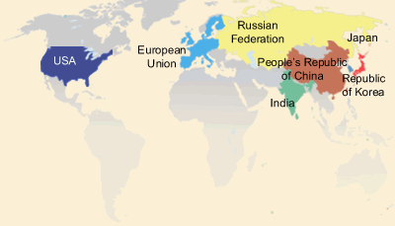
Data Management
Distributed community of users need to access and analyze large amounts of data
Requirement arises in both simulation and experimental science
Fusion community’s International ITER project

Slide 3
Data Management
Huge raw volume of data
Measured in terabytes, petabytes, and further …
Data sets can be partitioned as small number of large files or large number of small files
Store it long term in appropriate places (e.g., tape silos)
Move input to where your job is running
Move output data from where your job ran to where you need it (eg. your workstation, long term storage)
Notes:
What we have covered so far relates to jobs and execution.
One of the other very big areas in using the grid is dealing with large amounts of data.
We need to deal with things such as moving data around, storing it somewhere long term, keeping track of where we've stored it, for large amounts (terabytes, and heading towards petabytes) and large numbers of files.
So, like the GRAM case, we have some grid software to do this. For data movement, he standard is GridFTP.
There are various other pieces of software to deal with storing data within a site (similar to an LRM but designed for data) such as dCache, and for keeping track of where data is places (such as the Globus Replica Location Service).
The source of this large volume of data is either supercomputer simulations or experimental facilities.
DOE-funded climate modeling groups generate large reference simulations at supercomputer centers
Experimental program based upon the LHC at the CERN will produce petabytes of data per year for approximately 15 years.
Raw simulation or observational data is just a starting point for most investigations
Understanding comes from further analysis, reduction, visualization, and exploration

Slide 4
Data Management on the Grid
How to move data/files to where I want?
GridFTP
Data sets replicated for reliability and faster access
Files have logical names
Service that maps logical file names to physical locations
Replica Location Service (RLS)
Where are the files I want?
Notes:
GridFTP is the defacto standard for moving data on the Grid
First, you need to find the location of the data.

Slide 5
GridFTP
High performance, secure, and reliable data transfer protocol based on the standard FTP
http://www.ogf.org/documents/GFD.20.pdf\
Multiple implementations exist, we’ll focus on Globus GridFTP
Globus GridFTP Features include
Strong authentication, encryption via Globus GSI
Multiple transport protocols - TCP, UDT
Parallel transport streams for faster transfer
Cluster-to-cluster or striped data movement
Multicasting and overlay routing
Support for reliable and restartable transfers
Notes:
GridFTP: a high performance, secure, and reliable data transfer protocol based on the standard FTP. GridFTP enhances FTP with GSI security, multiple data channels for parallel transfers, third party transfers, and authenticated reusable channels.

Slide 6
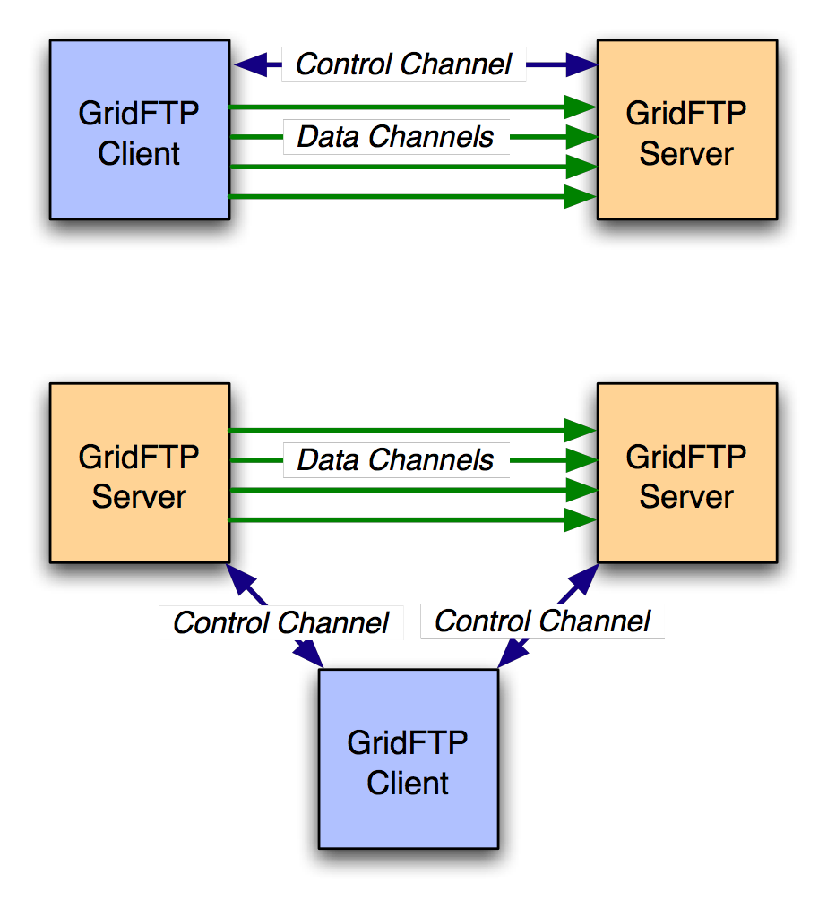
Basic Definitions
Control Channel
TCP link over which commands and responses flow
Low bandwidth; encrypted and integrity protected by default
Data Channel
Communication link(s) over which the actual data of interest flows
High Bandwidth; authenticated by default; encryption and integrity protection optional
Notes:
GridFTP is a two-channel protocol like FTP. GridFTP supports both client/server transfer and third-party transfer

Slide 7
Control Channel Establishment
Server listens on a well-known port (2811)
Client form a TCP Connection to server
Authentication
Anonymous
Clear text USER <username>/PASS <pw>
Base 64 encoded GSI handshake

Slide 8
Data Channel Establishment
227 <IP:PORT>
GridFTP Server
PASV
AUTH
GridFTP
Client
PORT <IP:PORT>
AUTH
GridFTP Server

Slide 9

Going fast – parallel streams
Use several data channels
TCP - default transport protocol used by GridFTP
TCP has limitations on high bandwidth wide area networks
Control channel
Server
Site B
Site A
Data channels
Notes:
GridFTP has various other modes for increasing speeds.
For example, it can do 'parallel streams'. With parallel streams, we establish several data channels, and send the file in pieces across all of the connections. There are a few advantages here. The underlying network protocol, TCP, that most data transfers on the internet use, tries to share bandwidth equally between each stream. By using more streams, we can get more shares.
Some people think this is cheating, though and some people will get upset about it as a form of network abuse.
Another advantage is that if one or more of the channels do not run at full speed (for example, a single lost packet can cause massive slow down), this slowdown is ameliorated.

Slide 10
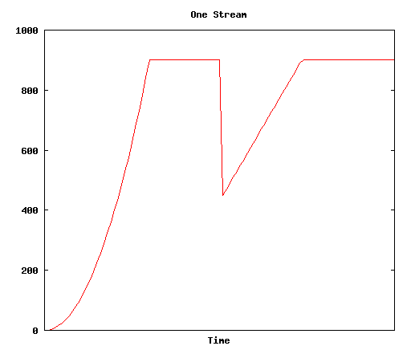
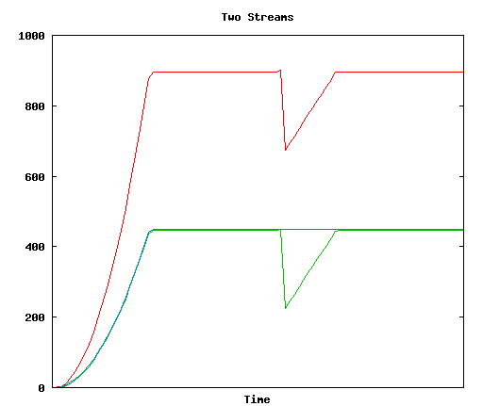
Parallel Streams

Slide 11
Cluster-to-cluster data transfer
GridFTP can do coordinated data transfer utilizing multiple computer nodes at source and destination
Node 1
Node 1
GridFTP
Control
node
GridFTP
Control
node
10x Gb/s
1 Gbit/s
1 Gbit/s
Node 2
Node 2
1 Gbit/s
1 Gbit/s
GridFTP
Data node
GridFTP
Data node
1 Gbit/s
1 Gbit/s
1 Gbit/s
1 Gbit/s
Node M
Node N
GridFTP
Data node
GridFTP
Data node
Cluster A
Cluster B
Notes:
If the network capacity between the source and destination clusters is greater than the data rate supported by each
computer at the clusters, GridFTP can be configured to use multiple computers at each end to drive data transfers

Slide 12
GridFTP usage
globus-url-copy - commonly used GridFTP client
Usage: globus-url-copy [options] srcurl dsturl
Conventions on URL formats:
file:///home/YOURLOGIN/dataex/largefile
a file called largefile on the local file system, in directory /home/YOURLOGIN/dataex/
gsiftp://osg-edu.cs.wisc.edu/scratch/YOURLOGIN/
a directory accessible via gsiftp on the host called osg-edu.cs.wisc.edu in directory /scratch/YOURLOGIN.
Notes:
Please note the triple slash: file:///home/etc…

Slide 13
GridFTP transfers using globus-url-copy
globus-url-copy
file:///home/YOURLOGIN/dataex/myfile
gsiftp://osg-edu.cs.wisc.edu/nfs/osgedu/YOURLOGIN/ex1
globus-url-copy
gsiftp://osg-edu.cs.wisc.edu/nfs/osgedu/YOURLOGIN/ex2
gsiftp://tp-osg.ci.uchicago.edu/YOURLOGIN/ex3
Notes:
First command will transfer the local file “myfile” to file “ex1” on the osg-edu.cs.wisc.edu machine.
The second command is an example of 3rd party tranfer (let’s assume that the user issues this command from workshop1.ci.uchicago.edu machine).
For more exercises, see the Data Management part of the lab http://www.ci.uchicago.edu/osgedu/schools/gridlab/data.html

Slide 14
Handling failures
GridFTP server sends restart and performance markers periodically
Restart markers are helpful if there is any failure
No need to transfer the entire file again
Use restart markers and transfer only the missing pieces
GridFTP supports partial file transfers
Globus-url-copy has a retry option
Recover from transient server and network failures
What if the client (globus-url-copy) fails in the middle of a transfer?

Slide 15
RFT = Reliable file transfer
GridFTP client that provides more reliability and fault tolerance for file transfers
Part of the Globus Toolkit
RFT acts as a client to GridFTP, providing management of a large number of transfer jobs (same as Condor to GRAM)
RFT can
keep track of the state of each job
run several transfers at once
deal with connection failure, network failure, failure of any of the servers involved.
Notes:
RFT: GridFTP client that provides more reliability and fault tolerance for file transfers.
Just as in the job submission section, we mentioned a facility, GRAM, for submitting jobs , and then another program, Condor, sitting on top of that that provides reliability. A similar situation in the data transfer context.
We have a component called RFT, the Reliable File Transfer service, which comes as part of the Globus Toolkit.
http://www.globus.org/toolkit/docs/4.0/data/rft/
RFT acts as a client to GridFTP, providing management of a large number of transfer jobs – RFT can keep track of the state of each job, run several transfers at once, deal with connection failure, network failure, failure of any of the servers involved.

Slide 16
RFT
Client
SOAP
Messages
Notifications
(Optional)
RFT
Persistent Store
Site A
Site B
Server
Server
Control channels
Data channel
Notes:
WS-RF compliant High Performance data transfer service
Soft state
Notifications/Query
Reliability on top of high performance provided by GridFTP
Fire and Forget
Integrated Automatic Failure Recovery
Network level failures
System level failures, etc.

Slide 17
Storage and Grid
Unlike compute/network resources, storage resources are not available when jobs are done
Release resource usage when done, unreleased resource need to be garbage collected
Need to enforce quotas
Need to ensure fairness of space allocation and scheduling

Slide 18
What is SRM?
Storage Resource Managers (SRMs) are middleware components
whose function is to provide
dynamic space allocation
file management on shared storage resources on the Grid
Different implementations for underlying storage systems are based on the same SRM specification
Notes:
Brief history will follow after this slide

Slide 19
Managing spaces
Negotiation
Client asks for space: Guaranteed_C, MaxDesired
SRM return: Guaranteed_S <= Guaranteed_C, best effort <= MaxDesired
Types of spaces
Access Latency (Online, Nearline)
Retention Policy (Replica, Output, Custodial)
Subject to limits per client (SRM or VO policies)
Lifetime
Negotiated: Lifetime_C requested
SRM return: Lifetime_S <= Lifetime_C
Reference handle
SRM returns space reference handle (space token)
Updating space
Resize for more space or release unused space
Extend or shorten the lifetime of a space

Slide 20
File Management
Assignment of files to spaces
Files can be assigned to any space, provided that their lifetime is shorter than the remaining lifetime of the space
Files can be put into an SRM without explicit reservation
Default spaces are not visible to client
Files already in the SRM can be moved to other spaces
By srmChangeSpaceForFiles
Files already in the SRM can be pinned in spaces
By requesting specific files (srmPrepareToGet)
By pre-loading them into online space (srmBringOnline)
Releasing files from space by a user
Release all files that user brought into the space whose lifetime has not expired

Slide 21
Transfer protocol negotiation
Negotiation
Client provides an ordered list of preferred transfer protocols
SRM returns first protocol from the list it supports
Example
Client provided protocols list: bbftp, gridftp, ftp
SRM returns: gridftp
Advantages
Easy to introduce new protocols
User controls which transfer protocol to use
How it is returned?
Transfer URL (TURL)
Example: bbftp://dm.slac.edu//temp/run11/File678.txt

Slide 22
Site URL and Transfer URL
Provide: Site URL (SURL)
URL known externally – e.g. in Replica Catalogs
e.g. srm://ibm.cnaf.infn.it:8444/dteam/test.10193
Get back: Transfer URL (TURL)
Path can be different from SURL – SRM internal mapping
Protocol chosen by SRM based on request protocol preference
e.g. gsiftp://ibm139.cnaf.infn.it:2811//gpfs/sto1/dteam/test.10193
One SURL can have many TURLs
Files can be replicated in multiple storage components
Files may be in near-line and/or on-line storage
In a light-weight SRM (a single file system on disk)
SURL may be the same as TURL except protocol

Slide 23
Directory management
Usual unix semantics
srmLs, srmMkdir, srmMv, srmRm, srmRmdir
A single directory for all spaces
No directories for each file type
File assignment to spaces is virtual

Slide 24
OSG & Data management
OSG relies on GridFTP protocol for the raw transport of the data using Globus GridFTP in all cases except where interfaces to storage management systems (rather than file systems) dictate individual implementations.
OSG supports the SRM interface to storage resources to enable management of space and data transfers to prevent unexpected errors due to running out of space, to prevent overload of the GridFTP services, and to provide capabilities for pre-staging, pinning and retention of the data files. OSG currently provides reference implementations of two storage systems the (BeStMan) and dCache

Slide 25
Storage Software used on OSG
dCache
Bestman with various backends (Lustre, Xrootd, hdfs, gpfs, cluster file system)

Slide 26
dCache
Allows space on nodes to be aggregated into a single namespace
Does not present a posix compliant file system yet
Supports tape backup systems for migrating infrequently used data to tape for nearline storage

Slide 27
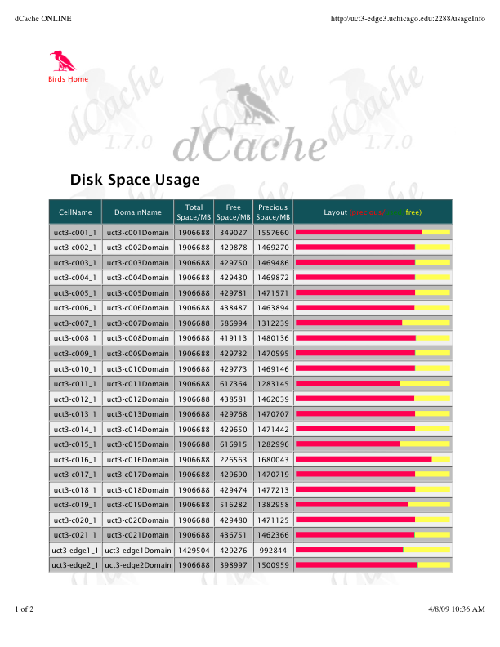
dCache Pool Usage
Space usage for the dCache pool on the tier 3 cluster at the University of Chicago. Each node contributes about 2TB of space

Slide 28
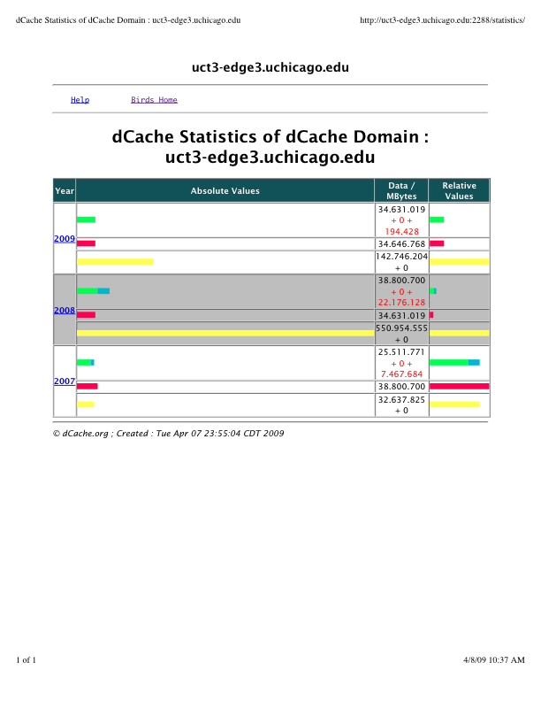
dCache Statistics
Annual statistics from the dCache pool at the tier 3 cluster at the University of Chicago.

Slide 29
Bestman
Bestman provides a srm gateway on top of a posix file system
Commonly used backends include (xrootd, hdfs, lustre, gpfs)
Simpler to configure and maintain then dCache
Doesn’t have all of the flexibility that dCache has

Slide 30
Comparison between Bestman and dCache
dCache has better support for some srm features (dynamic space reservation, replica management) and supports using a tape library as a backing store
dCache currently doesn’t have have a filesystem with posix semantics (need to use srm commands or dccp)
Bestman is easier to setup and maintain
Because Bestman is a shim layer on a filesystem, you can use your own solution as the backend filesystem (xrootd, hdfs, gpfs, lustre, etc.)
Both systems require several servers in order to have a production resource

Slide 31
dCache and Bestman usage on OSG
Primarily used by larger VOs
Heavy usage by CMS, ATLAS, CDF/Dzero
CMS is using dCache primarily but has been moving to bestman/xrootd or bestman/hdfs implementations
Tier 1 facilities (Fermilab and Brookhaven) are using dCache with tape libraries
Other resources use a mix of dCache and Bestman

Slide 32

Credits
Bill Allcock allcock@mcs.anl.gov
Ben Clifford benc@ci.uchicago.edu
Scott Koranda skoranda@uwm.edu
Alex Sim asim@lbl.gov

Slide 33
Directory Discovery
Notice anything odd when creating the directory on the clemson resource (osgce)?
condor_exec.exe: cannot create directory `/nfs/osgedu/train20': No such file or directory
The resource changed the location of the directory!
Problem with using fixed locations

Slide 34
A Solution
Luckily, the location of the data directory is available in an environment variable:
train20@vm-125-58:~/$ globus-job-run osgce.cs.clemson.edu/jobmanager-fork /bin/env | grep OSG_DATA
OSG_DATA=/export/osg/data
Let’s run the command again
globus-job-run osgce.cs.clemson.edu/jobmanager-fork /bin/mkdir /export/osg/osgedu/YOURNAME

