Slide 1
OSG Connect and Connect Client
Thursday, Part 1
Lauren Michael, CHTC

Slide 2
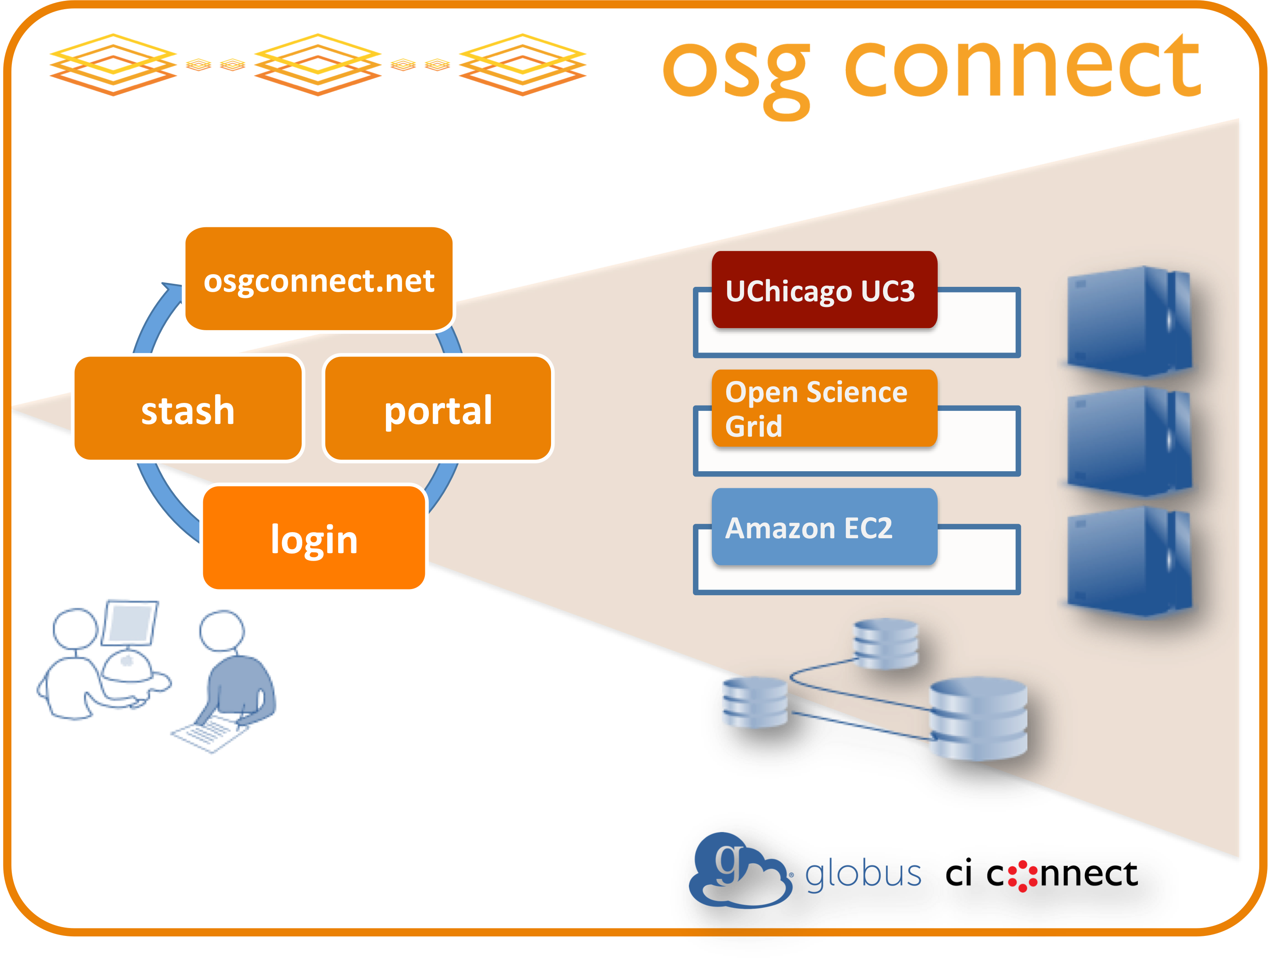
Overview
What is OSG Connect?
Using OSG Connect
Connect Client

Slide 3
Overview
What is OSG Connect?
Using OSG Connect
Connect Client

Slide 4
What is OSG Connect?
a OSG virtual organization (VO) for U.S. academics without a local VO
includes submit point, online guides, remote human support, some software, and data support

Slide 5
Review:
OSG Submit Points – 4 Ways
 | Local VO | OSG Connect | Connect Client | XSEDE
Available to | users with a campus/org VO | affiliates of U.S. research orgs | users of cluster with Connect Client | users with XSEDE allocation
Cost | unlikely | FREE | unlikely | FREE (but need allocation)
Limit on CPU hrs | unlikely | NO | NO | YES (per allocation)
Local Help | very likely (local staff) | unlikely | likely (cluster staff) | possibly* (Campus Champion)
Online Guides | likely | YES | YES | limited
Submit Point Type | submit server (or direct OSG entry server) | submit server to OSG entry server | cluster submit server to OSG entry server | submit server to OSG entry server
*not all XSEDE Campus Champions will have experience with HTC or OSG

Slide 6






OSG Connect Access Method:
HTCondor Pool
(or other type of Cluster)
Submit Server
Connect Client
OSG
(>120 sites)
Submit Server
OSG entry point
OSGConnect

Slide 7
Why OSG Connect?
not everyone has access to a local VO, or the means to establish one
(through the OSG User School, you have one!)
OSG via XSEDE requires an XSEDE account and allocation (limits CPU hours)
Tell colleagues who don’t have a local VO!

Slide 8
Overview
What is OSG Connect?
Using OSG Connect
Connect Client

Slide 9
Using OSG Connect
Get Access
Online Resources
  OSG Projects
Use the Submit Server
OSG Tools Supported by OSG Connect
  OSG Software
  Stash for large input (more later today)

Slide 10
Get Access
Account: http://osgconnect.net/signup
(you’ve already done this!)
Online resources: osgconnect.net
  including “helpdesk” online guides
Submit server: login.osgconnect.net

Slide 11
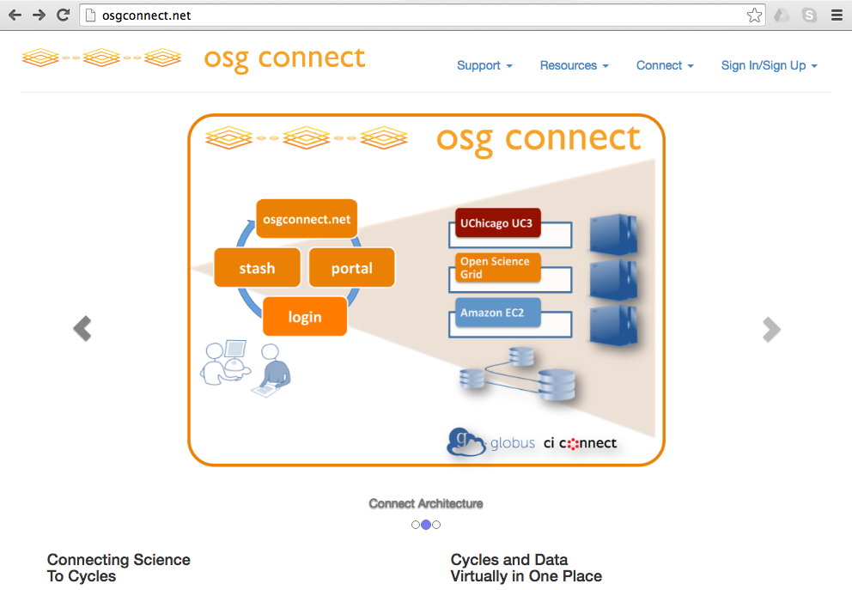
Online Resources

Slide 12
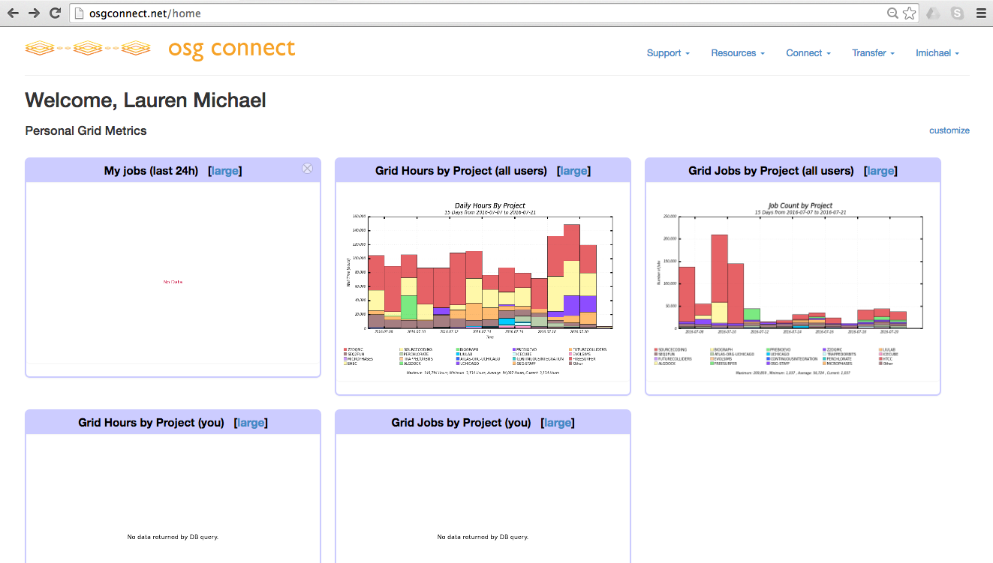
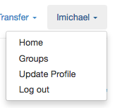
Your Home Page

Slide 13
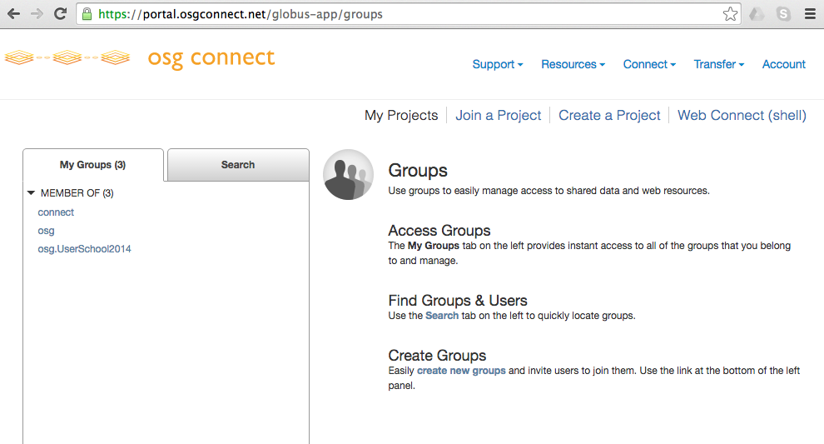
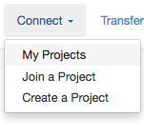
Your Projects

Slide 14
OSG Projects
Projects are how OSG accounts for resource usage by different research groups
  Your use of OSG via osg-learn.chtc.wisc.edu is automatically accounted for
Project managers can be a faculty PI or student representing the research group.
Via OSG Connect, you should always indicate a project in the submit file.

Slide 15
Projects After the School
For today’s exercises:
  +ProjectName = “UserSchool2016”
After the school, please create (or join) a new project before doing heavy computation from OSG Connect
  http://osgconnect.net/newproject (to create)
  http://osgconnect.net/project-summary (to join existing)

Slide 16
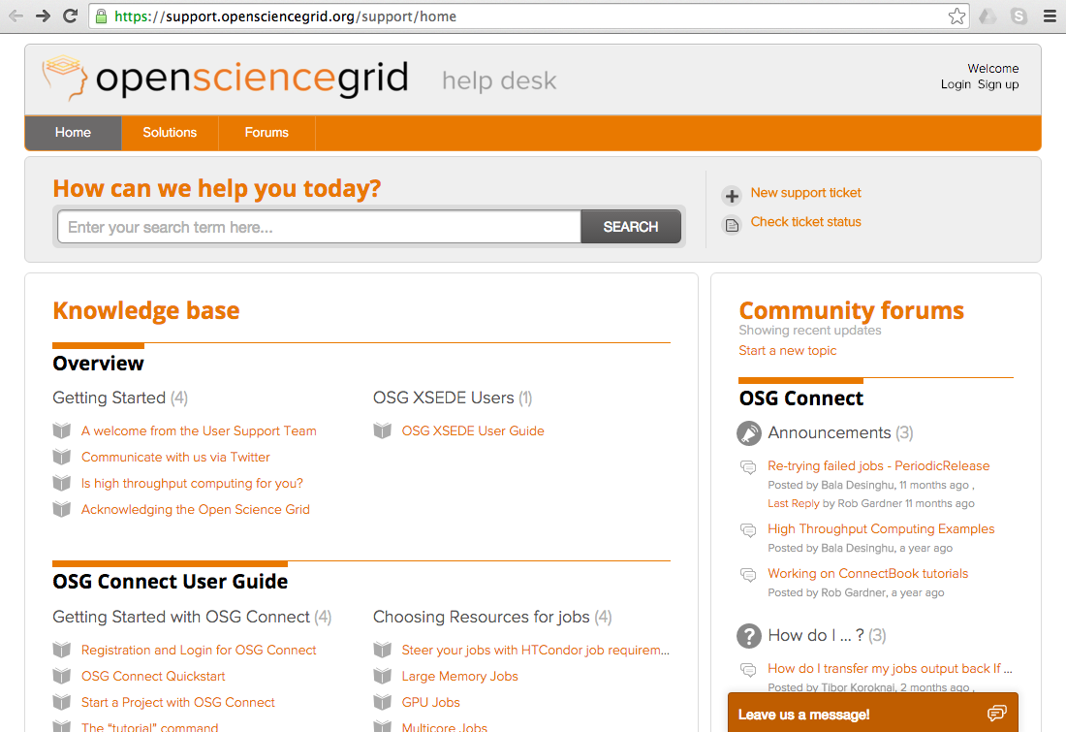
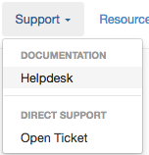
OSG help desk

Slide 17
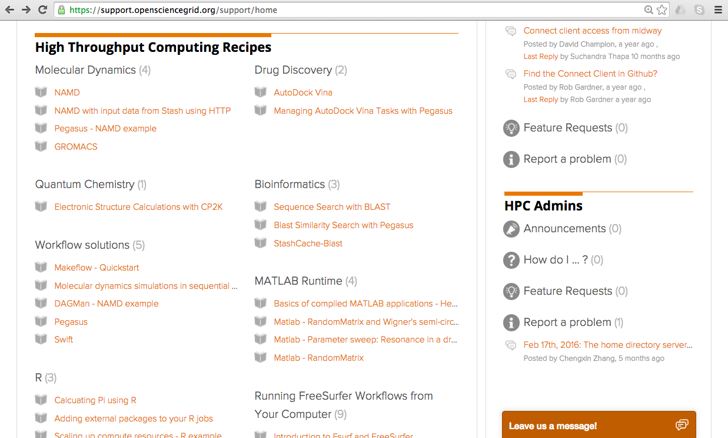
HTC Recipes

Slide 18
Tutorials
View list of tutorials on login.osgconnect.net:
$ tutorial
Load a tutorial to follow:
$ tutorial gromacs
Follow the steps!

Slide 19
Human help
new support ticket
chat or ticket

Slide 20
Using the Submit Point
SSH to: login.osgconnect.net
Use condor commands and submit files as usual!
  One exception: condor_status
  condor_status -pool osg-flock.grid.iu.edu

Slide 21
OSG Connect Access Method:
HTCondor Pool
(or other type of Cluster)
Submit Server
Connect Client
OSG
(>120 sites)
Submit Server
OSG entry point
OSGConnect

Slide 22
OSG Supported Software
OSG Connect maintains some software for all of OSG
  uses the “OASIS” data storage system (more details later today)
  available across ~90% of OSG sites
  requirements = (HAS_MODULES =?= true)
  use modules in jobs regardless of what OSG submit node you use!

Slide 23
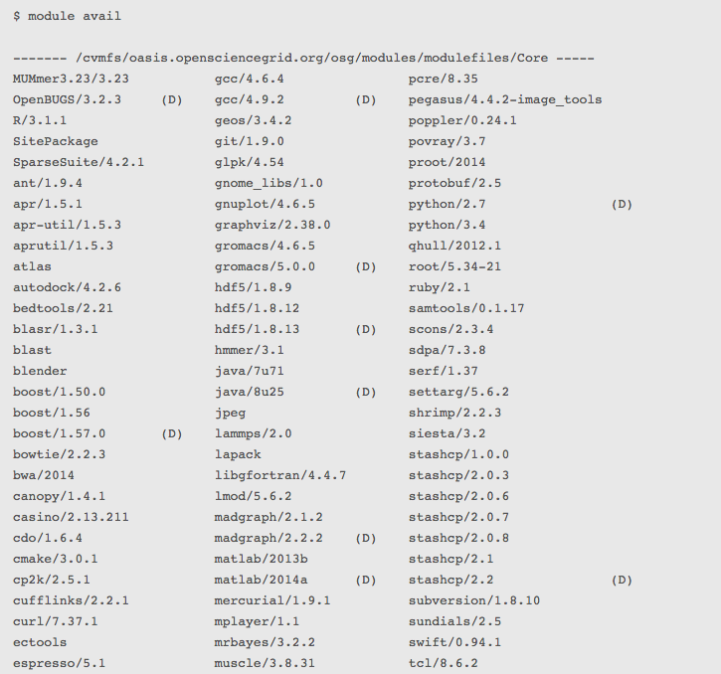
Check Software on OSG Connect

Slide 24
Software Modules in a Job
Activate modules:
. /cvmfs/oasis.opensciencegrid.org/osg/modules/lmod/current/init/bash
Load a software module:
module load modulename
List loaded modules:
module list
Unload a module (to prepare for another)
module unload modulename

Slide 25
Example: Check Python from login.osgconnect.net
$ module load python/2.7
$ module list
Currently Loaded Modules:
1) python/2.7
$ which python
/cvmfs/oasis.opensciencegrid.org/osg/modules/python-2.7.7/bin/python

Slide 26
Example: Python Wrapper Script
#!/bin/bash
# activate modules and load python2.7:
. /cvmfs/oasis.opensciencegrid.org/osg/modules/lmod/current/init/bash
module load python/2.7
# run my python script:
python myscript.py
# END

Slide 27
Using OSG Connect
Get Access
Online Resources
  OSG Projects
Use the Submit Server
OSG Tools Supported by OSG Connect
  OSG Software
  Stash for large input (more later today)

Slide 28
OSG Connect Exercises
1.1 Get acquainted with OSG Connect
1.2 Do the “OSG Connect Quickstart”
1.3 Run ‘Gromacs’ via the OASIS module
BONUS: submit jobs from osg-learn using other software in OASIS (matlab, python, etc)

Slide 29
Overview
What is OSG Connect?
Using OSG Connect
Connect Client

Slide 30
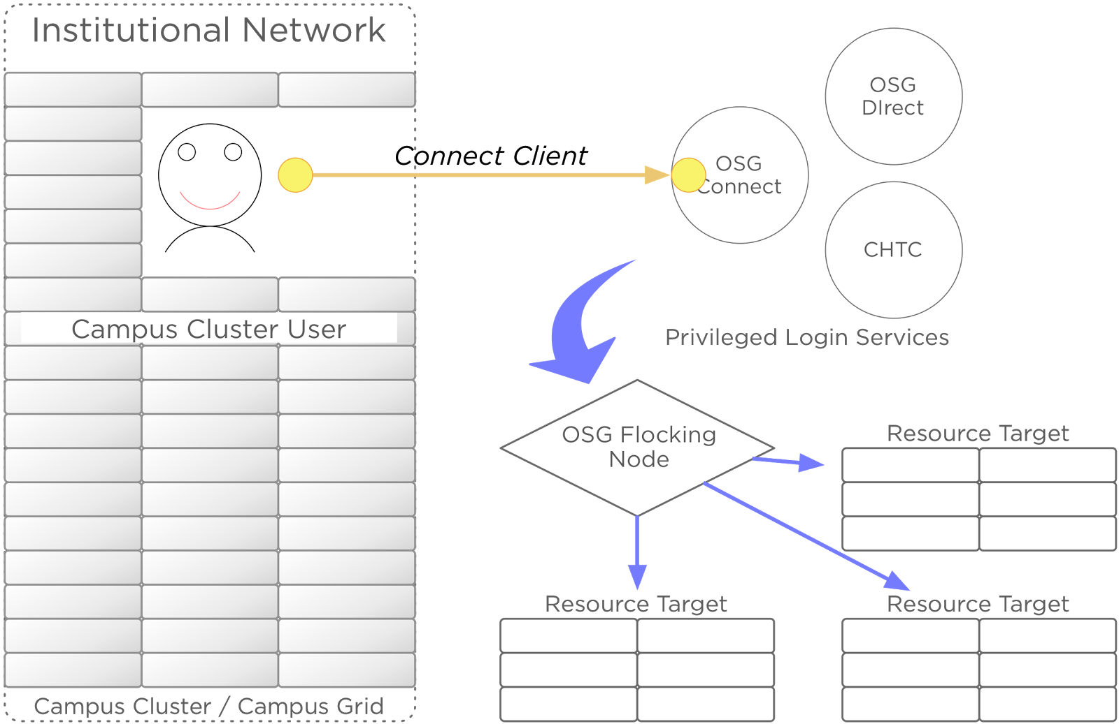
OSG’s Connect Client

Slide 31
OSG’s Connect Client
Clemson
Palmetto Cluster

Slide 32
OSG Connect Access Method:
HTCondor Pool
(or other type of Cluster)
Submit Server
Connect Client
OSG
(>120 sites)
Submit Server
OSG entry point
OSGConnect
Notes:
11) I think the submit node is the entry point.
12) Do we need to distinguish submit node and submit server? Probably calling submit node is fine I think

Slide 33
Connect Client Setup
Initial setup
connect setup
Show your accounting project(s), or set another
connect show-projects
connect project

Slide 34
Connect Client Commands
Some are just like condor commands
connect q
connect status
connect submit
connect rm
connect history
Submit files look the same!!

Slide 35
Job / Data Management
Monitor Job Activity
connect watch
connect histogram
Move data between local cluster server and OSG Connect
connect push / pull / sync
Full details in the help desk under “The Campus Connect Client”

Slide 36
Overview
What is OSG Connect?
Using OSG Connect
Connect Client

Slide 37
Questions?
Feel free to contact me:
  lmichael@wisc.edu
Next: OSG Connect Exercises
Later: Handling data in OSG

