Slide 1
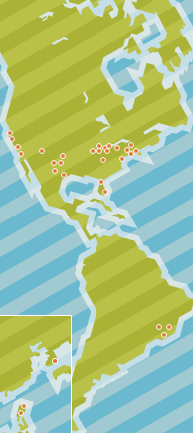
The Open Science Grid: Bringing the power of the Grid to scientific research
www.opensciencegrid.org

Slide 2
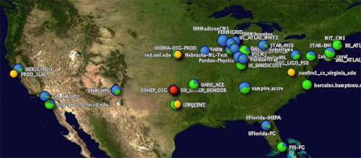
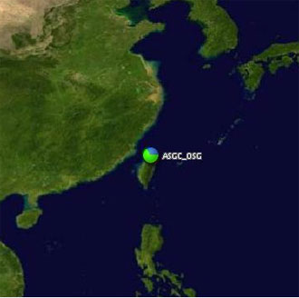
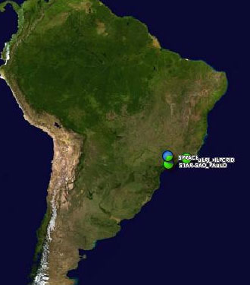
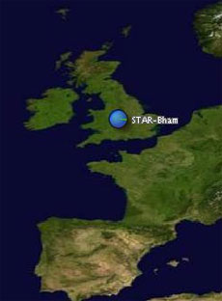
The Open Science Grid…
A distributed computing infrastructure for large-scale scientific research
Brings petascale computing and storage resources into a uniform grid computing environment
Integrates computing and storage resources from over 50 sites in the U.S. and beyond

Slide 3
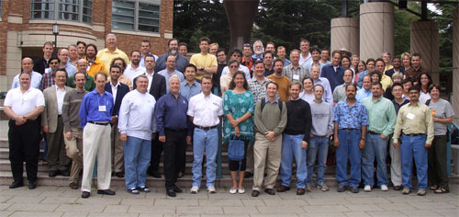
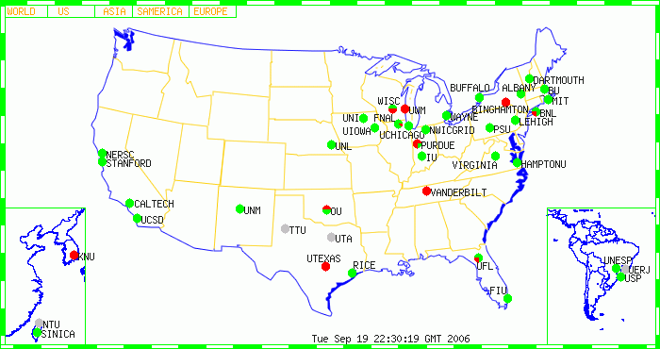
OSG Members
OSG welcomes new members, partners and collaborators.
OSG members today represent:
OSG Consortium Meeting, August 2006
Universities
National laboratories and computing centers
Scientific collaborations
Grid projects and alliances

Slide 4
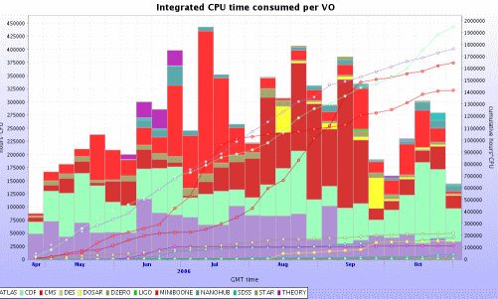
OSG News
OSG users have consumed over seven million hours of CPU time in 2006.

Slide 5
OSG Infrastructure
OSG sites provide computing or storage resources for grid users and a common infrastructure to access these resources.
Applications
Physics
Biology
Computer
science
Nanotech
Math
And more
Persistent Grid Infrastructure
User support center
Middleware providers
Certificate authorities
Service providers
Grid Operations Center
Database operators
Facilities
General
facility
for any
community
Laboratory
serving
multiple
communities
Community
facility
University
facility
Campus and
regional
grids

Slide 6
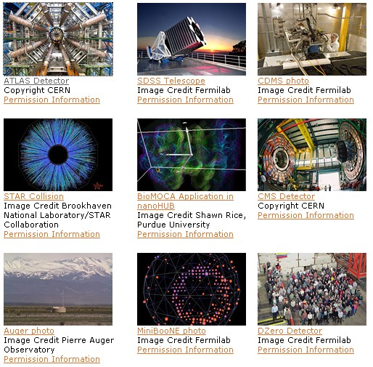
Using OSG Today
Applications run on
the OSG from
Astrophysics
Bioinformatics
Gravitational-wave physics
Mathematics
Nanotechnology
Nuclear and particle physics
And more…

Slide 7
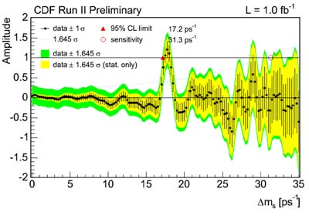
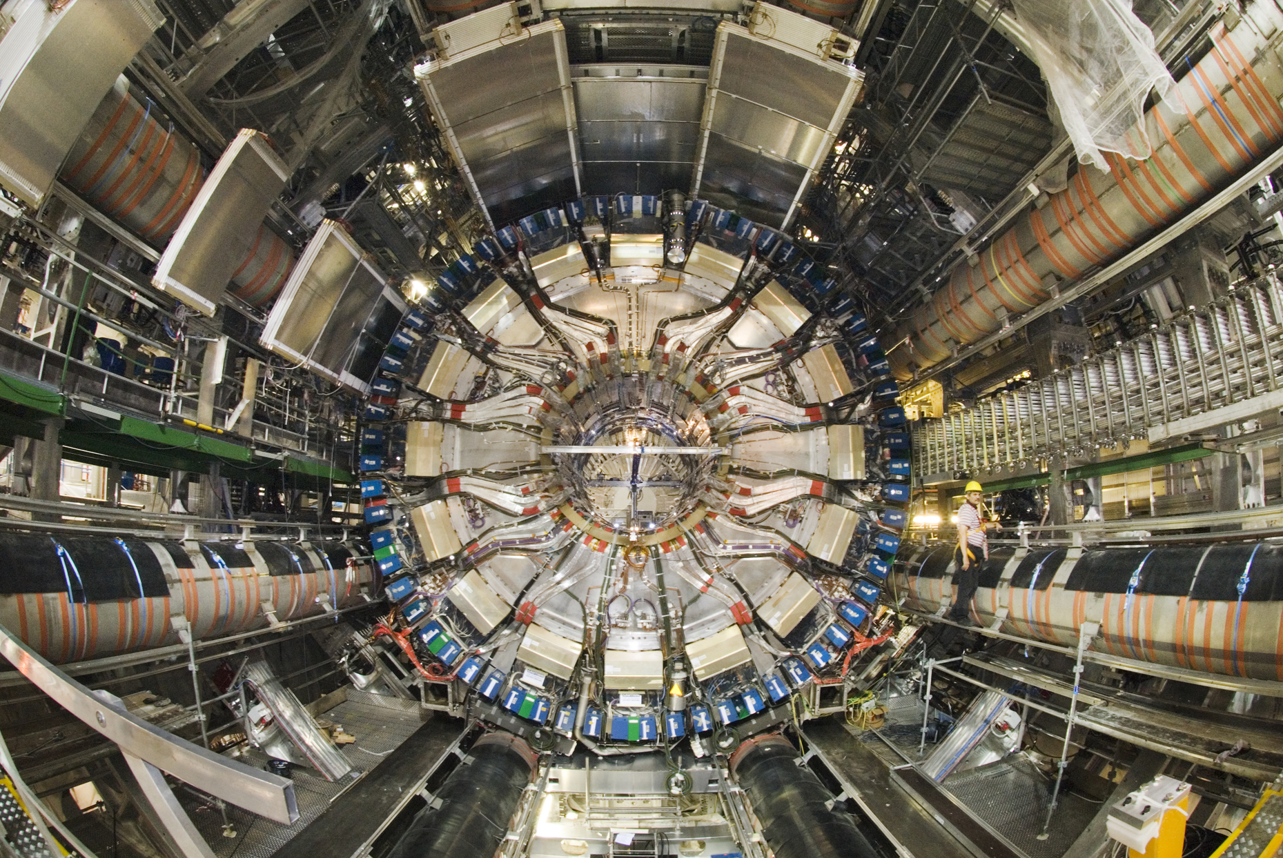
Used for Particle Physics
The ATLAS Collaboration
Will be searching for supersymmetry
The CDF Collaboration
Measuring the B_{s} meson
Central view of the ATLAS detector with its eight toroids around the calorimeter, before moving it in the middle of the detector. Image © CERN
A scan through matter - anti-matter oscillation frequencies for the B_{s} meson.

Slide 8
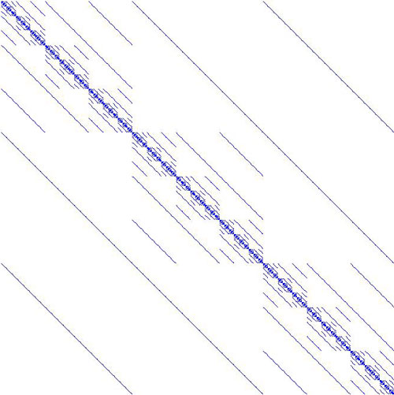
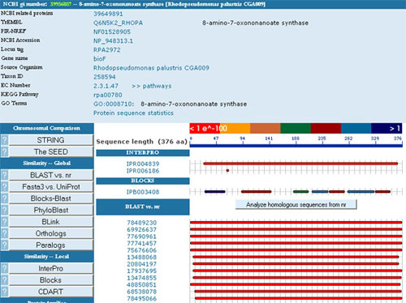
Used for Math and Biology
Genome Analysis and Database Update Supporting high-throughput genetic sequence analysis
Football Pool Problem
Solving a famous problem in
mathematical coding theory
Illustration of the football pool problem. Researchers look for the smallest set of columns of the matrix such that every row is covered by the set of chosen columns.
The PUMA2 application uses GADU to provide analysis of protein sequences.

Slide 9
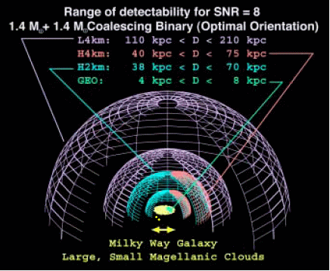
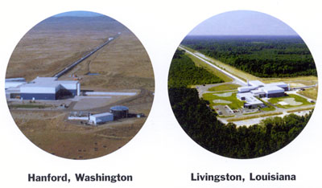
Used for General Relativity
The Laser Interferometer
Gravitational-Wave
Observatory (LIGO)
Detecting and measuring
cosmic gravitational waves
Studying general relativity as a manifestation of the curvature of space-time
Image illustrates sensitivity to Inspirals.
Image courtesy LIGO

Slide 10
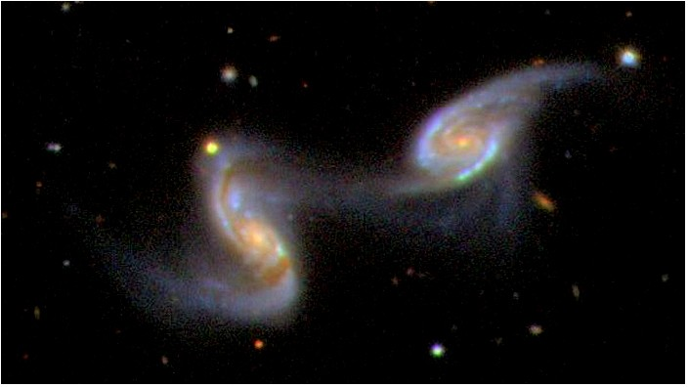
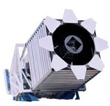
Used for Astronomy
SDSS, the Sloan Digital Sky Survey
Creating detailed optical images covering more than a quarter of the sky, and a 3-D map of about a million galaxies and quasars
NGC 5257 and 5258, two spiral galaxies in the constellation Virgo, are seen in the midst of a collision that has taken on the order of a billion years. Image courtesy SDSS
2.5-meter telescope on Apache Point, NM

Slide 11
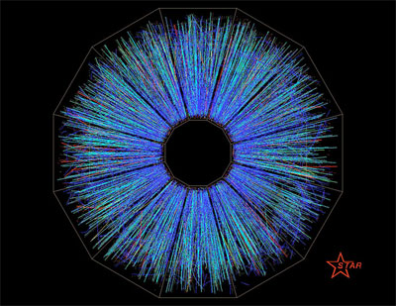
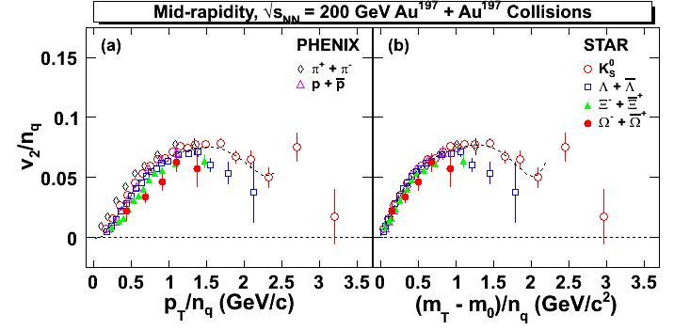
Used for Nuclear Physics
The STAR Collaboration Determining the properties of matter in the early universe
Collision of gold beams in the STAR detector. Image © Brookhaven National Laboratory
Preliminary STAR result shown at Hard Probes 2006 by Y. Lu, based on analysis of events transferred to China over the Grid.

Slide 12




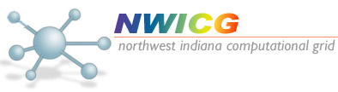

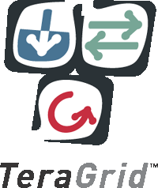


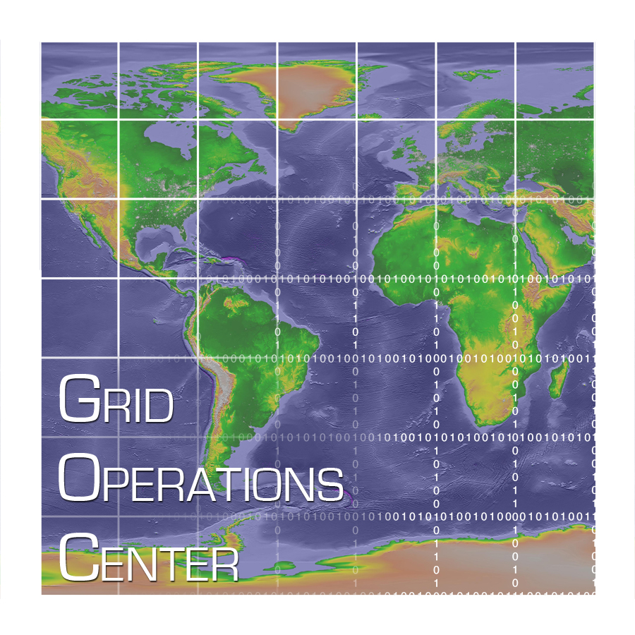

OSG Partners
TW Grid
Grid Laboratory of Wisconsin (GLOW)

