Slide 1
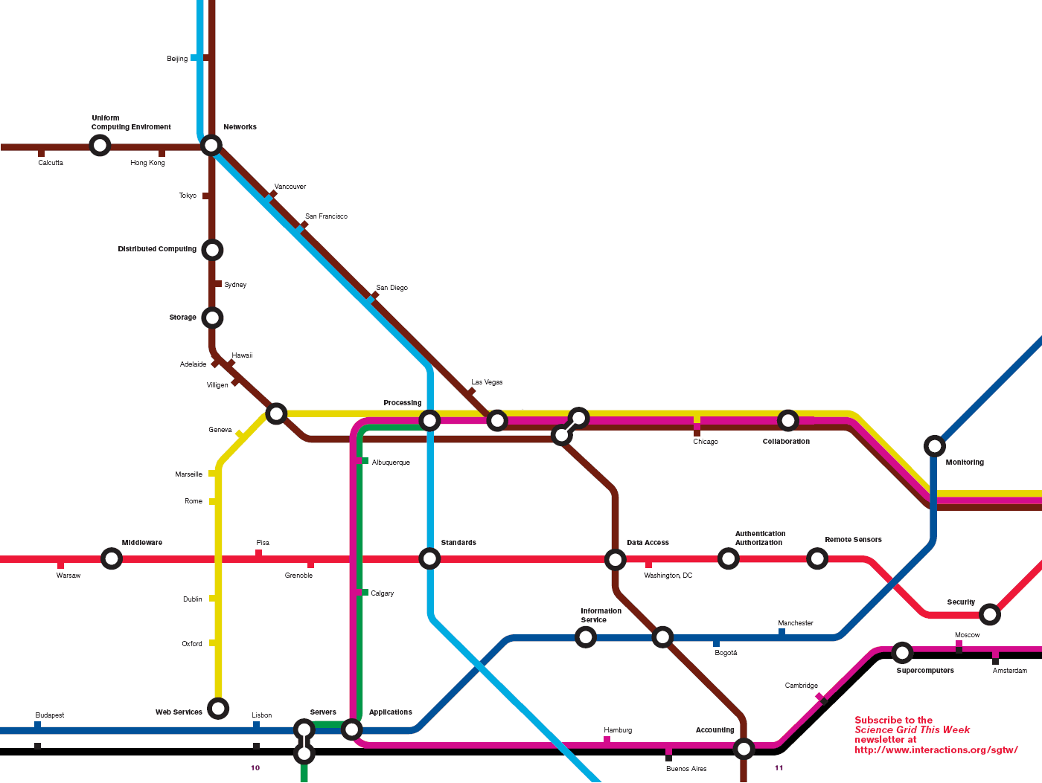
OSG at the Support Centers Meeting
Meet the Grid:

Slide 2
Our Meeting..
Get out of this meeting what You need to have OSG be a success for your organization, for You (merit increases..) and for the OSG.
goals to increase
the science.
  Status of our “lone” OSG VO user?
We succeed when we are
proactive about achieving the end result.
  Are there action items we should add here?

Slide 3
Ruth Pordes
What do I want out of it?
Achieve some deliverables
Action items for improvement and success
Communication, understanding, communication, understanding, comm

Slide 4


Slide 5
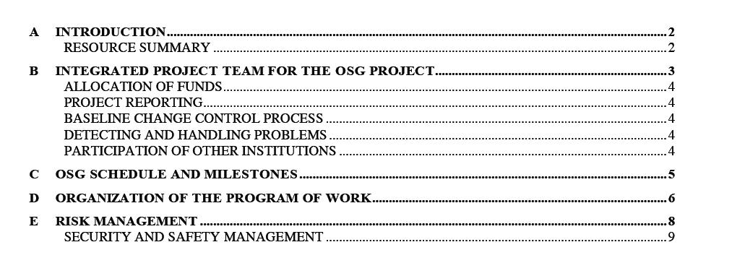
The situation for OSG:
Many experiments and groups contributing (Trillium still alive, base program, NMI, DISUN,SBIRs etc)
New OSG proposal at DOE SciDAC and NSF.
  We are asked for more information about how we will do our work: Project Execution Plan and WBS.
We are working with LIGO to increase our support for them and their engagement with OSG.
  What Does it take to support 500 LIGO jobs running on OSG?

Slide 6
The Project and The Consortium
Physics collaborations direct customers:
    STAR, LIGO, CDF, D0, LHC
Non-physics communities important collaborators:
    Nanohub, GRASE,
Campus and Regional Grids
    GRASE, GLOW, FermiGrid, TACC.
EGEE and TeraGrid.
The Lab facilities
The small universities
Community Support

Slide 7
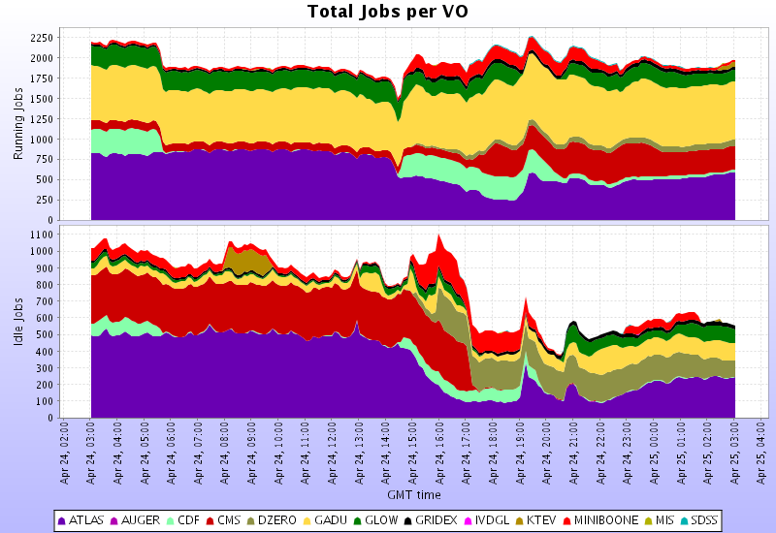
OSG 1 day last week:
Routed from Local UWisconsin Campus Grid
LHC
Bioinformatics
50 Clusters : used locally as well as through the grid
5 Large disk or tape stores
23 VOs
>2000 jobs running through Grid;
2000 running jobs
Run II
500 waiting jobs

Slide 8
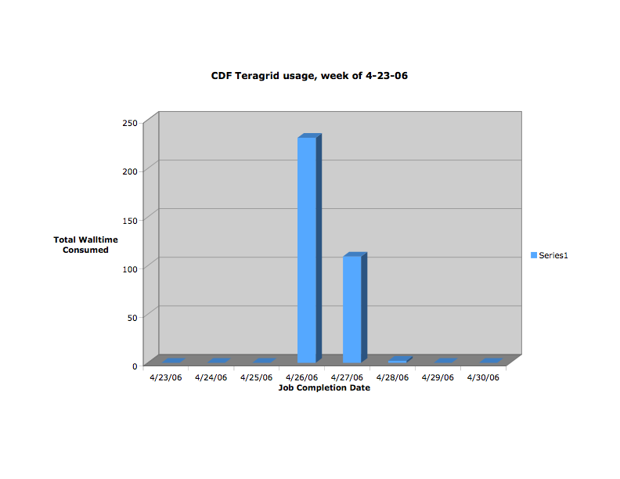
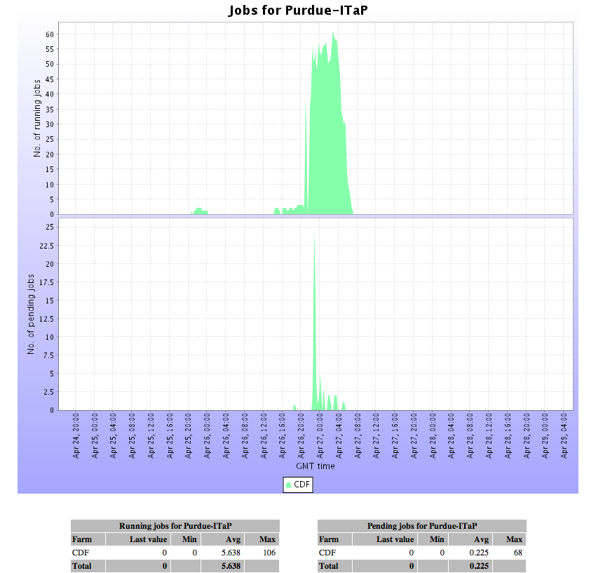
TeraGrid
Through high-performance network connections, TeraGrid integrates high-performance computers, data resources and tools, and high-end experimental facilities around the (US) country.
CDF MonteCarlo jobs running on Purdue TeraGrid resource; able to access OSG data areas and be accounted to both Grids.
http://www.nsf.gov/news/news_images.jsp?cntn_id=104248&org=OLPA

Slide 9



OSG - EGEE Interoperation for WLCG Jobs
VO UI
Data
Stores
VO RB
VO RB
VO RB
BDII
BDII
LDAP
URLs
SRM
SRM
T2
SRM
SRM
T2
SRM
T2
SRM
T2
SRM
T2
T2
T2
T2
T2
T2
Site
Site
GRAM
GRAM
GRAM
GRAM
GRAM
GRAM
GRAM
GRAM
GRAM
GRAM
Picture thanks to I. Fisk

Slide 10
Open Science Grid in 1 minute:
OSG Resources - use and policy under owner control. Clusters and storage shared across local, Campus intra-grid, Regional Grid and large federated Inter-Grids.
OSG Software Stack - based on Virtual Data Toolkit. Interfaces:
  Condor-G job submission interface;
  GridFTP data movement
  SRM storage management;
  Glue Schema V1.2; easy to configure GIPs;, CEMON coming in 3 months.
OSG Use - Register VO with with Operations Center; Provide
  URL for VOMS service - this must be propagated to sites.
  Contact for Support Center.
  Join operations groups.
OSG Job Brokering, Site Selection - no central or unique service.
  LIGO uses Pegasus;
  SDSS uses VDS;
  STAR uses Star-schedule;
  CMS uses EGEE-RB;
  ATLAS uses Panda;
  CDF uses CDF GlideCAF;
  D0 uses SAM-JIM;
  GLOW uses “condor-schedd on the side”.
  Nano-hub uses application portal.
OSG Storage & Space Management shared file systems; persistent VO application areas; SRM interfaces.
OSG Operations - Distributed including each VO, Campus Grid. Operations is also a WLCG ROC.
OSG Accounting & Monitoring -MonaLisa; can support rGMA; OSG meters/probes for Condor being released soon. US Tier-1s reporting monthly to WLCG APEL.

Slide 11
The Vision:
S
U
R
F
the Grid

Slide 12
Secure
Usable
Reliable
Fast

Slide 13
Secure:
Apply the NIST process:
Management - Risk assessment, planning, Service auditing and checking,
Operational - Incident response, Awareness and Training, Configuration management,
Technical - Authentication and Revocation, Auditing and analysis. End to end trust in quality of code executed on remote CPU -signatures?
Controls.
http://csrc.nist.gov/index.html

Slide 14
Usable: “me, my friends, the grid”
(Frank Wüerthwein)
(2)Lower Cost of User Entry:
Thin User Grid Interface
User Interface
(on my laptop)
  (3) Rich set of Virtual Organization Services.
Virtual Organization:
Services, Systems, Admins
Facility: Sites, Services & Admins
(1) Lower Cost of Resource Owner Entry:
Minimize software stack.

Slide 15
New Services coming in OSG
“Pull Mode” & Pilot Jobs just in time binding of job to site: (Panda, GlideCAF, Condor-C) VO downloaded executables subject to site authorization and security callouts/services. Use of gLITE GLEXEC.
Virtual Machine based Workspaces: VO/Globus workspaces encapsulate services.
Worker Nodes need not have access to the WAN; use of Condor Grid Connection Broker (GCB)
Resource Selection based on ClassAds & gLITE CEMON.
Move to WS GT4: Tests of WS Gram with CMS CRAB jobs sent Globus back to development table.Next MDS4.
Incremental upgrades where sensible. For HeadNodes (edge services) cleaner, we may make it a requirement, to replicate service and support both in parallel.
Accounting: Condor meter; possibility to share probes/meters with gLITE. Agreement on GGF Usage Record - needs extending. Joint EGEE, OSG, TeraGrid monthly phone-calls.

Slide 16
Digression..Accounting
What is an OSG Job?
Resources can be on Multiple Grids:
MyApplication
Job Submission
Condor-G
OSG
EGEE
Job Counted on OSG & EGEE

Slide 17
The Open in OSG
To Use
To Participation
To Contributions
To Getting Credit - don’t let us forget this one
(but not winning the lottery… sorry)

Slide 18
I am looking for help from this meeting!!

Slide 19
(2)Lower Cost of User Entry:
Thin User Grid Interface
User Interface
(on my laptop)
  (3) Rich set of Virtual Organization Services.
Virtual Organization:
Services, Systems, Admins
Facility: Sites, Services & Admins
(1) Lower Cost of Resource Owner Entry:
Minimize software stack.

Slide 20
(2)Lower Cost of User Entry:
Thin User Grid Interface
User Interface
(on my laptop)
  (3) Rich set of Virtual Organization Services.
Tools for the Facility
Admininistrators
Virtual Organization:
Services, Systems, Admins
Facility: Sites, Services & Admins
(1) Lower Cost of Resource Owner Entry:
Minimize software stack.

Slide 21
Support for the Users
(2)Lower Cost of User Entry:
Thin User Grid Interface
User Interface
(on my laptop)
  (3) Rich set of Virtual Organization Services.
Virtual Organization:
Services, Systems, Admins
Facility: Sites, Services & Admins
(1) Lower Cost of Resource Owner Entry:
Minimize software stack.

Slide 22
What do we do for these?
(2)Lower Cost of User Entry:
Thin User Grid Interface
User Interface
(on my laptop)
  (3) Rich set of Virtual Organization Services.
Virtual Organization:
Services, Systems, Admins
Facility: Sites, Services & Admins
(1) Lower Cost of Resource Owner Entry:
Minimize software stack.

Slide 23
Rick Thies
Better understanding of the grid process
Smooth process between Support Centers: Scale? Flow of problems - does everyone who needs to know get the info? Who “owns” a problem?
Please review the new RA with Doug O.

Slide 24
Doug Olson
Review and Education of what has been done by a smaller group.
Help us write training materials. List missing pieces. Assign people to help.
OSG RA.

Slide 25
Frederick Luehring
Community Support - how to sustain and move it forward.
Better define the OSG VO and its organization and support. What are the boundaries?
Documentation - something OSG can bring value to.
  List what is missing , what is wrong.
  Keeper of the documentation list
  Prioritize
  Resetablish energy of community support

Slide 26
Murali Ramsunder -
Working group for LIGO:
  Murali, Alain, Matt,Rob
  Write input to executive team.
LIGO CE needs: Doug, Murali, Rick
  Long lived
  Reduce overhead of getting them.
  Look at LIGO scripts that Scott wrote??
LIGO VOMS extensions: Murali, Igor
Software distribution - pick a subset like OSG. Can it b the same ? Can it be an OSG variant? Leigh, Rob, Murali

Slide 27
Stan Naymola
Understanding of OSG - what docs are missing?
Areas where might contribute
Keep a list of site adminsitrators tools - hear about, or think would be usefl.

Slide 28
Wayne Betts
Understanding of OSG.
Can we get STAR BNL site and help the other STAR sites reporting STAR jobs to ML?
Daily statistics from STAR-BNL
List of tools for site administrators.

Slide 29
David Skinner
How NERSC can implement OSG
Non-shell compute access, lightweight user interface
Worklload and performance characterisation

Slide 30
Steven Clark
Get Nanohub jobs running!
How to select sites from list. How do we tell the architecture?
  Ask Gabriele to solve this.
Job monitoring.
Authorization/Authentication
  Clear instructons of what should happen.
  Validate the information published.
Is there a nano hub web page with the status?

Slide 31
leigh grundhoefer

Slide 32
Shaowen Wang
CMS User Support & Troublehooting.
List of what is needed for Troubleshooting - Shaowen, RobG, Fred

Slide 33
Keith Chadwick
Write the first draft of the VO Management, admnistrator UP with the OSG (and by implciation with the sites) - Keith, Eric.
  VO to OSG? VO to VO or Site? Or…

Slide 34
John Rosheck
Responsible for the response time of ML.
For VORS development.
VOMS Monitor.
VO discovery service?

Slide 35
Neha Sharma
Make an SDSS , DES, Support Policy Page and astro twiki page.
How people are managing data on OSG?
Site selection tools. Get to 20 rather than 4 sites.

Slide 36
Nikolay Kuropatkin
Tools for application intetrfaces.
Expose site configurations - need unifomity at the applications layer.
Task force for running astro jobs - Nikolay, Rob Q
Web page to reflect attempt and “failures”
How do we know the policies at the sites and how many job slots are available? What file systems are available?

Slide 37
Alain Roy -
Read VDT To Do List
The is the mechanism for knowing what the s/w stack will have.
Alain promises to keep it up to date weekly.

Slide 38
Eric Shook
Make all GROW pages and policies.
Up to date list of security contacts for ITB and Production.
Access to registration database? What is the restriction here? Do Support Center Contacts get more access? Does Eric really want a list of the Support Center contacts?
  Available through VORS?
Make a list of info needed for the Support Center contact - Go through use cases - Eric, Leigh
Check the list of what a support center does

Slide 39
Ransom Briggs
SRM storage services.
SRM/dCache - password file? UIDs etc?
SRM/DRM service readiness plan and ITB path.

Slide 40
Anand Padmanabhan
SRM/dCache
SRM/DRM
GIPs
CMS Usage information.
Best practice between Support cente rand Site

Slide 41
John R. Hover

Slide 42
Jason Smith
Interaction between ATLAS, ATLAS Support Center and OSG for specific activities and events, including the integration testbed and testing.
What is engagement of support centers for this?

Slide 43
Mark L. Green

Slide 44
In-Saeng Suh
Learning about OSG, VDT, register etc.

Slide 45
David Meyers (video)

Slide 46
Rob Gardner
Integration Program of work
VO - OSG support center interaction for ATLAS, C-CI at Chicago,

Slide 47
Kevin Colby
Accounting for Nanohub
NW Indiana computational grid Support Center?

Slide 48
Burt Holzman (Video)

Slide 49
Matthew Norman

Slide 50
Igor Sfiligoi

Slide 51
Jason Temple
TACC -
????
Special LSF setup. This is like SLAC.
Can TACC test Gratia? Grid accounting/
Why does GADU not respond? Dina?
List of TACC issue - Jason, Ruth

Slide 52
Steve Gallo
Application and resource validation and tracking.
Steve, Alain, Leigh - please talk!

Slide 53
John Hicks

Slide 54
Horst Severini

