Slide 1
Internet2/OSG update
Rich Carlson
rcarlson@internet2.edu
May 14, 2009

Slide 2
Internet2/OSG
perfSONAR based servers deployed at USATLAS (T1, T2, T3), USCMS (T1, T2)
Regularly scheduled throughput tests from BNL (usatlas-T1) to Tier2 sites
Finishing up documentation tasks to allow other sites to enable scheduled testing
New server code scheduled for release in May/June
http://dc211.internet2.edu/cgi-bin/perfSONAR/serviceList.cgi

Slide 3
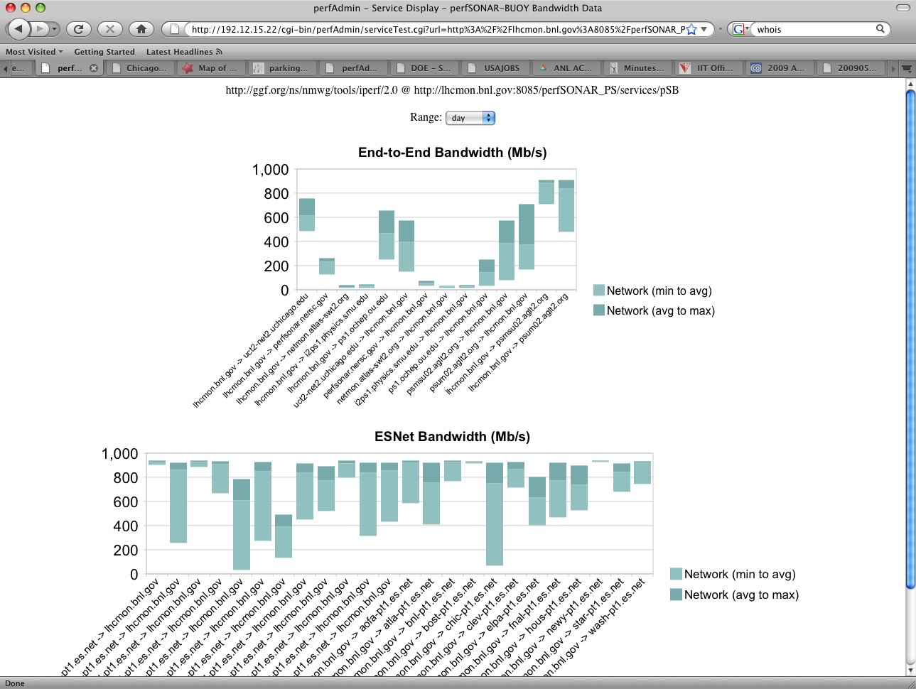

Sample Plot using perfSONAR data
Graph by Jay Packard (BNL)

Slide 4
perfSONAR Distribution
Source files
RedHat based RPM
  http://software.internet2.edu/
Bootable CD ISO image
Client code in VDT – coming soon

