Slide 1
Distributed Storage
Rob Quick <rquick@iu.edu>
Indiana University
Slides courtesy of
Derek Weitzel <dweitzel@cse.unl.edu>
University of Nebraska – Lincoln

Slide 2
Outline
Storage Patterns in Grid Applications
Storage Architecture for Grid Sites
Strategies for Managing Data
Reliability and the Cost of Complexity
Prestaging Data on the OSG
Advanced Data Management Architectures

Slide 3
Storage Patterns
There are many variations in how storage is handled.
Not only variations from different workflows, but even within a workflow.
Important: Pick a proper storage strategy for your application

Slide 4
Common Storage Patterns
I’m going to highlight a few of the storage patterns seen at Grid sites.
It’s important to note that moving files around is relatively easy. The hard part of storage management are large datasets and error cases.

Slide 5
Usage Patterns
Ask yourself, for each job:
  Events in a job’s life:
    INPUT: What should be available when the job is starting?
    RUNTIME: What data are needed while the job runs?
    OUTPUT: What output is produced?
  Important quantities:
    FILES: How many files?
    DATA: How big is your dataset? How big is the sum of all the files?
    RATES: How much data is consumed on average? At peak?

Slide 6
Why we care about quantities?
FILES: How many files?
  Many file systems cannot handle lots of small files
DATA:
  How much space do you need on the file server to store the input? Output?

Slide 7
Why we care about quantities?
RATES: How much data is consumed on average? At peak?
  Even professionals have a hard time figuring this out
  Rates determine how you should stage your data (talk about staging shortly)

Slide 8
Examples of Storage Usage
Simulation
  Small input, big output
Searches
  Big input, small output
Data processing
  About the same input and output
Analysis
  Big input, small output

Slide 9
Simulation
Based on different input configurations, generate the physical response of a system.
  Input: The Grid application must manage many input files; one per job.
  Runtime: An executable reads the input and later produces output. Sometimes, temporary scratch space is necessary for intermediate results.
  Output: These outputs can be small [KB] (total energy and configuration of a single molecule) or large [GB] (electronic readout of a detector for hundreds of simulated particle collisions).
    “Huge” outputs [TB] are currently not common in Grid applications.

Slide 10
Searches
Given a database, calculate a solution to a given problem.
  Input: A database (possibly several GB) shared for all jobs, and an input file per job.
  Runtime: Job reads the configuration file at startup, and accesses the database throughout the job’s runtime.
  Output: Typically small (order of a few MB); the results of a query/search.

Slide 11
Data Processing
Transform dataset(s) into new dataset(s). The input dataset might be re-partitioned into new logical groupings, or changed into a different data format.
  Input: Configuration file; input dataset
  Runtime: Configuration is read at startup; input dataset is read through, one file at a time. Scratch space used for staging output.
  Output: Output dataset; similar in size to the input dataset.

Slide 12
Analysis
Given some dataset, analyze and summarize its contents.
  Input: Configuration file and data set.
  Runtime: Configuration file is read, then the process reads through the files in the dataset, one at a time (approximately constant rate). Intermediate output written to scratch area.
  Output: Summary of dataset; smaller than input dataset.

Slide 13
OSG Storage Patterns
Just as we want to identify common successful patterns, we want to identify common patterns that are unsuccessful on OSG.
  Files larger than >5GB.
  Requiring a (POSIX) shared file system.
  Lots of small files (more than 1 file per minute of computation time).
  Jobs consuming more than 10GB per hour, or needing scratch space more than 5GB.
  Locking, appending, or updating files.
When using OSG resources opportunistically, the effective limitations may be even more restrictive than above.

Slide 14
Exercise to help identify problems
Remember, we want to identify:
  Input data – How much data is needed for the entire workflow?
  Working set – How much data is needed to run 1 unit of work? Including possible temporary files.
  Output data – How much data is output to the workflow.

Slide 15
Questions?
Questions? Comments?
  Feel free to ask us questions

Slide 16
Lecture 2: Using Remote Storage Systems
Rob Quick<rquick@iu.edu>
Slides courtesy of
Derek Weitzel <dweitzel@cse.unl.edu>

Slide 17
Storage Architectures on the OSG
Let’s look at how storage is structured on the OSG.
This will give you an idea of where the bottlenecks can be.
Can also help when forming data solutions on your own.

Slide 18
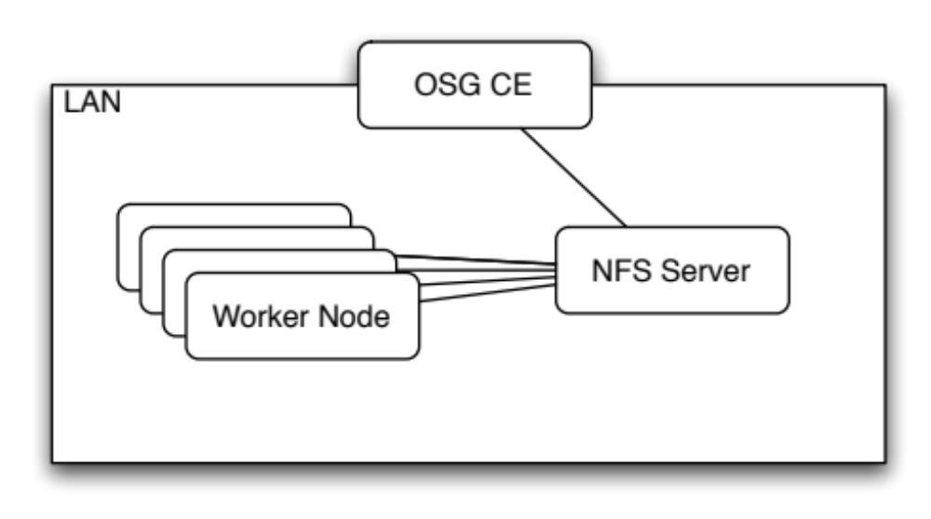
Original Storage at OSG CEs
All OSG sites have some kind of shared, POSIX-mounted storage (typically NFS).* This is almost never a distributed or high-performance file system
This is mounted and writable on the CE.*
This is readable (sometimes read-only) from the OSG worker nodes.
*Exceptions apply; Sites ultimately decide

Slide 19
Why Not?
This setup is called the “classic SE” setup, because this is how the grid worked circa 2003.
  Why didn’t this work?
Scalability issues.
High-performance filesystems not reliable or cheap enough.
Difficult to manage space.

Slide 20
Storage Elements
In order to make storage and transfers scalable, sites set up a separate system for storage (the Storage Element).
Most sites have an attached SE, but on wide range of scales.
These are separated from the compute cluster; normally, you interact it via a get or put of the file.
  Not necessarily POSIX.

Slide 21
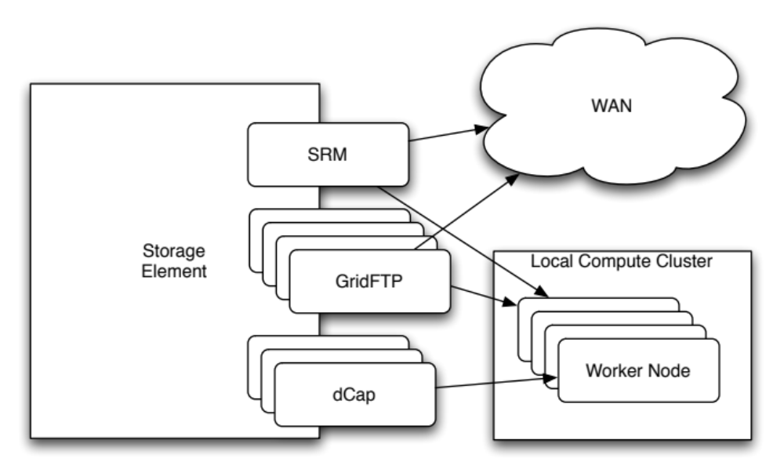
Storage Elements on the OSG
User point of View

Slide 22
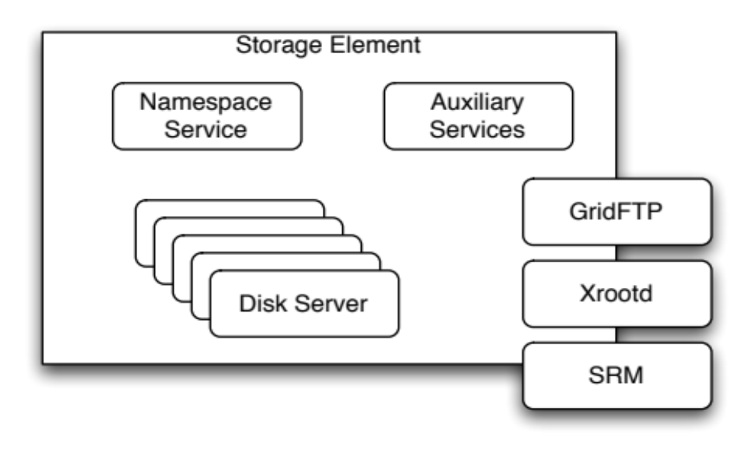
SE Internals
Only care about

Slide 23
GridFTP in One Slide
A set of extensions to the classic FTP protocol.
Two most important extensions:
  Security: Authentication, encryption, and integrity provided by GSI/X509. Use proxies instead of username/password.
  Improved Scalability: Instead of transferring a file over one TCP connection, multiple TCP connections may be used.

Slide 24
SRM
SRM = Storage Resource Management
SRM is a web-services-based protocol for doing:
  Metadata Operations
  Load-balancing
  Space management
This allows us to access storage remotely, and to treat multiple storage implementations in a homogeneous manner.

Slide 25
Data Access Methods
A few common approaches to implementing solutions:
  Job Sandbox
  Prestaging
  Caching
  Remote I/O
A realistic solution might combine multiple methods.
Descriptions to follow discuss common cases; there are always exceptions or alternates.

Slide 26
Job Sandbox
Data sent with jobs.
The user generates the files on the submit machines.
These files are copied from submit node to worker node.
  With Condor, a job won’t even start if the sandbox can’t be copied first. You can always assume it is found locally.

Slide 27
Prestaging
Data placed into local SE where the jobs are run.
By increasing the number of locations of the data and doing intelligent placement, we increase scalability.
  In some cases, prestaging = making a copy at each site where the job is run.
  Not always true; a single storage element may be able to support the load of many sites.

Slide 28
Caching
A cache transparently stores data close to the user jobs. Future requests can be served from the cache.
  User must place file/object at a source site responsible for keeping the file permanently. Cache must be able to access the file at its source.
  Requesting a file will bring it into the cache.
  Once the cache becomes full, an eviction policy is invoked to decide what files to remove.
  The cache, not the user, decides what files will be kept in the cache.

Slide 29
Remote I/O
Application data is streamed from a remote site upon demand. I/O calls are transformed into network transfers.
  Can be done transparently so the user application doesn’t know the I/O isn’t local.
  Typically, only the requested bytes are moved.
Can be effectively combined with caching to scale better.

Slide 30
Scalability
For each of the four previous methods (sandboxes, prestaging, caching, remote I/O), how well do they scale?
Depends on:
  How big are the data sets?
  What resources are consumed per job?

Slide 31
The Cost of Reliability
For each of the four previous methods, what must be done to create a reliable system? Depends on:
  What recovery must be done on failures?
    What must be done manually?
    Ideally, want to automate failure recovery as much as possible

Slide 32
Prestaging Data on the OSG
Prestaging is currently the most popular data management method on the OSG, but requires the most work.
  Requires a transfer system to move a list of files between two sites. Example systems: Globus Online, Stork, FTS.
  Requires a bookkeeping system to record the location of datasets. Examples: LFC, DBS.
  Requires a mechanism to verify the current validity of file locations in the bookkeeping systems.

Slide 33
Previous example
In the first exercise, you formulated a data plan for BLAST.
Now, you are going to implement the data movement of blast using pre-staging.

Slide 34
Lecture 3: Caching and Remote I/O
Horst Severini <severini@ou.edu>
Slides courtesy of
Derek Weitzel <dweitzel@cse.unl.edu>

Slide 35
HTTP Caching is easy on the OSG
Widely deployed caching servers (required by other experiments)
Tools are easy to use
  curl, wget
Servers are easy to setup
  Just need http server, somewhere

Slide 36
HTTP Caching
In practice, you can cache almost any URL
Sites are typically configured to cache any URL, but only accept requests from WN’s
Sites control the size and policy for caches, keep this in mind

Slide 37
HTTP Caching - Pitfalls
curl – Have to add special argument to use caching:
  curl -H "Pragma:” <url>
Services like Dropbox and Google Docs explicitly disable caching
  Dropbox: cache-control: max-age=0
  Google Docs: Cache-Control: private, max-age=0

Slide 38
HTTP Caching
The HTTP protocol is perhaps the most popular application-layer protocol on the planet.
Built-in to HTTP 1.1 are elaborate mechanisms to use HTTP through a proxy and for caching.
There are mature, widely-used command-line clients for the HTTP protocol on Linux.
  Curl and wget are the most popular; we will use wget for the exercises.
    Oddly enough, curl disables caching by default.

Slide 39
HTTP Caching: What do you need?
All you need is a public webserver… somewhere.
Will pull down files to the worker node through squid cache.

Slide 40
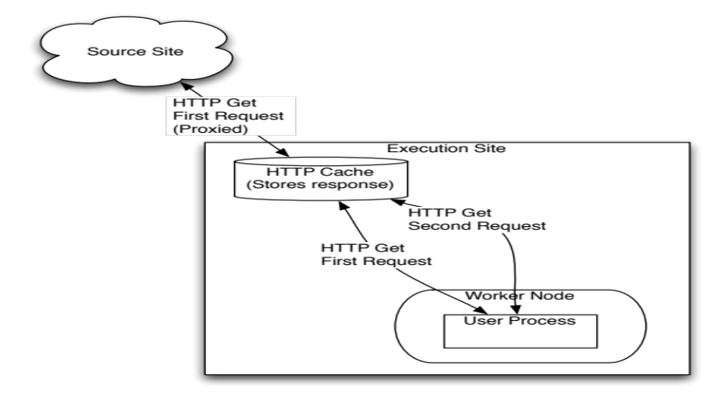
HTTP Cache Dataflow
For this class, we will use:
Source site: osg-ss-submit.chtc.wisc.edu
HTTP cache: osg-ss-se.chtc.wisc.edu

Slide 41
Proxy Request
Here’s the HTTP headers for the request that goes to the proxy osg-ss-se.cs.wisc.edu:
GET http://osg-ss-submit.chtc.wisc.edu/~dweitzel/stuff.html HTTP/1.0
User-Agent: Wget/1.11.4 Red Hat modified
Accept: */*
Host: osg-ss-submit.chtc.wisc.edu

Slide 42
Proxy Request
Response:
HTTP/1.0 200 OK
Date: Tue, 19 Jun 2012 22:53:26 GMT
Server: Apache/2.2.3 (Scientific Linux)
Last-Modified: Tue, 19 Jun 2012 21:26:56 GMT
ETag: "136d0f-59-4c2d9f120e800"
Accept-Ranges: bytes
Content-Length: 89
Content-Type: text/html; charset=UTF-8
X-Cache: HIT from osg-ss-se.chtc.wisc.edu
X-Cache-Lookup: HIT from osg-ss-se.chtc.wisc.edu:3128
Via: 1.0 osg-ss-se.chtc.wisc.edu:3128 (squid/2.6.STABLE21)
Proxy-Connection: close

Slide 43
HTTP Proxy
HTTP Proxy is very popular for small VO’s
Easy to manage, easy to implement
Highly recommend HTTP Proxy for files less than 100MB

Slide 44
Now on to Remote I/O
Do you only read parts of the data (skip around in the file?)
Do you have data that is only available on the submit host?
Do you have an application that requires a specific directory structure?

Slide 45

Remote I/O is for you

Slide 46
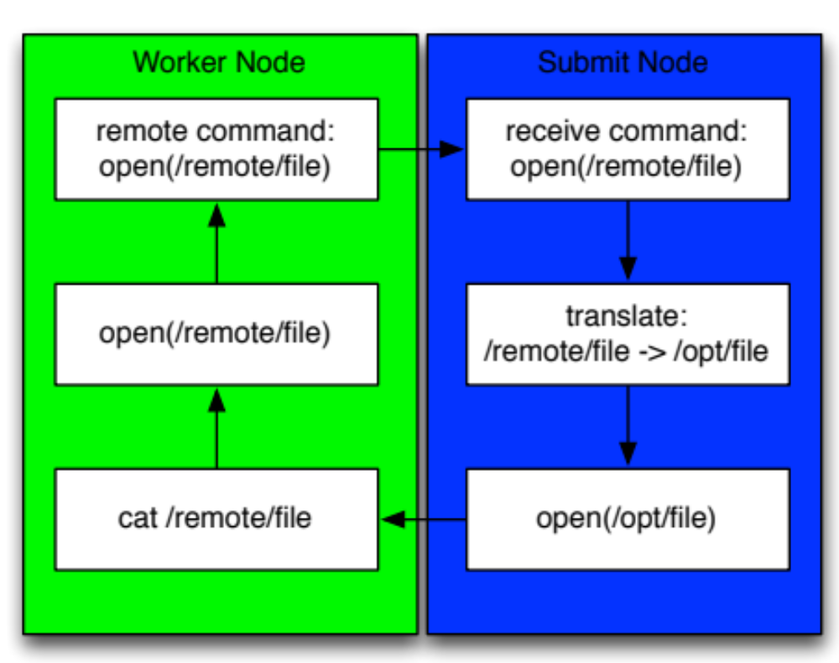
Remote I/O

Slide 47

Remote I/O
We will perform Remote I/O with the help of Parrot from ND.
It redirects I/O requests back to the submit host.
Can ‘pretend’ that a directory is locally accessible.

Slide 48
Examples of Remote I/O
What does Remote IO look like in practice?
submit host:
$ echo “hello from submit host” > newfile
script on the worker node (in Nebraska?)
$ cat /chirp/CONDOR/home/dweitzel/newfile
hello from submit host
$

Slide 49
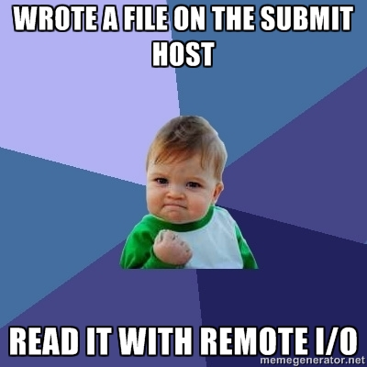
Celebrate!

Slide 50
Downsides of Remote I/O
What are some downsides to
Remote I/O?
All I/O goes through the submit host.
Distributed remote I/O is hard (though can be done, see XrootD)

