Slide 1
Overview
Resource & Project Management
Current Initiatives
  Establish stronger linkage (traceability) for OSG Work program to WLCG and other experiments
  Financial Report for period ending Dec 31, 2007
  Launch Area Coordinators Meeting
  Process FWPs for DOE funding for year3
Accomplishments Since Last Report
  Completed Finance Board Meeting on Nov 2 and published report
  Coordinated the production of 1st Area Coordinators Report for 4Q2007
  Baselined year2 WBS and started monthly status updates
  Achieved >75% SOWs approved within OSG
  Coordinated logistics for NSF/DOE Joint OSG Review
Issues / Concerns
  Need quality review of opportunistic resources management process (authored by Kent Blackburn)
  Internal obstacles to setting up sub-contract to Clemson and Nebraska (need to check with Wisconson – may have recently been resolved?)
  We are staff limited on WBS 5.5.5 (external projects) due to other priority tasks within OSG; falling farther behind on this work
  Establishing a strong WBS connection to WLCG and other experiments will require significant getting started effort in OSG and depends on pro-active help from the science communities

Slide 2
WBS
Resource & Project Management
WBS | Agency | TaskName | Start | Finish | %Complete
5.4 | No | Resource Management | 10/01/07 | 09/30/08 | 28%
5.4.1 | No | Develop & Implement new procedure for SOW approvals to achieve >75% SOWs processed by 11/15/07 | 10/01/07 | 11/15/07 | 100%
5.4.2 | No | Execute and support current change request process, as needed | 10/01/07 | 09/30/08 | 25%
5.4.3 | No | Quarterly financial reports | 10/01/07 | 09/30/08 | 25%
5.4.4 | No | Maximize use of resources needed by VOs to the satisfaction of the stakeholders | 10/01/07 | 09/30/08 | 25%
5.5 | No | Project Administration | 10/01/07 | 09/30/08 | 18%
5.5.1 | No | Baseline year2 WBS 11/1/2007 | 10/01/07 | 11/13/07 | 100%
5.5.2 | No | Execute monthly WBS status updating | 10/01/07 | 09/30/08 | 25%
5.5.3 | No | Execute quarterly PI reporting | 10/01/07 | 09/30/08 | 25%
5.5.4 | No | Execute quarterly Area Coordinator Reporting | 10/01/07 | 09/30/08 | 0%
5.5.5 | No | Keep list of external project dependencies and track deliverables | 10/01/07 | 09/30/08 | 10%

Slide 3
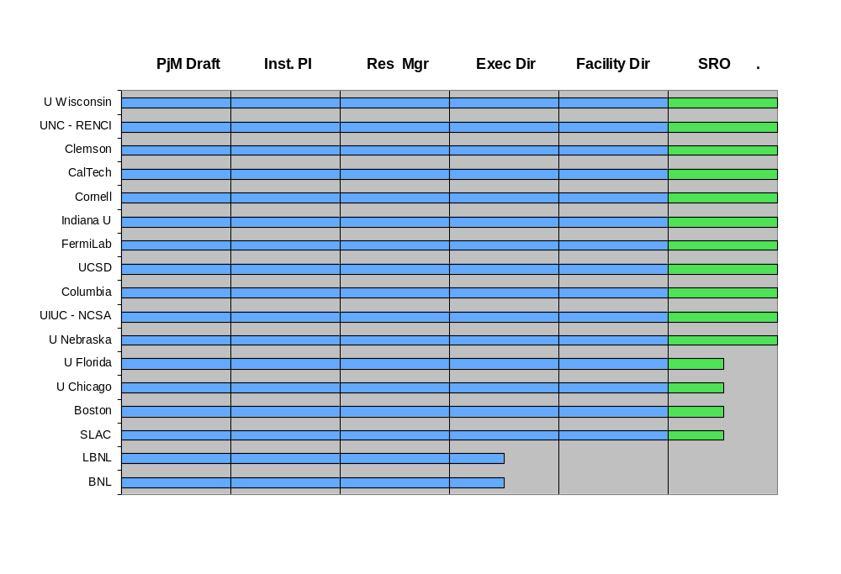
Additional Perspectives
Resource & Project Management

