Slide 1
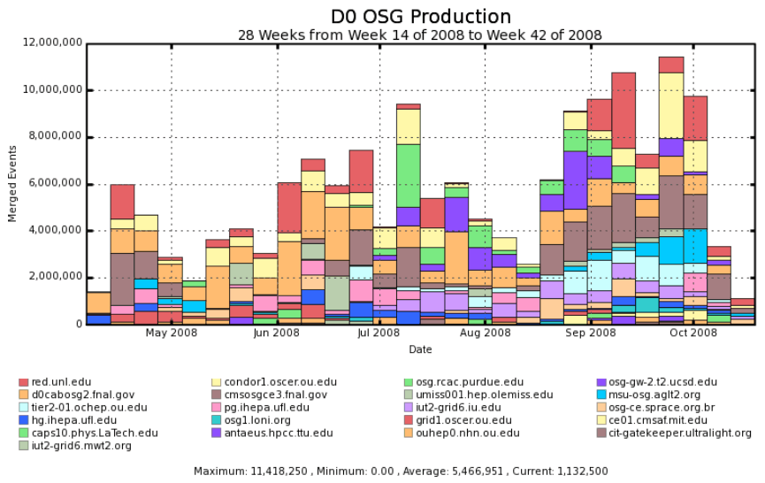
D0 Event Production volume
(During Joint D0-OSG Taskforce)
Started using Opportunistic
Storage on OSG
Initiation
phase
D0 SRM
Debug
phase

Slide 2
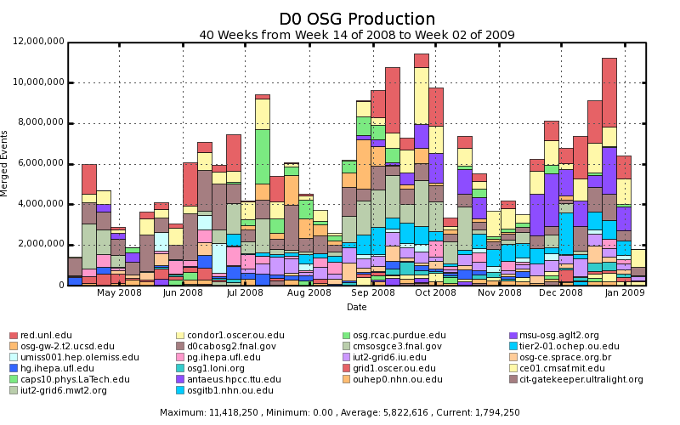
D0 Event Production volume
(Sustained, overall till Jan’09)
Started using Opportunistic
Storage on OSG
D0 Infrastructure
Overhaul
phase
D0 SRM
Debug
phase
Initiation
phase

Slide 3
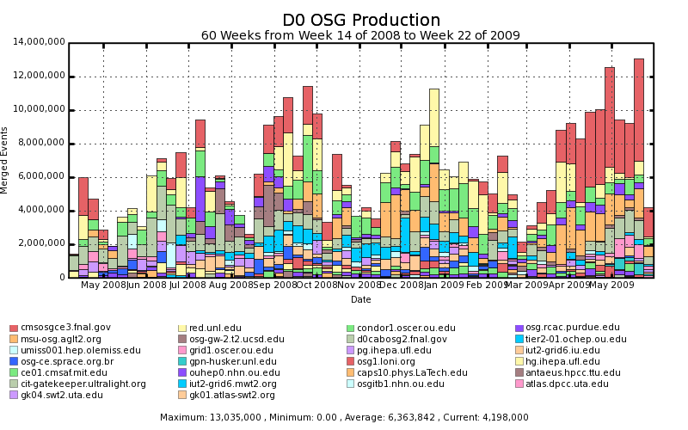
D0 Event Production volume
(Overall till May’09)
CAUTION:
CYCLIC
Started using Opportunistic
Storage on OSG
D0 Grid DP Initiative
Infrastructure
Overhaul phase-1
D0 Grid DP Initiative
Infrastructure
Overhaul phase-2
D0 SRM
Debug
phase
Initiation
phase

