Slide 1
OSG Storage Architectures
Tuesday Afternoon
Brian Bockelman, bbockelm@cse.unl.edu
OSG Staff
University of Nebraska-Lincoln

Slide 2
Outline
Typical Application Requirements.
The “Classic SE”.
The OSG Storage Element.
Simple Data Management on the OSG.
Advanced Data Management Architectures

Slide 3
Storage Requirements
Computation rarely happens in a vacuum – it’s often data driven, and sometimes data intensive.
OSG provides basic tools to manage your data.
  These aren’t as mature as Condor, but have been used successfully by many VOs.
  Most of these tools relate to transferring files between sites.

Slide 4
Common Scenarios
Simulation (small configuration input, large output file).
  Simulation with input (highly dynamic metadata).
Data processing (large input, large output).
Data analysis (large input, small output).
Common factors:
  Relatively static input.
  Fine data granularity (each job accesses only a few files).
  File size of 2GB and under.

Slide 5
Scenarios which are un-OSG-like
What kind of storage patterns are unlikely to work on the OSG?
  Very large files.
  Large number of input/output files
  Requiring POSIX.
  Jobs which require a working set larger than 10GB.

Slide 6
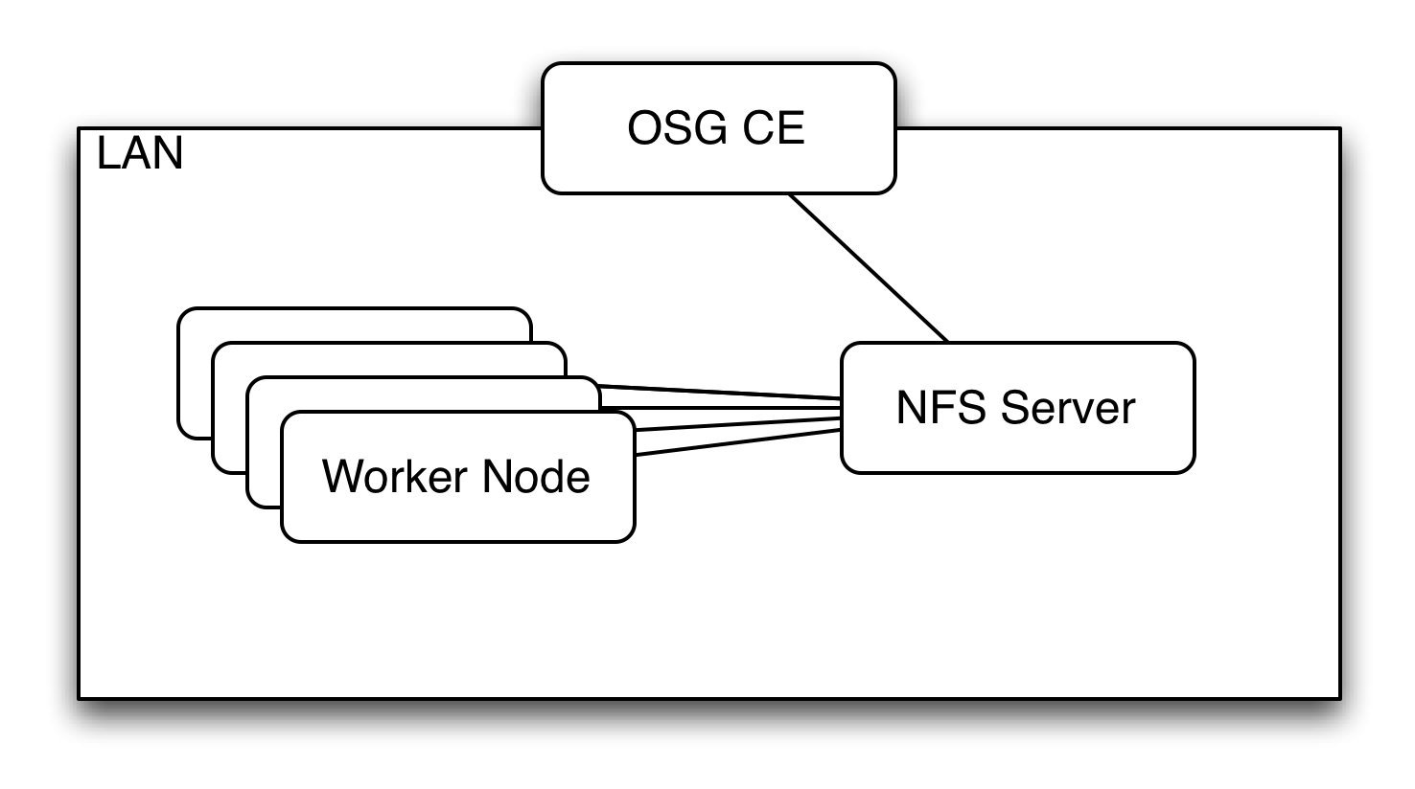
Storage at OSG CEs
All OSG sites have some kind of shared, POSIX-mounted storage (typically NFS).* This is almost never a distributed or high-performance file system
This is mounted and writable on the CE.*
This is readable (though sometimes read-only) from the OSG worker nodes.
*Exceptions apply! Sites ultimately decide

Slide 7
Storage at the OSG CE
There are typically three places you can write and read data from. These are defined by variables in the job environment (never hardcode these!).
  $OSG_APP: Install applications here; shared.
  $OSG_DATA: Put data here; shared
  $OSG_WN_TMP: Put data here; local disk

Slide 8
First Stab at Data Management
How would you process BLAST queries at a grid site?
  Install BLAST application to $OSG_APP via the CE (pull).
  Upload data to $OSG_DATA using the CE’s built-in GridFTP server (push).
  The job will run the executable from $OSG_APP and read in data from $OSG_DATA. Outputs go back to $OSG_DATA.

Slide 9
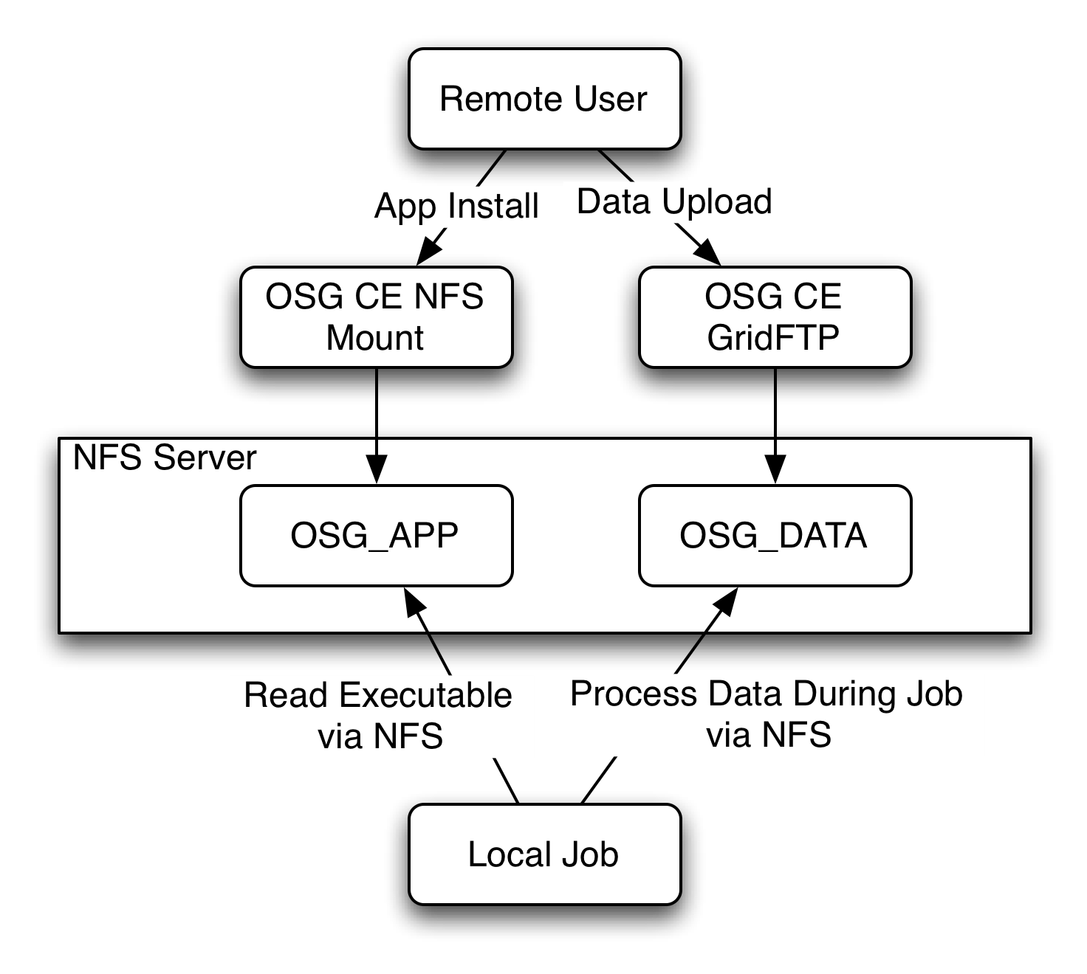
Picture
Now – go off and do this! Data Management Exercises 1

Slide 10
Why Not?
This setup is called the “classic SE” setup, because this is how the grid worked circa 2003.
  Why didn’t this work?
Everything through CE interface is not scalable.
High-performance filesystems not reliable or cheap enough.
Difficult to manage space.

Slide 11
Storage Elements
In order to make storage and transfers scalable, sites set up a separate system for storage (the Storage Element).
Most sites have an attached SE, but there’s a wide range of scalability.
These are separated from the compute cluster; normally, you interact it via a get or put of the file.
  Not POSIX!

Slide 12
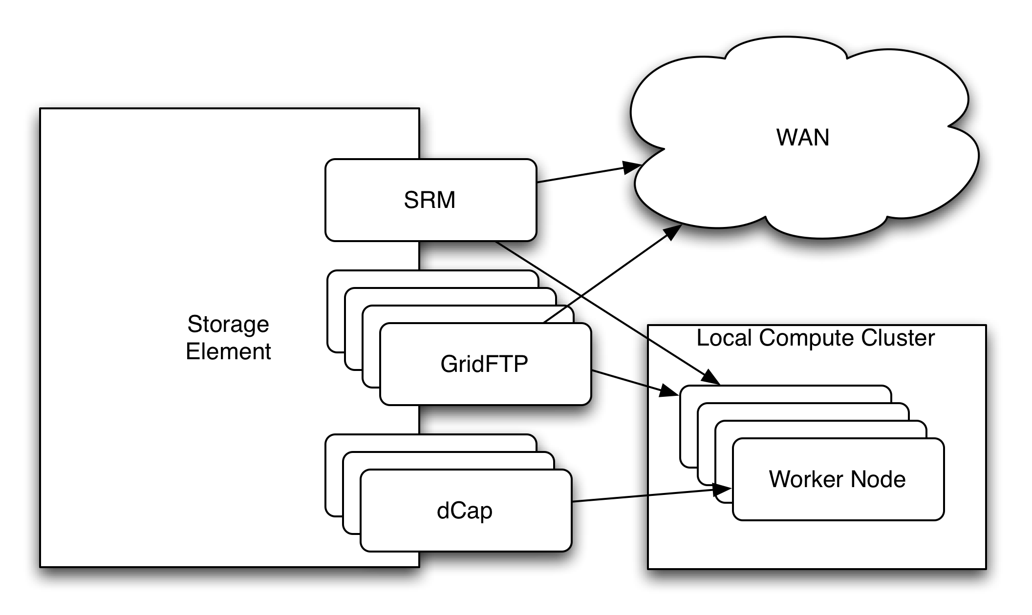
Storage Elements on the OSG
User point of View!

Slide 13
User View of the SE
Users interact with the SE using the SRM endpoint.
  SRM is a web services protocol that does metadata operation at the server, but delegates file movement to other servers.
  To use it, you need to know the “endpoint” and the directory you write into.
  At many sites, file movement is done via multiple GridFTP servers, load-balanced by the SRM server.
  Appropriate for accessing files within the local compute cluster’s LAN or the WAN.
  Some sites have specialized internal protocols or access methods, such as dCap, Xrootd, or POSIX – but we won’t discuss them today as there is no generic method.

Slide 14
Example
At Firefly, the endpoint is:
  srm://ff-se.unl.edu:8443/srm/v2/server
The directory you write into is:
  /panfs/panasas/CMS/data/osgedu
So, putting them together, we get:
  srm://ff-se.unl.edu:8443/srm/v2/server?SFN=/panfs/panasas/CMS/data/osgedu

Slide 15
Example
Reading a file from SRM:
  User invokes srm-copy with a SRM URL it would like to read.
  srm-copy contacts remote server with a “prepareToGet” call.
  SRM server responds with a either a “wait” response or a URL for transferring (TURL).
  srm-copy contacts the GridFTP server referenced in the TURL. Performs download.
  srm-copy notifies SRM server it is done.

Slide 16
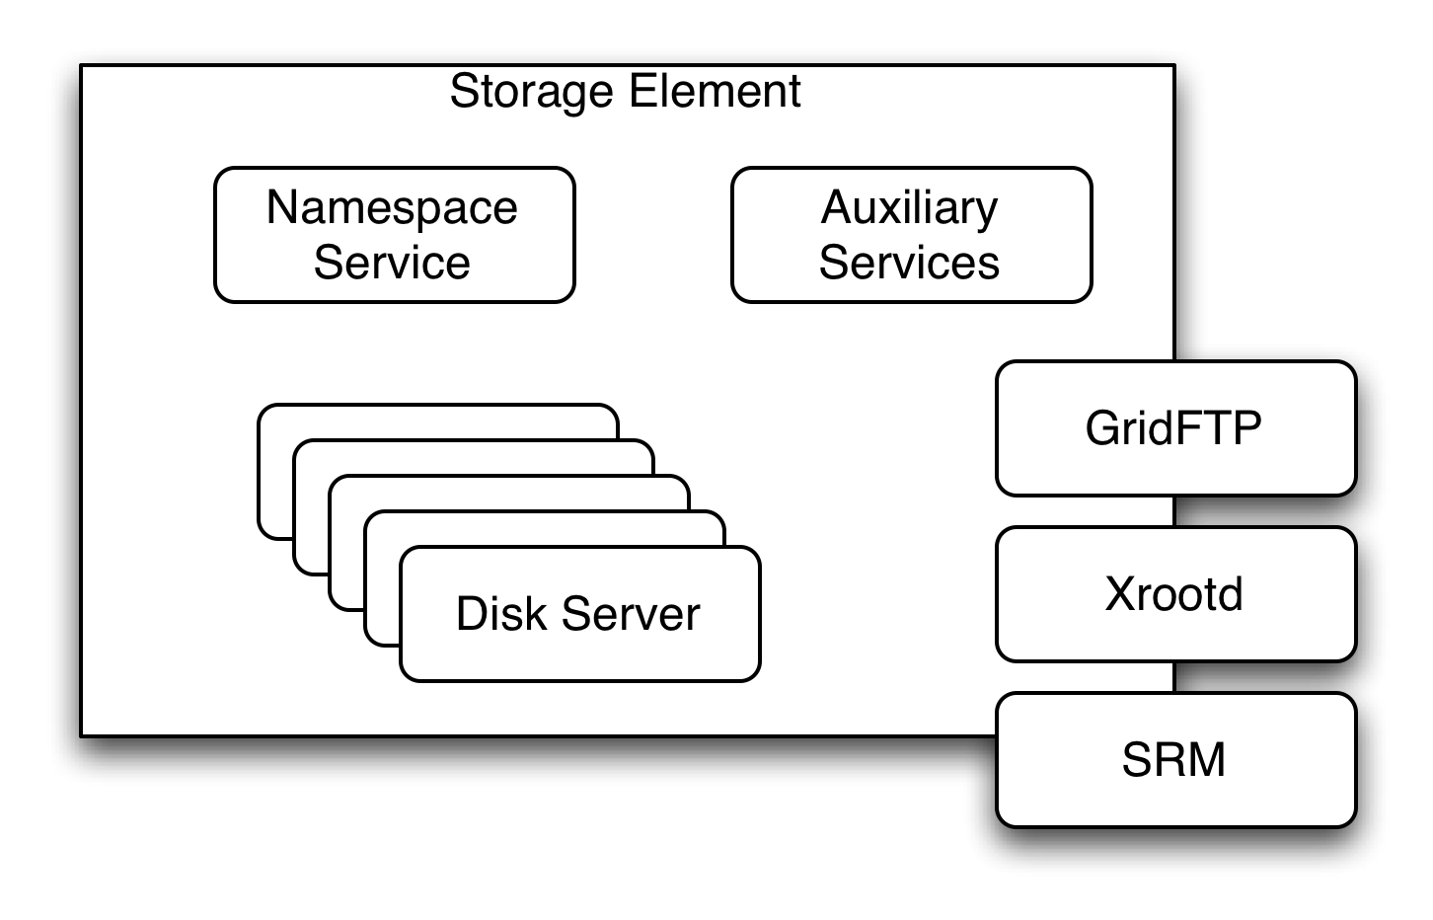
SE Internals

Slide 17
SE Internals
A few things about the insides of large SEs:
  All the SEs we deal with have a single namespace server. This limits the number of total metadata operations per second they can perform (don’t do a recursive “ls”!)
  There are tens or hundreds of data servers, allowing for maximum throughput of data for internal protocols.
  There are tens of GridFTP servers for serving data with SRM.

Slide 18
SE Internals
Not all SEs are large SEs!
  For example, the OSG-EDU BestMan endpoint is simply a (small) NFS server.
  Most SEs are scaled to fit the site. Larger sites will have the larger SEs.
    Often, it’s a function of the number of worker nodes at the site.
  There are many variables involved with using a SE; when in doubt, check with the site before you do strange workflows.

Slide 19
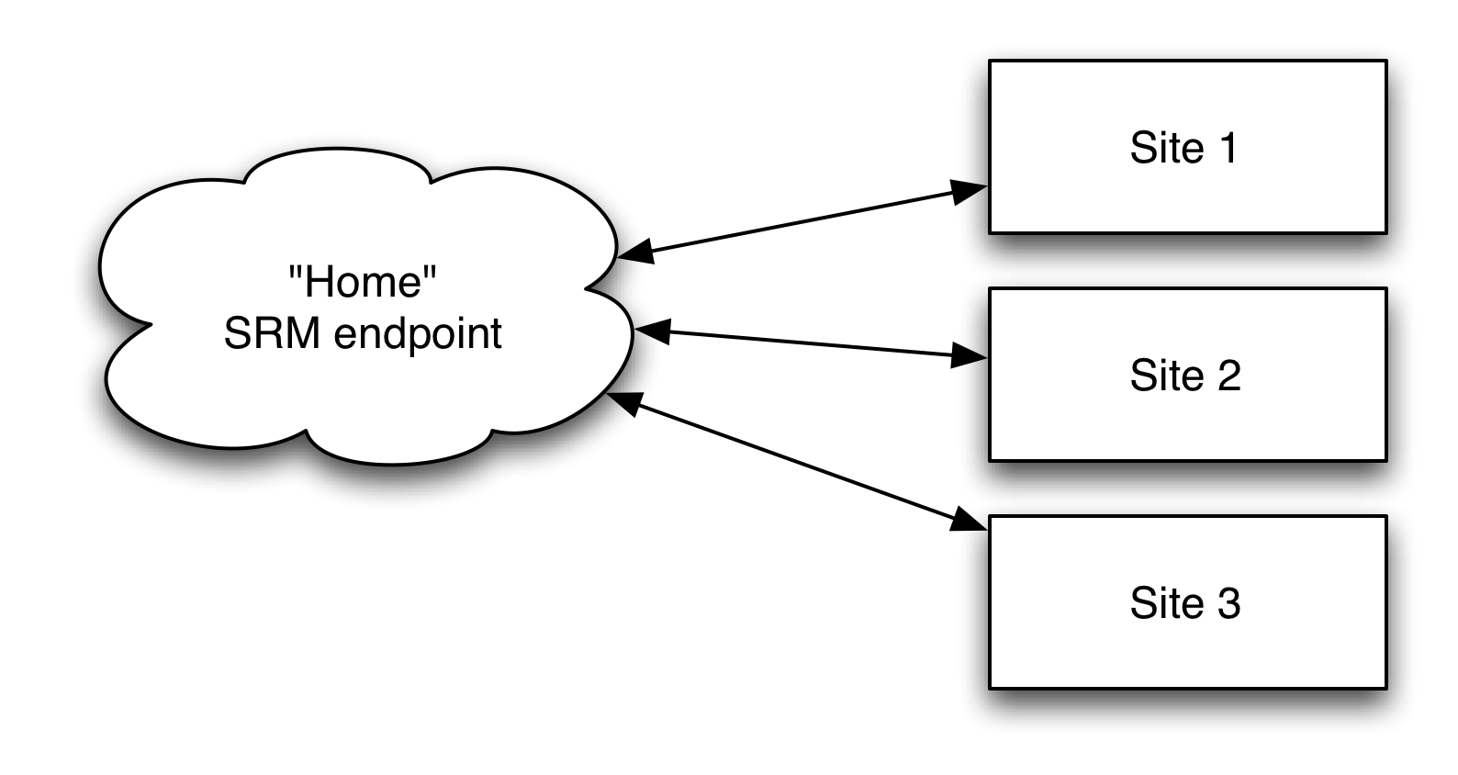
Simple SE Data Management

Slide 20
Simple Data Management
Use only 1 dependable SRM endpoint (your “home”).
  All files are written to here and read from here.
  Each file has one URL associated with it.
    You thus know where everything is! No synchronizing!
  Pay dearly for this simplicity with efficiency (lose data locality).
    I would argue, for moderate data sizes (up to hundreds of GB), this isn’t so bad – everyone is on a fast network.
  Regardless of what cluster the job runs at, pull in from the storage “home”.
This system is scalable if not all people call the same place “home”.
This model is simple, but we mostly provide low-level tools. Using this model prevents you from having to code too much on your own.

Slide 21
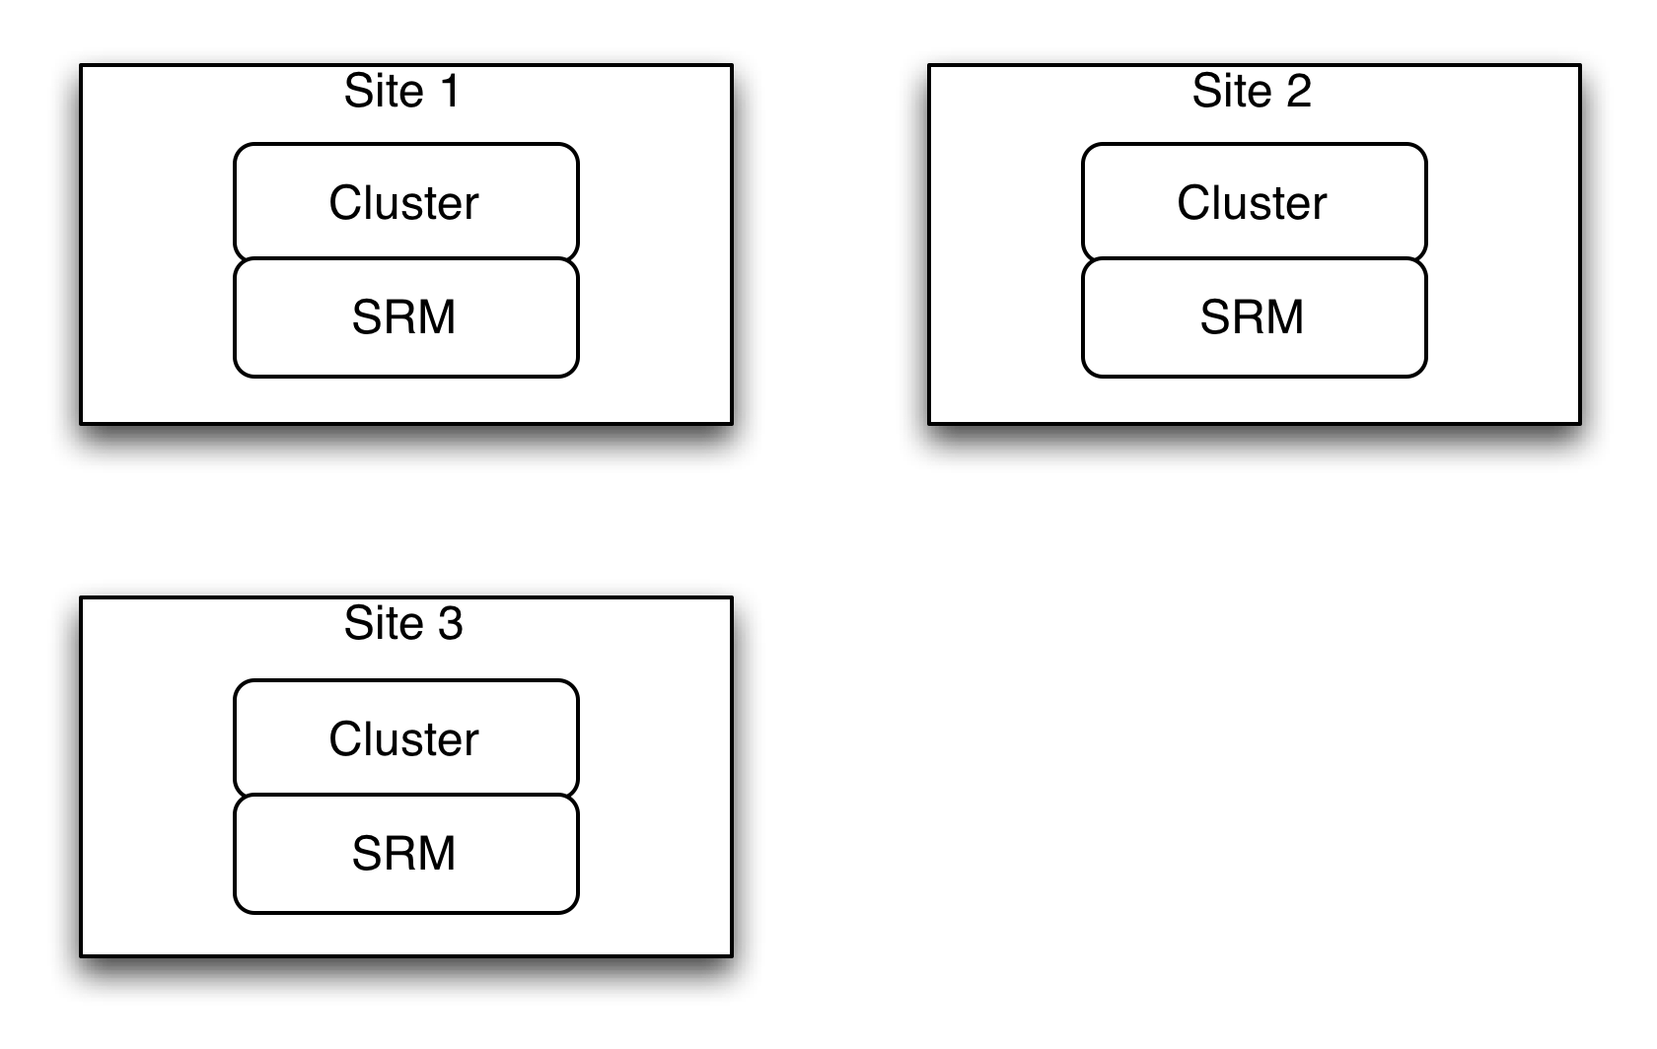
Advanced Data Management Topics
How do you utilize all these boxes?

Slide 22
Data Management
Different Techniques Abound
  Cache-based: jobs ping the local SRM endpoint and if a file is missing, it downloads from a known “good” source. (SAM)
  File transfer systems: You determine a list of transfers to do, and “hand off” the task of doing the transfer to this system. (Stork, FTS)
  Data placement systems: Built on top of file transfer systems. Files are grouped into datasets and humans determine where the datasets should go. (PhEDEx, DQ2).
    These are built up by the largest organizations.

Slide 23
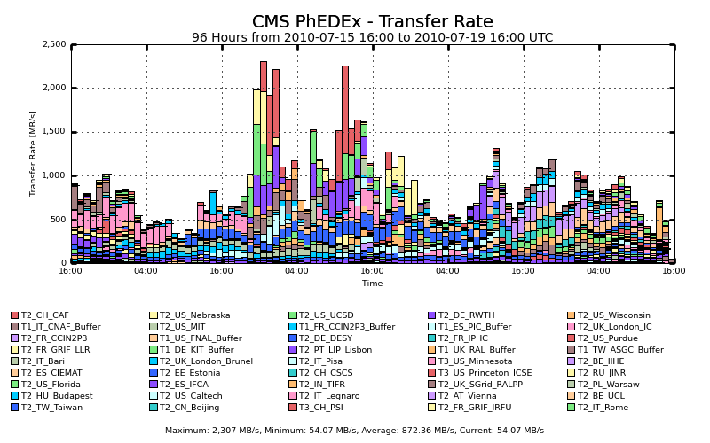

Recent PhEDEx activity

Slide 24
Storage Discovery
As opportunistic users, you need to be able to locate usable SEs for your VO.
The storage discovery tools query the OSG central information store, the BDII, for information about deployed storage elements.
  They then return a list of SRM endpoints you are allowed to utilize.
Finding new resources is an essential element of putting together new transfer systems for your VO.

Slide 25
Parting Advice
(Most) OSG sites do not provide a traditional high-performance file system.
  The model is “storage cloud”. I think of each SRM endpoint as a storage depot.
  You get/put the files you want into some depot. Usually, one is “nearby” to your job.
Only use the NFS servers for application installs.
Using OSG storage is nothing like using a traditional HPC cluster’s storage.
  Think Amazon S3, not Lustre.

Slide 26
Questions?
Questions? Comments?
Feel free to ask me questions later:
  Brian Bockelman, bbockelm@cse.unl.edu

