Slide 1


The Landscape of Academic
Research Computing
Kyle Gross – kagross@iu.edu
Operations Support Manager - Open Science Grid
Research Technologies - Indiana University
Some Slides Contributed by the University of Wisconsin HTCondor Team, Rob Quick, and Scot Kronenfeld

Slide 2
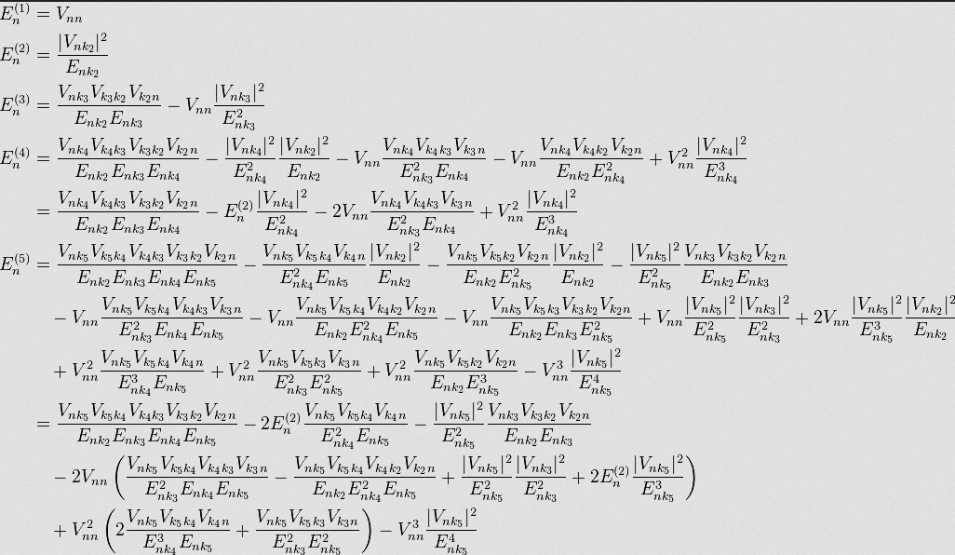
Let’s jump right in…

Slide 3
Who Am I?
Operations team for Open Science Grid – 10+ years
OSG Operations Support Manager
SWAMP Support Coordinator

Slide 4
Protein Docking Project at the
IU School of Medicine
SPLINTER - Structural Protein-Ligand Interactome
Used autodock-vina – “…open-source program for drug discovery, molecular docking and virtual screening…”
First run in 2013 - docked ~3900 Proteins with 5000 Ligands for a total of ~19M docked pairs.
Submitted via command line to Condor using Pegasus on the OSG-XSEDE submission node
Infrastructure is set and new runs can be easily started

Slide 5
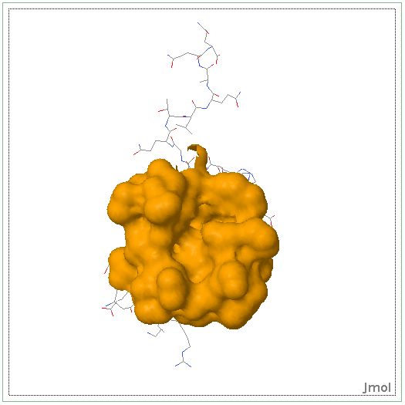
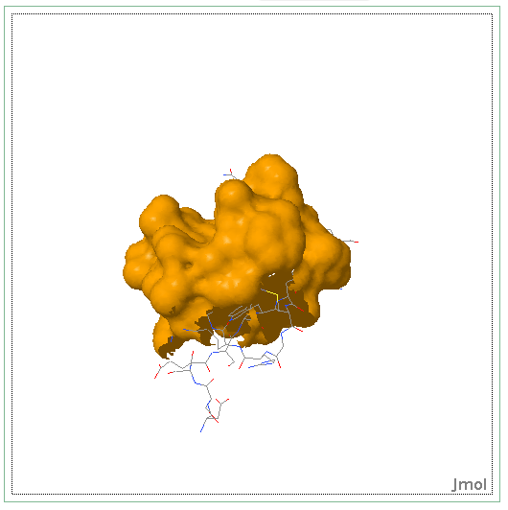
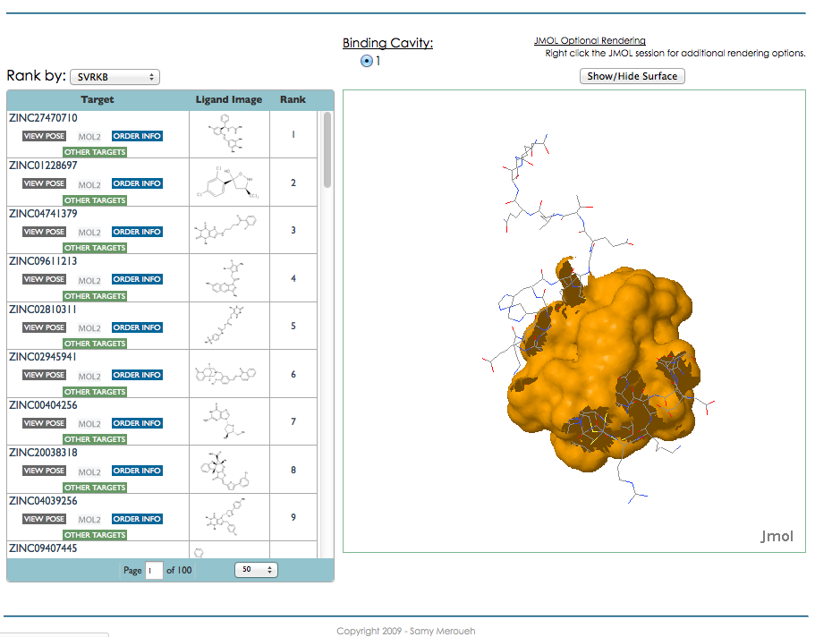
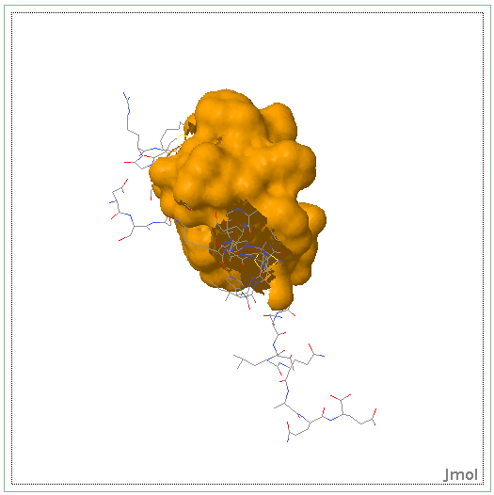
Various rotations of Protein CBFA2T1 (Cyclin-D-related protein) (Eight twenty one protein) (Protein ETO) (Protein MTG8) (Zinc finger MYND domain-containing protein 2)

Slide 6
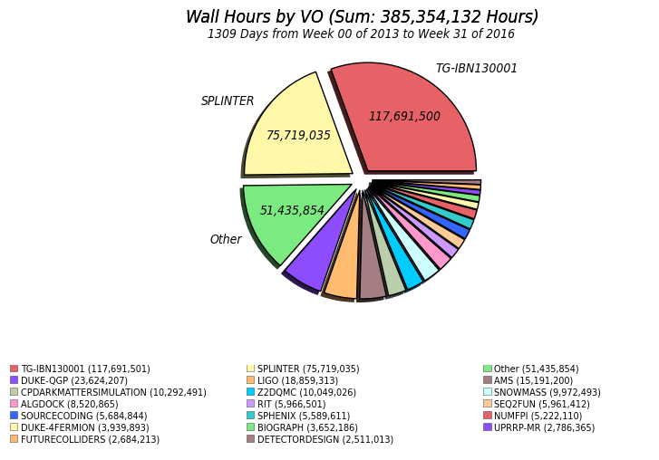
Some Numbers
Amazon EC2 Computing $0.073/hour
$5.5M Compute Only
Data Transfer and Storage Not Included
Notes:
Replace this

Slide 7
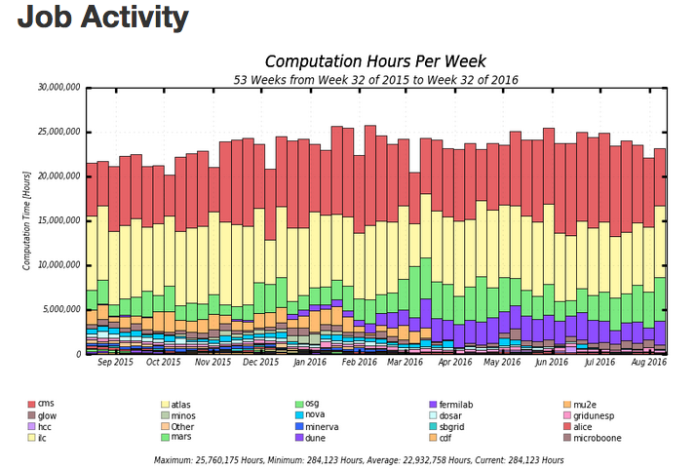
At what scale?

Slide 8
Follow Along at:
  https://twiki.opensciencegrid.org/bin/view/Education/ASP2016/

Slide 9
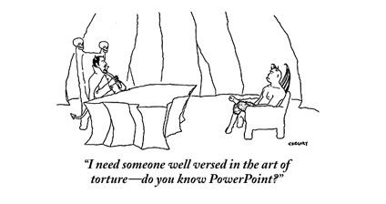
Overview of day
Lectures alternating with exercises
  Emphasis on lots of exercises
  Hopefully overcome PowerPoint fatigue

Slide 10
Some thoughts on the exercises
It’s okay to move ahead on exercises if you have time
It’s okay to take longer on them if you need to
If you move along quickly, try the “On Your Own” sections and “Challenges”

Slide 11
Most important!
Please ask questions!
  …during the lectures
  …during the exercises
  …during the breaks
  …during the meals
  …over dinner
  …via email after we depart (kagross@iu.edu or rquick@iu.edu)
If I don’t know, I’ll find the right person to answer your question.

Slide 12
Goals for this session
Define Local, Clustered, High Throughput Computing (HTC), High Performance Computing (HPC), and Cloud Computing (XaaS)
Shared, Allocated, and Purchased
What is HTCondor? And why are we using it in this Summer School?

Slide 13
The setup: You have a problem
Your science computing is complex!
  Monte carlo, image analysis, genetic algorithm, simulation…
It will take a year to get the results on your laptop, but the conference is in a week.
What do you do?

Slide 14

Option 1: Wait a year

Slide 15
Option 2: Local Cluster Computing
Easy access to additional nodes
Local support for porting to environment (maybe)
Often a single type of resource
Often running at capacity

Slide 16
Option 3: Use a “supercomputer” aka High Performance Computing(HPC)
“Clearly, I need the best, fastest computer to help me out”
Maybe you do…
  Do you have a highly parallel program?
    i.e. individual modules must communicate
  Do you require the fastest network/disk/memory?
Are you willing to:
  Port your code to a special environment?
  Request and wait for an allocation?

Slide 17
Option 4: Use lots of commodity computers
Instead of the fastest computer, lots of individual computers
May not be fastest network/disk/memory, but you have a lot of them
Job can be broken down into separate, independent pieces
  If I give you more computers, you run more jobs
  You care more about total quantity of results than instantaneous speed of computation
This is high-throughput computing

Slide 18
Option 5: Buy (or Borrow) some computing from a Cloud Provider
Unlimited resources (if you can afford them)
Full administrative access to OS of the resources you ‘buy’
Specialized VM images reducing effort in porting
XaaS Business Model

Slide 19
These are All Valid Options
Remember the problem: You have one month to publish results for your conference
  Option 1: You will miss your deadline
  Option 2: You might miss your deadline – But if you’re lucky you’ll make it (or if you know the admin)
  Option 3: If you have parallelized code and can get an allocation you have a good chance
  Option 4: If you can serialize your workflow you have a good chance
  Option 5: You can meet your deadline for a price. Though some efforts are underway to enable academic clouds

Slide 20
Computing Infrastructures
Local Laptop/Desktop – Short jobs with small data
Local Cluster – Larger jobs and larger data but subject to availability
HPC – Prime performance with parallelized code
HTC – Sustained computing over a long period for serialized
Cloud – Need deeper permission on an OS and have deeper pockets

Slide 21
Why focus on high-throughput computing? (HTC)
An approach to distributed computing that focuses on long-term throughput, not instantaneous computing power
  We don’t care about operations per second
  We care about operations per year
Implications:
  Focus on reliability
  Use all available resources
    Any Linux based machine can participate

Slide 22

Think about a race
Assume you can run a three minute kilometer
Does that mean you can run a 126 minute marathon?
The challenges in sustained computation are different than achieving peak in computation speed

Slide 23
Why is HTC hard?
The HTC system has to keep track of:
  Individual tasks (a.k.a. jobs) & their inputs
  Computers that are available
The system has to recover from failures
  There will be failures! Distributed computers means more chances for failures.
You have to share computers
    Sharing can be within an organization, or between orgs
    So you have to worry about security
    And you have to worry about policies on how you share
If you use a lot of computers, you have to handle variety:
  Different kinds of computers (arch, OS, speed, etc..)
  Different kinds of storage (access methodology, size, speed, etc…)
  Different networks interacting (network problems are hard to debug!)

Slide 24
Let’s take one step at a time
Small
Large
Local
Distributed
Can you run one job on one computer?
Can you run one job on another computer?
Can you run 10 jobs on a set of computers?
Can you run a multiple job workflow?
How do we put this all together?
This is the path we’ll take

Slide 25

Discussion
For 5 minutes, talk to a neighbor: If you want to run one job in a local environment:
    What do you (the user) need to provide so a single job can be run?
    What does the system need to provide so your single job can be run?
      Think of this as a set of processes: what needs happen when the job is given? A “process” could be a computer process, or just an abstract task.

Slide 26
What does the user provide?
A “headless job”
  Not interactive/no GUI: how could you interact with 1000 simultaneous jobs?
A set of input files
A set of output files
A set of parameters (command-line arguments)
Requirements:
  Ex: My job requires at least 2GB of RAM
  Ex: My job requires Linux
Control/Policy:
  Ex: Send me email when the job is done
  Ex: Job 2 is more important than Job 1
  Ex: Kill my job if it runs for more than 6 hours

Slide 27
What does the system provide?
Methods to:
  Submit/Cancel job
  Check on state of job
  Check on state of available computers
Processes to:
  Reliably track set of submitted jobs
  Reliably track set of available computers
  Decide which job runs on which computer
  Manage a single computer
  Start up a single job

Slide 28
Quick UNIX Refresher
Before We Start
$ #This symbolizes the prompt.
ssh username@training.osgconnect.net
nano, vi, emacs, cat >, etc.
which, rpm, ps, mkdir, cd, gcc, ls
A variety of condor_* commands

Slide 29
Questions?
Questions? Comments?
  Feel free to ask me questions now or later:
  Kyle Gross kagross@iu.edu
  Exercises start here:
  https://twiki.grid.iu.edu/bin/view/Education/ASP2016/AfricaGridSchoolMaterials
  Presentations are also available from this URL.

