Slide 1
OWAMP
March 10th 2011, OSG All Hands Meeting, Network Performance
Jason Zurawski – Internet2

Slide 2

Agenda
Tutorial Agenda:
  Network Performance Primer - Why Should We Care? (15 Mins)
  Getting the Tools (10 Mins)
  Use of the BWCTL Server and Client (30 Mins)
  Use of the OWAMP Server and Client (30 Mins)
  Use of the NDT Server and Client (30 Mins)
  Diagnostics vs Regular Monitoring (30 Mins)
  Network Performance Exercises (1 hr 30 Mins)
<number> – 11/08/26, © 2010 Internet2

Slide 3
OWAMP: What is it
OWAMP is:
  Command line client application
  Policy and scheduling daemon
  Used to determine one way latencies between hosts.
Implementation of the OWAMP protocol as defined by http://www.rfc-editor.org/rfc/rfc4656.txt
  Command Protocol to speak between client and server, server and server
  Test protocol
Different attempts to do this in the past:
  Surveyor
  RIPE
<number> – 11/08/26, © 2011 Internet2

Slide 4
Why One Way Latency?
Passive Measurements (e.g. SNMP)
  Higher polling interval may mask queue depths
  Active probing gives a better picture of real traffic
Round Trip Measurements:
  Hard to isolate the direction of a problem
  Congestion and queuing can be masked in the final measurement
  Can be done with a single ‘beacon’ (e.g. using ICMP responses)
One Way Measurements:
  Direction of a problem is implicit
  Detects asymmetric behavior
  See congestion or queuing in one direction first (normal behavior)
  Requires ‘2 Ends’ to measure properly
<number> – 11/08/26, © 2011 Internet2

Slide 5
OWAMP Control Protocol
Supports authentication and authorization of the users that will test
Used to configure the parameters of a test
  Endpoint controlled port numbers
  Extremely configurable send schedule
  Configurable packet sizes
Used to start/stop tests
Used to retrieve results
  Provisions for dealing with partial session results in the event of a failure
<number> – 11/08/26, © 2011 Internet2

Slide 6
OWAMP Test Protocol
“Lightweight” compared to the control protocol
Uses UDP as the transport protocol, since the protocol needs to be able to measure individual packet delivery times
Supports varying packet sizes
Data needed to calculate experimental errors on the final result is in every packet
Packets can be “open”, “authenticated”, or “encrypted”
<number> – 11/08/26, © 2011 Internet2

Slide 7
Sample Implementation
Applications
  Daemon (owampd)
  Clients (owping, powstream)
Open Source License & Development
  Modified BSD (http://www.internet2.edu/membership/ip.html)
  Mailing lists for developer communication – come join us!
Protocol Abstraction Library
  Will support development of new clients
  Add custom ‘hooks’ into the policy (e.g. add authentication via OpenID or similar)
<number> – 11/08/26, © 2011 Internet2

Slide 8
Functionality (owping client)
Meant to operate like traditional “ping”
owping client requests OWD tests from an OWAMP server (owampd)
Client can be ‘sender’ or ‘receiver’
  Both directions are tested unless otherwise specified
Communication can be “open”, “authenticated”, or “encrypted”
Supports the setup of many tests concurrently
Supports the storage of results on the server for later retrieval
<number> – 11/08/26, © 2011 Internet2

Slide 9
Functionality (owampd server)
Accepts requests for OWD tests
Responds with accepted/denied
Tests are formally started with a StartSessions message from the client.
Runs tests
Sessions with packets received at the server are buffered for later retrieval
<number> – 11/08/26, © 2011 Internet2

Slide 10
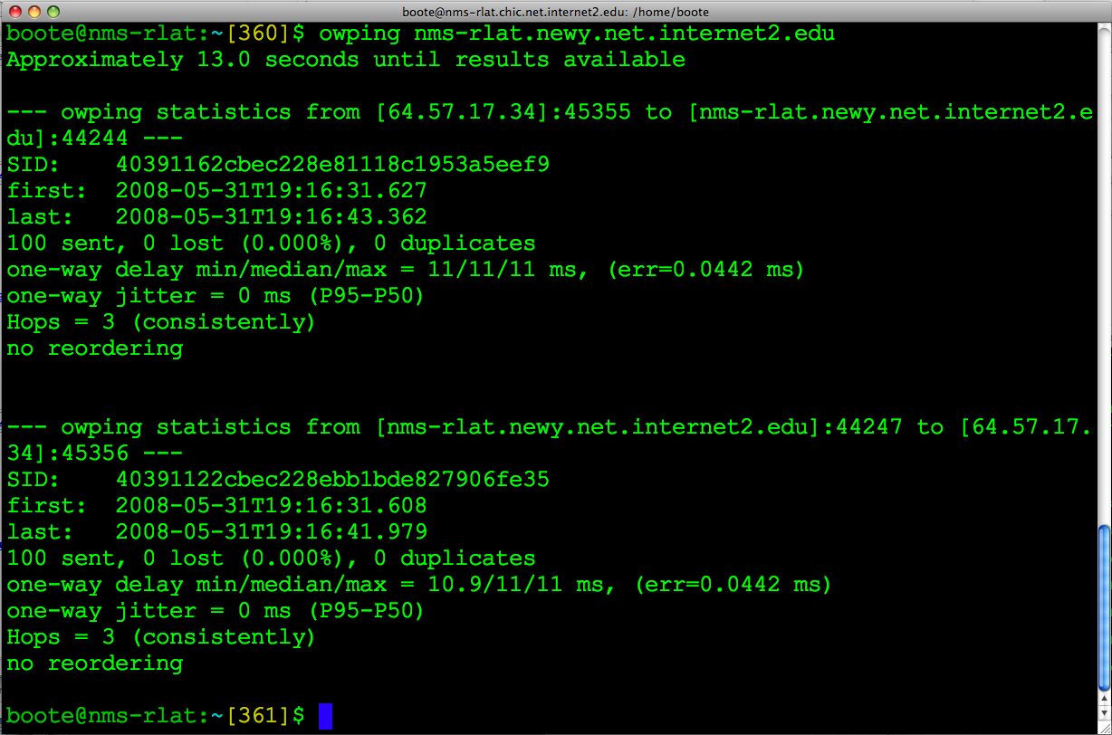
OWPING Example
<number> – 11/08/26, © 2011 Internet2

Slide 11
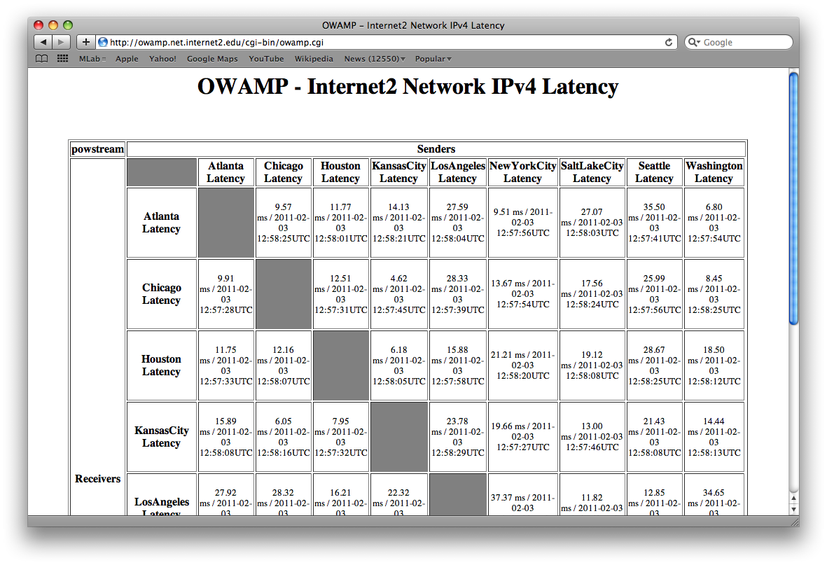
OWAMP GUIs - Mesh
<number> – 11/08/26, © 2011 Internet2

Slide 12
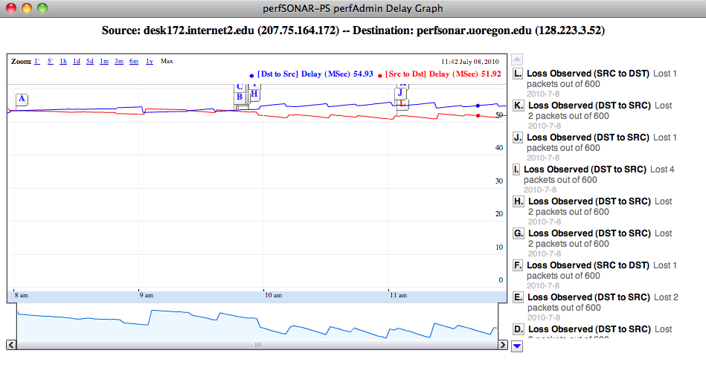
OWAMP GUIs – Delay/Loss Plot
<number> – 11/08/26, © 2011 Internet2

Slide 13
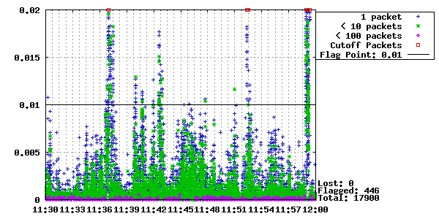
OWAMP GUIs - Jitter
<number> – 11/08/26, © 2011 Internet2

Slide 14
Resource Allocation
Each connection is “classified” (authentication)
Each classification is associated with a set of hierarchical limits
  Bandwidth (bandwidth)
  Session buffer (disk)
  Data retention (delete_on_fetch)
  Connection policy (allow_open_mode)
(no time dependent dimension to resource allocation in owampd)
<number> – 11/08/26, © 2011 Internet2

Slide 15
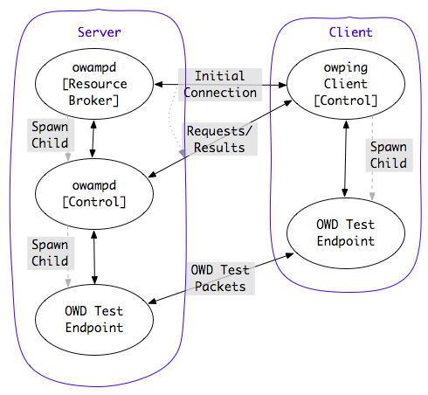
Architecture
<number> – 11/08/26, © 2011 Internet2

Slide 16
OWAMP Requirements
Clock requirement is the strongest
  Doesn’t work well in virtualized environments
  Doesn’t work well when machine is doing heavier testing (e.g. BWCTL), results may be suspect
NTP (ntpd) synchronized clock on the local system
  Specific configuration requirements as specified in NTP talk…
  Strictly speaking, owamp will work without ntp. However, your results will be meaningless in many cases
<number> – 11/08/26, © 2011 Internet2

Slide 17
General Requirements – Time Source
NTP (ntpd) synchronized clock on the local system
  Configure NTP properly (don’t rely on system defaults!)
  Strictly speaking, owamp will work without NTP. However, your results will be meaningless in many cases
  More info here: http://www.internet2.edu/performance/owamp/details.html#NTP
<number> – 11/08/26, © 2011 Internet2

Slide 18
General Requirements – Support
Source Code
  All modern Unix distributions (Free BSD/Linux)
  OS X
Packages
  Support for CentOS 5.5 (x86)
  Packages have been shown to operate on similar systems (CentOS, Fedora, RHEL, and x86_64 architecture)
<number> – 11/08/26, © 2011 Internet2

Slide 19
Hardware
“Bare Metal” – virtualization is tricky
Stable System Clock
  Temperature controlled environment
  No power management of CPU
  Reduction of “background” services – may institute noise
No strict requirements for CPU, Memory, Bus speed
  More tasking schedules will require more capable hardware
<number> – 11/08/26, © 2011 Internet2

Slide 20
Operational Concerns
Time:
  NTP issues predominate the problems
  Determining an accurate timestamp “error” is in many ways more difficult than getting a “very good” timestamp
  Working as an “open” server requires UTC time source (For predefined test peers, other options available)
Firewalls:
  Port filter trade-off
    Administrators like pre-defined port numbers
    Vendor manufactures would probably like to “prioritize” test traffic
    Owampd allows a range of ports to be specified for the receiver
<number> – 11/08/26, © 2011 Internet2

Slide 21
Policy/Security Considerations
Third-Party DoS source
  Compromised server may send packets to other locations.
DoS target
  Excessive traffic will harm measurement results
  Someone might attempt to affect statistics web pages to see how much impact they can have
Resource consumption
  Time slots
  Memory (primary and secondary)
  Network bandwidth
<number> – 11/08/26, © 2011 Internet2

Slide 22
Policy Recommendations
Restrict overall bandwidth to something relatively small
  Most OWAMP sessions do not require much
Limit “open” tests to ensure they do not interfere with precision of other tests
<number> – 11/08/26, © 2011 Internet2

Slide 23
Availability
Currently available
  http://www.internet2.edu/performance/owamp
  http://www.software.internet2.edu
Mail lists:
  https://lists.internet2.edu/sympa/info/owamp-users
    owamp-users@internet2.edu
  https://lists.internet2.edu/sympa/info/owamp-announce
    owamp-announce@internet2.edu
<number> – 11/08/26, © 2011 Internet2

Slide 24
Hands On
Testing OWAMP:
  Log on to testbed
  Test from one host to another:
    owping HOSTNAME
  Try different hosts. Try longer tests. What happens when we use:
    -c (number of packets to send, try 1000)
    -t (test to HOSTNAME only)
    -f (test from HOSTNAME only)
<number> – 11/08/26, © 2011 Internet2

Slide 25
OWAMP
March 10th 2011, OSG All Hands Meeting, Network Performance
Jason Zurawski – Internet2
For more information, visit http://www.internet2.edu/workshops/npw
<number> – 11/08/26, © 2011 Internet2

