Slide 1
OSG Finance Board
Project & Resource Management Report
Chander Sehgal
02 November 2007

Slide 2
Outline
Year1 Status
  End of year Budget Update
  Staffing Changes
  Change Request Summary
  Completion of WBS
  Status of Reporting
  Lessons from year1
Year2 Status and Planning
  Year2 Budget and Contingency
  Status of WBS
  Status of SOWs
  Changes to Reporting Process

Slide 3
OSG Year1

Slide 4
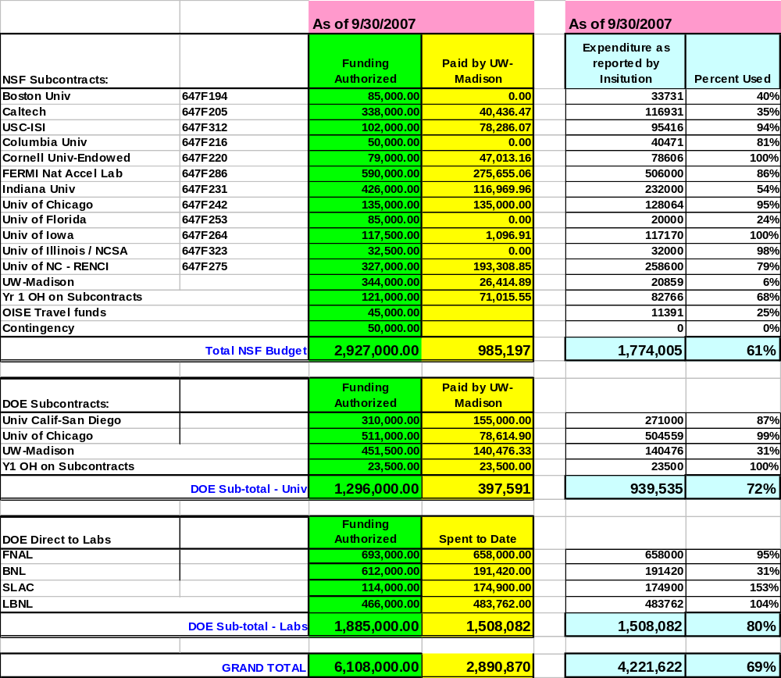
End of Year1 Budget Update

Slide 5
Year1 Staffing Changes
Indiana SOW “restarted” due to loss of key personnel and resolved in April 2007
U-Iowa subcontract terminated and new subcontract awarded to UIUC reflecting staff movement effective July 1, 2007
Institutions made good progress on hiring (next chart)
Identified challenges of managing and motivating a technical team that is heavily matrixed; discussed later under lessons learned

Slide 6
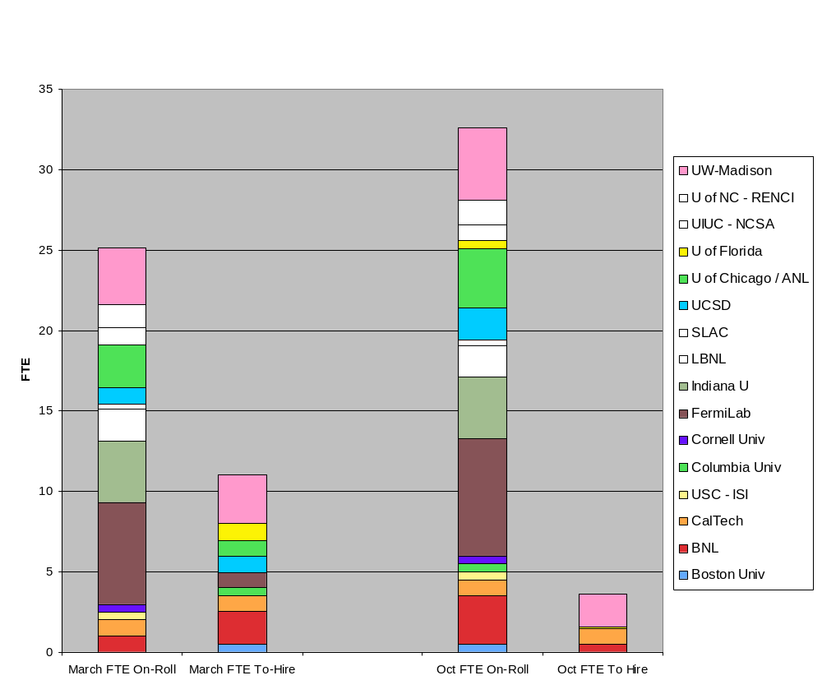
Year1 Staffing Progress
30%
10%

Slide 7
Change Requests Summary
Approval process updated based on process execution experience (OSG DocDB 523-v2 and 538-v3); two options now exist
  Approval via signature routing
  Approval via review at Executive Team meeting
8 change requests executed thru defined process
  4 involved scope/funding
  4 involved schedule
Process was used to discuss and resolve funding plans for year2 (3 change requests)

Slide 8
Completion of WBS
Monthly Update using Twiki based WBS update tool
Final task status currently being canvassed from task “InCharge” owners
Final WBS posted on DocDB #720-v1
Incomplete tasks need to be evaluated for year2 carry-over
Current year1 WBS Statistics (on 10/30/07)
  267 total tasks
    62 summary tasks
    205 non-summary tasks
      164 tasks 100% complete – 80%
      18 tasks >50% complete – 09%
      23 tasks <50% complete – 11%

Slide 9
OSG Year1 WBS Agency Milestones
WBS | Task | InCharge Owner | Finish | %Complete
1.1.4.2 | Release Security Plan | Don Petravick | 01/02/07 | 100%
1.1.6.2.3 | Release OSG 0.6.0 | Rob Quick | 03/05/07 | 100%
1.1.6.3.2 | OSG-TeraGrid software using common Globus and Condor releases. | Alain Roy | 04/02/07 | 100%
1.1.7.2.4 | Production use of OSG by one additional science community | John McGee | 04/20/07 | 100%
1.3.2.2.4 | Complete deployment and registration of 15 Storage Resources using srm/dCache from VDT. | Wuerthwein, Wenaus, Oleynik | 06/11/07 | 73%
1.1.1.2 | Define Operational Metrics for Year 1 | Tannenbaum, Livny, (Pordes) | 09/08/07 | 100%
1.1.1.5 | Report on Operational Metrics for Year 1 | Tannenbaum, Livny, (Pordes) | 09/22/07 | 100%
1.1.7.2.5 | Production use of OSG by a 2nd additional science community | John McGee | 09/28/07 | 100%
1.1.6.2.4 | Release OSG 0.8.0 | Rob Quick | 11/01/07 | 100%

Slide 10
OSG Year1 WBS Science Milestones
WBS | Task | InCharge Owner | Finish | %Complete
1.3.1.3.2 | LIGO: Binary Inspiral Analysis runs on OSG | Warren Anderson | 6/15/07 | 100%
1.3.1.3.3 | ATLAS: Support for WLCG and Experiment Challenges | Jim Shank | 6/15/07 | 100%
1.3.1.3.4 | CMS Support for WLCG and Experiment Challenges | Lothar Bauerdick | 6/15/07 | 100%
1.3.1.3.5 | STAR: Migration of >80% of simulation to OSG | Jerome Lauret | 6/15/07 | 100%
1.3.1.3.6 | CDF: Full use of OSG for MC | Ashutosh Kotwal | 6/15/07 | 25%
1.3.1.3.7 | D0: Successful reprocessing using 6 million CPU hours | Brad Abbott | 6/15/07 | 100%
1.3.1.3.8 | SDSS: Fit all spectra beyond data release 5, QSO fitting project | Chris Stoughton | 6/15/07 | 100%
1.3.1.3.9 | Support for CMS Opportunistic use of OSG Sites for Monte Carlo | Lothar Bauerdick | 6/15/07 | 90%
1.3.2.1.4 | Support for CMS Job Throughput 50Kjobs/day | Frank Wuerthwein | 4/1/07 | 100%
1.3.2.1.5 | Support for CMS Job Throughput 75Kjobs/day | Frank Wuerthwein | 9/28/07 | 66%
1.3.2.1.6 | Support for CMS Job Throughput 100K jobs/day | Frank Wuerthwein | 9/28/07 | 50%
1.3.2.1.7 | CMS site validations using the SAM infrastructure | Frank Wuerthwein | 6/1/07 | 100%
1.3.2.1.8 | Support for ATLAS Throughput of 20-30K | Jim Shank | 7/3/07 | 100%

Slide 11
Year1 Status of Reporting
Project agreement on periodic update of key project indicators
  Monthly individual work reports
  Monthly WBS Update
  Quarterly Financial Reports
  Quarterly PI reports
  Semi-annual Agency Reports
Progress on structured Project Management but more work ahead
JOT Review Planned for Jan 22-23 (with pre-meeting in Washington, DC on Jan 21)

Slide 12
Lessons from year1
Project & Resource Mgmt
ISSUE | RESPONSE
Median point for SOW completions was February/March 2007 | Much earlier start of SOW process; planned for all SOW drafts available in September 2007
Year 1 review of SOWs was disjoint regarding work scope | Year 2 SOWs were clustered and reviewed to the extent possible together where work scope overlapped
Serialized review of SOWs too time consuming and introduced additional delays | Added milestone to year 2 WBS: >75% completion of SOW reviews by Resource Managers by November 15th ( Goal Achieved ). Organized regularly scheduled telecons of Resource Managers and Project Associate to work through SOWs as a team. Organized similar meetings with Exec Director and Facilities Director for their review & signature
Staff management, motivation, and retention in a highly matrixed, distributed workforce is challenging | Resource Managers and Project Associate met to review issue and made a recommendation to executive team
Responsiveness to periodic reporting requests is poor, resulting in lack of visibility into the progress on tasks | Used “repetitive reminders” but workable response to this issue still needs to be found

Slide 13
OSG Year2
Status and Planning

Slide 14
Year2 Planning Overview
Interviewed PIs and area coordinators for inputs
Proposed focus areas needing attention in year2
Generated draft WBS and list of focus areas based on inputs and original OSG work proposal to NSF/DOE
Refined WBS via review with area coordinators
Allocated staff and FTE levels to each work area
Created Draft Year2 Budget
Created Draft SOWs for finalization by PIs
Baselined WBS (Excel version as DocDB #709-V3)
Next convert WBS into Microsoft Project for tracking and status updates
Driven by plan presented at April 26 Finance Board Meeting
Good progress with excellent support from PIs and Staff
  SOW ready for review/approval 9/04/2007 09/30/2007c
  Finalize WBS 9/30/2007 10/26/2007c

Slide 15
Year2 Operational Focus Areas
Ability of users to determine job status and sources of failures and thus improve ease of use
    Added Site Coordination role led by Rob Gardner
Metrics (accounting & presentation)
    Added staff at U-Nebraska
Progress on data movement/management
    Specific tasks in WBS led by Ted Hesselroth
Strengthen customer support function
    Added/re-assigned staff at Caltech, BNL, and Indiana
Operations stability
    Specific tasks in WBS
Need method for tracking progress on these five focus areas

Slide 16
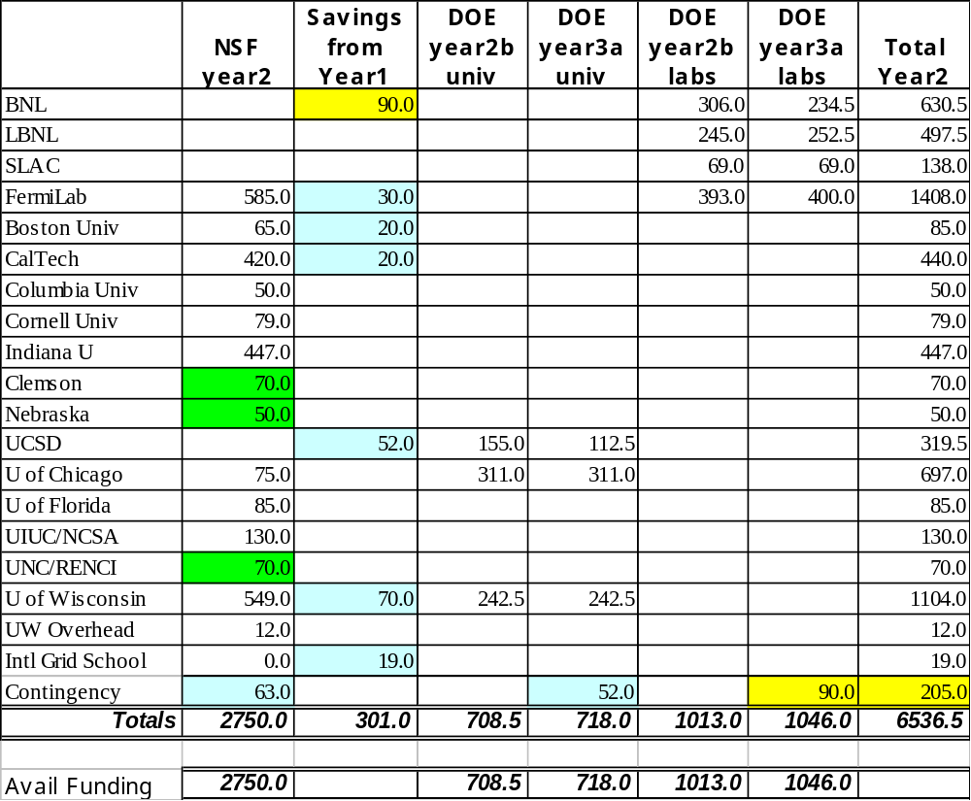
Year2: Budget Plan
10/1/07 to 9/30/08
Legend
year2b: 9/30/07 to 3/30/08 – 2nd half of year2 funding
year3a: 4/1/08 to 9/30/08 – 1st half of year3 funding
Green Background: new funding and/or new institution
Light Blue Background: Saving from year1 that are resolved
Yellow Background: Savings from year1 pending closure

Slide 17
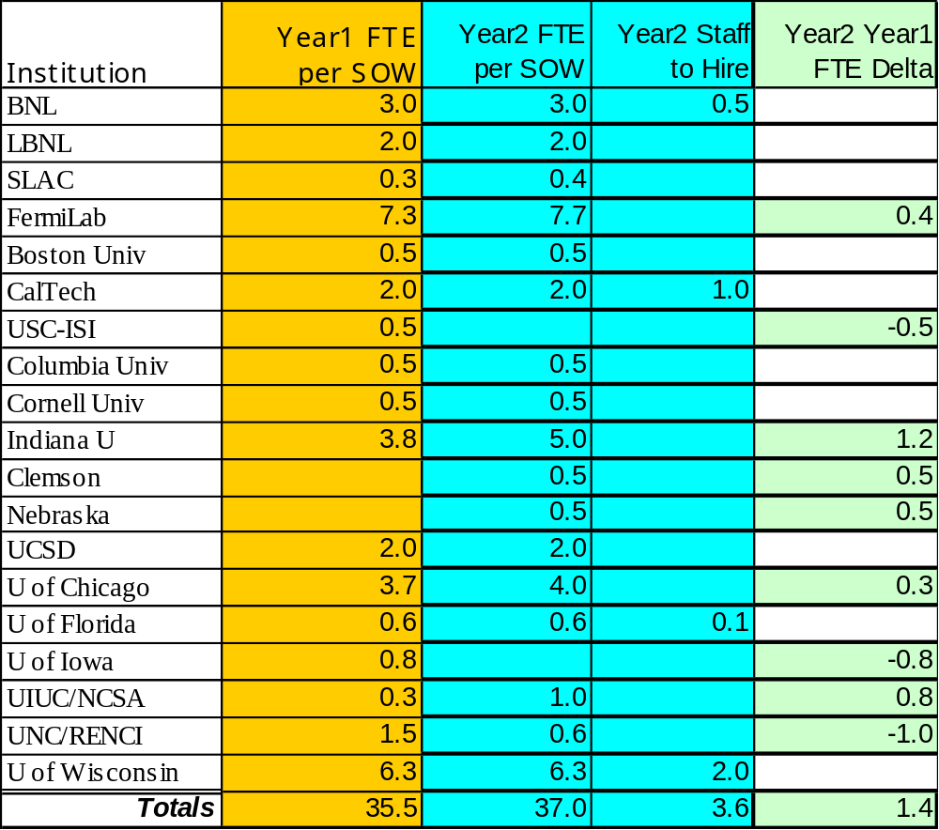
Year2: Staff Plan
FTE growth in year2 supported by year1 savings to add staff energy to focus areas and project needs

Slide 18
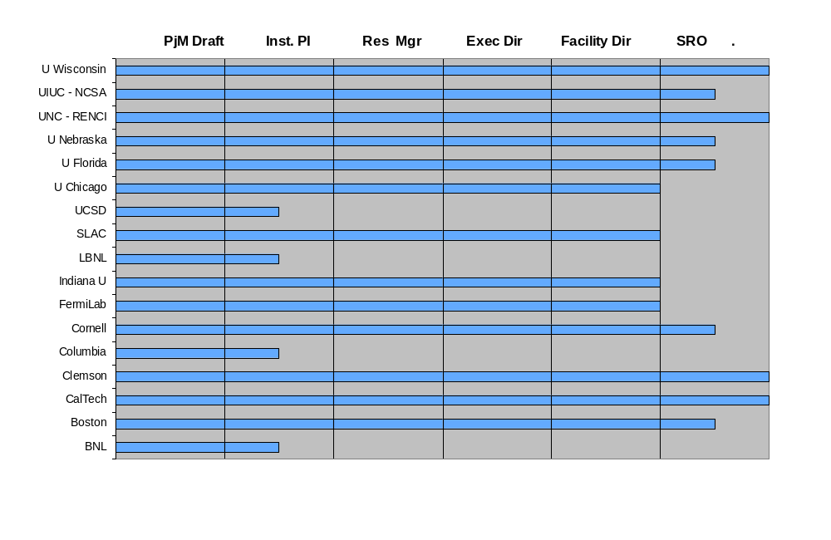
Year2 OSG SOW Status
Year2 WBS Goal of >75% SOW processed by resource managers met on 10/30/07 (goal = 11/15/07)

Slide 19
Year2: Status Reporting
(Project Management System)
Periodic update of key project indicators
  Monthly individual work reports
  Monthly WBS Update
  Quarterly Financial Reports
  Quarterly PI reports
  Quarterly Area Coordinator Reports – reinforced in SOWs
Culture change toward structured Project Management is a challenge; progress made but more work ahead

Slide 20
Questions and
Discussion

