Slide 1
OSG Area Coordinators
Network Monitoring Update: February 2014
Shawn McKee

Slide 2
Key Initiatives in Network Area
OSG modular dashboard service / OSG network service
Original Modular Dashboard orphaned: still in GitHub: https://github.com/PerfModDash but no developers active since Tom Wlodek left.
Replacement prototyped over December holidays (more later)
OSG has basic network service up, but really needs new capabilities
Need to address data-store issue and how best to deploy prototype in test/production
Will require Operations help to integrate the new services as they are ready
Improving perfSONAR-PS toolkit for OSG
We had 3.3.2 released on February 3. Fixed all known issues except intermittent PingER DNS lookup issue (under investigation)
Significant security improvements and minor bug fixes.
Push within OSG should now start; get ALL OSG sites to install (Rob/Shawn)
Documentation updates: network tools & troubleshooting
New “WhyPerfSONAR” page setup to encourage adoption/installation.
Installation guide for perfSONAR-PS Toolkit in place and updated for 3.3.2
https://twiki.grid.iu.edu/bin/view/Documentation/PerfSONARToolKit
Outreach and community interaction
Attended LHCONE/LHCOPN and Grid Deployment Board meetings at CERN last week. Presented on perfSONAR deployment and plans.

Slide 3
Top Concerns
Orphaned modular dashboard needs addressing
Had a call of stakeholders Dec 17th.
Choose MaDDash for the metrics visualization
Choose OMD for basic service monitoring/tests.
Prototyped and working but now needs to migrate into OSG
Getting the OSG Network Service into “production”
Current service in OSG works and gathers data
Misses traceroute and pinger data.
Based upon orphaned dashboard code
Replacement needs to be implemented and evolved
Need OSG “home” to migrate prototype replacements into.
Need to determine technology and API for “datastore” component
We should start migrating/consolidating into OSG Operations
Automating generation of the mesh-configs from OIM/GOCDB
Need to determine what is missing to do this
Breadth of deployment: Basically we have only WLCG-OSG sites with deployments. Need to pursue the rest but now well positioned with 3.3.2 and documentation.

Slide 4
Recent Accomplishments
Prototyping of alternative components for the Modular Dashboard
See http://maddash.aglt2.org/maddash-webui for MaDDash implementation
See https://maddash.aglt2.org/WLCGperfSONAR/check_mk for OMD (login is WLCGps and pw given on call) See following slides
ESnet is very supportive. MaDDash will be supported for foreseeable future
Release and deployment of perfSONAR-PS 3.3.2
Security fixes for EGI issue and NTP amplification
Improvements in resiliency of services
Minor bug fixes
Updated docs on installing PS (3.3.2), troubleshooting issues
Engagement with LHCONE/LHCOPN, WLCG and GDB communities at February meetings at CERN
Positive feedback.
Strong interest in being able to ACCESS the network metrics

Slide 5
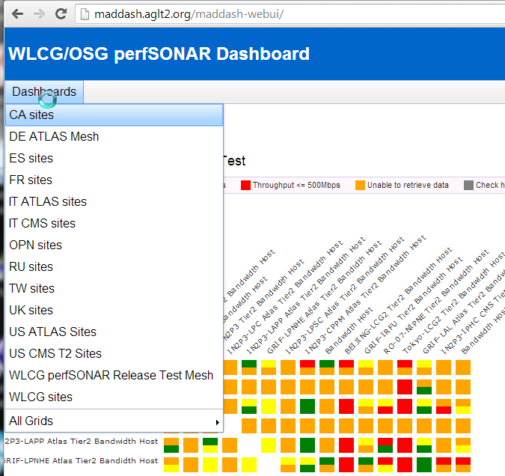
Modular Dashboard Replacement
MaDDash (Monitoring and Debugging Dashboard) is a perfSONAR-PS project developed and maintained by ESnet.
It is easy to install, provides drill-down capability and will be supported for the foreseeable future. (Install details at https://twiki.cern.ch/twiki/bin/view/LCG/MadDashWLCG )
It doesn’t provide any primitive service monitoring nor the ability to create/edit meshes via the GUI.

Slide 6
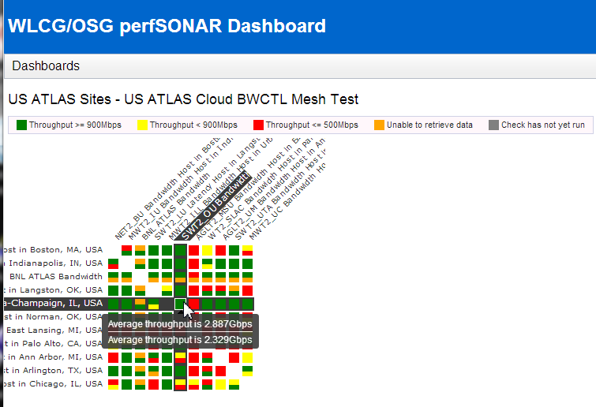
Example Throughput Mesh
Colors denote defined ranges of throughput (using default from ESnet for now)
Hovering provides results from both Measurement Archives(MAs) involved in the test
Clicking allows you to drill down

Slide 7
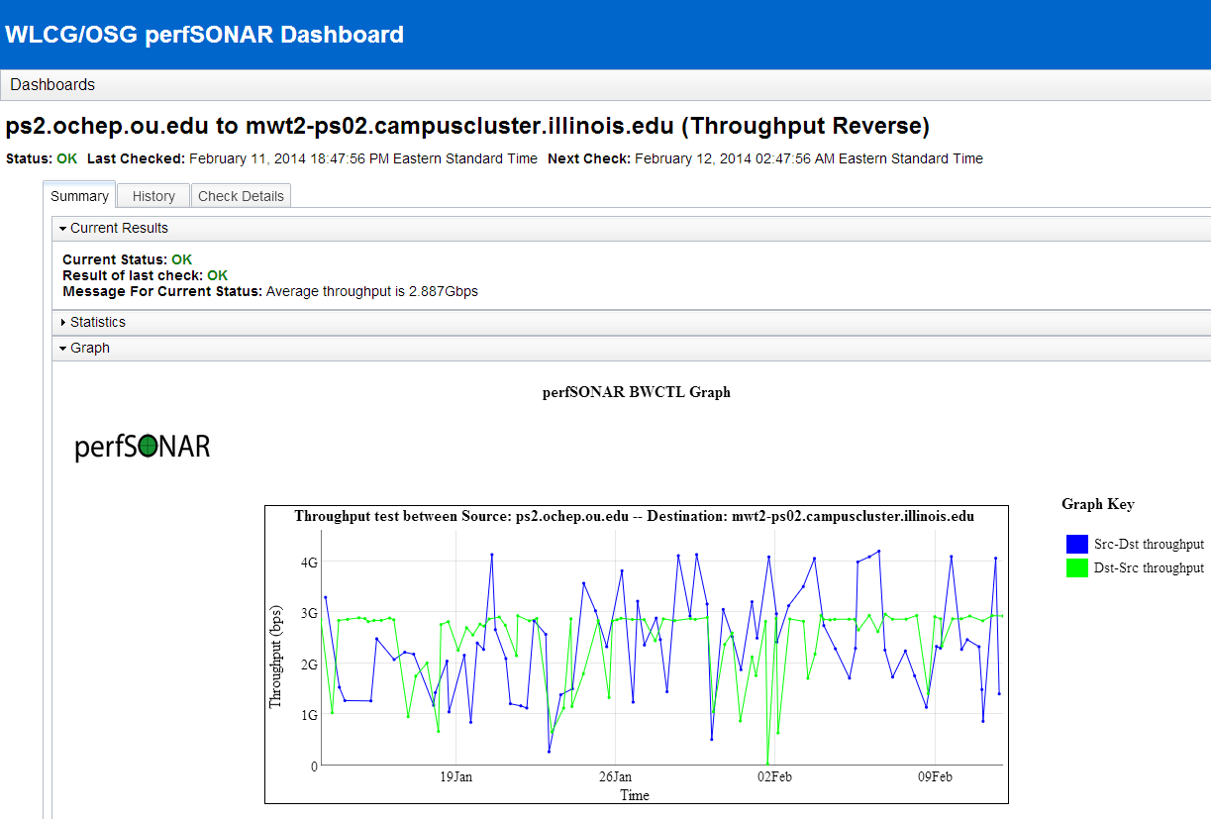
MaDDash Drill-down to Graphs

Slide 8
OMD Description and Capabilities
OMD (Open Monitoring Distribution) was selected to complement MaDDash and replicate the service testing component present in the Modular Dashboard.
OMD bundles Nagios/Icinga/Shinken with various tools in a single RPM. Easy to deploy and configure; provides nice features.
For those familiar with Nagios there is a low barrier to use.
The Check_MK (rule-based configuration) is a very powerful component we can leverage.
Installation via yum by : ‘yum install omd-1.10’ (once repo setup)
Currently prototype for WLCG evaluation is running at: https://maddash.aglt2.org/WLCGperfSONAR/omd

Slide 9
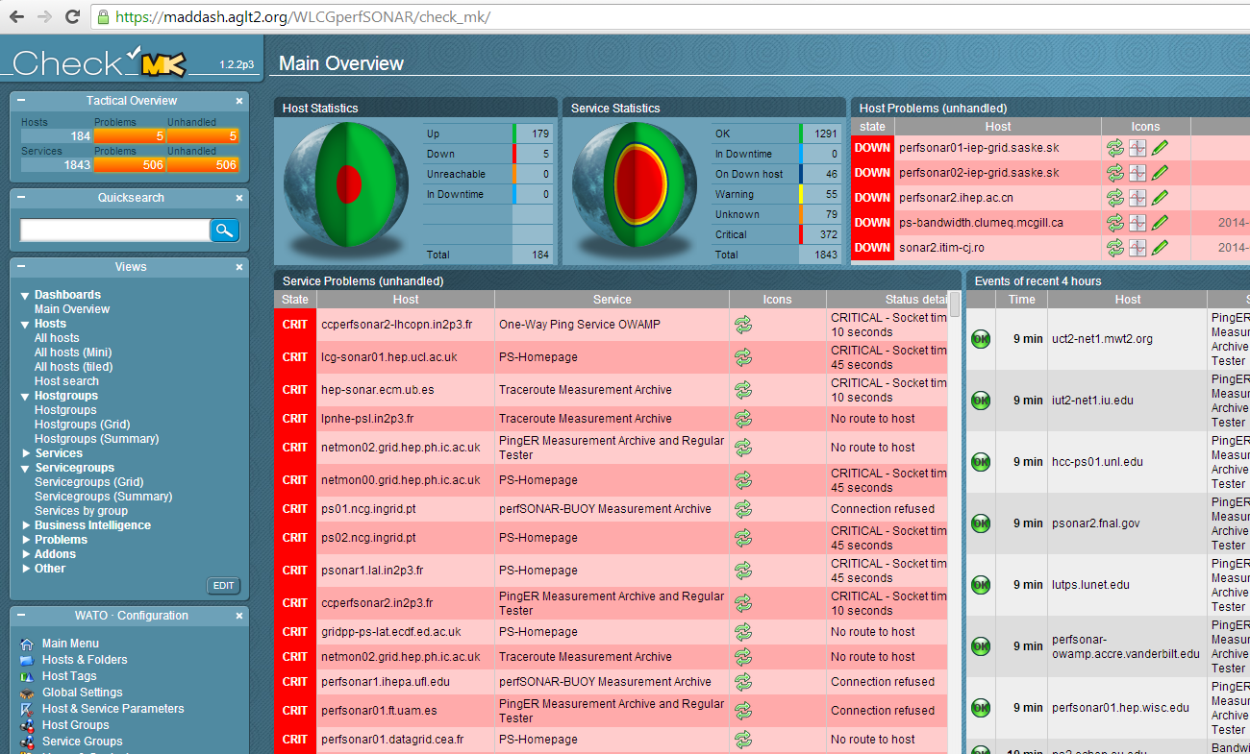
WLCG OMD Check_MK Mainpage

Slide 10
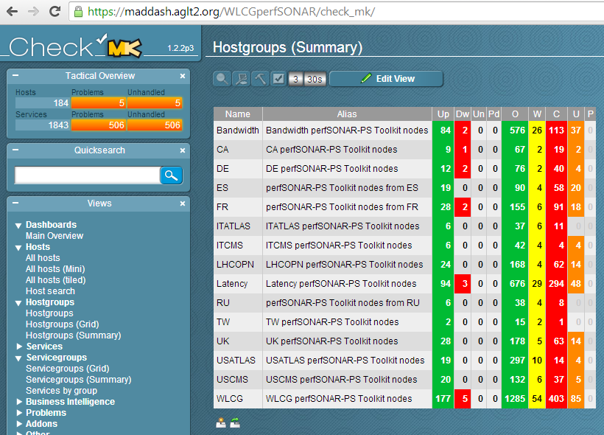
Grouping By Hosts
Check_MK rules were used to setup host groups
Easy to track Regional/VO cloud status this way
Can also organize by perfSONAR node type
The “Name” column is a link you can use to drill-down to host lists

Slide 11
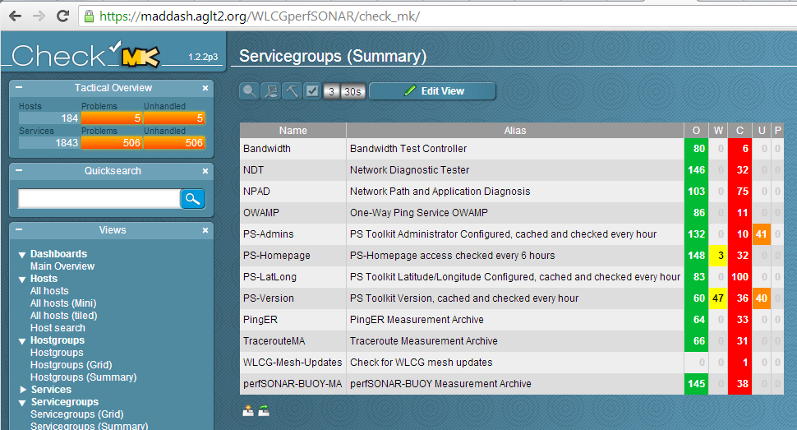
Grouping By Service
We can also group by service type, allowing us to quickly check service status by grouping. Name column is clickable. Note we check needed PS services but don’t yet have a good check of sites mesh-configuration (use dashboard for now)

Slide 12
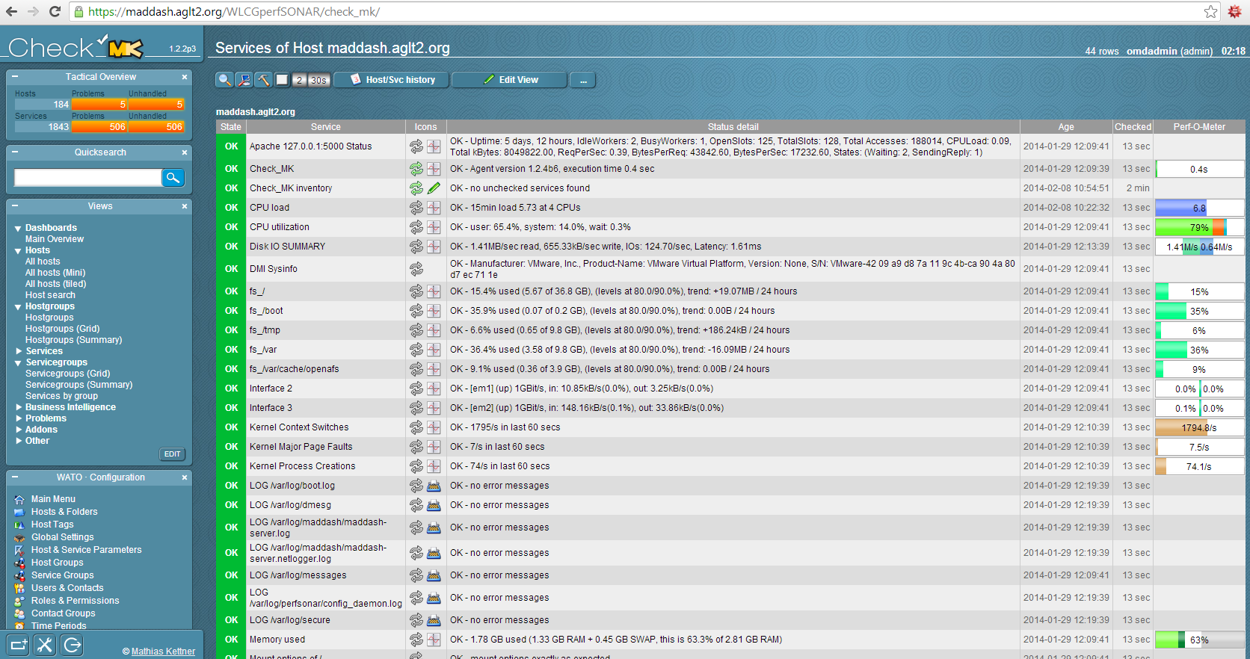
Example of Detailed Host Monitoring
Individual hosts can be monitored in detail by installing check_mk-agents
See https://twiki.cern.ch/twiki/bin/view/LCG/WLCGperfSONARMonitoring

Slide 13
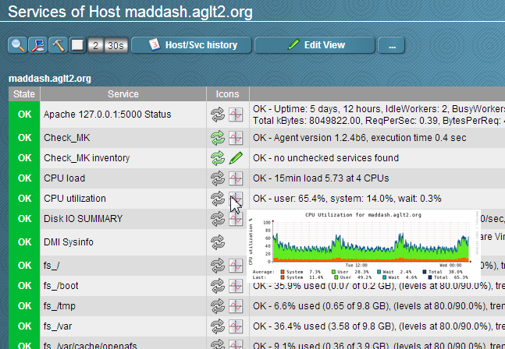
Feature: Graphs Automatically Created
Graphs are created automatically where checks provide performance data.
Hovering over the “graph” icon shows a thumbnail. Clicking takes you to a page will larger graphs sequenced by timescale (RRD).

Slide 14
Near term items
Migrate prototypes into OSG?
Goal is one service/dashboard for OSG (and WLCG)
Lots of questions about integration with MyOSG vs standalone components
Define Operations responsibilities vs OSG/WLCG’s
Complete upgrades for sites with perfSONAR-PS versions prior to 3.3.2 and ensure mesh-config use
Identify and lobby non WLCG OSG sites to install
Expand automated creation of “mesh-configs”
Prototype and test creation of WLCG meshes.
Needs interaction between Soichi and CERN/GOCDB experts.
Using and improving the OSG network service
As sites upgrade and use the mesh, verify data, displays
Begin testing “clients” of OSG network metrics
Will require some API changes to get certain typical queries
Continued documentation updates and additions
Maintain/update documented procedures
Augment as we develop new components (generation of mesh-config, datastore and API, use-cases, etc.)

Slide 15
URLs of Relevance
Network Documentation https://www.opensciencegrid.org/bin/view/Documentation/NetworkingInOSG
perfSONAR-PS OSG Installation Instructions
https://twiki.opensciencegrid.org/bin/view/Documentation/PerfSONARToolKit
Modular Dashboard Replacement Prototypes
http://maddash.aglt2.org/maddash-webui https://maddash.aglt2.org/WLCGperfSONAR/check_mk
perfSONAR-PS Installation Motivation:
https://twiki.grid.iu.edu/bin/view/Networking/WhyPerfSNOAR
Initial OSG mesh details http://confluence.grid.iu.edu/display/CENTRAL/Perfsonar+Mesh+Configs

Slide 16
Questions or Comments?
Thanks!

