Slide 1
OSG Council, Mar 14-15th 2013
Ruth Pordes, Council Chair

Slide 2
Thank you to Elizabeth for filling in for Kimberly at short notice.
She will take down decisions and action items – not full minutes.

Slide 3
Debrief on AHM
Very energetic, team building, team meeting, AHM
Well Done and Much Appreciation to Rob Quick and his Team!

Slide 4
Aug 2012 - Mar 2013
August: Take concrete decisions towards ensuring the Council membership and agendas are truly representative of and focused on extending the mutual benefits of new communities (especially non-physics and campus) and the OSG.
March: Application by Campus Infrastructure at CRC/ND accepted onto the Council. 2 other approaches in progress but both individuals have constraints: a) overload b) availability for the months traditionally have face to face meetings.

Slide 5
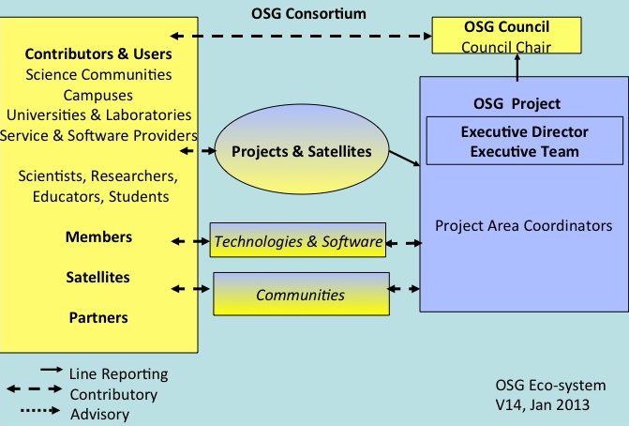
Consortium Members:
All organizations and their members who benefit from the OSG eco-system. Benefits include use of and/or contributions to one or more of the resources, the fabric of services, software, computer science experimentation, sociological study, etc.
Council Members:
Govern. Represent all Consortium Members. Are the most active contributors to the mission. Oversee the Projects.

Slide 6
Aug 2012 - Mar 2013 cont.
August: Hear about the work plans for OSG, our Satellites and our members. Identify gaps in addressing the needs and objectives of members. Decide on sub-groups of (delegees of) the Council to think about whether and/or how to address these gaps.
March: Decided on 3 sub-committees. Reports available for discussion later in the meeting.

Slide 7
Ongoing Actions
Keep list of action items which are followed up on and are closed. Now at ~90 of which ~5 remain open.
Too Many.
Not all “complete” – some “dropped”.
Keep to Roberts rules of order to help move the agenda forward.
Work in progress

Slide 8
Agenda for this meeting
Understand /endorse progress and direction of the OSG Project.
Hear about usage and plan for use of OSG SP by XSEDE allocated applications.. and update on being an SP.
Hear, discuss, (no worries?) about PKI transition project progress (DOE Grids stops issuing certs Mar 23rd) and new Satellite on VO IDM.
Review/understand the 3 sub-committee reports.
Council members visions on continuing to carry the torch/flame.

Slide 9
VOs | Some are for PKI only
ALICE | geant4 | DREAM | NERSC*
ANL* | GLOW | DZero | Nova
ATLAS | Gluex | Engage | ORNL
Belle | GridUNESP | enmr.eu | OSG
CDF | HCC | ESGF* | OSGEDU
CMS | LBNL | Fermilab | SBGrid
CSIU | LQCD | FusionGrid* | SLAC
DayaBay | LSST | GCEDU | STAR
DES | NEBioGrid | GCVO | SURAgrid
DOSAR | NEES |  | UC3
= registered for use of PKI Service only.
Should we start recording VO “flavors” according to services used?

Slide 10
My Goals for Mar Council
Plan for next year?
Act on sub-committee recommendations
Revisit Council members key interests.
Get agreement on:
Quarterly (rather than monthly) longer, more discursive, meetings
Semi-annual in Aug/Sept a “brainstorming/white boarding” meeting

Slide 11
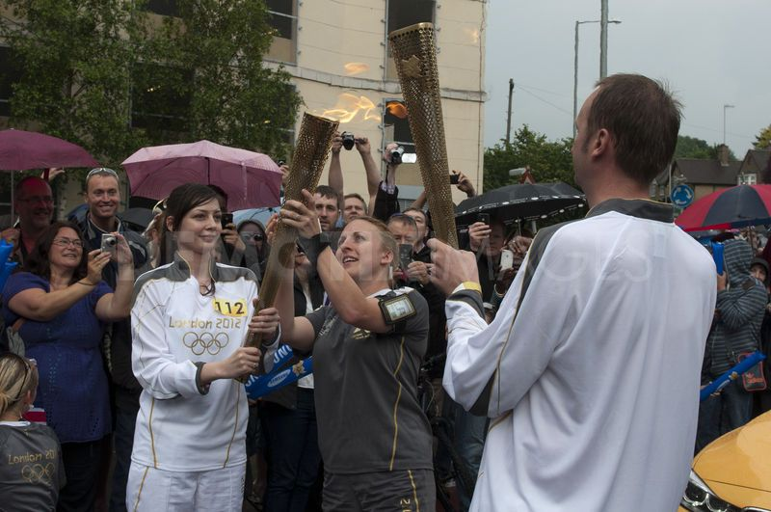

Slide 12
last – quick Communications poll

Slide 13
Do you get the newsletter?
Do you
read the newsletter?

