Slide 1
Report to the OSG Council
Ruth Pordes
Executive Director,
March 2009

Slide 2

Summary of the Collaboratory
OSG Consortium in existence since 2005.
OSG Project in 3rd year of 5 year funding cycle.
Core collaboration remains, strengthened by new participants and openness to new approaches.
US ATLAS, US CMS, & LIGO with accomplishments on the ground, open collaboration to face realities and changing needs.
Involvement of other physics increasing (CDF, D0, Alice)
Processes of engaging new non-physics users and communities being “shaken out”.
Leadership remains, strengthened by an excellent team and energetic contributors
Challenges and issues from detail to the national level continue - no shortage of work!

Slide 3
End of FY08 - slides from Jan review
DOE SciDAC/NSF review closeout
FY09 Plans
Revised project organization
Internal Security Review
Computer Science Student Fellowship
International Summer School for Grid Computing

Slide 4
Project Phase II: Months 19-36
3a
From OSG Proposal: Overarching goals are to complete the extensions needed by the initial stakeholders, increase the capabilities and usability for new communities and establish operating procedures for effective use of the infrastructure.
We see progress (now at month 28) but completion in extensions for initial stakeholders not expected by end of FY09:
LHC data taking not expectedto restart til ~FY10. Note that experiences from Run II, SDSS, other large projects dictate that significant evolution in capability, technologies and performance will be needed for at leat 3-5 years after the start of data taking.
Advanced (FY11) LIGO involves significantly increased data rates.

Slide 5
Project Phase II: Science Goals
3a
Status related to the plans in the proposal for 6 science stakeholders show mix of successful use and evolution towards Community Grid model (use of services & software):
 | Proposal | Status
LIGO | Expand ..applications such that the entire LIGO Scientific Collaboration user base derives scientific benefit from transparent operations across LDG and OSG. | Evolution of model to use of OSG Services and Software on LIGO Community Grid, with specific analysis (Einstein@home) running on OSG.
LHC | Support for low and then high luminosity LHC Physics analysis. ... | Delayed due to delay in accelerator schedule.
STAR | Support for user batch analysis on the distributed facility.... | Evolution of model to use of OSG Services and Software on STAR Community Grid/Clouds, with data movement supported by OSG.
CDF | Analysis CAF infrastructure and data analysis applications on the OSG-CAF | Development in progress. Significant throuhgput across FermiGrid.
D0 | Initial support for user analysis on some OSG sites.... | Good throughput for reprocessing and simulation; Analysis application testing in progress.
SDSS | Continued use with scaled resource needs | SDSS analysis needs finished.

Slide 6
Project Phase II: Facility
3a
Work continues in all areas; Progress in some areas slowed due to realities of complexity and difficulty of some problems in the heterogeneous, distributed environment.
Proposal | Status
Reduce the “in-effectiveness” metrics of the Facility by 50% | Operations working on measurements of uptime, effort, response times etc. to make more quantitative assessment towards the goal.
Deploy distributed logging infrastructure and establish periodic analyses of cyber security audit logs | Currently using logs from accounting information. (Some discussion with SCIDAC CEDPS/Troubleshooting & CDIGS/Auditing)
Support transparent data movement between OSG & EGEE. | In ongoing production on WLCG. Maybe added needs for data taking. (Continued collaboation with Globus/CEDPS GridFTP efforts)
End to end monitoring and problem determination across the Grid infrastructures. | Currently remains responsibility of VOs themselves. Difficult problem, with insufficient computational scientist effort available in OSG.
Support transparent movement of data and applications across OSG & TeraGrid. | Initial tests of automated job dispatch from OSG to TeraGrid NCSA site in progress (Dark Energy Survey, D0).

Slide 7
Project Phase II: Education, Training
3a
Deliverables are being met. Actual effectiveness of overall goals of “training new users/site administrators to enter OSG” give concern (see later in metrics section).
Support of I2U2 VO(s) | None needed to date.
Add new modules as needed e.g. SRM. | OSG training programs have added modules in storage and workflow, will add resource selection in early 2009.
Create tutorial material to provide necessary prerequisites in LINUX and networking. | Training modules from Nov ‘08 site admins workshop are being resused.
Setup of student VO for independent research projects | OSGEDU and OSG VOs in use (ref Alain/Mine’ talk).
Modularize courseware for self-paced delivery. Test and extend existing material | First self-paced course released. Little feedback to date. Course material used by CS faculty (RIT, UofMissouri)
South African Grid site launched for scientific analysis. | Organizational issues in the SA group have caused delay.

Slide 8
Project Phase II: Extensions
3a
Priority remains with robustness, reliability, ease of use and (as anticipated) meeting the direct needs of new users (effort moved from Extensions to VO & Engage support over past year).
Proposal | Status
Expand the use of new capabilities introduced in the previous phase towards additional application communities. | Late binding technology successfully used by Molecular Biology App, with publication of science result.Opportunistic storage roll-out more difficult than expected. Working with initial users.
Expect to spend significant effort on understanding robustness, reliability, efficiency, and ease of operations issues...Work with computer science partners on new releases that address these issues. | Scalability, WMS, metrics areas doing work here. New versions of condor, globus in response to findings. Progress slowed due hiring delays
Deliver a first production system that incorporates new network management tools into the facility. | Needs modified to monitoring tools, currently being added to VDT
Deploy a high-level user language to consistently express user interactive analysis and batch-based workflow. | Dropped due to lack of stakeholder request.
Expect to work on specifying requirements for new capabilities with new communities that started initial operations on the OSG during the previous phase. | Ongoing effort in VO Group.
Deliver the final auditing system to be used by OSG for the remainder of this 5-year funding period. | Not started due to lack of appropriate effort.

Slide 9
Defining and Measuring Goals
3a
The baselined WBS defines science and project deliverables and milestones. The % completion gives a measure of matching deliverables to goals.
For FY08 65% completion of 264 tasks.
Carry-forward or cancelled tasks mainly due to delay of (abitrary) OSG Software Release 1.2 software release from 10/08 to Q2 ’09 to allow change from full install to incremental upgrade (see Alain/Mines talk).
Some science goals carried forward or cancelled due to change in experiment needs.
We define a set of measurable goals annually. For FY08 17 were defined of which 11 were fully met. Illustrative examples follow.
We have documented a model for the Value and Benefit of OSG. (The initial exercise was useful for us, and we will be interested in whether there is continued utility).

Slide 10
Some of the FY08 Metrics Goals
3a
These examples in the main show throughput values of the Facility; the easiest to measure but not really indicative of the effectiveness or “good-output” of the system.
We talk about scientific publications later on in this talk.
Goal | Status | Comments
5 citations for OSG contribution in scientific publications | MISSED | 4 explicit citations.
1000 individual end users using the OSG. | ACHIEVED | 1427 individuals used the OSG (when report written)
10% sharing (opportunistic use) of OSG Resources | ACHIEVED | Average of >20% as measured by accounting systems.
Average of 60 functional compute resources per month | ACHIEVED | Average of 60 measured centrally by resource availability tests
Average 100,000 batch jobs a day over one week and average 75,000 batch jobs a day over one month. | ACHIEVED | Average of 150k jobs a day sustained over more than a week
Have an average of 30,000 CPUs utilized during 1 week | MISSED | 16k simultaneous jobs recorded. (when report written; now at >25K)

Slide 11
Example: Response to need for Security Patches
3a
Goal: 95% of all high priority patches or security patches are released into the production infrastructure within 1 week of the first notice – defined as a way of showing commitment to security. NOT ACHIEVED
18 of 23 (78%) of security-related tickets 18 were closed within 1 week.
FY08 saw twice the number of incidents than FY07 (more information in the metrics report).
The problems are hard (our Security Team is “best of breed”):
Affects sites and users who can be advised but not required to make changes.
Security Officer has authority to exert pressure through “removal” but...
Is the goal well defined?
Will the incident rate continue to grow at this rate?

Slide 12
Example: Do we successfully Educate & Train new entrants ?
3a
Goal: Train more than 300 people and have more than 10 run jobs on OSG after the class.
~250 people attended training including 3 traditional “OSG Grid Schools”. (40% students; 20% female; 30% facility researchers; 10% IT;35% minority)
15 attendees ran jobs on OSG after the class ended.
We are concerned about the low % of follow on users.
In FY09 we are realigning the program to include more applications focus and to be more integrated with the OSG training for new user and site administrators,

Slide 13
The January Review (1)
Charge & Reviewers
Closeout
Continued Challenges:
Scientific productivity argument could be presented in a more compelling manner.
Can’t rely on interaction with VOs to effectively represent what’s happening in end user community.
Didn’t tell OSG’s excellent story in a cohesive way.
Accomplishments:
OSG is a very critical piece of the infrastructure for the LHC and potentially important for LIGO.
This initiative has significant potential value for other large-scale science endeavors.
Clear that model for incorporating new HW resources can be successful – i.e. enabled CDF resources for D0 re-processing.

Slide 14
Encouragement to Proceed
National cyberinfrastructure, of this type (OSG) is important, getting established and funding agencies need to appreciate the importance of this evolution. Encourage broad thinking on this by agencies and researchers.
Larger returns possible from serving large scale science (short term) communities. (i.e. climate community)
Continue to engage in the larger strategic questions of national cyberinfrastructure(s) among relevant parties.
Continue to iterate on the best rules and framework for federation – evolutionary and strategic for all large cyberinfrastructures – be focused and need-driven (i.e. archival storage).
Create conditions at the right levels for discussion of frontier issues of cyberinfrastructure.

Slide 15
FY09 to date
Collected requirements from the experiments.
Agreed on priorities between OSG and the experiments. WBS written by area coordinators with project manager and baselined. 1st quarter update in progress.
New face: Dave Ritchie Communications area coordinator.
Software task lists defined and tracked by Software Tools Group which provides oversight of all s/w work in the project.
All Hands meeting & talk;
Major account managers; Quarterly meetings with key stakholders; Annual phone meetings with partners; are all being useful.
Value of OSG document – sometime request of Council. Would ask for a review of this.
WLCG MB accounting/ availability reporting in place; Installed Capacity in implementation

Slide 16
All Hands Meeting
At LIGO Livingston.
Very very well organized and coordinated by Kent. A BIG THANK YOU
Good program committee helped. Workshops well attended; US ATLAS Tier-3 and US CMS Tier-2 energetic.
Plenary day focus on LIGO + ; Presentations by program officers very useful (still challenge for talks in the last pm when people are leaving).

Slide 17
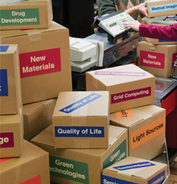
Summary of the Operations
We are successfully continuing to operate a large, shared, distributed system.
We are making more than promised contributions to the World Wide LHC Computing Grid (WLCG).
>2500 people used resources through the OSG in 2008.
We deployed 1st software version labelled Production Level OSG 1.0
We have improved monitoring, administrative services and security response processes.
Notes:
on behalf of many stakeholders

Slide 18
Improvements in Technologies in 2008 Integrated into the Software Stack the Virtual Data Toolkit (now at ~70 components)
Initial use of opportunistic storage for science output (D0)
Early adoption in physics and generalization of “overlay” job scheduling or “pilot” technologies
Resource service validation framework and (security, functionality) probes for monitoring site configurations and services
Site Resource selection and OSG matchmaking services in more general use

Slide 19
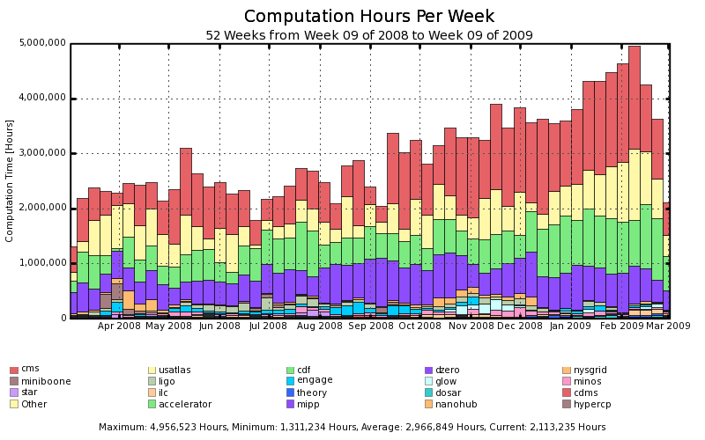
VO throughput over past year >40 sites contributing
20,000 CPUdays/day
ATLAS & CMS
CDF & D0
The Rest

Slide 20
Science output
CDF + D0 >100 physics publications in 2008;
STAR >10 publications in 2008.
In discussion with Patrick about how to add LIGO
~5 non-physics publications.
The Challenge of Engagement.

Slide 21
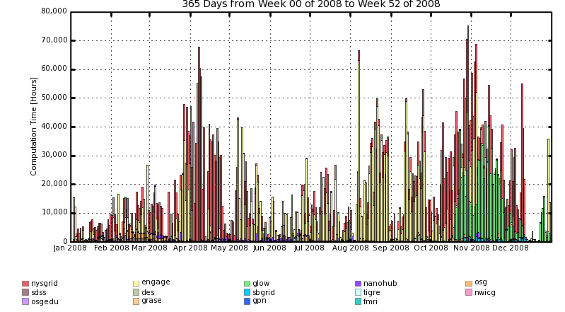
Non-Physics VOs & Usage – 2008
Applications smoothly come in, use resources and disappear (e.g. Glow, protein mapping)
At max <~4,000 cpudays/day queue times increased.
Total shows significant “cycles of use”.
1,000 CPUdays/day

Slide 22
Search for a Production Manager
Recommendation of JOT to fill production manager position – 10/08
Distributed job description to all organizational PIs - 11/18/08
Two applicants, both senior and good potential – 1/10/09
Both Interviewed by Executive Team (in person), Council-co-chairs (by phone), Software Tools Group co-chairs & operations coordinator (In person) – 2/10/09
Executive Director decision, with consensus of interviewers, to offer Production Manager position to Dan Fraser 0.5 FTE with front loaded 1.0 FTE for 6 months.
Interest from both sides for 2nd candidate would be at most 0.5 FTE. Expected to know by Mar 1st. Plan to discuss “need to know by” date (?April 1)

Slide 23
New Project Structure
Joint Oversight Team
DOE & NSF
OSG PI: Miron Livny
OSG Co-PIs: Paul Avery, Kent Blackburn, Ruth Pordes
OSG Council
Chairs: Paul Avery, Kent Blackburn,
Executive Team
Executive Director: Ruth Pordes,
Technical Director: Miron Livny,
Project Manager: Chander Sehgal,
Major Account Managers to
US ATLAS, US CMS, LIGO
Extensions /Applications
Torre Wenaus, Frank Würthwein
Metrics: Brian Bockelman
Comm. & iSGTW: David Ritchie
Proj Mgmt: Chander Sehgal
Software Tools
Alain Roy, Mine Altunay
Production Coordinator Dan Fraser, tbd?
Software + VDT : Alain Roy, (Storage: Tanya Levshina)
Scalability: Frank Wuerthwein
WMS: Maxim Potekhin
Storage: Matt Crawford
Internet2: Rich Carlson
Security Officer: Mine Altunay; Deputy: Doug Olson
Integration : Rob Gardner : Site Coordination
Operations: Rob Quick
User Communities:
VOs,
Site Administrators
VOs : Abhishek Rana, Britta Daudert
Asking for Council Endorsement of these changes.
Education, Training: Alina Bejan
E4CI
CI-Team
Project
Engagement: John McGee; Campus Grids: Sebastien Goasguen
Production Facility
Feb 2009
Notes:
23

Slide 24
Internal Review of Security Program
Security Plan (FY07) specifies “annual review of security called by the Executive Director.”
1st security review held Feb 26/27th. Jim Marsteller (TG), Todd Tannenbaum(Condor), Von Welch(NCSA), Romain Wartel(EGEE). Summary “Thank you and your team for the work you put into this review. I believe I speak for the whole review committee when I say we were very impressed with your teams accomplishments.”

Slide 25
Computer Science Student Fellowship Program
Concern by Executive Board at lack of engagement by Computer Scientists in OSG as a wonderful laboratory for Computer Science.
Proposal by UofC for OSG funding (0.5 FTE, within scope of current budget) of a CS graduate student studying errors encountered by ATLAS and other jobs on OSG.
“Opportunistic” definition of CS Student Fellowship Project under which this work will be done.

Slide 26
The Open Science Grid Computer Science Student Fellowship provides for one year of funding to a graduate or undergraduate student in Computer Science. The fellowship provides funding for up to 20 hours a week for computer science research of value both to the OSG and the broader community. The Fellowship is offered for the institutions that are funded as part of the OSG project at the time of application and delivery of the research.
The CS Fellowship program consists of:
The Project Manager sends a solicitation for applications to the CS Fellowship to the OSG organizational PIs and Council members before May 1st of each year.
Application submission by June 1 of each year.
The application consists of a few page description of the research to be performed with the goals of the work; the research sponsor or mentor and student’s information; and the proposed budget and timeline. The mentor is expected to be familiar and committed enough to OSG to act as the liaison to the project, answer the student’s questions about OSG etc.
A committee of 3 members of the OSG Consortium (of which at least one is from the OSG Council, and one from the OSG staff) will review the applications. The committee is appointed by the OSG Technical Director and makes a recommendation on the selected candidate to the Executive Team. The Executive Team makes the final selection by July 1.
Once the candidate is selected the funding is included in the SOW for the institution for the following fiscal year. The funding period is expected to start at the beginning of the academic year and last 12 months.
Guidance and ongoing help for the Fellow is the responsibility of the mentor in collaboration with identified OSG staff.
During the Fellowship itself the fellow will submit quarterly reports to the OSG Executive Board on the progress of the research. The OSG project management will organize two meetings during the time of each fellowship where the student and sponsor will present details of the work for discussion and feedback.
It is expected the student will write and publish a paper in a peer-reviewed journal during the time of the fellowship. Papers written will be available from the OSG document repository.
There is no requirement for code development. However, any code developed as part of the research will be available for further use by the OSG.
The OSG Executive Team will work with the mentor on any issues or concerns during the life of the fellowship.
At the end of each fellowship the committee that selected the Fellow will meet to review the success of the research and give input for future work of the student and for the future of the OSG CS Fellowship.
Asking for Council Endorsement of this program

Slide 27
International Summer School for Grid Computing

Slide 28

And in the current climate: OSG, Facility, & the National Cyberinfrastructure ?
How can OSG’s experience on the Campuses be of most value?
Is OSG a facility? a Software Facility?
What is OSG’s role and place in partnering with TeraGrid?
How can OSG contribute to the usability of the Leadership Class Facilities?
How does OSG contribute to software sustainability?
Is OSG an exemplar from which Europe in its next phase of National Grids can benefit?

