Slide 1

Grid Execution of Virtual Data Workflows
Summer Grid Workshop 2005
UT Brownsville South Padre Island Center
14 July 2005
Presented by: Mike Wilde
Argonne National Laboratory
Mathematics and Computer Science Division
Exercise & Example Preparation: Jed Dobson
Dartmouth College
Brain Imaging Center, Department of Psychology

Slide 2
Acknowledgements:
VDS is a Large Team Effort
The Virtual Data System group is:
  ISI/USC: Ewa Deelman, Carl Kesselman, Gaurang Mehta, Gurmeet Singh, Mei-Hui Su, Karan Vahi
  U of Chicago: Catalin Dumitrescu, Ian Foster, Luiz Meyer (UFRJ, Brazil), Doug Scheftner, Jens Voeckler, Mike Wilde, Yong Zhao
  www.griphyn.org/vds
The Pegasus Planner is the work of
Ewa Deelman, Carl Kesselman, Gaurang Mehta, and Karan Vahi
Applications described are the work of many people, including: James Annis, Rick Cavanaugh, Jed Dobson, Dan Engh, Rob Gardner, Albert Lazzarini, Natalia Maltsev, Marge Bardeen, and their teams
Pegasus Slides from:
SC2004 Virtual Data System Tutorial
Gaurang Mehta, Karan Vahi, Mike Wilde
Globus Alliance

Slide 3


Acknowledgements
GriPhyN, iVDGL, and QuarkNet
(in part) are supported by the National Science Foundation
The Globus Alliance, PPDG, and QuarkNet are supported in part by the US Department of Energy, Office of Science; by the NASA Information Power Grid program; and by IBM

Slide 4
Functional View of Virtual
Data Management
Application
Location based on
metadata attributes
Metadata Service
Planner:
Data location,
Replica selection,
Selection of compute
and storage
resources
Replica Location
Service
Location of one or
more physical replicas
State of grid resources,
performance measurements
and predictions
Information Services
Security and Policy
Executor:
Initiates
data transfers and
computations
Data Movement
Data Access
Compute Resources
Storage Resources

Slide 5
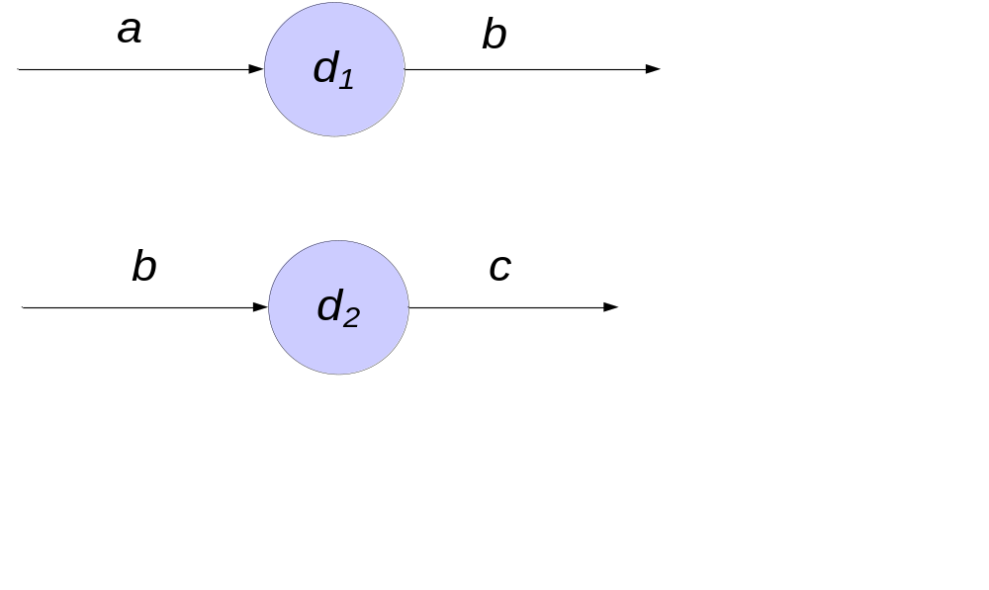
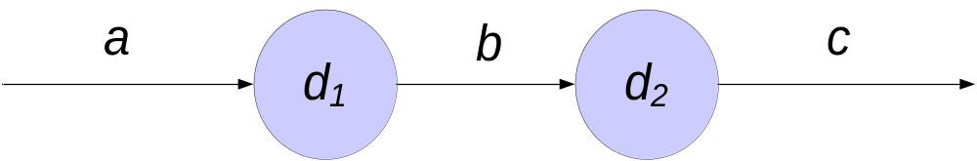
VDL and Abstract Workflow
VDL descriptions
User request data file “c”
Abstract Workflow

Slide 6
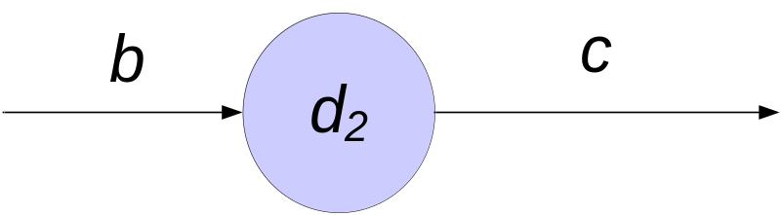
Example Workflow Reduction
Original abstract workflow
If “b” already exists (as determined by query to the RLS), the workflow can be reduced

Slide 7
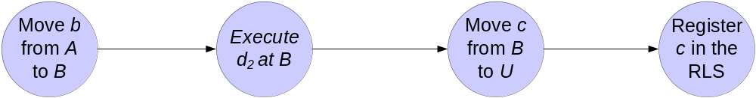
Mapping from abstract to concrete
Query RLS, MDS, and TC, schedule computation and data movement

Slide 8
Workflow management in GriPhyN
Workflow Generation: how do you describe the workflow (at various levels of abstraction)? (Virtual Data Language and catalog “VDC”))
Workflow Mapping/Refinement: how do you map an abstract workflow representation to an executable form? (“Planners”: Pegasus)
Workflow Execution: how to you reliably execute the workflow? (Condor’s DAGMan)

Slide 9
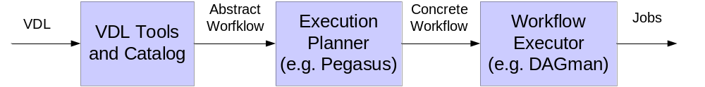
Executable Workflow Construction
VDL tools used to build an abstract workflow based on VDL descriptions
Planners (e.g. Pegasus) take the abstract workflow and produce an executable workflow for the Grid or other environments
Workflow executors (“enactment engines”) like Condor DAGMan execute the workflow

Slide 10
Terms
Abstract Workflow (DAX)
  Expressed in terms of logical entities
  Specifies all logical files required to generate the desired data product from scratch
  Dependencies between the jobs
  Analogous to build style dag
Concrete Workflow
  Expressed in terms of physical entities
  Specifies the location of the data and executables
  Analogous to a make style dag

Slide 11
Pegasus
Pegasus - Planning for Execution on Grids
Planning framework
Take as input an abstract workflow
  Abstract Dag in XML (DAX)
Generates concrete workflow.
Submits the workflow to a workflow executor (e.g. Condor Dagman).

Slide 12
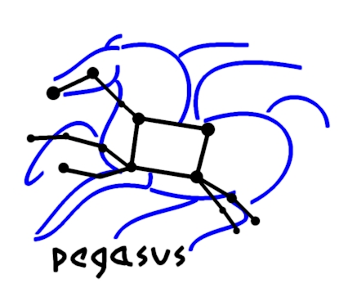
Pegasus Outline
  Introduction
  Pegasus and How it works
  Pegasus Components and Internals
  Deferred Planning

Slide 13
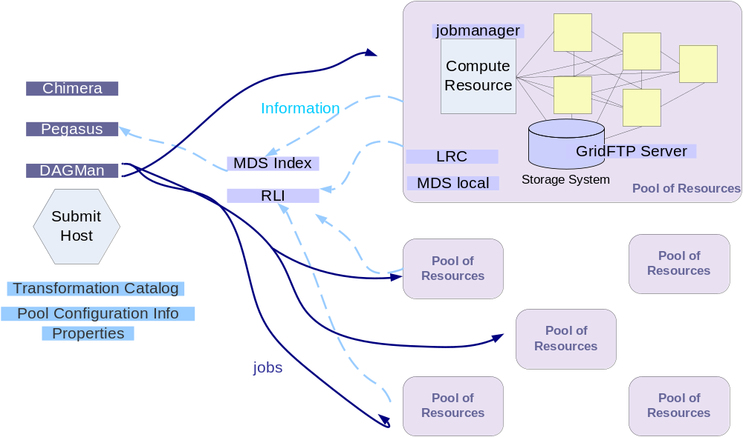
Notes:
Focus on the box in the middle.

Slide 14
Abstract Workflow Reduction
Job c
Job a
Job b
Job f
KEY
The original node
Input transfer node
Registration node
Output transfer node
Node deleted by Reduction algorithm
Job d
Job e
Job g
Job h
Job i
The output jobs for the Dag are all the leaf nodes i.e. f, h, i.
Each job requires 2 input files and generates 2 output files.
The user specifies the output location

Slide 15
Optimizing from the point of view of Virtual Data
Job c
Job a
Job b
Job f
KEY
The original node
Input transfer node
Registration node
Output transfer node
Node deleted by Reduction algorithm
Job d
Job e
Job g
Job h
Job i
Jobs d, e, f have output files that have been found in the Replica Location Service.
Additional jobs are deleted.
All jobs (a, b, c, d, e, f) are removed from the DAG.

Slide 16
Planner picks execution
and replica locations
Plans for staging data in
Job c
adding transfer nodes for the input files for the root nodes
Job a
Job b
Job f
Job d
Job e
Job g
Job h
KEY
The original node
Input transfer node
Registration node
Output transfer node
Node deleted by Reduction algorithm
Job i

Slide 17
Staging data out and registering
new derived products
Job c
Job a
Job b
transferring the output files of the leaf job (f) to the output location
Job f
Job d
Job e
Job g
Job h
Staging and registering for each job that materializes data (g, h, i ).
Job i
KEY
The original node
Input transfer node
Registration node
Output transfer node
Node deleted by Reduction algorithm

Slide 18
The final, executable DAG
Input DAG
Job g
Job h
Job c
Job a
Job b
Job i
Job f
Job d
Job e
KEY
The original node
Input transfer node
Registration node
Output transfer node
Job g
Job h
Job i

Slide 19
Pegasus Outline
  Introduction
  Pegasus and How it works
  Pegasus Components and Internals
  Deferred Planning

Slide 20
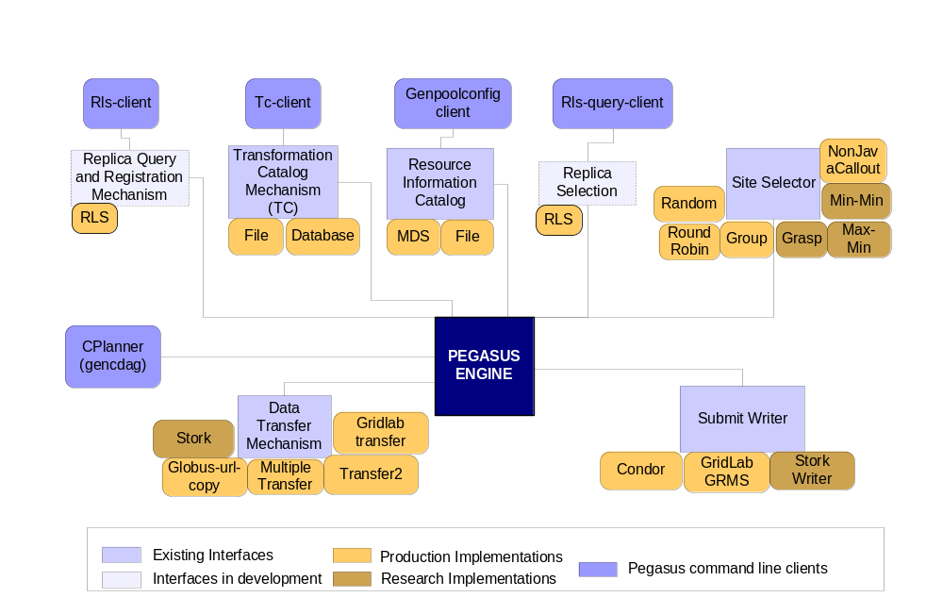
Pegasus Components

Slide 21
Replica Location Service
Pegasus uses the RLS to find input data
RLI
Computation
LRC
LRC
LRC
Pegasus uses the RLS to register new data products
Notes:
Should explain and remind them about RLS and what RLI and LRC’s are. Remember to use full names as opposed to acronyms.

Slide 22
Pegasus Components

Slide 23
Transformation Catalog
Transformation Catalog keeps information about domain transformations (executables).
It keeps information like the logical name of the transformation, the resource on the which the transformation is available and the URL for the physical transformation.
The new transformation catalog also allows to define different types of transformation, Architecture, OS, OS-version and glibc version of the transformation.
Profiles which allow a user to attach Environment variables, hints, scheduler related information, job-manager configurations

Slide 24
Transformation Catalog
A set of standard api's are available to perform various operations on the transformation Catalog.
Various implementations are available for the transformation catalog like
  Database :
    Useful for large Catalogs and supports fast adds, deletes and queries.
    Standard database security used.
  File Format :
    Useful for small number of transformations and easy editing.
    isi vds::fft:1.0 /opt/bin/fft INSTALLED INTEL32::LINUX ENV::VDS_HOME=/opt/vds
Users can provide their own implementation.
Notes:
Show an example on the slide and show it as demo.

Slide 25
Pegasus Components

Slide 26
Resource Information Catalog
(Pool Config)
Pool Config is an XML file which contains information about various pools/sites on which DAGs may execute.
Some of the information contained in the Pool Config file is
  Specifies the various job-managers that are available on the pool for the different types of schedulers.
  Specifies the GridFtp storage servers associated with each pool.
  Specifies the Local Replica Catalogs where data residing in the pool has to be cataloged.
  Contains profiles like environment hints which are common site-wide.
  Contains the working and storage directories to be used on the pool.

Slide 27
Resource Information Catalog
Pool Config
Two Ways to construct the Pool Config File.
  Monitoring and Discovery Service
  Local Pool Config File (Text Based)
Client tool to generate Pool Config File
  The tool gen-poolconfig is used to query the MDS and/or the local pool config file/s to generate the XML Pool Config file.

Slide 28
Monitoring and Discovery Service
MDS provides up-to-date Grid state information
  Total and idle job queues length on a pool of resources (condor)
  Total and available memory on the pool
  Disk space on the pools
  Number of jobs running on a job manager
Can be used for resource discovery and selection
  Developing various task to resource mapping heuristics
Can be used to publish information necessary for replica selection
  Publish gridftp transfer statistics
  Developing replica selection components
Notes:
Refresh what is MDS and explain what we are doing with it in Pegasus.

Slide 29
Pegasus Components

Slide 30
Site Selector
Determines job to site mappings.
Selector Api provides easy pluggable implementations.
Implementations provided
  Random
  RoundRobin
  Group
  NonJavaCallout
Research on advance algorithms for site selector in progress

Slide 31
Pegasus Components

Slide 32
Transfer Tools / Workflow Executors
Various transfer tools are used for staging data between grid sites.
Define strategies to reliably and efficiently transfer data
Current implementations
  Globus url copy
  Transfer
  Transfer2 (T2)
  Stork
Workflow executors take the concrete workflow and act as a metascheduler for the Grid.
Current supported workflow executors
  Condor Dagman
  Gridlab GRMS

Slide 33
System Configuration - Properties
Properties file define and modify the behavior of Pegasus.
Properties set in the $VDS_HOME/etc/properties can be overridden by defining them either in $HOME/.chimerarc or by giving them on the command line of any executable.
  eg. Gendax –Dvds.home=path to vds home……
Some examples follow but for more details please read the sample.properties file in $VDS_HOME/etc directory.
Basic Required Properties
  vds.home : This is auto set by the clients from the environment variable $VDS_HOME
  vds.properties : Path to the default properties file
    Default : ${vds.home}/etc/properties

Slide 34
Pegasus Clients in the Virtual Data System
gencdag
  Converts DAX to concrete Dag
genpoolconfig
  Generates a pool config file from MDS
tc-client
  Queries, adds, deletes transformations from the Transformation Catalog
rls-client, rls-query-client
  Queries, adds, deletes entry from the RLS
partiondax
  Partitions the abstract Dax into smaller dax’s.

Slide 36
Concrete Planner Gencdag
The Concrete planner takes the DAX produced by Chimera and converts into a set of condor dag and submit files.
You can specify more then one execution pools. Execution will take place on the pools on which the executable exists. If the executable exists on more then one pool then the pool on which the executable will run is selected depending on the site selector used.
Output pool is the pool where you want all the output products to be transferred to. If not specified the materialized data stays on the execution pool
Authentication removes sites which are not accessible.

Slide 37
Pegasus Outline
  Introduction
  Pegasus and How it works
  Pegasus Components and Internals
  Deferred Planning

Slide 38
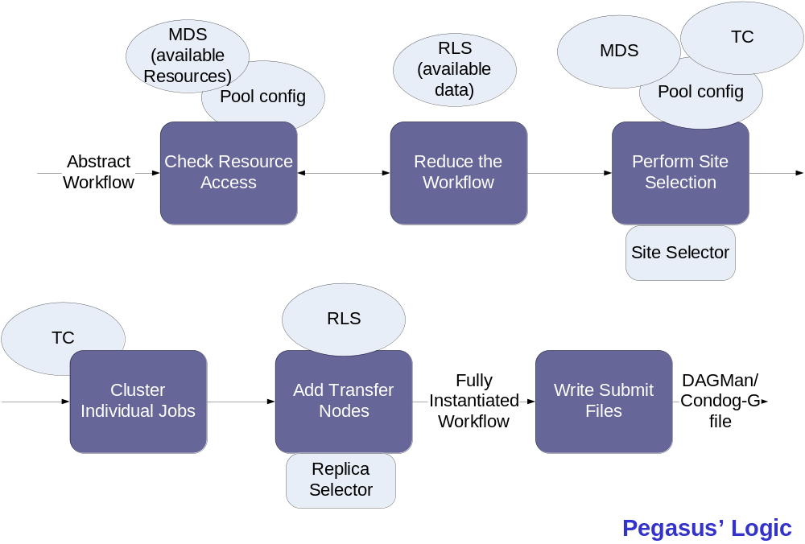
Abstract To Concrete Steps
Notes:
This is a transition slide for Karan from Full ahead to Deferred. I would talk little on this for the time the dag is executing, that Gaurang submits.

Slide 39
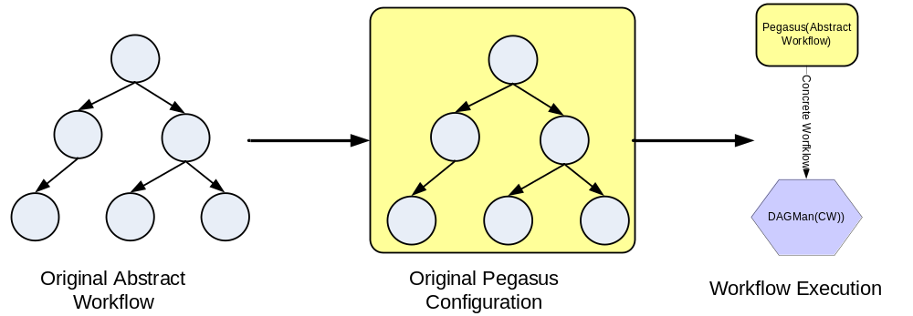
Original Pegasus configuration
Simple scheduling: random or round robin
using well-defined scheduling interfaces.

Slide 40
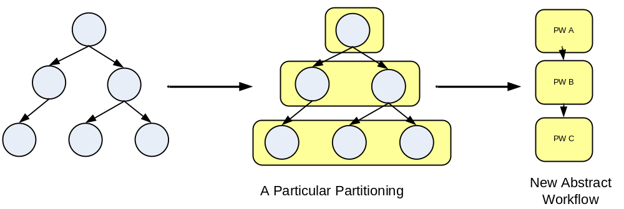
Deferred Planning through Partitioning
A variety of partitioning algorithms can be implemented

Slide 41
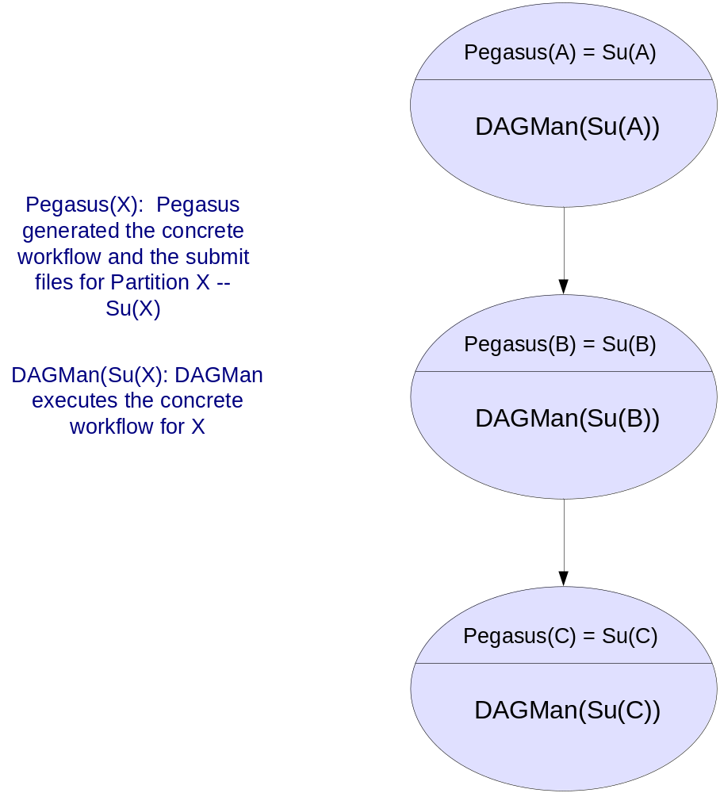
Mega DAG is created by Pegasus and then submitted to DAGMan

Slide 42
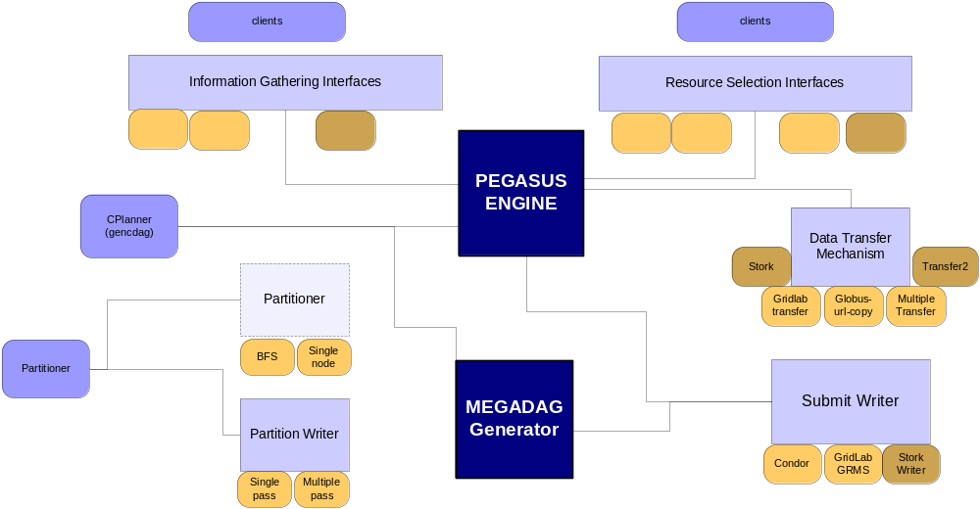
Mega DAG Pegasus

Slide 43
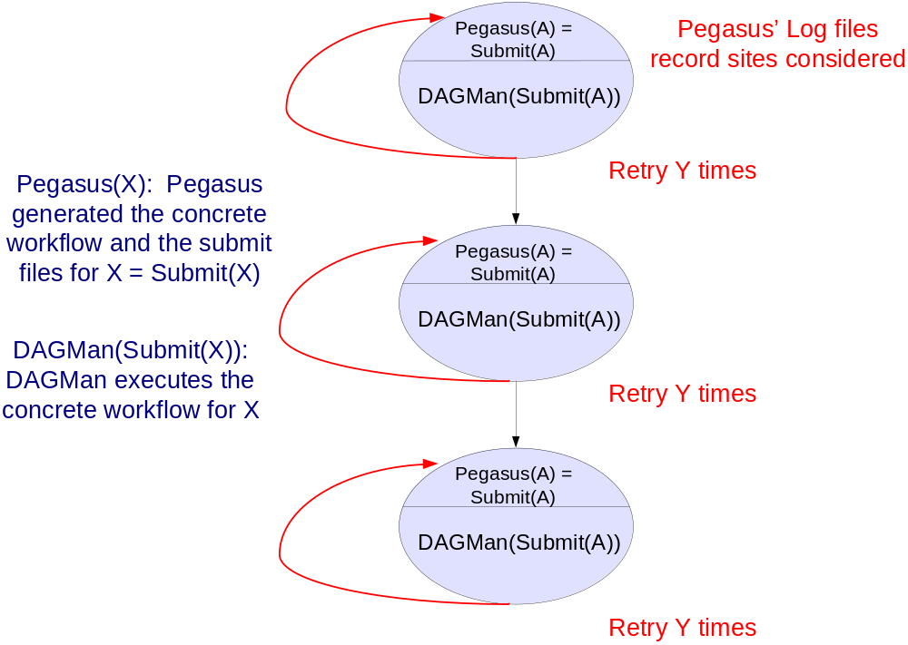
Re-planning capabilities
Notes:
Partitioning introduces a level of indirection to the workflow execution.
We now have to run the partition graph thru the DAGMAN. This we refer to as the MEGADAG.

Slide 44
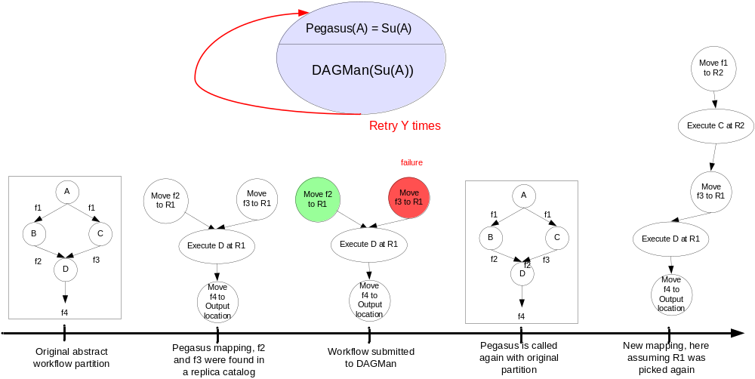
Complex Replanning for Free (almost)

Slide 45
Planning & Scheduling Granularity
Partitioning
  Allows to set the granularity of planning ahead
Node aggregation
  Allows to combine nodes in the workflow and schedule them as one unit (minimizes the scheduling overheads)
  May reduce the overheads of making scheduling and planning decisions
Related but separate concepts
  Small jobs
    High-level of node aggregation
    Large partitions
  Very dynamic system
    Small partitions

Slide 46
Partitioned Workflow Processing
Create workflow partitions
  partition the abstract workflow into smaller workflows.
  create the xml partition graph that lists out the dependencies between partitions.
Create the MegaDAG (creates the dagman submit files)
  transform the xml partition graph to it’s corresponding condor representation.
Submit the MegaDAG
  Each job invokes Pegasus on a partition and then submits the plan generated back to condor.

Slide 47
Future work for Pegasus
Staging in executables on demand
Expanding the scheduling plug-ins
Investigating various partitioning approaches
Investigating reliability across partitions

Slide 48
Future Improvements
A sophisticated concrete planner with AI technology
A sophisticated transformation catalog with a DB backend
Smarter scheduling of workflows by deciding whether the workflow is compute intensive or data intensive.
In-time planning.
Using resource queue information and network bandwidth information to make a smarter choice of resources.
Reservation of Disk Space on remote machines

Slide 49
Summary:
GriPhyN Virtual Data System
Using Virtual Data helps in reducing time and cost of computation.
Services in the Virtual Data Toolkit
  Chimera. Constructs a virtual plan
  Pegasus. Constructs a concrete grid plan from this virtual plan.
Some current applications of the virtual data toolkit -

Slide 50
For further information
Globus Project: www.globus.org
Pegasus: pegasus.isi.edu
MCS: www.isi.edu/~deelman/MCS
VDS : www.griphyn.org/vds

