Slide 1

Harold Castro
Associate professor,
Systems and Computing Engineering Department
Universidad de los Andes

Slide 2
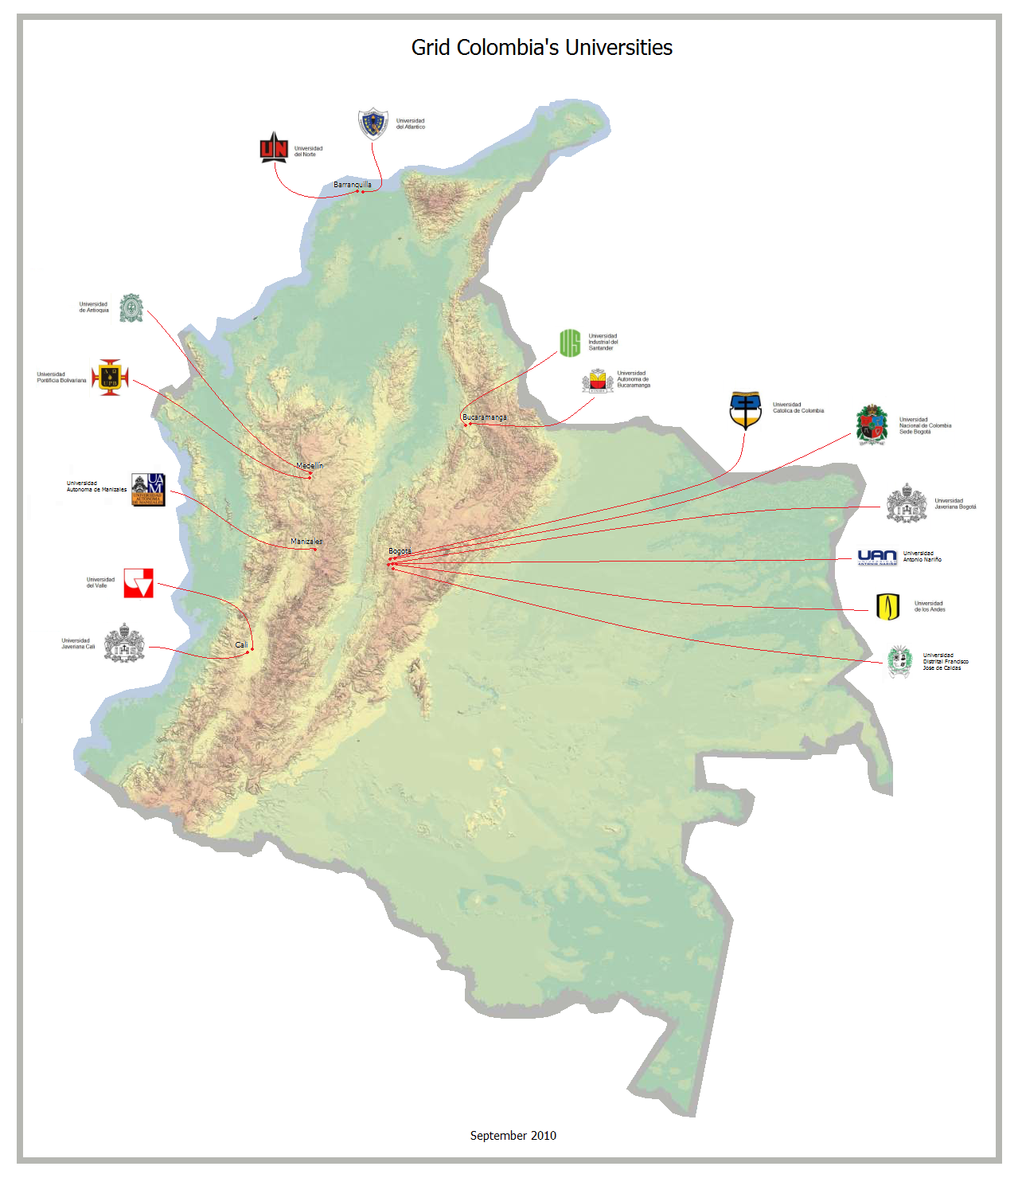

Slide 3

Members
Grid Colombia’s community is composed by 15 universities:

Slide 4

Work Methodology
Universidad de los Andes and Universidad Javeriana
are the universities in charge of coordinating the Grid
Colombia project
Support from Renata (National Research and Education Network)
Task forces:
Infrastructure
Communications
Organizational Model
Applications
Bioinformatics
Weekly f2f regional conferences
Monthly national skype conference

Slide 5
What has been done?
2 OSG and 2 EELA workshops
Training Process:
A process of knowledge replication was developed, advancing in cluster and grid training around the country in order to strengthen the group and encourage cooperation among universities
Region | Host University | Participants
Eje Cafetero | Universidad Autónoma de Manizales | 25
Valle del Cauca | Universidad del Valle | 17
Atlántico | Universidad del Norte | 14
Santander | Universidad Industrial del Santander | 18
Centro | Universidad Católica | 16

Slide 6
What has been done?
Courses content:
Condor Cluster
Installation
Configuration
Running applications
BoT
MPI
CE Installation

Slide 7
What has been done?
Installed Clusters
University | Number of Clusters
Universidad de los Andes | 3
Universidad Javeriana Bogotá | 3
Universidad Autónoma de Manizales | 2
Universidad Industrial del Santander | 1
Universidad del Valle | 2
Universidad Javeriana Cali | 2
Universidad del Norte | 2
Universidad Católica | 2

Slide 8
Current steps
National CA deployment at Universidad de los Andes
Waiting for green light
Negotiating government support
Identifying applications to be supported
MoU with National Research Institutes
Testing a National Infrastructure
Administrative process for opening TCP ports in each university
Grid Colombia VO
Installing Clusters in the remaining universities
Organizational model development

Slide 9
Next steps
Go for a production quality infrastructure
Real clusters
Integration with regional/global initiatives
GISELA
OSG
EGI
Developing/Porting applications to impact national researchers

