Slide 1
OSG Area Coordinators
Network Monitoring Update: June 24, 2015
Shawn McKee

Slide 2
Key Initiatives in Network Area
Improving perfSONAR-PS toolkit for OSG
perfSONAR 3.4.2 widely deployed (202 out of 241 on 3.4.2)
Track details at http://grid-monitoring.cern.ch/perfsonar_coverage.txt
Version 3.5RC1 out in two weeks
OSG modular dashboard service / OSG network service
“Datastore” should be production by end of July.
Lots of work involved in getting this production ready
RSV probes are also publishing to ActiveMQ hosted at CERN
Outreach and community interaction
Participated in LHCOPN/LHCONE meeting. Presented on perfSONAR
Co-chairing WLCG Network and Transfer Metrics WG
Last meeting June 8; next meeting July 8
Ongoing meetings/interactions with perfSONAR developers
PuNDIT (OSG satellite) testing on perfSONAR testbed in OSG..

Slide 3
Recent Accomplishments
Version 3.4.2 of perfSONAR out and auto-updated at most sites
Tracking an issue with the nightly service restarts “hanging” specific OWAMP tests
See http://maddash.aglt2.org/rrd/ (note the daily cycle of working/missing changes)
Progress on datastore; production datastore hardware arrived and online.
Code to publish network metrics to a message bus tested and working.
Proposed as a quick way to help debugging and allow easy access (more later)
Numerous issues fixed/addressed for specific instances
Mis-configurations; some hosts <4GB ram; residual problems from 3.4.1; firewalls
New effort “MadAlert” started (see later slide)
Effort from WLCG to follow-up with problematic perfSONAR instances ongoing (12 month qualification task for ATLAS at 0.5 FTE). Sites being contacted
Updating of bandwidth and traceroute tests completed
Switched from Iperf to Iperf3; traceroute to tracepath didn’t work; reverted to troute
New metrics on data-freshness being used to isolate problems
LHCONE point-to-point test-bed previewing “network control” demonstrated at LHCOPN/LHCONE meeting July 2.
Showed Caltech, Michigan and Vanderbilt working with circuits via Internet2/Esnet.
Working on augmenting by adding FIU, UTA and Florida

Slide 4
Known Issues
MaDDash using the datastore has filter issue (cells are not properly split top/bot). Problem fixed in “head” repo.
OWAMP tests impacted by nightly service restarts. Fix being tested
Some perfSONAR instances “clogged” with remnants from 3.4.1 or before. Mostly cleaned up; a few nonresponsive sites
No easy way to configure meshes for non WLCG OSG sites
Have created a temporary mesh to host them for now
Underpowered perfSONAR instances (<4GB ram) having problems in some cases. Campaign to upgrade/replace them.
Some perfSONAR instances not auto-updating or not exposing all needed info. Usually site “choice”
Must test/document migrating datastore (Esmond) to new hardware or to archive old data to different locations

Slide 5
Top Concerns
OSG Network Datastore is primary focus
Plan is in place to get to “production”
Weekly meetings of a subgroup: target production by July
Validity testing has exposed bugs; almost all resolved.
Last known issue may be a “tool type” misunderstanding. Some data may be incorrectly referenced. Fixed this week.
Updated RSV pilots are publishing to message bus at CERN. Should this be put into “production”? (later slide)
Must optimize new hardware setup to support datastore.
Still 22 (down from 41 last time) instances with multiple problems.
Follow-up via ATLAS qualification task helping

Slide 6
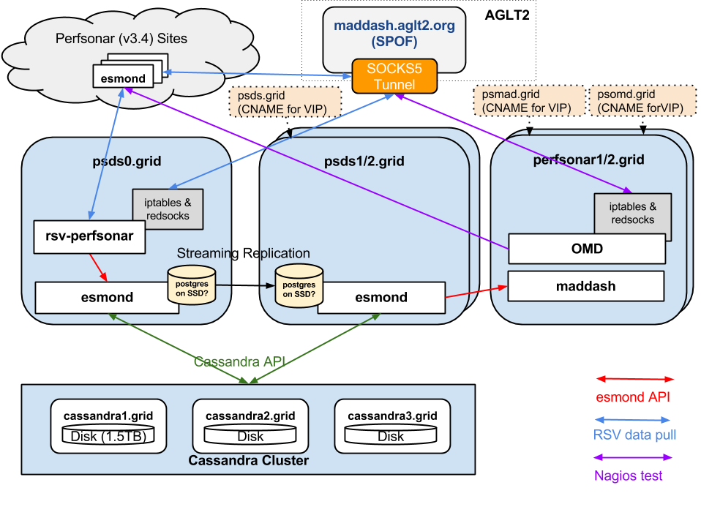
Logical Diagram of Datastore
8 VMs
Storage must host 7 distinct areas

Slide 7
Publishing Net-Data to MQ?
Edgar has implemented Marian’s code to allow the RSV perfSONAR probes to publish data to the MQ instance at CERN
Works well so far.
Generating 102K OWAMP records / hour (2.3 GB/hour; data not summarized like Esmond)
WLCG/CERN willing to put into production.
Want a go-ahead from OSG. Will create 3-node cluster to host service at CERN
Would allow subscriptions to data from clients
Doesn’t “persist” data; only provides access to specific subscribed data to users
Discussion on this? Concerns?

Slide 8
New Project: MadAlert
Gabriele Carcassi (original author of GUMS) is working with me at Michigan on a new project for one of our OSG Networking Goals: alerting on problems
The idea is to use the MaDDash API to analyze the data we are acquiring to identify problems based upon patterns in the data collected.
Just started this week. Will be hosted in GitHub
Gabriele only 20%
Seeking input on which problems we might be able to identify
More information by the next Net AC report

Slide 9
Questions or Comments?
Thanks!

Slide 10
URLs of Relevance
Network Documentation https://www.opensciencegrid.org/bin/view/Documentation/NetworkingInOSG
Networking CLI tools: https://twiki.grid.iu.edu/bin/view/Documentation/Release3/NetworkPerformanceToolkit
Deployment documentation for both OSG and WLCG hosted in OSG (migrated from CERN)
https://twiki.opensciencegrid.org/bin/view/Documentation/DeployperfSONAR
New 3.4 MA guide https://code.google.com/p/perfsonar-ps/wiki/MeasurementArchiveClientGuide
Modular Dashboard Replacement Prototypes
http://maddash.aglt2.org/maddash-webui https://maddash.aglt2.org/WLCGperfSONAR/check_mk
perfSONAR-PS Installation Motivation:
https://twiki.grid.iu.edu/bin/view/Networking/WhyPerfSNOAR
Esmond install info http://antg-dev.es.net/esmond-docs/rpm_install.html
Mesh-config in OSG https://oim.grid.iu.edu/oim/meshconfig
perfSONAR homepage: http://www.perfsonar.net/

