Slide 1
OSG Council Co-Chairs’ Report Kent Blackburn California Institute of Technology Paul Avery University of Florida
OSG Council Face-to-Face Meeting
March 11th, 2010
FNAL

Slide 2
Council Co-Chairs
Paul Avery, Kent Blackburn
Originally elected to two year term:
March, 2008 through March, 2010
Results of Action Items 7 & 8 from August, 2009 Meeting shift end date to April 15th each year.
Paul and Kent have declared their intent to run for a second term
First council chairs to attempt this madness!

Slide 3
Review of Membership
Council Membership is made up of
Representatives (voting members
Ex-Officio Partners (EGEE, TeraGrid, WLCG)
The OSG Executive Board (Ex-Officio)
Some changes since our August Face-to-Face
Collective VO Representation now filled & active
Ann Chervenak of GLOBUS Alliance stepped down
Doug Olson became an alternate for STAR
Horst Severini became DOSAR Representative

Slide 4
Attendance at Council Meetings
This includes ex-officio and guest participation.
In general, it is the same individuals attending on a regular basis.
There is a subset of the council that rarely participates!

Slide 5
OSG Participation by Council
iSGTW readership continues to grow (Paul).
Development of Annual DOE Report Completed
Increased Participation in TeraGrid Meetings
Paul Avery co-PI on Joint OSG/TeraGrid Proposal
Paul and Kent invited to talk to OGF 27
Support continues with OSG Executive Team
Planning for the future – Important topic!

Slide 6
DOE Annual Report Dec. 2009
http://osg-docdb.opensciencegrid.org/cgi-bin/ShowDocument?docid=932
90 pages
Includes Executive Summary
Production Report in separate file

Slide 7
CMU OSG Software Ecosystems Workshop
The OSG/CMU Scientific Software Ecosystem Workshop was held February 16 & 17, 2010 Caltech, supported by the National Science Foundation through grant #0943168.
It was an invitation workshop on scientific software development ecosystems, organized by the SciSoft research team at CMU (Jim Herbsleb and James Howison) and the OSG, hosted by LIGO at Caltech.
The purpose of the workshop was to learn from each other in order to improve how we produce, share and sustain scientific software in our various fields and to develop positions regarding possible scientific research funding agency policies on software practices.
The workshop itself consisted of presentations from the organizers, based on interviews they conducted, and presentations from each of the virtual organizations addressing the issues in their position papers.
Website:
http://conway2.isri.cmu.edu/scisoft-ecosystem-workshop/ (description)
http://conway2.isri.cmu.edu/scisoft-ecosystem-workshop/?q=node/3 (talks)
http://conway2.isri.cmu.edu/scisoft-ecosystem-workshop/?q=node/5 (draft results)

Slide 8
Action Items Generated by Council
Working in teams, the council addressed 12 separate action items since the face-to-face meeting in Chicago.
Web page to capture Action Items:
https://twiki.grid.iu.edu/bin/edit/Council/CouncilActionItems?t=1249910348

Slide 9
Science Advisory Group
Ruth Pordes lead Action Item to formulate new SAG
Currently have identified 6 members:
High Energy Physics: Marjorie Shapiro (ATLAS and CDF, LBNL)
Nuclear Physics: Thomas Ullrich (STAR analysis)
Computer science: Jack Dongarra http://www.netlib.org/utk/people/JackDongarra/
Biology and biomedicine: - Gaudenz Danuser - image processing: http://lccb.hms.harvard.edu/;
Biology and biomedicine: Zac Kohane: http://www.childrenshospital.org/cfapps/research/data_admin/Site113/mainpageS113P0.html
Fusion - Bill Tang, PPPL, http://w3.pppl.gov/theory/tang.html
Teamed up with Kent, Paul, and Piotr as liaisons.
Interviewed with SAG members 1-on-1 or small teams
Feedback from Dongarra, Shapiro and Ullrich documented to Council at Jan 12th, 2010 council teleconference.

Slide 10
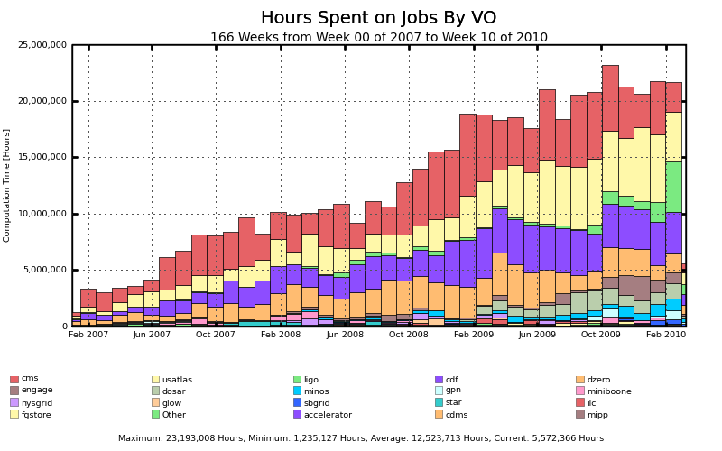
OSG Facility Usage 2007-2010
2007: 71M hours
2008: 141M hours
2009: 241M hours
~500M hours 2007-10

Slide 11
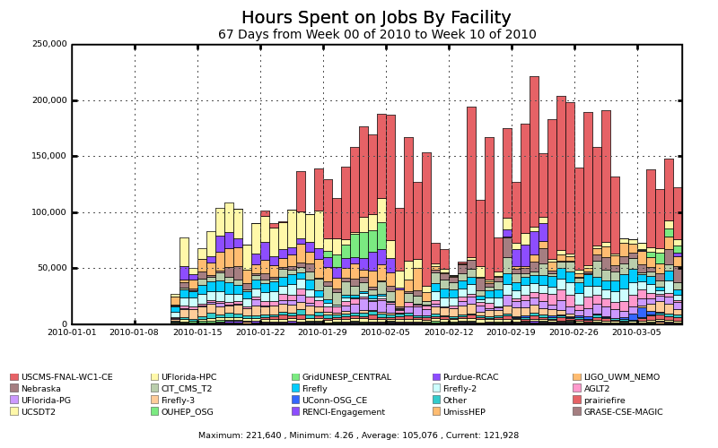
New Einstein@Home Usage (Jan. 12)
Runs on many facilities
125,000 hr/day

Slide 12
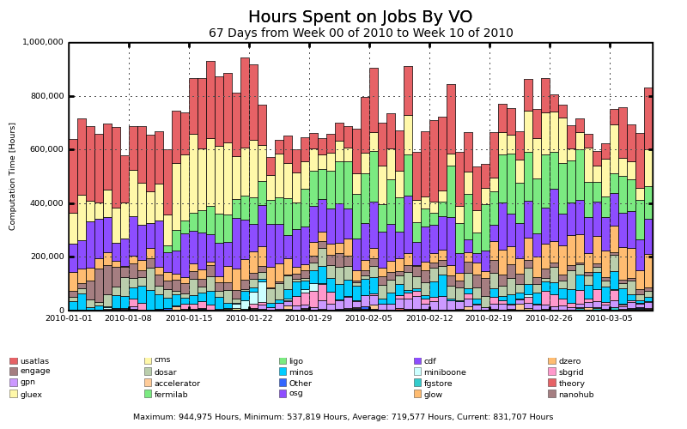
2010 Usage: >1M hrs/day?

Slide 13
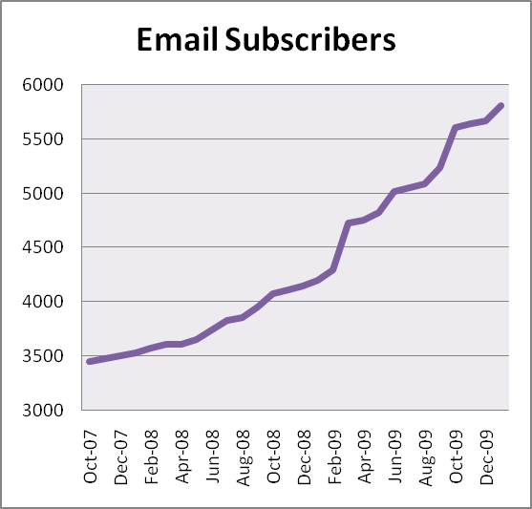
iSGTW Statistics
Aug. 10, 2009: Total = 5,041
Mar. 10, 2010: Total = 5,855
Now
Aug.

Slide 14
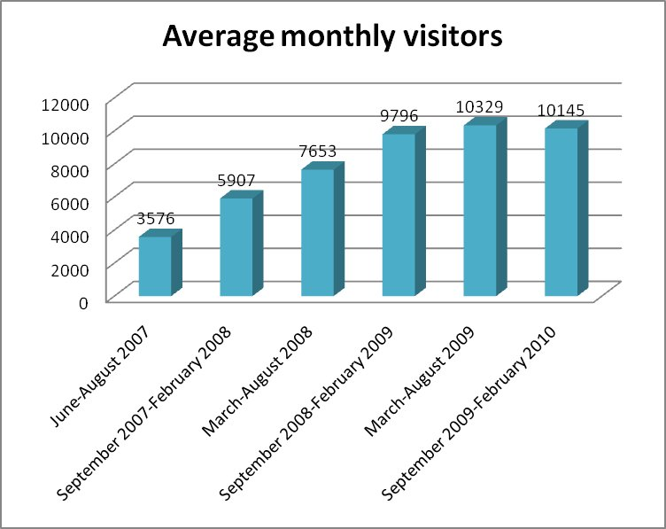
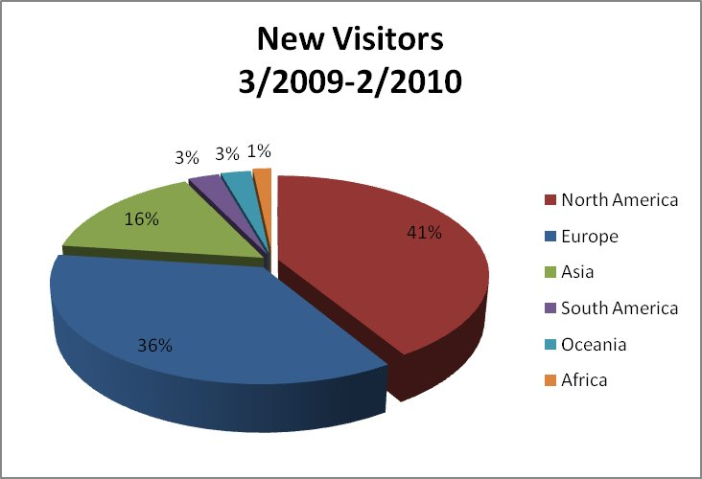
iSGTW Stats (cont)

Slide 15
ISGTW Survey (Jan. 2010)
See next slides…

Slide 16
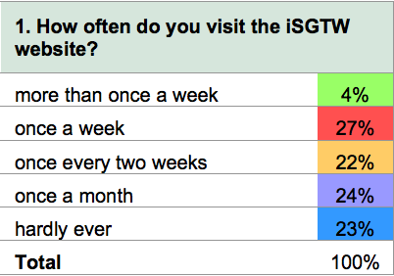
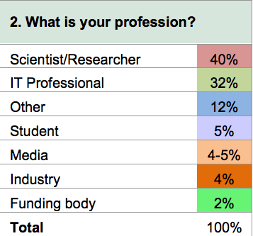
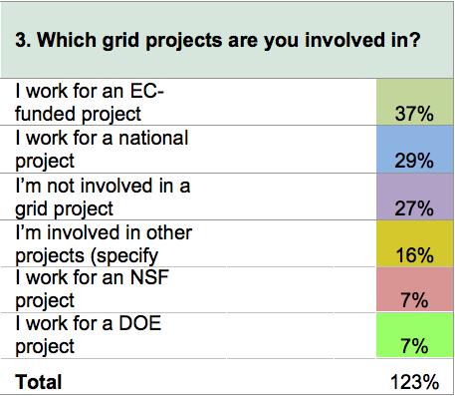
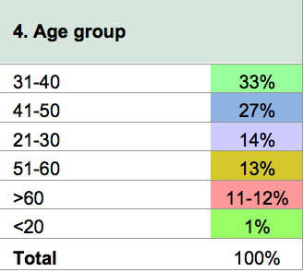

Slide 17
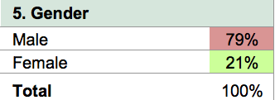
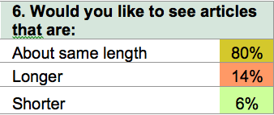
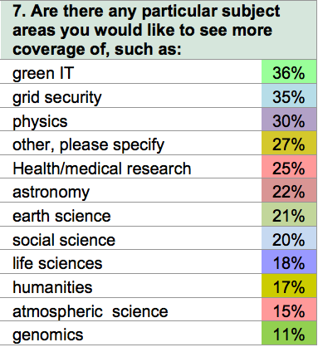

Slide 19
ISGTW Funding
Current funding situation
U.S. supports 1.0 FTE (Miriam Boon)
EGEE supports 1.0 FTE (Dan Drollette)
Some content provided by a person in Asia
U.S. editor position funded from multiple sources
1/8 ASCR/DOE
1/8 HEP/DOE
1/4 iVDGL/NSF (ending)
1/4 OSG/NSF
1/4 OSG/DOE
We are pursuing a new proposal with TeraGrid
Possibly NSF + DOE
White paper describing new scope still being developed

Slide 20
Summary
New Term Council Chairs and Executive Director will carry OSG through the process of developing a follow-on proposal.
Many of the key stakeholders are entering the next phase of their scientific and computing missions
Involvement by Council Representatives up slightly in the past six months, this is the second six months with a positive derivative.
OSG has been working on many fronts with close communications and involvement with the Council.
Collaborative joint activities with TeraGrid continue to be explored as a component of OSG’s future.
Plans for OSG’s futures will be the focus.

