Slide 1
OSG Site Administrators Workshop
Vanderbilt, 2010
Security
infrastructure, certificates and recommendations
Igor Sfiligoi
for the OSG Security team

Slide 2
OSG Security
Part One
OSG Security model
A high level overview

Slide 3
OSG Security model
Multiple administrative domains;
each Site
  Decides how to run its own resources
  Decides which users to support
Federated trust
  Too many users and too many sites to require
  each user to register at each site
  Virtual Organizations (VOs) as a middle man
    A VO trusts its own users
    A Site trusts a VO

Slide 4
Authentication structure
Users want a single sign-on to run on all sites
  Remember, they are not registering with all the sites
Username+password cannot be used
  That would require all sites to synchronize the password/shadow files -> not practical
Public Key Infrastructure (PKI) used instead
  In particular X.509 certificates and proxies
  Sites only need to know the “user name”
    PKI takes care of the security aspect

Slide 5
PKI – x.509 certificate
The user is issued a certificate,
which is composed of 2 parts:
  A public part, containing
    The user name (also known as the DN)
    Validity period
    The public key
    The signing chain (more on this later)
  A private part (containing the private key)
The private part MUST be kept private
  The public part can (and will) be sent around

Slide 6

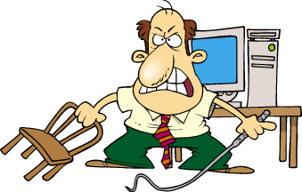
PKI – How it works?
User proves who he is
by signing using the private key
  The public key in the pub_cert allows for verification
Hello
Identify yourself!
Sign XY#B.
I am <pub_cert>.
The signature is <sign_with_priv>
User
Welcome!
Site

Slide 7
PKI – What is a signature?
A digital signature proves who you are
  Because only you own the private key
It is strongly correlated to the public key
  Not enough time to go into technical details here,
  consult wikipedia if interested:
  http://en.wikipedia.org/wiki/Digital_signature

Slide 8
PKI – Signature validation
The site must validate the signature
  Else the user may just fake it!
So the Site uses the public key sent by the user to do the validation
  But why should a site trust the public key sent?
The public key itself is signed by a trusted entity
(in the signing chain)
  By a trusted Certification Authority (CA)
  The site must already have
  the CA public key pre-installed locally
  (typically getting it through the OS or the VDT)

Slide 9
PKI – What is a CA?
Not all CAs
are trusted!
A CA is someone who issues certificates
A trusted CA is someone who you trust to issue user certificates only if they know that user
  i.e. User X cannot get a certificate with username Y
There are relatively few trusted CAs in existence
  At least compared to the number of users
  Pre-installing their public keys is thus manageable
A CA can also revoke a user certificate
  By publishing its public key in
  a Certificate Revocation List (CRL)
  Make sure you download the updated CRLs often!
Self signed certs
not issued
by a trusted CA

Slide 10
PKI – And what is a proxy?
You probably have heard about proxies
A proxy is just a new certificate
derived from a user certificate
  Possibly many
  times!
The signing chain
contains the info to
safely climb back to
the CA
http://tools.ietf.org/html/rfc3820
CA
User Cert
User Proxy
...
User Proxy

Slide 11
PKI – Why a proxy?
The user jobs may need to talk to a remote service when running on the worker nodes
  But cannot access the user cert's private key!
A proxy is thus sent (delegated) with the job
to the worker node
  And the proxy contains a private key!
  So the job can impersonate the user
Of course, delegating a private key is dangerous
  Mitigated by the fact that proxy lifetime is short
  (much shorter than the user certificate one)

Slide 12
PKI – Sites have certificates, too
Security only if mutual authentication
  The Site trusts the User and
  the User trusts the Site
The Site must prove who he is to the User
  Especially if a proxy is being delegated there!
All nodes with services at a Site thus
need a host or service certificate
  Similar to a user certificate, but issued by a CA
  for a specific DNS host
  (can only be used on that DNS address)

Slide 13

Example: One way authentication
Bad guy
The network alone
is not secure
Hi, I am <cert>
Welcome
Here is my proxy
Welcome
Hi, I am <proxy>
Thanks
User
Site

Slide 14
Authorization
Just because someone can authenticate, does not mean a Site will authorize him/her to run on its resources
  Authorization is a separate step
The Site may also want to give different privileges to different users
  The user must be mapped to a local security domain
  Certificate DN -> (typically) UNIX UID

Slide 15
VO-based Authorization
As mentioned in the introduction,
Sites trust VOs (not users directly)
  Each VO will keep a list of trusted user DNs
  Through a service called VOMS
OSG provides a list of trusted VOs and
their VOMS servers
  The Site needs to pick which VOs to support
  Should always support the MIS VO
  (OSG operations)
Users authenticate with a VOMS-extended proxy
(voms-proxy-init -voms ...)

Slide 16
Mapping
OSG provides GUMS for mapping
  Talks to VOMS servers to get the list of user DNs
Site admin must decide the mapping
  Still VO based, possibly based on VO groups
  Either pool (recommended) or group mappings
The admin must also create all the necessary UNIX accounts
  Part of “administrative autonomy” principle

Slide 17
Pool vs group mapping
Pool mapping maps each user
to a different UNIX username/UID
  Something like uscms0001,...,uscms2345
  May need lots of accounts!
Group mapping maps all the users
to the same UNIX username/UID
  Something like mis
  No protection between users
Pool accounts recommended
(unless VO explicitly asks for a group account)

Slide 18
Additional reading
OSG Certificate page
https://twiki.grid.iu.edu/bin/view/ReleaseDocumentation/CertificateWhatIs
Wikipedia X.509 description
http://en.wikipedia.org/wiki/X.509
A talk about VOs
http://staff.science.uva.nl/~demch/presentations/cts2006-ydemchenko-vo-dynamic-associations01.pdf
OSG Security Home page
https://twiki.grid.iu.edu/twiki/bin/view/Security/

Slide 19
OSG Security
Part two
Technical details

Slide 20
Which CAs do we use
DOEGrids CA (OSG Recommended)
  https://pki1.doegrids.org/ca/
CERN CA (Used by WLCG)
  https://ca.cern.ch/ca/
Fermilab CA (Fermilab-based users)
  Converts krb5 tickets into certificates
Foreign Country CAs
  Each country has at least one CA
Commercial CAs
  Verisign, Thawte, GoDaddy, etc.

Slide 21
CAs supported as a Site
OSG provides a list of trusted CAs known to be used by OSG-affiliated VOs
  Get them trough VDT
  http://software.grid.iu.edu/pacman/cadist/ca-certs-version
You likely want to support all those CAs
  But you are free to remove the ones you know are not being used
  And add additional ones for non-OSG users
Make sure you keep the CRLs updated
  fetch-crl

Slide 22
CAs supported as a User
Users use certificates through two interfaces
  Command line
  Web browser
Command line based on VDT
  See previous slide
Web browser mostly for Web pages
  Commercial CAs come with the OS
  The other CAs need to be imported
  https://www.tacar.org/repos/

Slide 23
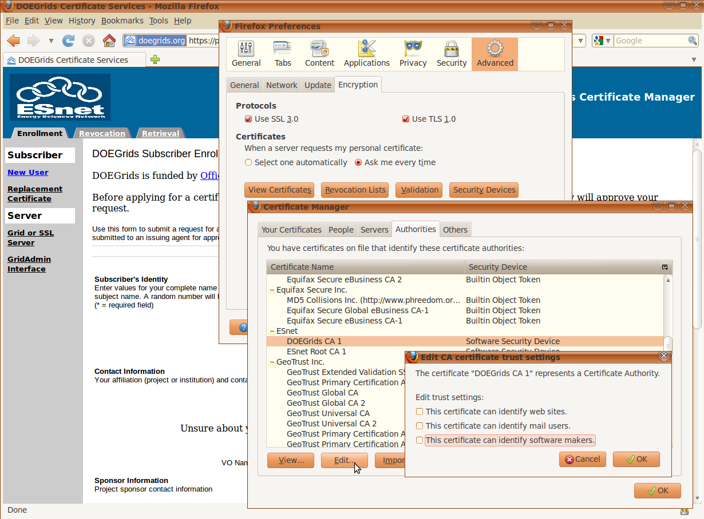
Installed but disabled CAs
Some browsers require explicit CA activation

Slide 24
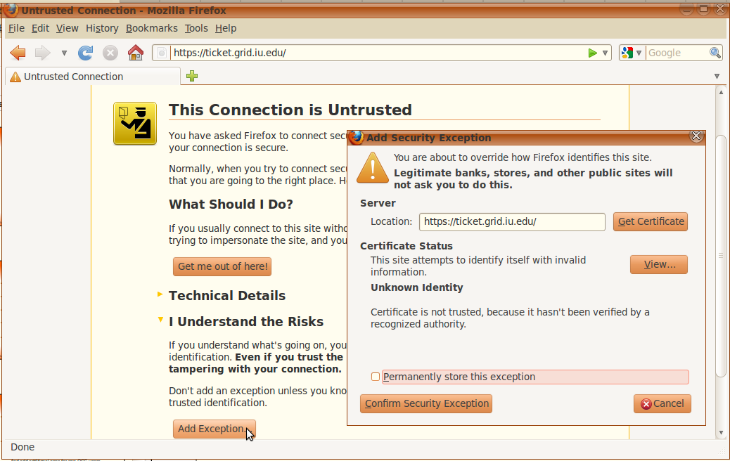
Browser security
Do not override browser security!

Slide 25
Requesting a certificate
You likely want to use DOEGrids
  Both for personal and service certificates
You can request them either
trough the Web interface or
https://twiki.grid.iu.edu/bin/view/ReleaseDocumentation/CertificateGetWeb
trough the command line interface
https://twiki.grid.iu.edu/bin/view/ReleaseDocumentation/CertificateGetCmd
  Command line easier for bulk requests
  (e.g. for service certificates)

Slide 26
How long does it take?
Getting a certificate can take days
  So plan accordingly
Delay due to security implications
  Someone must validate your request/identity
  A Registration Agent (RA)
  typically associated with the VO
For user certificates you also need to register with the VO VOMS server
  Procedure VO-specific

Slide 27
Certificate format
Two formats
  .p12 – single file, containing both public and private part
  .pem – two files, one for public (cert.pem) and one for private part (key.pem)
.p12 and key.pem must be private to the user
  No group or world read permissions!
Can convert between them
openssl pkcs12 -clcerts -nokeys -in cert.p12 -out usercert.pem
openssl pkcs12 -nocerts -in cert.p12 -out userkey.pem

Slide 28
Services accepting certificates
Compute Element (CE)/ Globus Gatekeeper
  Submits jobs to the local batch system
  Handles user proxies
Storage Element (SE)/ SRM/ gridFTP
  Interface to the disk storage area
Web server
(optional)
All of the above need a service certificate

Slide 29
No sharing of service certificates
A service certificate is released for a specific DNS address
  Like osgce.ucsd.edu
You cannot reuse it for on a different node
  For example www.ucsd.edu
  The certificate validation will fail

Slide 30
Additional reading
OSG Security and Certificates FAQ
https://twiki.grid.iu.edu/bin/view/Documentation/OsgFaq#Security_and_Certificates
OSG Certificate Request Documentation
https://twiki.grid.iu.edu/bin/view/ReleaseDocumentation/CertificateGet
NCSA OpenSSL Cheatbook
http://security.ncsa.illinois.edu/research/grid-howtos/usefulopenssl.html

Slide 31
OSG Security
Part three
Security recommendations

Slide 32
What is security?
Security is much more than just technology
  It is as much a social problem
We have a secure system only if the participants act responsibly
Malicious participants are obviously removed from the system
  But a careless one can make almost as much damage!

Slide 33
Knowing who is out there
Knowing the participants is the first step
Each Site should have
a designated security contact
  Interface to the rest of the Grid
The OSG repository for such information is OIM
https://oim.grid.iu.edu/oim/home
Please make sure you keep your information updated there
  You will need a user certificate to interact with it

Slide 34
Security communication
Security contacts will receive
security notifications through e-mail
  Please read and act upon them
  Make sure they have a legitimate signature
  https://twiki.grid.iu.edu/bin/view/ReleaseDocumentation/OSGSecurityNotifications
Know and possibly be in contact with your Campus/Institution cyber security team
  They can provide invaluable help both
  in preventing and fixing security incidents

Slide 35
Technical tasks
Keep all the software up-to-date
(mostly patching, but also upgrades as needed)
  Operating system
  System services
  OSG/VDT provided software
Keep security data up-to-date
  List of trusted CAs
  Associated CRLs
  List of supported VOs
Without, the risk of a compromise raises significantly

Slide 36
Advanced technical tasks
If possible, actively look for signs of
a compromise
Log files can provide a lot of info
https://twiki.grid.iu.edu/bin/view/ReleaseDocumentation/SearchLogFiles
Yes, it can take a lot of time
  But it pays big dividend, if you can afford it
  A security incident can make a Site unusable for weeks (or worse)

Slide 37
What if you have a security incident?
If you suspect a compromise,
immediately notify the OSG security team
https://twiki.grid.iu.edu/bin/view/ReleaseDocumentation/IncidentDiscoveryReporting
  Even if it turns out that it was a false alarm,
  better safe than sorry (just don't do it every day!)
Involving ALSO your local Campus/Institutional security team is a good idea
  Especially if you are fairly sure you have a problem

Slide 38
Additional reading
OSG Site Security Responsibilities
https://twiki.grid.iu.edu/bin/view/ReleaseDocumentation/SecuritySiteResponsibilities
OSG Security Hands On Training
https://twiki.grid.iu.edu/bin/view/Security/SecurityHandsOnTraining
Security Session at the 2009 OSG Admin Workshop
http://indico.fnal.gov/sessionDisplay.py?sessionId=4&slotId=0&confId=2497#2009-08-06

Slide 39
Summary
Security is both a social and technical problem
Certificates are used for authentication,
authorization is a separate step
Not all the CAs are trusted,
and you need to keep CRLs updated
Keep your system software up-to-date
Keep your contact information up-to-date in OIM
Know how to report a security incident

Slide 40
Copyright notice
These slides contain copyrighted images by
ToonADay.com
All such images have been licensed to
Igor Sfiligoi
for use in presentations
Extracting such images and use them in other context is not permitted

