Slide 1
OSG RA plans
Doug Olson, LBNL
May 2006

Slide 2
Contents
RA, agent, sponsor layout & OU=People use case
Sample web form
Agent Role
GridAdmin Role
Questions
Schedule

Slide 3



Grid Classic PKI
People Certificate Workflow
Registration Manager (RM)
PKI1.DOEGrids.Org
4
CA
Sponsor
1
2
2
4
3
Project
DBMS
8
5
Registration Authority (RA) Agent
9
Subscriber
6
7
Subscriber requests Certificate
RM posts signing request notice
The RA for the Subscriber retrieves request
The RA agent reviews request with Grid project
The agent updates/approves/rejects request
Approved Certificate Request is sent to CM
Certificate Manager (CM)
(Certificate Signing Engine)
CM issues certificate
RM sends Email notice to Subscriber
Subscriber picks up new certificate

Slide 4



OSG RA Layout
10. download
Certificate
Subscriber
6.
Registration
Manager
Registered
Support
Centers
1. submit
2,8. notify
7.
request
DOEGrids CA 1
2. notify
2,8. notify
CDF
CMS
DES
DOSAR
DZero
Fermilab
fMRI
GADU
geant4
GLOW
GRASE
GridChem
GridEx
GROW
i2u2
iVDGL
LIGO
mariachi
MIS
nanoHUB
SDSS
STAR
USATLAS
CSC
DOSAR
DZero
Fermilab
fGOC
GADU
GRASE
GROW-GOC
LIGO
mariach-support
OSG-GOC
PROD_SLAC
SDSS
STAR
TACC
UC CI
USATLAS
USCMS
VDT
4.c verify
4.d reply
3. retrieve
request
Sponsor
4.b authenticate
4.e. confirm or deny
VO
sponsor
DB
4.a check authorized
sponsors
5. approve
or reject
9. Record RA actions
Agents within each
support center know
which VOs and sites
they support
RA Log
Registered
VOs
Subscriber chooses
one of the existing
OSG registered VOs
Typical use case for
personal certificate.
Draft 19 Apr 2006

Slide 5
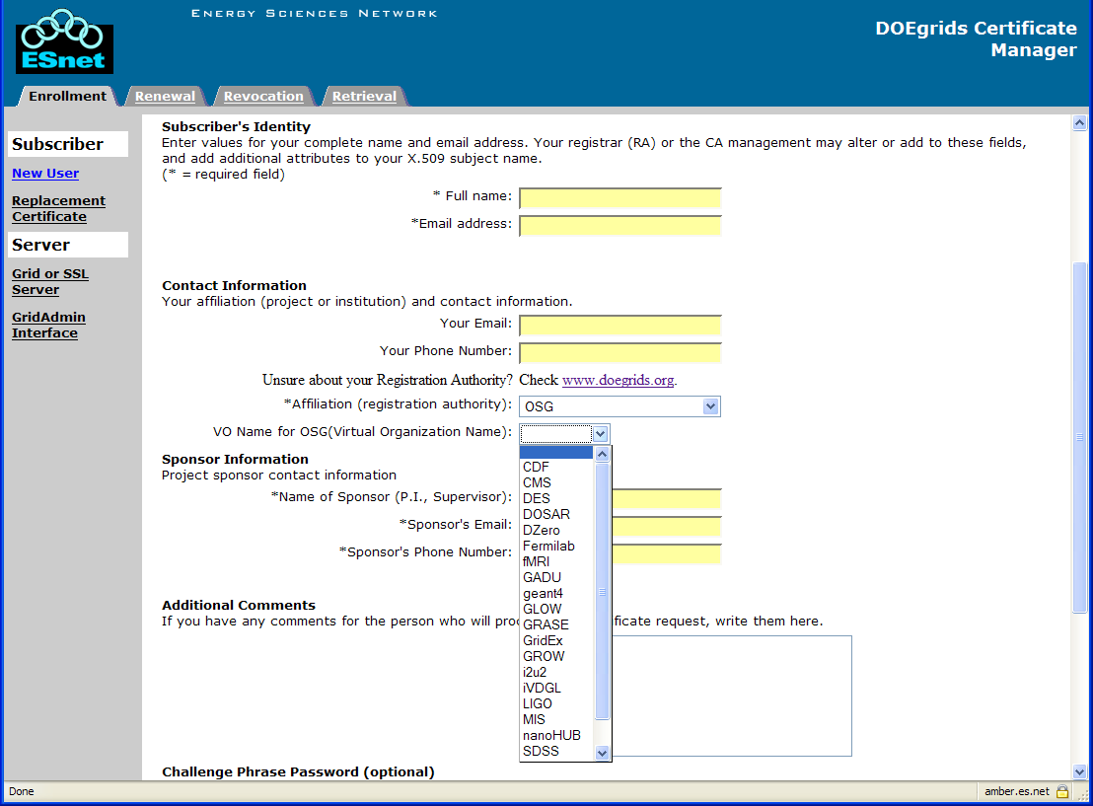
Example request web form
Subscriber chooses
OSG RA and then
selects their VO.
Agents seen an email
notification with
“OSG - <VO>” in the
subject line, where
<VO> is one from the
list.
Sponsor is a hint to the
agent for where to find
an actual sponsor.
Subscriber should put
a meaningful description
in the comment field about
why the need a certificate.

Slide 6
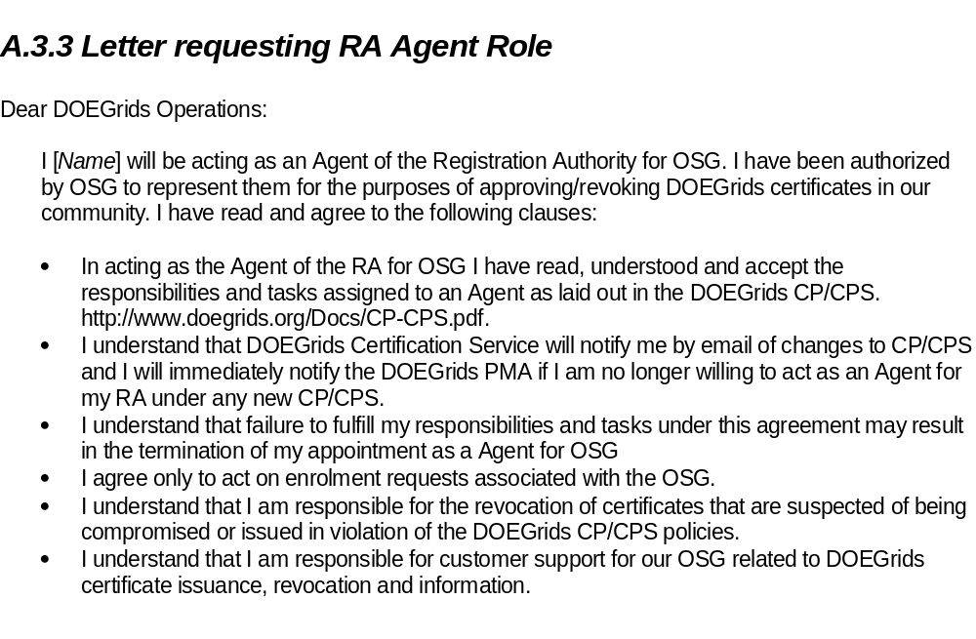
Agent Authorization

Slide 7
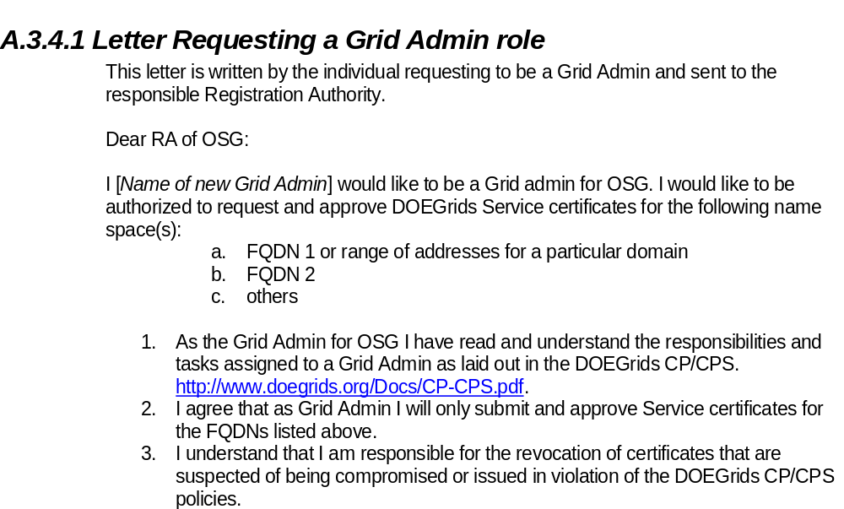
Authorization for GridAdmin

Slide 8
Questions
What about people not members of one of the existing VOs?
What about OU=Services requests?
  Require specifying domain name of server along with RA affiliation, to include in subject line of email notification
    Current style example: (email subject, request DN)
    [doesg-ra] DOEGrids CA - OSG Certificate Request in Queue (request id: NNNNN)
    CN=http/bandicoot.uits.indiana.edu,OU=Services,DC=doegrids,DC=org.
    Would become:
    [doesg-ra] DOEGrids CA - OSG uits.indiana.edu Certificate Request in Queue (request id: NNNNN)

Slide 9
OSG RA Schedule
Addition of OSG RA policy expected soon (Friday?)
OSG RA functioning by July 1
Establishing agents in Support Centers will proceed as practical

