Slide 1
Campus Grids & Campus Infrastructures Community
Rob Gardner
Computation Institute / University of Chicago
June 4, 2013
(revised & condensed for June 26 Area Coordinator’s meeting)

Slide 2
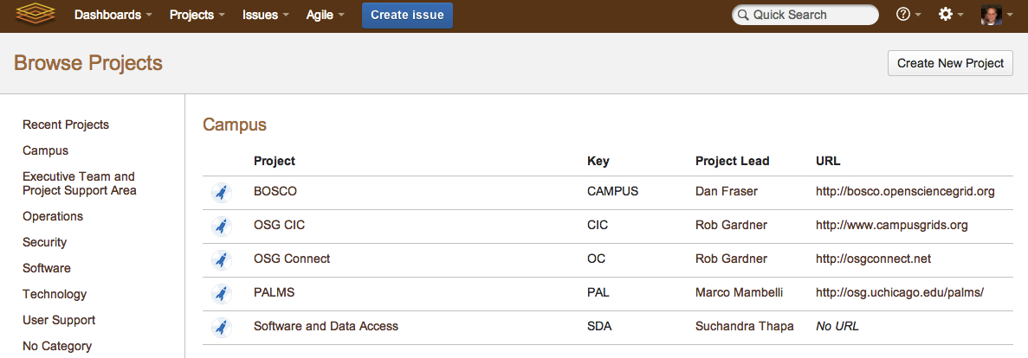
Campus area
Will discuss all but BOSCO in Campus area
Not everything has been captured in JIRA yet but we’re working on it
Obviously there are many dependencies throughput OSG++: User Support, Production, Operations, Accounting, Software, GlideinWMS, PandaWMS, Networking and facilities teams

Slide 3
OSG CONNECTION SERVICES
PLATFORM OF SERVICES FOR CAMPUS-BASED RESEARCHERS

Slide 4
Recasting Campus Grids as Platform of Services
“OSG Connect”
Accelerate engagement
Suite of services for campuses
Connecting science to resources with increasing capability
Task Launch
Cycle Share
Software Share
Data Share
Data
Local access
Anywhere access
Transfer services
Advanced analytics
Software
Campus access
Anywhere access
Tasks
Resource access
Campus
Grid
Cloud
HPC
Connected Science Shared Capabilities

Slide 5
What are the elements?
Graduated Platform of Services
Campus Engagement & Identity Integration tools
Job management: BOSCO and its extensions + pure HTCondor
Distributed software access (OASIS, PALMS, PARROT)
Distributed data access (SRM, XRD, HTTP, SKELETONKEY)
Accounting and Informatics services for cycle sharing (GRATIA, CIVAIS)
Campus Infrastructures Community
Forum, meetings, context to drive adoption, gather feedback, register impact
Tutorials, demonstrators, campus blueprints, engagements

Slide 6
Capabilities
Foundational
Campus identity ( → federated, grid)
Job management over diverse resources
Ubiquitous software and data access
Monitoring and accounting services
Practical
Application best practices on d-HTC
Advanced workflow services
Advanced user interfaces

Slide 7

Simplify job submission to OSG
Build off experience from OSG-XSEDE
Avoid the burden of VO creation for new communities
Get them going quickly, using a carrier VO and pilot submission service (glideinWMS or PandaWMS)
Leverage campus identities and new tools which accelerate uptake

Slide 8
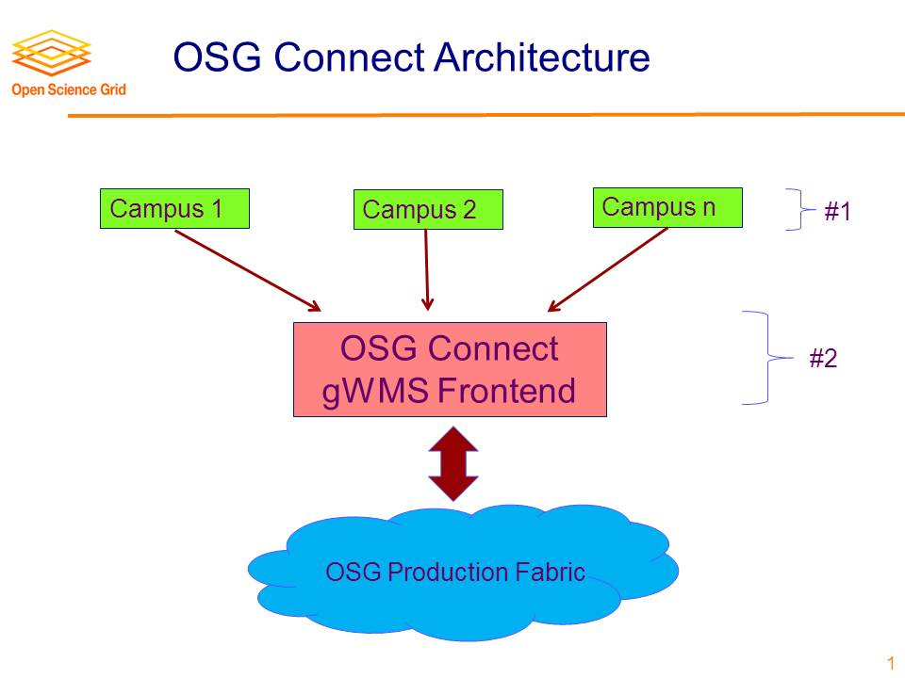
High Level Block Diagram (Chander)
Chander’s diagram
Layout
https://twiki.grid.iu.edu/bin/view/VirtualOrganizations/OSGConnectService

Slide 9
login.osgconnect.net
gssi-ssh
ssh
bosco
login1.osgconnect.net
login2.osgconnect.net
loginn.osgconnect.net
…
OSG operations production services
VO
Carrier VO
Production facilities contributing to OSG

Slide 11
OSG Connect Web Service
Leveraged existing implementation at UC3
Leverages CHTC portal, UC3 UBolt
Working with OSG Security to get InCommon and OSG Connect service working together
Effort for this coming from ATLAS Tier 2
Expect to have first version of this together in time for the Duke workshop
Fall-back plans with reduced capability

Slide 12
OSG Connect Submit Infrastructure
Start small, but plan for a scale of 1000 users submitting through multiple VO carriers and pilot factories
Start with existing OSG mechanisms
Expressed interest to engage ATLAS Tier 3 community, providing access to “beyond pledge” resources at ATLAS sites
Will setup a separate VO front end for this purpose

Slide 13
Distributed Software Access
Parrot and SkeletonKey
Motivated by UC3 users needing to have an easy way to remotely access their software and data on clusters around campus
Designed as an easy alternative for users to manually using Parrot
Also Chirp for data access
Provides an easy to use configuration file

Slide 14
Design Goals
Provide an easily understood way for users to incorporate remote software/data access into their current workflows
Allow users to expand their computations to incorporate opportunistic usage of other campus clusters
Eventually, allow users to expand from campus grids to using OSG opportunistically

Slide 15
Current Work
Have initial ‘version one’ implementation
Working with three groups to incorporate SkeletonKey in their workflows and actively utilize campus grid environment at U of C
Incorporating user feedback into current code and updating features based on user needs
More input and feedback welcome from Parrot experts out there

Slide 16


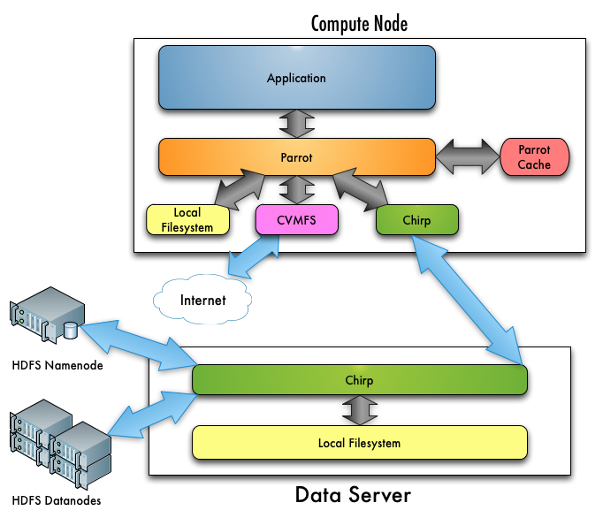
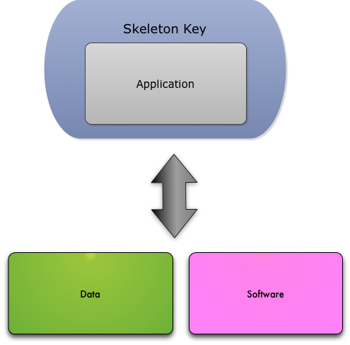
SkeletonKey
Directly
With SkeletonKey
Notes:
Use diagrams for software / data slides

Slide 17
PALMS project
OASIS:
provides the infrastructure to host the software in CVMFS but users need more guidance to install the software (1) and to access it from OSG resources (2)
Programs, Applications and Libraries Management and Setup (PALMS)
A system to install and manage software in OASIS
Simplifies the packaging and installation of different versions for different platforms
Helps users to setup the correct and desired environment (applications and libraries)

Slide 18
PALMS software manager features
Help packaging application and deploying it on OASIS (or into any CVMFS stratum)
Allow installs, updates and removals of applications and libraries
Allow multiple versions for distinct platforms
Allow multiple versions for the same platform
Does not require root on the OASIS server
Can manage and solve dependencies and conflicts
Help adapting and installing native packages

Slide 19
PALMS user features
Help select the correct version for the platform
Provide a default version but allow to choice
Setup the correct environment for the user shell
Work automatically with different shells
Add no performance penalty compared to default OASIS

Slide 20
PALMS activities
Project planning
Presentations and white paper
Software development, packaging and documentation
Deployment on OSG OASIS and on UC3
Librarian (software manager) activities for the OSG VO

Slide 21
CIVAIS project
There is a lot of information about the operation of a Campus Infrastructure or OSG
Processed information is more valuable than raw data
Data and info differ by role (researcher, PI, computer center director, funding program manager, network administrator, …)
CIVAIS: Campus Infrastructures Visual Analytics and Informatics Services
A analytics service collecting information form a Campus Infrastructure
Provides clear, concise and flexible views for users
And an open data platform (policy based) to stimulate derived metrics and 3rd party apps for advanced analytics

Slide 22
Use Case Example (1)
What do computing center executive/steering committees most want to know?
How are resources being used
Are they serving investing stakeholders fairly, as well as the broader university community
Is capacity meeting demand
Which technologies (processing, storage, network, visualization) are most likely to yield the most benefit to the most users
How do we judge the effectiveness of resource usage for advancing the scientific goals of our stake-holding partners

Slide 23
Use Case Example (2)
What does the OSG Executive Team most want to know?
How effective is the campus program in engaging new users and research communities on campuses
Which disciplines, outside of high energy physics, have received benefit from OSG
What are the impacts of OSG services and technologies on accelerating the scientific mission of our stake-holding organizations as well as the national

Slide 24
CIVAIS key features
Design starting from the user experience
Multiple roles determining access policies and interests
Interactive extensible web displays tailored to the role of the user
Designed for a Campus Infrastructure
Easy to install and deploy on a Campus
Hierarchical reporting for a wider community (e.g. OSG CIC)
Highly scalable
a single Campus reporting running on a single machine, bigger and more complex structures scaling on a distributed architecture
Pluggable and open interface
Accepting multiple inputs (Gratia, message queues, etc…)
Ability to add custom views to the display
Open Data available via RESTful API

Slide 25
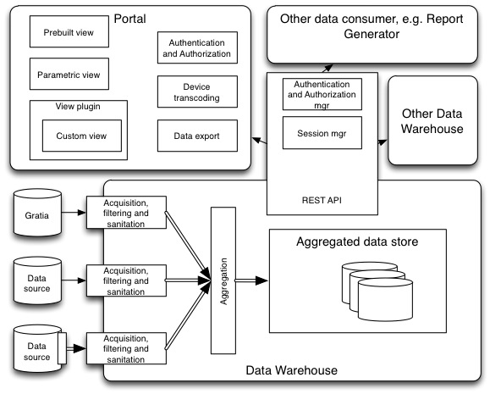
CIVAIS architecture diagram

Slide 26
CIVAIS architecture highlights
Highly scalable and reliable data warehouse
Multiple data inputs including Gratia server and probes and Google documents and Web forms
Message bus for flexible and reliable communication (double arrows in the diagram)
RESTful API for controlled data access
Multiplatform portal using HTML5 and vector graphics for viewing, browsing and exporting data
Standard plug-in definition for both data input and viewer extension

Slide 27
CIVAIS activities
Project planning
Presentations and white paper
Project mock-ups and evaluation
Software development, packaging and documentation
Deployment and testing on UC3

Slide 28
OSG Campus infrastructures community
SHARING CAMPUS-CENTRIC DHTC EXPERTISE AND BEST PRACTICES

Slide 29
CIC Year 1 Goals
Development of a topical seminar series and forum highlighting concepts in the development and use of campus infrastructures (done, continue in Y2)
Convening face-to-face meetings of the OSG CIC for both infrastructure providers and domain experts/leaders on campuses (done, continue in Y2)
Development of a campus engagement program which programmatically develops ties between research domain experts, campus infrastructure providers and the CIC. (failed) (addressed 4 Y2 below)
Developing a program for CIC engagement with XSEDE. (invited to meetings, but no program) (Y2 strategy in context of above)

Slide 30
CIC Year 1 Milestones
Define the appropriate metrics for telling the campus story in OSG. We have discussed these in terms of:
Making distributed high throughput computing easy, visible (awareness) and ubiquitous (failed) (New capabilities in Y2)
Finding the appropriate metric for measuring “presence” on campuses (failed) (Will be addressed in Y2)
Capture science success stories, indicating the multiplicative effects of using campus and distributed HTC resources (failed) (To be addressed in context of OSG Communications, OSG Connect, in Y2)
Classification of infrastructures with a maturity model [12] (TBD, augment with user-focused metric)
Establish the CIC Topic Seminar series as a staple for community building and knowledge sharing (done, continue in Y2)
Convene one face-to-face CIC meeting with a broad technical program compelling to the campus infrastructure providers and users (done, transition from topical to campus engagement focus in Y2)
Promote community through use of a CIC resource center (social contacts, topical seminar materials, pointers to tools and guides) (done, continue in Y2)

Slide 31
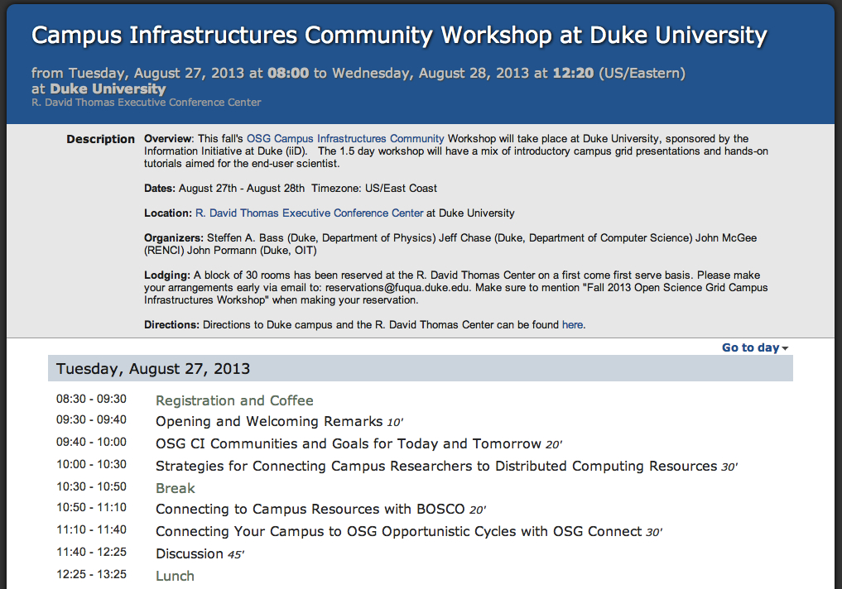
August 27-28 Workshop at Duke

Slide 32
August 27-28 Workshop at Duke
WORKSHOP USER METRICS: TARGET = 50
# USERS REGISTERED TO OSGCONNECT
# USERS SUCESSFULLY COMPLETING QUICKSTART
# USERS BOSCO TO CAMPUS
# USERS OSGCONNECT:DIRECT TO OSG
# USERS OSGCONNECT:BOSCO TO OSG
# USERS > 1000 JOBS ON OSG
WORKSHOP CAMPUS RESEARCHER METRICS: TARGET = 5
# NEW REGISTERED CAMPUSES
# NEW RESEARCH PROJECTS
# NEW APPLICATIONS
WORKSHOP CAPABILITY METRICS: TARGET = 5
# ABLE TO USE OASIS
# ABLE TO USE DISTRIBUTED DATA
TBD

Slide 33
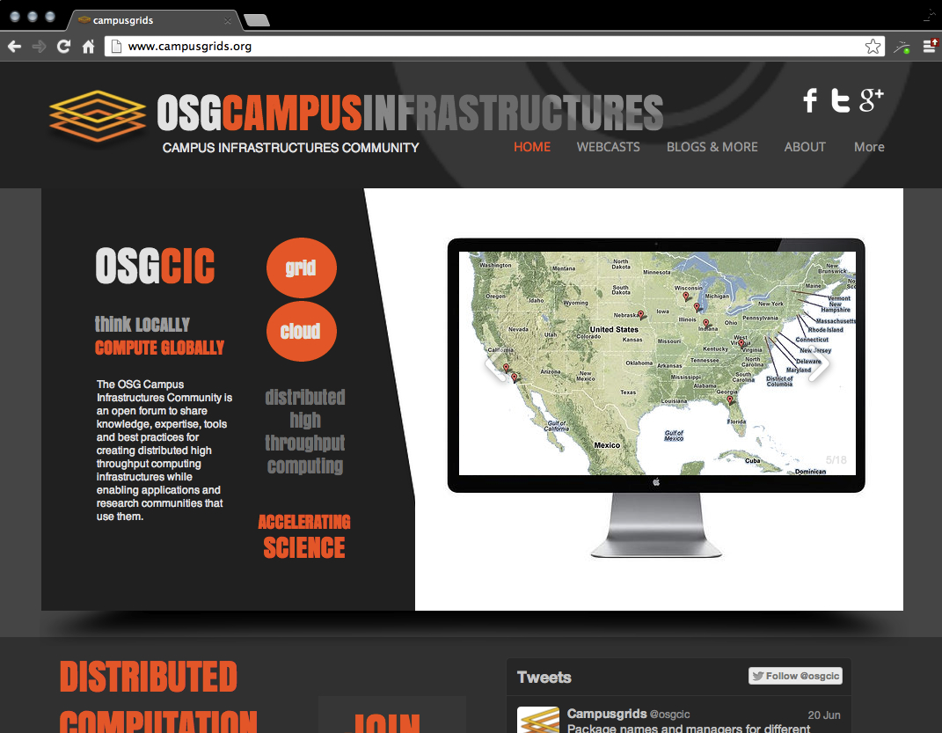
Archive of expertise established at http://www.campusgrids.org/
OSG community activity with broad visibility
With OSG Communications, plan to absorb into openscienegrid.org family in Y2

