Slide 1

VDT-dCache
Neha Sharma
Fermilab
OSG Consortium All Hands Meeting March 5-7 2007

Slide 2
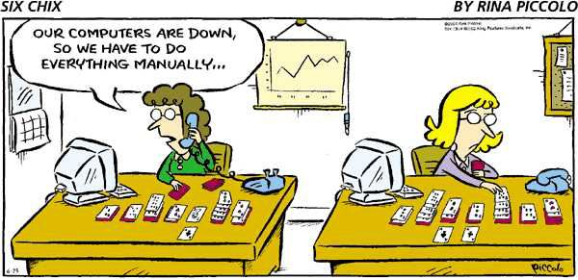
Goal
Ease the installation and configuration of SRM/dCache !!
OSG Consortium All Hands Meeting March 5-7 2007 2

Slide 3
What has been made easier ?
Process | Usual Approach | VDT-dCache
Installation Figure out which services/doors are running Install rpms Create various postgres users and databases (if applicable) Edit configuration files | Need to perform all of these and almost on each node 4-node install involves ~46 steps | Need to perform only step 1 and only on one node 4-node install involves ~9 steps
Troubleshooting | Stdout, stderr on screen. | Files vdt-install.log & vdt-install.err created during install
OSG Consortium All Hands Meeting March 5-7 2007 3

Slide 4
Main features
Convenient and easy deployment of SRM/dCache (OSG Storage Element)
single configuration file for multi-node installations
Hardware and configuration recommendations
Dry run option
dCache Gratia probe (Gregory Sharp)
Documentation - Step by Step installation, Cleanup, PNFS upgrade & Gratia setup instructions
Installation and Debugging Support
OSG Consortium All Hands Meeting March 5-7 2007 4

Slide 5
The Ease of Use
Easy Two Step Process
Step 1) Generate site configuration file by answering questions such as
Number and names of admin and door nodes
Services/doors to run on each admin/door node
Private network that pools are in (if applicable)
Names and storage locations of pool nodes
Step 2) Run install script
Installs needed RPMs (not Pacman based yet)
Edits various configuration files on your behalf
OSG Consortium All Hands Meeting March 5-7 2007 5

Slide 6
Sample Run
[root@fapl034 src]# ./install.sh -s site-info.def
Unpacking dCache server software.
Checking services running on this node ...
Installing Postgres ...
Setting up Postgres users and databases ...
Installing PNFS Server software ...
Starting PNFS Server...
Installing dCache -
Copying templates
Modifying dCache configuration files
Running dCache setup script.
Finished installing dCache.
[root@fapl034 src]#
OSG Consortium All Hands Meeting March 5-7 2007 6

Slide 7
Sample Dryrun
[root@fapl034 src]# ./install.sh -s site-info.def -d
------------------------------------------------------------------------------------------------
During Postgres installation, following commands will run on this node
------------------------------------------------------------------------------------------------
o rpm -ivh /opt/vdt-dcache/dcache/src/../RPMS/postgresql-*.rpm
….
---------------------------------------------------------------------------------------------------
During PNFS Server installation, following commands will run on this node
--------------------------------------------------------------------------------------------------
o rpm -ivh /opt/vdt-dcache/dcache/src/../RPMS/pnfs-postgresql-*.rpm
….
---------------------------------------------------------------------------------------------------
During DCache installation, the following will be done.
---------------------------------------------------------------------------------------------------
….
Will execute "cp /opt/d-cache/etc/node_config.template /opt/d-cache/etc/node_config"
OSG Consortium All Hands Meeting March 5-7 2007 7

Slide 8
Upcoming features…
dCache 1.8.0 - full srmv2.2 functionality (April release by DESY)
dCache test-suite (DESY)
“Introduction to dCache” document (Forrest Christian)
SRM Monitoring (DmitryLitvintsev & Olga Telyga- Summer Student)
https://srm.fnal.gov/twiki/bin/view/SrmProject/SrmMonitoring
OSG Consortium All Hands Meeting March 5-7 2007 8

Slide 9
Users
UCSD - Abhishek Rana
Doors: dcap (6), gridftp (6), gsidcap (1)
Pool nodes: ~ 132 - private network
Purdue - Preston Smith
Doors: dcap, gridftp (6)
Pool nodes: 148 - public network
UNL - Brian Bockelman
Doors: dcap, gridftp(1)
Pool nodes: 15 - public network
Rio de Janeiro - James Letts
Doors: gridftp(1), dcap (1)
Pool nodes: 60 - private network
OSG Consortium All Hands Meeting March 5-7 2007 9

Slide 10
Documentation & Support
Main website
http://vdt.cs.wisc.edu/components/dcache.html
Readme
Step by Step instructions
Support
vdt-support@opensciencegrid.org
OSG Consortium All Hands Meeting March 5-7 2007 10

Slide 11
Team members
Alain Roy (UW)
Gene Oleynik (Fermilab)
Michael Zalokar (Fermilab)
Neha Sharma (Fermilab)
Ted Hesselroth (Fermilab)
OSG Consortium All Hands Meeting March 5-7 2007 11

Slide 12
Questions?
OSG Consortium All Hands Meeting March 5-7 2007 12

