Slide 1
Principles for High Throughput Computing
Alain Roy <roy@cs.wisc.edu>
Open Science Grid Software Coordinator

Slide 2
Reminder: What is HTC?
An approach to distributed computing that focuses on long-term throughput, not instantaneous computing power
  We don’t care about operations per second
  We care about operations per year
Implications:
  Focus on reliability
  Use all available resources
  That slow four-year old cluster down the hall? Use it!

Slide 3
Q: What system am I describing?
If you adopt system X, you will get:
  High availability
  High reliability
  Resource sharing
  Automatic load sharing
  Easy expansion in both capacity and function
  Good response to temporary overloads
Condor? OSG?
Amazon EC2? Other Clouds?

Slide 4
Actually…
Those as promises for distributed data processing systems from the 1970s, more than 30 years ago!
  Drawn from paper by Enslow, 1978
Yet they sound very similar to the promises for today’s distributed systems, grids, and clouds

Slide 5
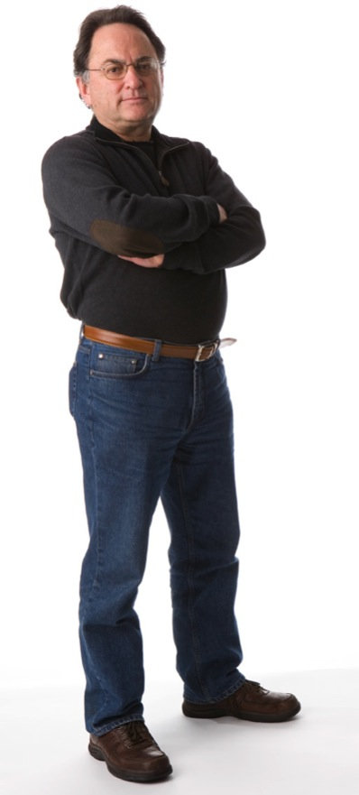
Miron Livny
Founder and leader of the Condor Project since mid-80’s
PI and technical director of the Open Science Grid
Coined the term “high throughput computing”
Has a principled approach to high throughput computing research

Slide 6
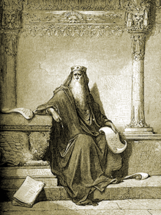
Miron likes to remind us:
The words of Koheleth son of David,
king in Jerusalem ~ 200 B.C.
  Only that shall happen
  Which has happened,
  Only that occur
  Which has occurred;
  There is nothing new
  Beneath the sun!
Ecclesiastes Chapter 1 verse 9
Ecclesiastes, (קֹהֶלֶת, Kohelet, “son of David, and king in Jerusalem” alias Solomon, Wood engraving
Gustave Doré (1832–1883)

Slide 7
There is nothing new
Distributed data processing | Virtualization
Cluster computing | Peer-to-peer
Grid computing | Client-server
Cloud computing | Cyberinfrastructure…
New terms, new hype…
But the underlying problems are the same.
The principles to address the problems are the same.

Slide 8
Really? Aren’t clouds new and cool?
Amazon EC2 makes it easy to create virtual machines on the fly. That’s new, right?
  Condor matchmaking:
  Allocate a computer + Start a job
  Amazon EC2:
  Allocate a virtual machine + Start it
  Conceptually a virtual machine is just another kind of job: you start it, you stop it, you provide policies to control it

Slide 9
Clouds are a little bit new
In OSG and XSEDE, it is free to allocate a computer
  OSG: Allocate as many as you like (when they’re available)
  XSEDE: You get a free allocation if your science is “good”… And you can request a free extension
In Amazon EC2: you need a credit card
  No more free lunches
  Sure you can have more time—if you pay
  You can evaluate “build local cluster” vs “outsource to Amazon”

Slide 10
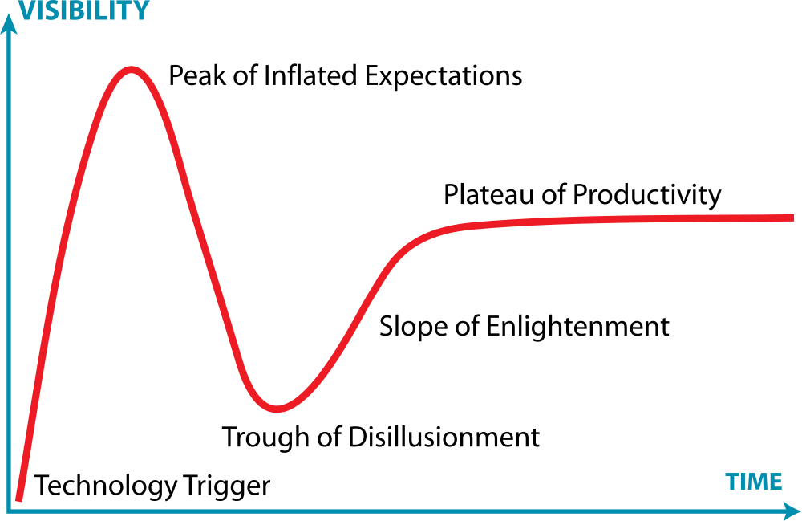
Don’t fall for the hype
Cloud
Cluster
Grid
Gartner Hype Cycle
http://www.gartner.com/technology/research/methodologies/hype-cycle.jsp

Slide 11
Instead:
Know the principles
Understand how the principles apply
And you will be able to use the next technology in the next hype cycle to help your science
So let’s look at some principles

Slide 12
First, let’s define distributed computing
“You know you have a distributed system when the crash of a computer you’ve never heard of stops you from getting any work done.”
–Leslie Lamport

Slide 13
First, let’s define distributed computing
Distributed computing systems:
  Have a multiplicity of resources
  Are physically distributed
  Provide unity of system operation
  Have system transparency
  Have cooperative autonomy
From What is a “Distributed” Data Processing System?, by Philip Enslow, IEEE Computer, Vol 11, No. 1, January 1978, p 13-21.

Slide 14
1. Multiplicity of resources
There should be multiple general-purpose resource components—physical and logical—that can be assigned to tasks
Homogeneity is not essential
More resources helps maintain reliability and performance

Slide 15
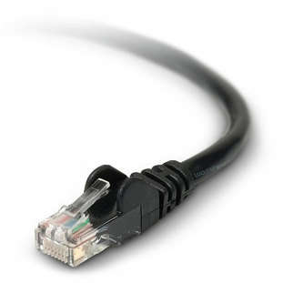
2. Physical distribution
Components should be physically distributed
They should be connected via network with a two-party cooperative protocol
  Protocol allows requests to be refused based on local knowledge
  Example: HTTP

Slide 16
3. Unity of System Operation
All components in the system should be unified to achieve a common goal
Unification can be via
  Shared software, or
  Well-defined policies
There are multiple centers of control
  No critical paths
  No critical components

Slide 17
4. System Transparency
It feels like a “single virtual machine”
When requesting a service, the user does not need to know:
  Which physical component will do it
  Where that component is located

Slide 18
5. Cooperative autonomy
There is cooperation: common policies and goals
Resources make their own decisions:
  Accept or refuse requests
  Based on local policies for use of resource

Slide 19
Does your laptop fit?
Multiplicity? | Yes, multiple CPUs/cores
Physically distributed? | No, all in one box
Unity of system operation? | Yes, one OS
System transparency? | Yes
Cooperative autonomy? | No, centrally controlled
Answer: your laptop alone does not do distributed computing

Slide 20
Are glideins distributed computing?
Multiplicity? | Yes, multiple CPUs/cores
Physically distributed? | Yes, across the world
Unity of system operation? | Yes, one system & one goal
System transparency? | Yes
Cooperative autonomy? | Yes, sites are autonomous
Answer: glideins are a distributed computing system
On your own: A single web-server? A load-balanced set of web servers with db backend?

Slide 21
Four principles for distributed computing
These principles are guiding principles for the Open Science Grid
  Copied from the recent OSG Proposal

Slide 22
Four principles for distributed computing
Resource Diversity
The system must be flexible enough to accept many types of resources, software and services
Dependability
Throughput must be tolerant to faults: there will always be services or resources that are not available

Slide 23
Four principles for distributed computing
Autonomy
You must allow resource providers from different organizations to share
You must allow them to preserve local autonomy to set policies and select technologies
Mutual Trust
You must support complex trust relationships across organizations and software tools

Slide 24
Do we apply these principles for glideins in OSG?
Let’s check them out…

Slide 25
1. Glideins & resource diversity
Glideins can submit to different kinds of compute elements:
  GRAM, CREAM, NorduGrid
Compute elements work with different clusters
  Condor, Torque, PBS, LSF, SGE
Glidein software supports multiple OSes and architectures:
  32 & 64 bit
  Scientific Linux 5 & 6

Slide 26
2. Glideins and dependibility
GlideinWMS uses Condor:
  Reliable queue to manage jobs
  Tolerance to resources appearing and disappearing
Glideins use multiple sites:
  Individual sites come and go

Slide 27
3. Glideins and Autonomy
Sites are autonomous
  They choose to accept VOs and users
  They can limit how many pilot jobs run
  They can limit how long pilot jobs run
  They can prefer local users (preempt glideins)
Glideins are autonomous
  Factory decides how many pilots to submit
  Factory controls policy on running pilots
  Glidein pool has policies for how glidein users share resources

Slide 28
4. Glideins and mutual trust
Glidein pilot jobs are authenticated and authorized
  Based on X.509 certificates
Glexec
  Some sites are uncomfortable that pilot users is not the owner of the job
  Glexec is voluntary way to authorize and/or log the owner of the jobs

Slide 29
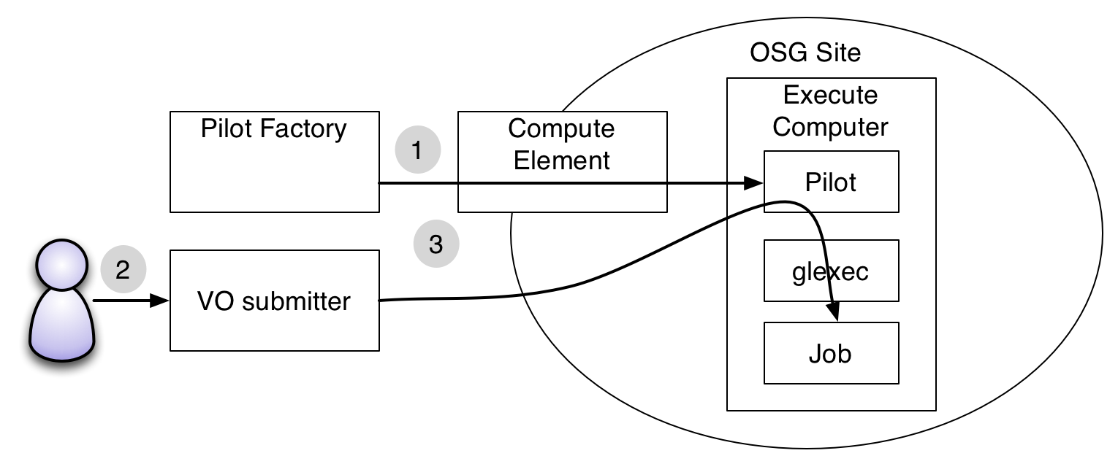
Glexec

Slide 30
How should you apply the principles?
Resource diversity
  Can your application run on multiple OSes?
  In multiple environments?
  If you gain access to more computers, how hard will it be for you to use them?
Dependability
  Use a system that recovers from faults
  Write your code to expect failures and recover (or report good errors!)
  c.f. Greg’s talk from this morning

Slide 31
How should you apply the principles?
Autonomy
  Expect resources to be autonomous: they make choices for their own benefits
  Resources come and go unpredictably

Slide 32
How should you apply the principles?
When someone sells you a new technology, or software or …
Ask:
  Can it handle diverse resources?
  Is it dependable?
  Are components autonomous?
  Does it manage trust relationships?
  Does it improve on the ability to provide these fundamental principles, or is it merely a shiny new version of what we already have?

Slide 33
These apply at all scales
The principles apply:
  For a single computer
  For a cluster
  For a campus
  For a grid/cloud (like OSG)

Slide 34
Questions?
Questions? Comments?
  Feel free to ask me questions later:
  Alain Roy <roy@cs.wisc.edu>
Upcoming sessions
  Now – 2:45
    Break
  2:45 – 4:20
    High Throughput Computing Showcase

