Slide 1




Lecture 2
Grid Security Fundamentals

Slide 2
Credits
Gabrielle Allen
  Center for Computation & Technology
  Louisiana State University
  gallen@cct.lsu.edu
  From Grid Summer Workshop June 21-25, 2004

Slide 3
Topics
Introduction: Computer Security Topics
Public Key Infrastructure
X.509 Certificates
SSL and SSH
GSI: Grid Security Infrastructure

Slide 4
Security Concepts:
Some Whys

Slide 5
Security Concepts: Some Whys
Authentication: Establishing identity
Authorization: Establishing rights
Message protection
  Message integrity
  Message confidentiality
Non-repudiation

Slide 6
Authentication
Process of identifying who you are
  Username/password
  Passport/visa
  Driving License or ID Card
  Public keys
  Finger prints/DNA
  Credit Account Information
Authentication stops masquerading imposters

Slide 7
Authorization
Given who you are, what are you allowed to do?
  The process of deciding if device X is allowed to have access to service Y
  Unix rwx permissions
  Access Control Lists (ACLs) provide more flexible control

Slide 8
Message Integrity
Has the message has been tampered with between its origin and destination?
Authentication and integrity are closely linked: Message integrity secures the communication of entity (person, host, etc.) authentication

Slide 9
Message Confidentiality
Being sure that no one else is able to read or interpret the message
Encrypted message are not available to unauthorized users
Analogy: Sending your message in a safe … only people with the key can open it.

Slide 10
Non-Repudiation
“I meant what I said and I said what I meant.”
Ensuring that a transferred message has been sent and received by the parties claiming to have sent and received the message.
Guarantees that the sender of a message cannot later deny having sent the message.
Guarantees that the recipient cannot deny having received the message.

Slide 11
Security Concepts:
Some Hows

Slide 12
Security Concepts: Some Hows
PKI: Public Key Infrastructure
Digital Signatures
X.509 Certificates
Certificate Authorities
Authentication Delegation

Slide 13
PKI:
Public Key Infrastructure

Slide 14
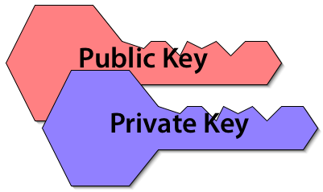
Public Key Infrastructure
User (or entity) gets a related key pair:
  one private key, known only to the user
  one public key, distributable to the world
A message encrypted with one key requires the other key for decryption

Slide 15
Key Reciprocity
Data encrypted using the public key requires the private key for decryption.
  If you know my public key, you can send me via an open channel a message only I can read.
Data encrypted using the private key requires the public key for decryption.
  If my public key decrypts an encrypted message I have sent via an open channel, then only I could have sent it.

Slide 16
How PKI keys get around
Your public key can be distributed freely, because by itself it isn’t enough to prove your identity.
Your private key should be kept as secure as possible, because that is the secret information only you should have.
If I have your private key, then as far as PKI is concerned, I’m you.

Slide 17
X.509 Certificates and Certificate Authorities

Slide 18
Digital Signature
An electronic signature authenticates the identity of the sender of a message, the signer of a document, or ensures that the contents of a message are intact.
Digital signatures are easily transportable, cannot be imitated by someone else, and can be automatically time-stamped.
The ability to ensure that the original signed message arrived means that the sender cannot easily repudiate it later.

Slide 19
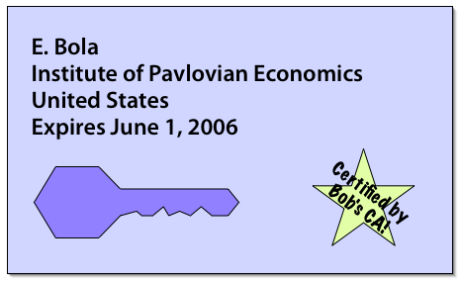
What is a Certificate?
Analogous to passport or driver’s license
Signifies identity, and signed by a trusted party
Name
Issuer
Public Key
Signature

Slide 20
More on Digital Certificates
The signer of a digital certificate says something like “I attached my public key to this digital certificate and then signed it with my private key”
Any user of my digital certificate must completely trust the competency and honesty of the person/organization who signed the certificate
For anyone to confidently use my digital certificate they must also trust that they have a validated copy of the signer’s public key
There is nothing secret about the contents of a digital certificate
Has expiration date

Slide 21
Verifying a Certificate
By checking the signature, one can determine that a public key belongs to a given user
Hash
Hash
Name
Issuer
Public Key
Signature
=?
Decrypt
Hash
Public Key from
Issuer
Issuer

Slide 22
Managing Digital Certificates
Digital certificate administrative frameworks are called “public key infrastructures” (PKIs).
Two major ones (sometime interoperable)
  X.509 (standardized by IETF)
  Pretty Good Privacy (PGP)
Centrally controlled system for managing digital certificates in the X.509 world is a “certificate authority.”

Slide 23
Certificate Authorities (CAs)
A small set of trusted entities known as Certificate Authorities (CAs) are established to sign certificates
A Certificate Authority is an entity that exists only to sign user certificates
The CA signs it’s own certificate which is distributed in a trusted manner
Name: CA
Issuer: CA
CA’s Public Key
CA’s Signature

Slide 24
Certificate Authority
Trusted third party (CA) which manages digital certificate application, certification, issuance and revocation
Examples: DOE, NCSA “Alliance”
Another example: SimpleCA
X.509 trust networks (e.g. Mississippi will trust driving licenses issued in LA)
Each X.509 PKI implementation has a root CA, which produces a self signed or root certificate

Slide 25
An Alliance Certificate
Certificate:
Data:
Version: 3 (0x2)
Serial Number: 338 (0x152)
Signature Algorithm: md5WithRSAEncryption
Issuer: C=US, O=National Computational Science Alliance, OU=Certification Authority
Validity
Not Before: Aug 31 10:16:51 2002 GMT
Not After : Aug 30 10:16:51 2004 GMT
Subject: C=US, O=National Computational Science Alliance, CN=Gabrielle Allen
Subject Public Key Info:
Public Key Algorithm: rsaEncryption
RSA Public Key: (1024 bit)
Modulus (1024 bit):
00:b6:ad:2f:fc:20:f3:45:8e:a0:9c:e2:a8:a5:1d:
ETC ETC ff:f4:b7:2a:ce:d4:f8:e3:cd
Exponent: 65537 (0x10001)

Slide 26
An Alliance Certificate
X509v3 extensions:
X509v3 Key Usage: critical
Digital Signature, Non Repudiation, Key Encipherment, Data Encipherment
X509v3 Authority Key Identifier:
keyid:9F:2D:DC:82:F0:CC:81:B2:FE:9D:AC:8E:23:47:1B:B6:D5:BE:B9:E2
X509v3 CRL Distribution Points:
URI:https://ca.ncsa.edu/5aba75cb.r0
Signature Algorithm: md5WithRSAEncryption
a8:0f:c5:d6:ea:18:d7:6a:f6:76:61:a0:19:2e:3c:db:66:a6:
ETC ETC
1b:7f:39:61:14:77:41:44:0d:15:70:cc:12:01:3b:79:29:66:
52:b9:a5:e0:6e:01:09:70:e8:4e:ac:0d:48:c8:31:ba:62:f1:
cd:ac:c8:73:82:79:18:8b:5d:0d:d1:78:cc:2b:85:ff:92:95:
37:26:1c:f0

Slide 27
GSI:
Grid Security Interface

Slide 28
Grid Security Infrastructure (GSI)
Users:
  Easy to use
  Single sign-on: only type your password once
  Delegate proxies
Administrators
  Can specify local access controls
  Have accounting

Slide 29
Grid Certificates
On the Grid, each user and service is identified via a GSI certificate, which includes
  A subject name, which identifies the person or object that the certificate represents.
  The public key belonging to the subject.
  The identity of a Certificate Authority (CA) that has signed the certificate to certify that the public key and the identity both belong to the subject.
  The digital signature of the named CA
GSI certificates are encoded in the X.509 certificate format.

Slide 30



How Do You Get a Certificate?
User generates
public/private
key pair
User send public key to CA along with proof of identity
CA confirms identity, signs certificate and sends back to user
Cert
Request
Public Key
Cert
Certificate
Authority
State of Illinois
ID
Private Key encrypted on local disk

Slide 31
GSI: How Does Single Sign-on Work?
Look at your certificate subject name
  grid-cert-info –subject
  /DC=org/DC=doegrids/OU=People/CN=Alain Roy 424511
Tell people that wish to accept you what your subject name is—they put it into an authorization file on their machine
From your certificate, create a proxy
  grid-proxy-init
  grid-proxy-info –subject: note the “/CN=proxy”
Each person that likes you will accept your proxy: you only have to create it once
  Well, until it expires anyway

Slide 32
GSI: Your Certificates
Sometimes it can take a few days to get a certificate from a CA, because it takes time to verify your identity
What does your certificate look like?
  grid-cert-info

Slide 33
GSI: Certificate Details
User certificates are stored in your .globus directory:
  % ls –l .globus
  -rw-r----- 1 roy roy 1317 Sep 24 2003 usercert.pem
  -r-------- 1 roy roy 1209 Sep 24 2003 userkey.pem
Usercert.pem is the public key and is not private
-----BEGIN CERTIFICATE-----
MIIDHjCCAgagAwIBAgICAe8wDQYJKoZIhvcNAQEFBJomT8ixk
…
-----END CERTIFICATE-----
Userkey.pem is the private key, and must be kept private - never transmitted or shared

Slide 34
GSI: What Else Uses It?
All of Globus uses GSI, so you’ll use it for:
  Submitting jobs
  Transferring data
  Querying information services (maybe)
    It’s often turned off.
Condor uses GSI
Lots of other software uses GSI:
  GSI OpenSSH
  MyProxy
  Grid CVS

Slide 35
Certificate Proxies and MyProxy

Slide 36
GSI: Proxies
It’s a bad idea to use your certificate as identification
  What if someone successfully steals it? They can impersonate you until the certificate expires
  Certificates usually last about a year
Using your certificate, GSI can create a proxy certificate.
  This represents you in the same way.
  It has a short life-time: usually 12 hours, but configurable

Slide 37
GSI: Proxy Details
Create a proxy with grid-proxy-init [-hours N]
A proxy is marked with a “not valid before” timestamp
  If your clocks are not synchronized, you may experience security failures!
Your proxy is stored in /tmp/x509up_uNNNN
  NNNN is your numeric user ID
  You can store it elsewhere, if you need to.
Destroy a local proxy: grid-proxy-destroy

Slide 38
GSI: Proxy Delegation
When you submit a job or transfer data, your proxy travels over the network to that computer
  The remote computer actually gets a limited proxy
    Not all services accept a limited proxy. This is another layer of safety
  Grid-proxy-destroy does not remove proxies that have been transferred.

Slide 39
GSI: /etc/grid-security
/etc/grid-security is the default location to store GSI information for a host
  hosts have certificates too
Job authorization happens in /etc/grid-security/grid-mapfile. This file maps certificates to users:
  “/DC=org/DC=doegrids/OU=People/CN=Alain Roy 424511” roy
  “/DC=org/DC=doegrids/OU=People/CN=Mike Wilde 326321” wilde

Slide 40
MyProxy: Credential Repository
Developed at NCSA
A MyProxy repository is also maintained by NCSA at myproxy.ncsa.uiuc.edu.
To be distributed with Globus Toolkit 4
Excellent documentation at http://grid.ncsa.uiuc.edu/myproxy

Slide 41
Why use MyProxy?
Using MyProxy, you don’t need to store a copy of your Grid credentials on every machine you use to access the Grid.
You can use MyProxy to delegate credentials to a grid portal.
You can allow trusted servers to renew your proxy credential.

Slide 42
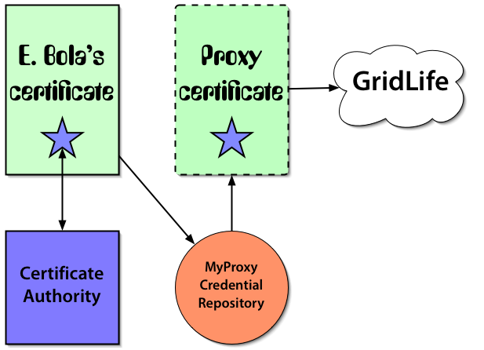
Registering a Proxy Certificate

Slide 43
MyProxy Commands
myproxy-init: store (or renew) proxy
myproxy-get-delegation: retrieve proxy
myproxy-info: query stored credentials
myproxy-destroy: remove credential
myproxy-change-pass-phrase: change password encrypting private key

Slide 44
Credential Renewal
Q: What happens if my credential goes away in the middle of a big job?
  A: “Undefined” disasters
MyProxy lets you extend the lifetime of a stored credential
Condor-G can automatically renew your about-to-expire credential if you’ve set things up properly

Slide 45
SSL, SSH, and OpenSSH

Slide 46
Secure Sockets Layer: SSL (TLS)
Protocol that transmits communications over the Internet in an encrypted form
  SSL ensures that the information is sent, unchanged, only to the server you intended to send it to.
SSL uses a private key to encrypt data
  Netscape and Internet Explorer support SSL
  Web sites use SSL to obtain confidential user information, such as credit card numbers.
  By convention, URLs that require an SSL connection start with https: instead of http:.
Newest version of SSL is called Transport Later Security (TLS)
HTTP
FTP
Secure Socket Layer
(SSL)
TCP
IP

Slide 47
GSI: OpenSSH
OpenSSH has been modified to use GSI
This means that you can use ssh like you are used to, but you don’t have to type your password: just use your proxy
We’ll try it out during the exercises: gsissh

