Slide 1
OSG Area Coordinators
Network Monitoring Update: Sept 9 2015
Shawn McKee

Slide 2
Key Initiatives in Network Area
Improving perfSONAR-PS toolkit for OSG
Track adoption at http://grid-monitoring.cern.ch/perfsonar_coverage.txt
Testing 3.5RC1 in OSG testbed revealed a few issues
Version 3.5RC2 just out. Planned release end of month
OSG modular dashboard service / OSG network service
“Datastore” targeting “production” status next Monday
Lots of work involved in getting this production ready
RSV probes testing publishing to ActiveMQ hosted at CERN
Outreach and community interaction
Co-chairing WLCG Network and Transfer Metrics WG
Last meeting Sept 3; next meeting Sept 30th
Ramping up “full mesh” of WLCG / OSG latency tests (more later)
Ongoing meetings/interactions with perfSONAR developers
PuNDIT continues testing on perfSONAR testbed in OSG..

Slide 3
Recent Accomplishments
Full WLCG/OSG mesh updated; target 100 latency instances
Hit problem at 81. Paused while we evaluate solutions
OSG Datastore almost “production”;
All datastore hardware operational except for 2 additional disks (ordered)
Documentation (“living operations guide”) written: https://docs.google.com/document/d/1l144BSo-88M0cLMMjKcKMIE-Q5s21X-w3lYl-0Pn_08/edit?usp=sharing
Risk assessment document written https://docs.google.com/document/d/182O18IF_5CLPHKeOioHJjfYjVFC0JkEjL_vD4GUevLU/edit#heading=h.kpx7wu1vzcq7
SLA at https://twiki.grid.iu.edu/bin/view/Operations/PSServiceLevelAgreement
Project to monitor meshes underway: “MadAlert”
Proximity service under test. Example:
http://proximity.cern.ch/api/0.3/geoip/nearest?se=head01.aglt2.org&count=3
Effort from WLCG to follow-up with problematic perfSONAR instances successful (~20 instances fixed)
Now “paused” while we fix problems identified during ramp-up

Slide 4
Project Update: MadAlert
Recap: Gabriele Carcassi (original author of GUMS) is working with me at Michigan on a new project for one of our OSG Networking Goals: alerting on problems
The idea is to use the MaDDash API to analyze the data we are acquiring to identify problems based upon patterns in the data collected.
Seeking input on which problems we might be able to identify
Example view on next slide

Slide 5
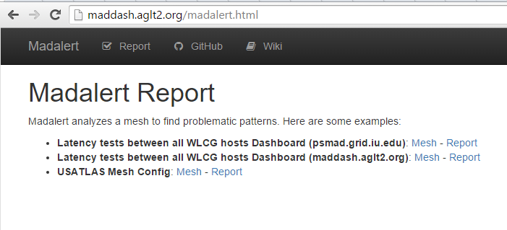
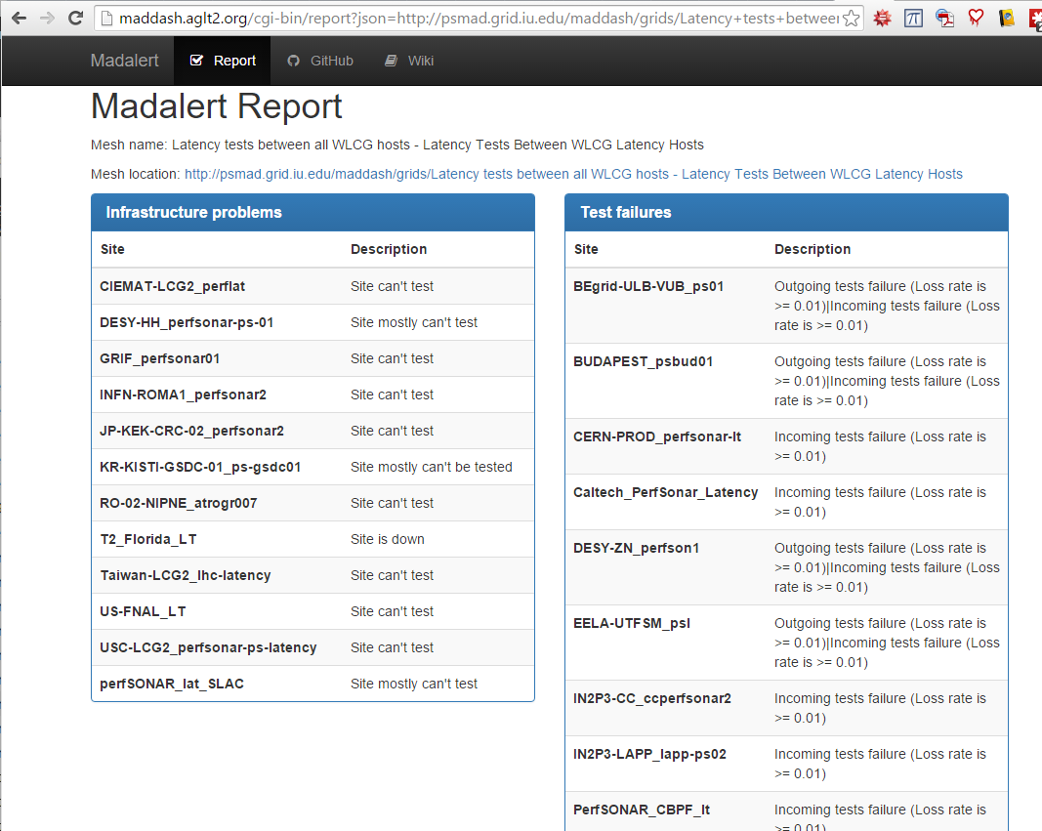
MadAlert
http://maddash.aglt2.org/madalert.html

Slide 6
Known Issues
Still a bug in the RSV probe -> Datastore process. Soichi may have identified culprit. Fixes being created.
OWAMP tests impacted by nightly service restarts. Fix from Andy Lake only partially successful. Load issue?
Underpowered perfSONAR instances (<=4GB ram) having problems in some cases. Was <4GB but at testing scale for WLCG even 4GB not enough.
Campaign to upgrade/replace them. Not always possible.
Next: we are adjusting testing to be uni-directional; results soon.
Publishing network metrics from ITB to CERNs test instance running
Useful to quickly debug data content issues
Load on OSG endpoint is too large; investigating

Slide 7
Top Concerns
OSG Network Datastore is still primary concern
Plan : “production” next Monday (Sep 14)
Weekly meetings of a subgroup very fruitful
Validity testing has exposed bugs; almost all resolved.
Main concern is having the service function smoothly
Hardware/software configuration still being tweaked to support datastore operation.
Resource issues for MaDDash & Message Publishing
Some operational bumps with “normal” maintenance caused downtime.
Not critical now but worried about “production”
We must address the data migration process.
How do we move “older” data off the primary system and onto a new location while retaining some means of access? Waiting for process from Esnet…

Slide 8
Questions or Comments?
Thanks!

Slide 9
URLs of Relevance
OSG Network Datastore Documents
Operations https://docs.google.com/document/d/1l144BSo-88M0cLMMjKcKMIE-Q5s21X-w3lYl-0Pn_08/edit#
Risk Assessment https://docs.google.com/document/d/182O18IF_5CLPHKeOioHJjfYjVFC0JkEjL_vD4GUevLU/edit#heading=h.kpx7wu1vzcq7
SLA https://twiki.grid.iu.edu/bin/view/Operations/PSServiceLevelAgreement
Network Documentation https://www.opensciencegrid.org/bin/view/Documentation/NetworkingInOSG
Deployment documentation for both OSG and WLCG hosted in OSG (migrated from CERN)
https://twiki.opensciencegrid.org/bin/view/Documentation/DeployperfSONAR
perfSONAR-PS Installation Motivation:
https://twiki.grid.iu.edu/bin/view/Networking/WhyPerfSNOAR
Esmond install info http://antg-dev.es.net/esmond-docs/rpm_install.html
Mesh-config in OSG https://oim.grid.iu.edu/oim/meshconfig
perfSONAR homepage: http://www.perfsonar.net/

Slide 10
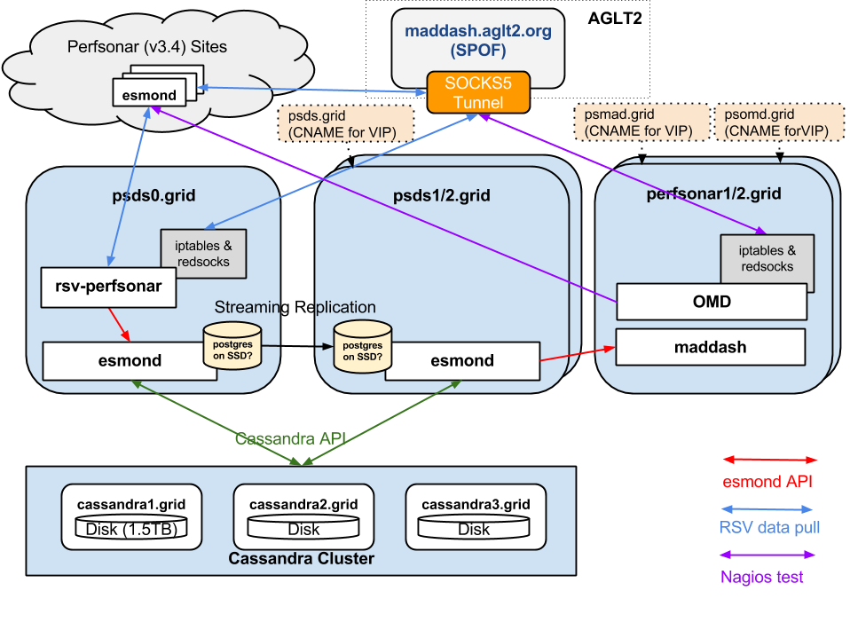
Logical Diagram of Datastore
8 VMs
Storage must host 7 distinct areas

