Slide 1
OSG Area Coordinators
Network Monitoring Update: January 4 2017
Shawn McKee

Slide 2
Review Networking Goals Year 5
Maintain / update the OSG networking services / documentation.
Reach out to non-WLCG OSG sites; Integrate those interested:
Advertise that OSG is ready to help sites with networking issues via:
OSG web pages
Targeted email (Cyberinfrastructure list, perfSONAR user list, etc)
Via interactions with sites at conferences and meetings.
Encourage as many NSF CC*xxx sites as possible to integrate their perfSONAR instances into OSG networking; OSG will provide them a mesh-configuration and gather their data.
Provide Soichi’s standalone mesh-configuration tool for use by campuses and VOs.
OSG will create a network alerting service to find “obvious” network problems
This will involve the creation of a suitable analysis pipeline such that perfSONAR data can be analyzed on a timescale of every 1-2 hours.
Obvious problems include significant decrease in bandwidth between a source and destination or continuing significant packet loss along a path or correlated with a specific site.
Actual alerts will be issued by GOC staff based upon alarms they receive.
Enable automated alerting (email, SMS) on well identified alarms.
This is a “reach” goal for the year but I think it should be feasible
Requires accurate, synchronized mapping of sites to contacts
Tunable pattern of alerts (e.g., 1 alert, wait 1 day and alert if problem continues, then every 3 days until fixed)

Slide 3
The Slipped Milestones
Recruiting of 10 new sites for OSG networking -- October 31, 2016 (slipped)
Side tracked waiting for MCA and pS v4.0
Initial release of Soichi’s standalone mesh-configuration utility packaged and available --- September 30, 2016 (Moved)
See later slide
Initial Alarming system into production --- December 1, 2016 (partial)

Slide 4
Recruiting non-WLCG Sites
One passed set of milestones was to recruit 10 (or more) non-WLCG sites who have perfSONAR instances to “join” OSG
This means they use the OSG mesh-configuration to define tests
OSG will gather metrics from their instances
Our dashboard and check_mk will display their metrics and monitor their perfSONAR services
Delayed waiting for the standalone mechconfig and perfSONAR v4.0
Makes sense to recruit when those are ready
Plan a target email campaign soon.
Operations + User Support help?
Suggestions needed and welcome.

Slide 5
Standalone Mesh-config (MCA)
Soichi was approved Nov 16 to work 20% on this for 4 months followed by 10% for 2 months
Ticket 31359 open on getting OSG “pre-production” version running (Chris Pipes)
Documentation at http://docs.perfsonar.net/mca_configuration.html
Issues tracked at https://github.com/soichih/meshconfig-admin/issues (12 open, 2 closed)
OSG instance running at https://meshconfig.grid.iu.edu/meshconfig/ (create an account to play with this)
Currently missing many hosts. Needs ability to get data from OIM/GOCDB.

Slide 6
Enabling Alarming
We have a longer term goal of alerting and alarming on network issues.
Milestone completed: technical design of a suitable analysis system based upon existing time-series technologies
Worked with Ilija Vukotic to enable ActiveMQ to ElasticSearch at UC: ELK stack + Jupyter seems to be suitable
Very effective so far using attached Jupyter instance (Python workbook) to do analytics and graphs
Anyone can subscribe to simple alert-emails.
Currently can alert when >50% of paths to/from a site show >2% packet-loss for 3 hrs OR when any one path has packet loss >50% for 3 hrs
OSG could benefit from such an analytics system...other use-cases?
Not “production” yet.
Marian Babik and I are looking into check_mk rule-based notifications as a future means of implementing the alerting component. Not yet enabled but Marian is working on ETF implementation (now ~end of January)

Slide 7
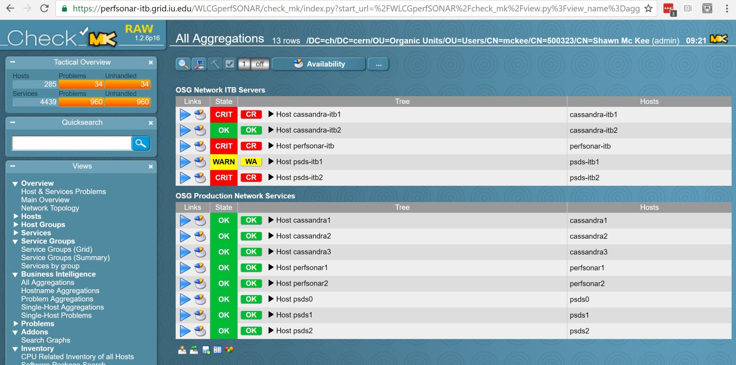
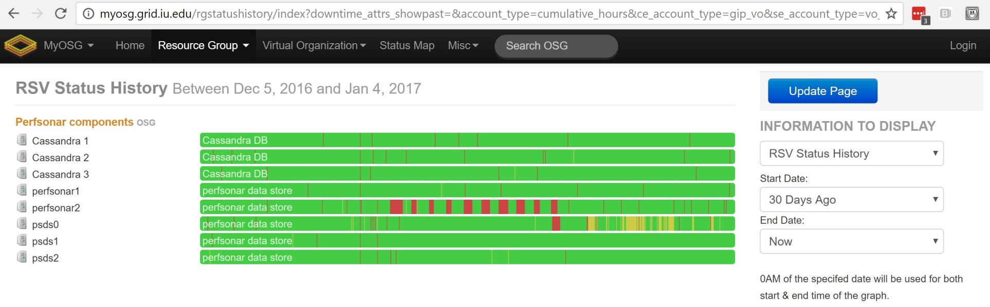
Status of OSG Net Services

Slide 8
Service “Challenges”
As you can see on the previous 30 day RSV status we have had some occasional problems with some services
MaDDash (on perfsonar2) had nightly stops at around 9:30 and would stay down for 12 hrs
No reason identified…mitigated with cron restart script from Scott
The psds0 system has more RSV probes than expected recently. I increased the warning/critical thresholds but it may need more study
The ITB instances have problems. Full /var, MaDDash not running, intermittent load issues
Would like to get check_mk monitoring on the virtualization host.
Sent email to Thom to see if that might be possible
Useful to understand resource use and possible conflicts

Slide 9
perfSONAR v4.0 / MaDDash 2.0
The perfSONAR v4.0 release was delayed from the nominal Dec 1 2016 date
Needed an RC3 release to follow-up on more issues found in RC2
Targeting ~Feb 1, 2017
MaDDash 2.0 is close to ready.
I believe an official release should happen at the same time as perfSONAR?
Fix the issues we have seen in OSG?
Once these are released we will want to update ITB and then Production
Will need a global campaign to get sites updated

Slide 10
Getting ALL perfSONAR Metrics
When we initial setup the perfSONAR RSV probes and ActiveMQ message queue at CERN we only supported part of all the possible data metrics perfSONAR can measure.
Both the RSV probes and Stompctl/ActiveMQ systems needed to support whatever data types we wanted
Now we want to make sure we are getting all the data possible and allow for new future tests that may be needed
Opened a ticket to add this support (31257)
Also fixing event size issue we saw which crashed things
ActiveMQ updated already
Next is to get update RSV perfSONAR
Will increase the amount of data we gather but not expected to be more than about 25% increase
We will be able to customize the event types gathered in perfSONAR RSV and limit the maximum message size.

Slide 11
OSG Net Data Lifecycle Mgmt
We are running out of storage space for the OSG network data
We had originally said we would keep data “indefinitely” (we gather ~5TB/year)
Document written up describing the problem and possible solutions related to OSG Network Data-Lifecycle Management
Not certain about long-term MA technology
No reliable data migration tool in place
No long-term repository space identified

Slide 12
OSG Net Service Hardware
All our Production OSG network services run on a dedicated Dell R730xd with 18 drive bays (12 external 3.5", 4 internal 3.5", 2 internal 2.5")
The 2 internal 2.5" bays are occupied by 1TB HDDs that are in RAID-1
All bays are currently occupied:
4 internal bays are occupied by 4TB HDDs that are in RAID-10.
4 bays are occupied by 4TB HDDs that are in RAID-10.
4 bays are occupied by 4TB HDDs that are in RAID-10.
4 bays are occupied by 512GB SSDs that are in RAID-10.
Configuration of the disks
One 8TB RAID-10 (7.28 TiB) is partitioned into:
4 TB (3.64 TiB): Directly mounted as /usr/local for cassandra1 VM
4 TB (3.64 TiB): LVM PV, contributes to general host space for VM virtual drives
One 8TB RAID-10 (7.28 TiB) is partitioned into:
4 TB (3.64 TiB): Directly mounted as /usr/local for cassandra2 VM
4 TB (3.64 TiB): LVM PV, contributes to general host space for VM virtual drives
One 8TB RAID-10 (7.28 TiB) is partitioned into:
4 TB (3.64 TiB): Directly mounted as /usr/local for cassandra3 VM
4 TB (3.64 TiB): LVM PV, contributes to general host space for VM virtual drives
The four SSDs are organized into a 1TB RAID-10 that is visible to the host system as a block device, but has not been partitioned/formatted/mounted yet.

Slide 13
Plan to Address Storage Space
The long term solution for data life-cycle mgmt depends upon the choice of measurement archive (MA), the creation of suitable tools for that MA and identification of long-term storage
Won’t happen in time for OSG needs
For now we can fix things for the next couple years by purchasing eight 10TB datacenter disks for about $570 each
Will add 24TB additional storage
Needs careful implementation…

Slide 14
Draft Plan (for Discussion)
Purchase 8 WD Gold Datacenters 10TB disks
Since current R730xd is full we need to move things to deploy the new space
Uninstall SSDs; replace with 4 x 10TB R10
Pick existing R10(old) and move/stop services
Copy all data to R10(new); restore services
Remove R10(old) and replace with new 10TB R10
Pick second R10(old); move/stop services
Copy all data to R10(new); restore services
Remove 2nd R10(old) and replace with SSDs
Need to discuss partitioning & space use

Slide 15
Talks and Papers (Outreach)
There are 3 CHEP 2016 papers covering CHEP talks that are due Feb 6, 2017 with OSG components that I know of
Networks in ATLAS (done)
The OSG Network Service
HEP Networking
In addition, next week is the Pre-GDB on Networking at CERN

Slide 16
Pre-GDB on Networking
Next week is the Pre-GDB on Networking at CERN
https://indico.cern.ch/event/571501
The goal is to bring together the experiments, sites and network operators to discuss what the near, mid and long-term work required in networking
This is relevant for OSG.
OSG’s role in gathering network metrics and alerting and alarming are likely to be central items for near-term work

Slide 17
Concerns (Much as last time)
Operation of services
OSG production network service still seeing some issues
Monitoring being tweaked to be less noisy
MaDDash v1 has had issues. Maybe v2 will fix things?
Challenging to identify root cause/fixes with indirect access
Significant set of updates coming in 30-45 days…need to prep
Identifying suitable non-WLCG sites to benefit from OSG networking services (need ~5 sites identified to recruit)
Long-term data lifecycle management
Details earlier in talk. Must implement additional storage
Need MA choice, corresponding tools and long-term storage
Convergence on “alarming” system.
Needed components are in place and being played with
Need to build the user-facing interface and enable continuous operation

Slide 18
Questions or Comments?
Thanks!

Slide 19
URLs of Relevance
OSG Network Datastore Documents
Operations https://docs.google.com/document/d/1l144BSo-88M0cLMMjKcKMIE-Q5s21X-w3lYl-0Pn_08/edit#
SLA https://twiki.grid.iu.edu/bin/view/Operations/PSServiceLevelAgreement
Data lifecycle https://docs.google.com/document/d/1mJ1kf43nZf6gvKoNtiTOc0g0MYDv_wSfSm7YdiMs3Lo/edit#
Current OSG network documentation https://www.opensciencegrid.org/bin/view/Documentation/NetworkingInOSG
OSG networking year-5 goals and milestones: https://docs.google.com/document/d/1FzmXZinO4Pb8NAfd5SWUzaAFYOL23dt66hQsDmaP-WI/edit
perfSONAR adoption tracking: http://grid-monitoring.cern.ch/perfsonar_coverage.txt
Deployment documentation for both OSG and WLCG hosted in OSG (migrated from CERN)
https://twiki.opensciencegrid.org/bin/view/Documentation/DeployperfSONAR
ATLAS Analytics: http://cl-analytics.mwt2.org:5601/
Mesh-config in OSG https://oim.grid.iu.edu/oim/meshconfig
Beta Mesh-config: https://ps-test.sca.iu.edu/meshconfig/
Pre-Production Meshconfig https://meshconfig.grid.iu.edu/meshconfig/
MadAlert: http://madalert.aglt2.org/madalert/diff.html
perfSONAR homepage: http://www.perfsonar.net/

