Slide 1
Executive Director Report to the OSG Council July 12th 2011, Ruth Pordes
Input to the Magic group on the state of production grid technologies.
Usage on the OSG.
Interactions with XSEDE Campus Champions
Report from the OSG Summer school

Slide 2
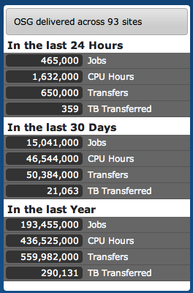
Input to Magic - OSG Production Services
1.2Million CPU-hours/day; 1/ Million Jobs/day ¼ Petabyte over the WAN/day
from >90sites
18 VOs
260 peer reviewed publications /year

Slide 3
Input to Magic - Challenges
Technical, Programmatic, Human
Sustaining the people, services, software.
Keeping production flowing while evolving and extending the services, software, people.
Communicating and consulting to show faculty, educators, students on the campuses the potential benefits.

Slide 4
Input to Magic - What we can do
Separately address
What needs to be done – technically
From the Who does it – funding of the implementations
Develop methods and processes that protect our investment in development in software, services and people.
Sustaining the Workforce : education, training, engagement

Slide 5
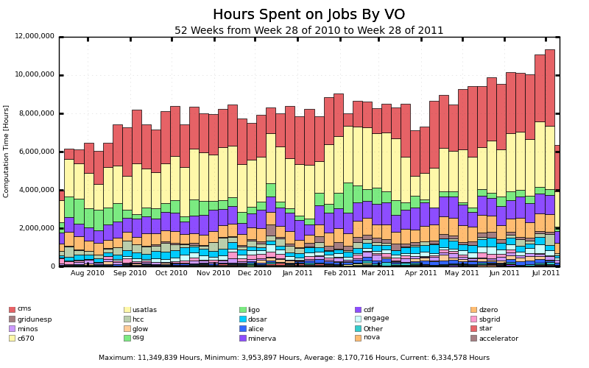
Usage
1.6Milllon hours/day

Slide 6
OSG Campus Grids <-> XSEDE Campus Champions
TeraGrid 2011 next week in Salt Lake City
Kay Hunt and Kim Dillman coordinating Campus Champions meeting on Sunday and Tutorial about “how to identify and access appropriate resources from XSEDE” on Monday
Dan, Marco and Jim will attend.
Ruth or designee attending couple of days for FutureGrid Advisory Board and “How to organize VOs” at the Science Agency Uses of Clouds and Grids.
Immediately brings up Q’s of detail e.g.
Purdue resources accessible through TG, OSG, DiaGrid, Condor-Pool – how to advise the users?
“before and after OSG integrated into XSEDE allocation processes.

Slide 7
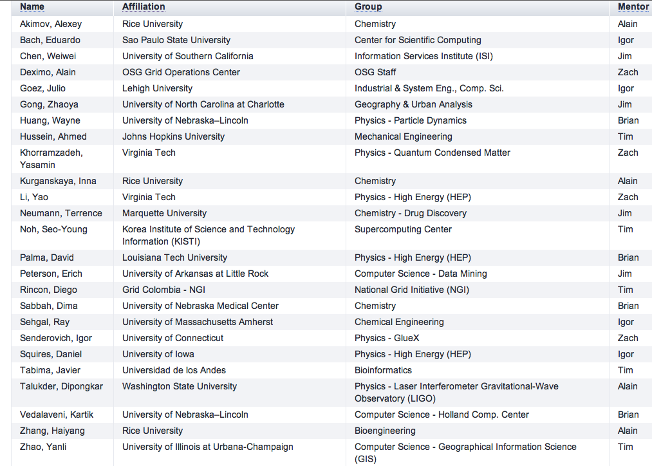
Summer School a great success!! Mentors in place!

Slide 8
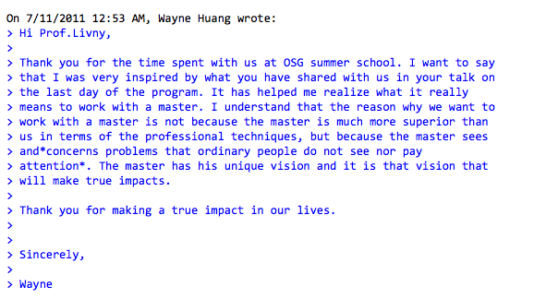
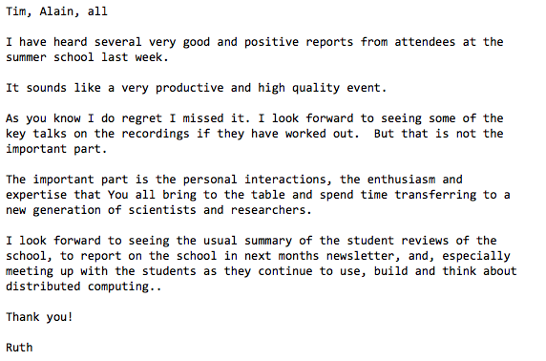
..
Eduardo Bach spending 3 more weeks working with OSG@FNAL to install and learn submission services to support these in GridUNESP.

