Slide 1


Deployment metrics and planning
(aka “Potentially the most boring talk this week”)
GridPP16
27th June 2006
Jeremy Coles
J.Coles@rl.ac.uk

Slide 2
Overview
1 An update on some of the high-level metrics
2 Even more metrics….zzZ
3 zzzzzzzzzZZZZZZZZZZZZZ
4 What came out of the recent deployment workshops
5 What is happening with SC4
6 Summary

Slide 3
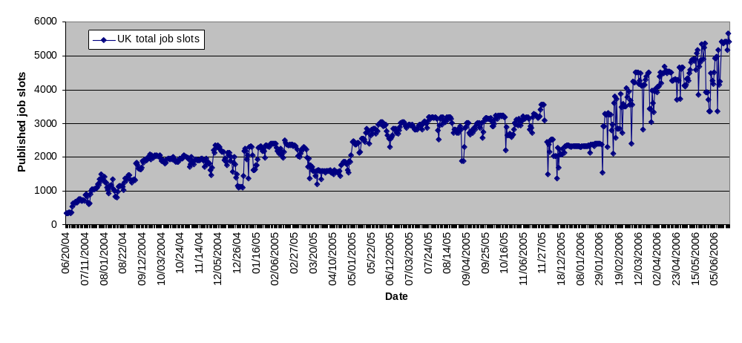
Available job slots have steadily increased
Contribution to EGEE varies between 15% and 20%.
From this plot stability looks like a problem!
Thanks to Fraser for data update

Slide 4
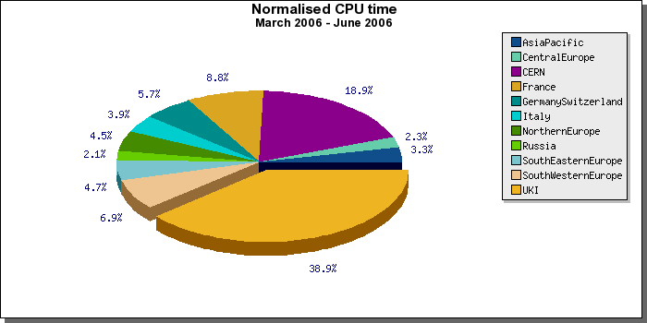
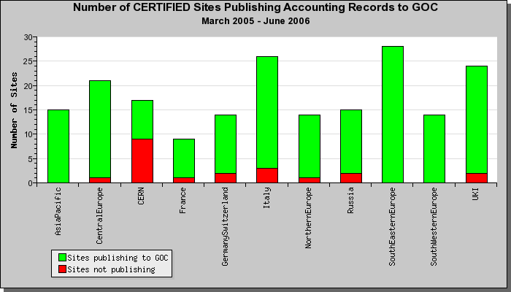
Our contribution to EGEE “work” done remains significant but…
… but be aware that not all sites have published all data to APEL. Only 1 GridPP site is not currently publishing

Slide 5
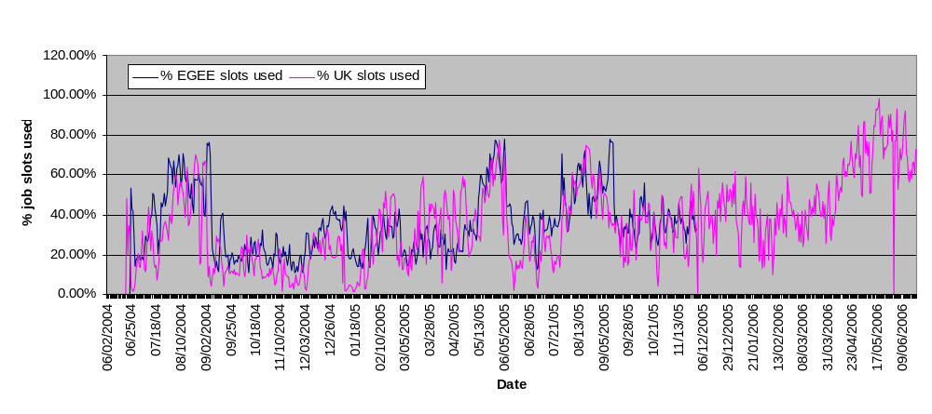
CPU usage has been above 60% since May
Update for GridPP15

Slide 6
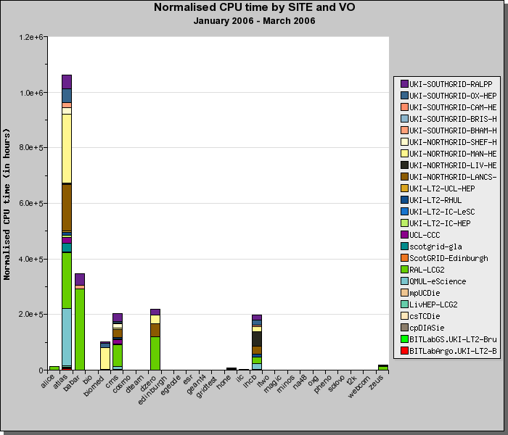
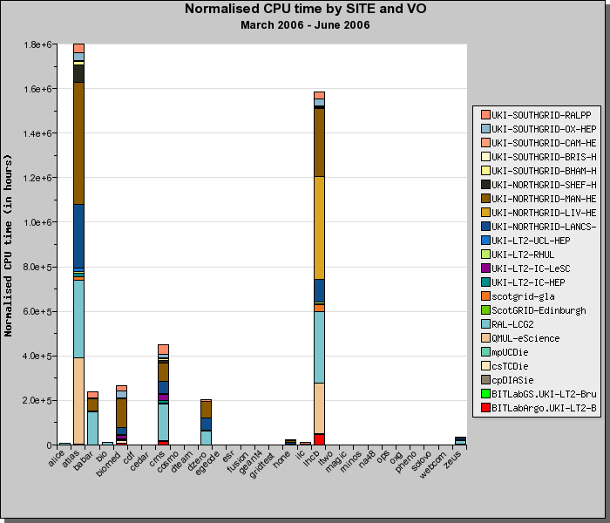
This is because most VOs have doubled job rates – note LHCb!

Slide 7
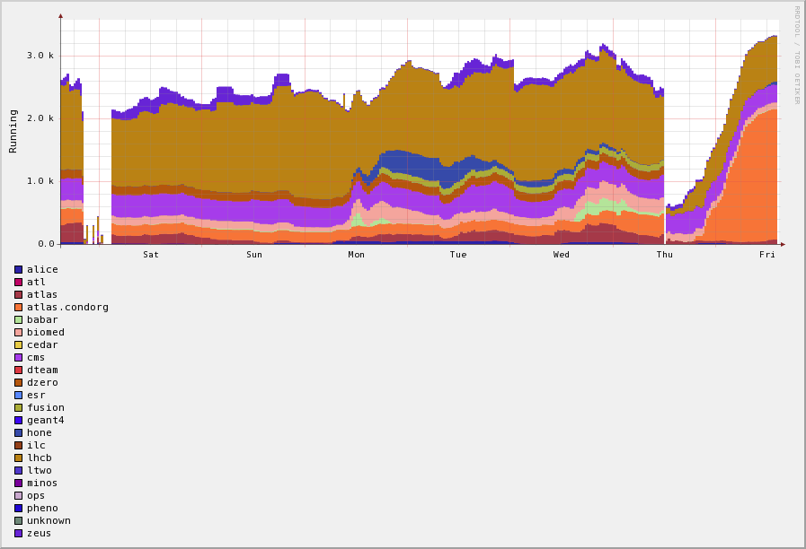
IC-HEP are developing a tool to show job histories (per CE or Tier-2)
View for GridPP CEs covering last week

Slide 8
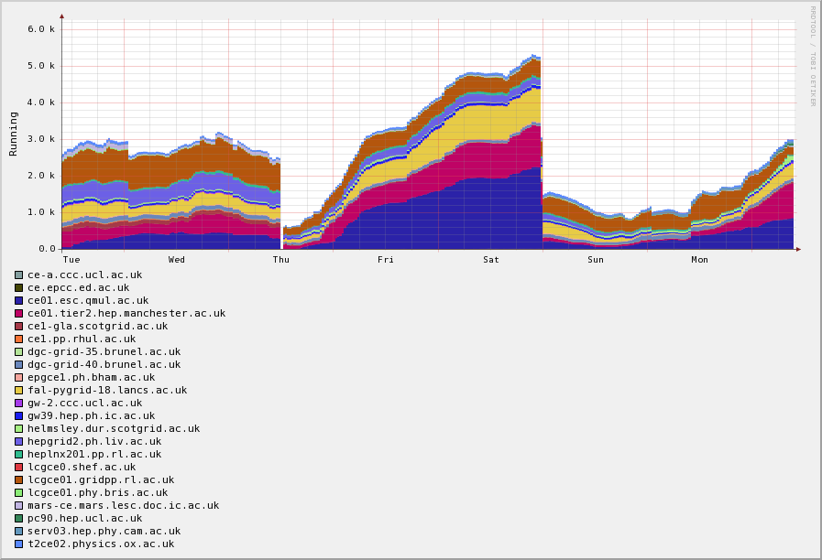
..but it looks a little rough sometimes!
Over 5000 jobs running

Slide 9
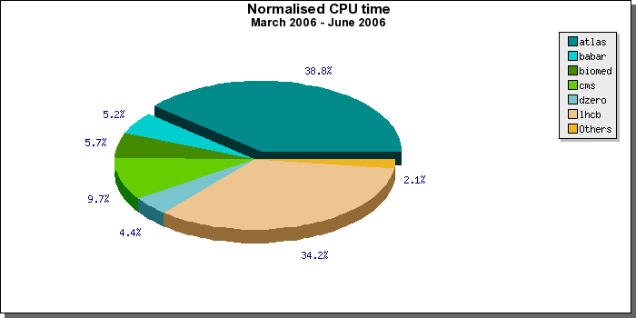
The largest GridPP users by VO for last 3 months
ATLAS
BABAR
BIOMED
CMS
ZEUS
DZERO
LHCb

Slide 10
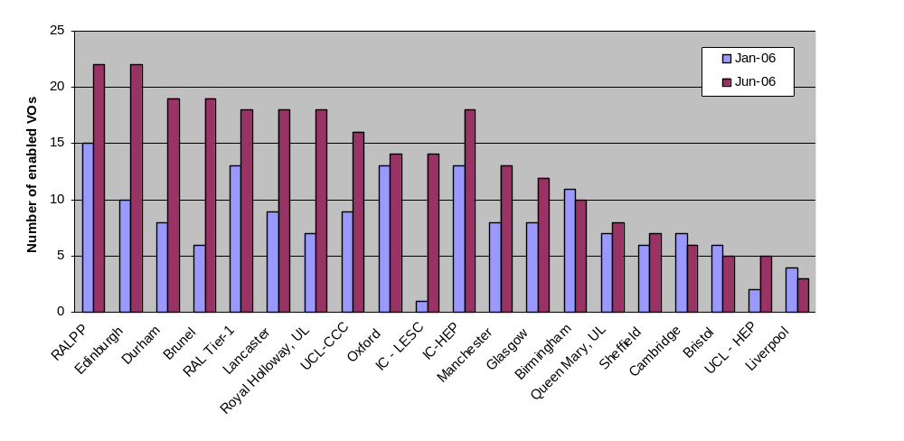
VOs = a big success
But we do now need to make sure that schedulers are giving the correct priority to LHC VO jobs!
The ops VO will be used for monitoring from the start of July

Slide 11
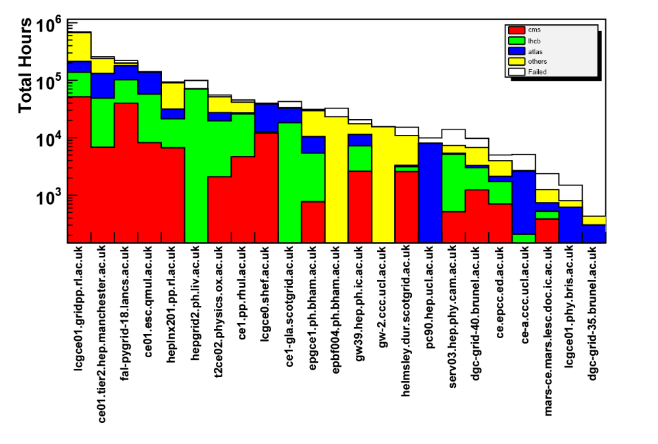
Ranked CEs for Apr-Jun 2006
Thanks to Gidon and Olivier for this plot.

Slide 12
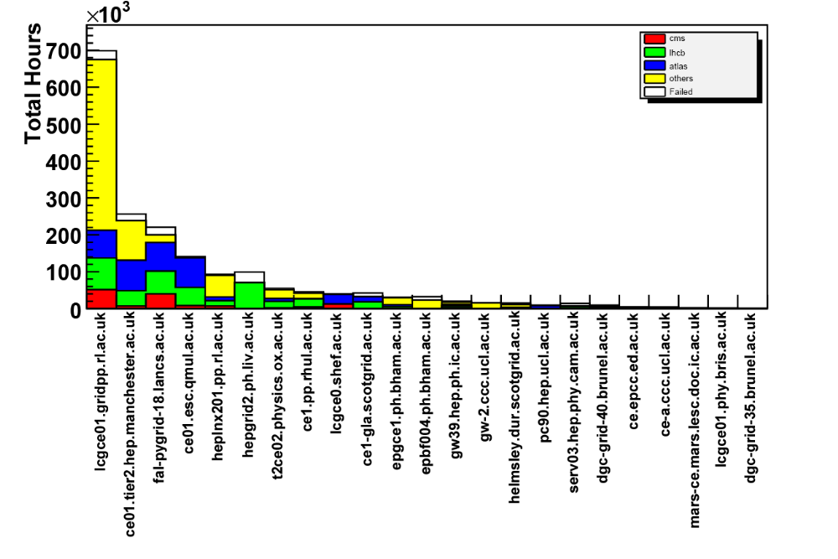
Ranked CEs for Apr-June 06

Slide 13
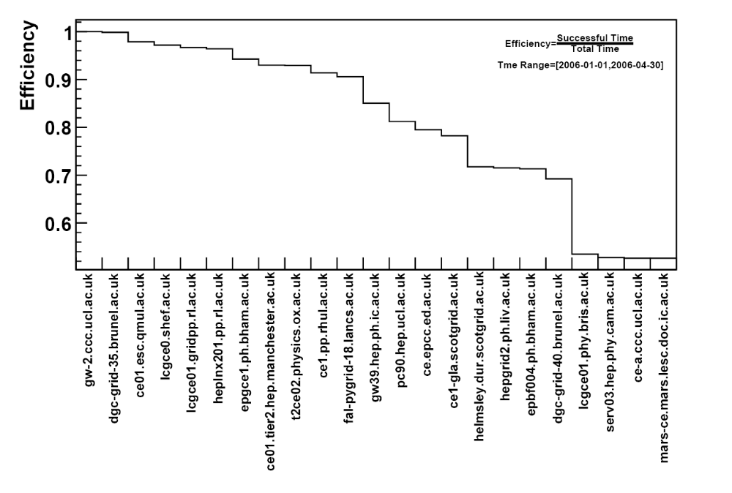
Successful time / total time
Thanks to Gidon and Olivier for this plot.

Slide 14
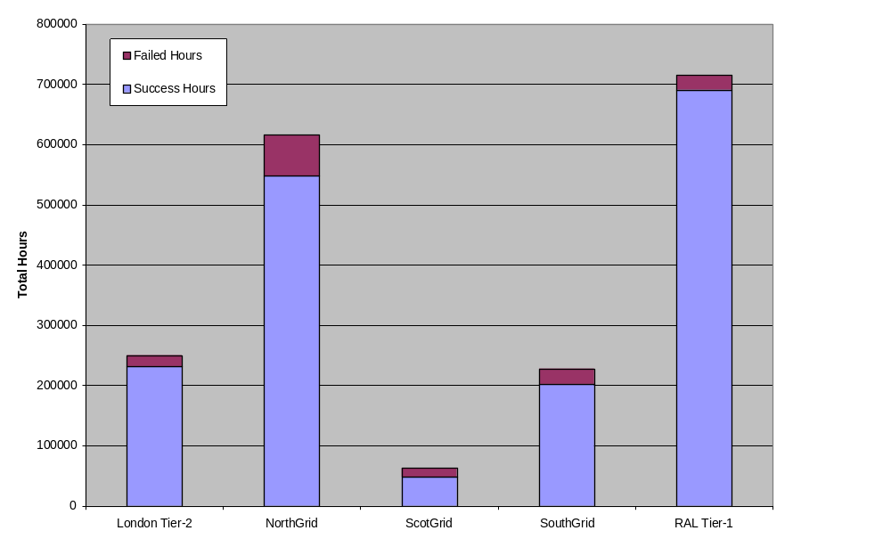
An interesting view by Tier

Slide 15
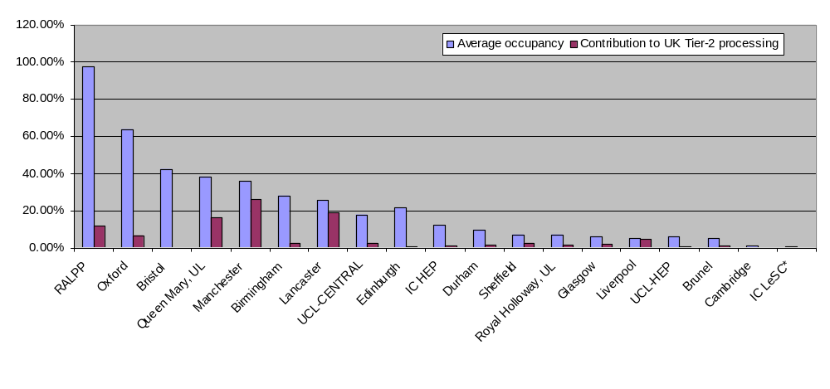
A little out of date Q1 view for contribution and occupancy
Some sites appear more successful at staying full even when overall job throughput is not saturating the resources. For Q2 most sites should show decent utilisation. (of course this plot involves estimates and assumes 100% availability).

Slide 16
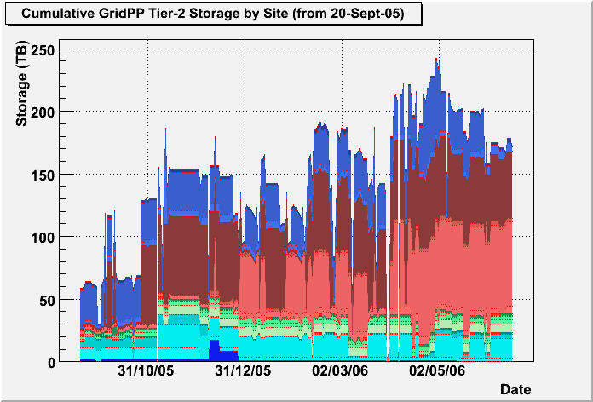
Storage has seen a healthy increase – but usage ~40%
SRM V2.2 is delayed. There have been several workshops/meetings taking forward the details of storage types (custodial vs permanent etc.)

Slide 17
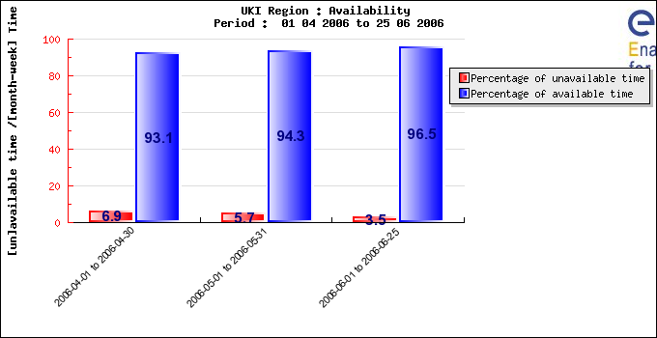
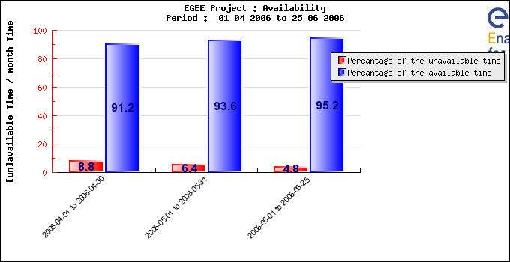
Scheduled downtime is better than EGEE average
…. Still not really good enough to meet MoU targets. Sites need to update without draining site… there are still open questions in the area of what “available” means. GOCDB needs finer granularity for different services.

Slide 18
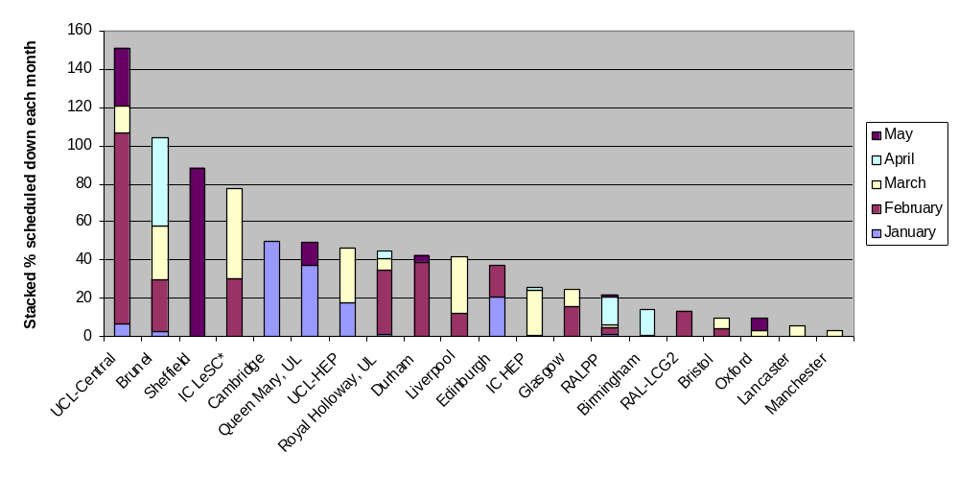
So are there any recent trends!?
This is the percentage of time that a site was down for a given period – if down for whole month the monthly stack (each colour) would be 100%

Slide 19
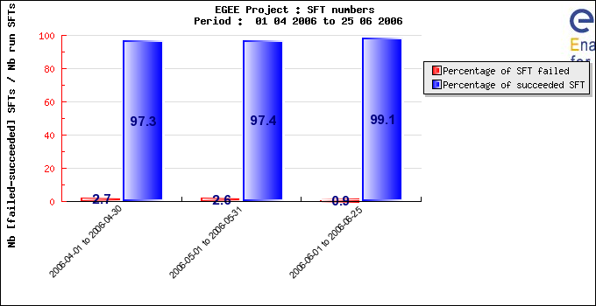
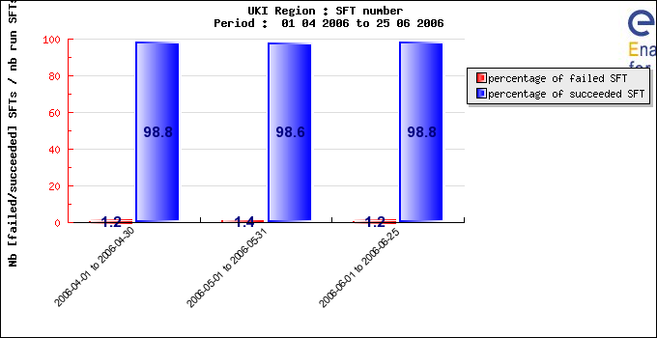
% SFTs failed for UKI
Seems better than the EGEE average for April and May but slightly worse in June so far.
These figures really need translating into hours unavailable and the impact on the 95% annual availability target.

Slide 20
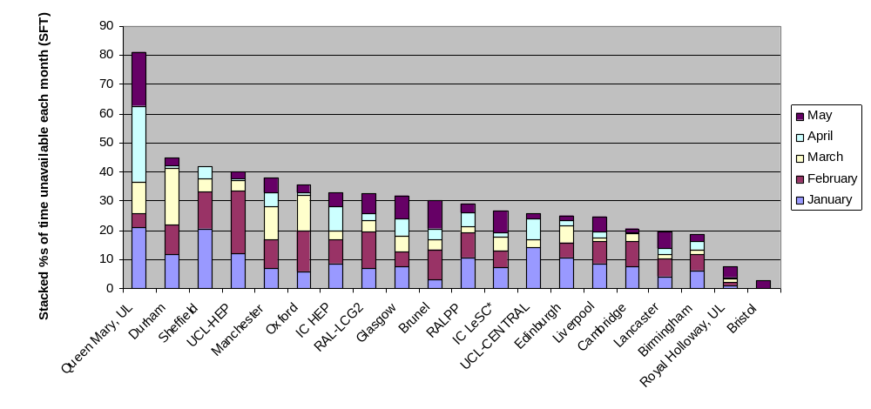
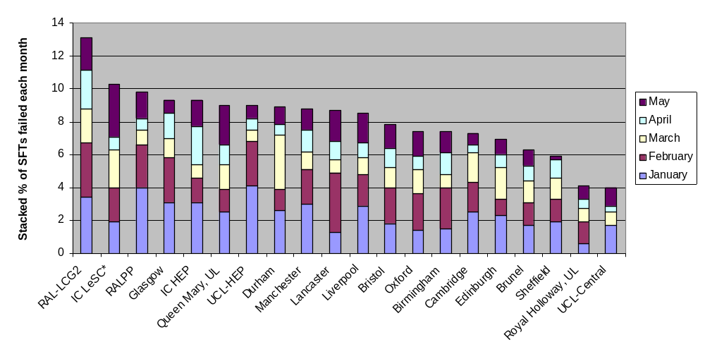
SFTs per site - time
Generally April and May seem to be improvements on January to March

Slide 21
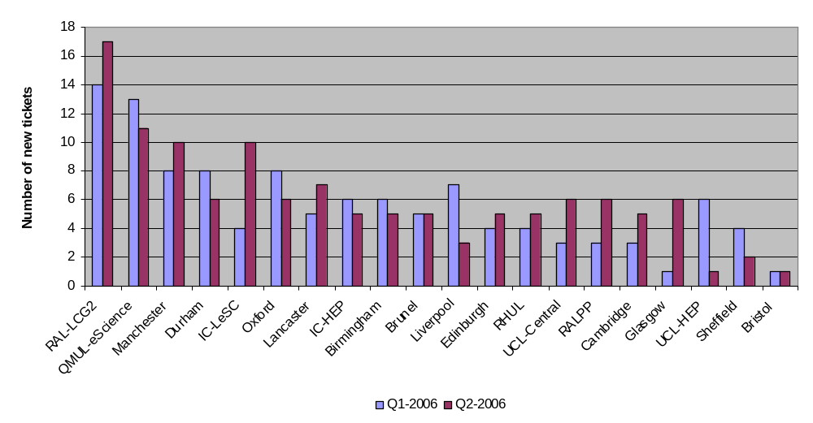
Number of trouble tickets
More tickets in Q2 2006 so far! This seems correlated with the increased job loads. The profile is really quite similar between Q1 and Q2 2006

Slide 22
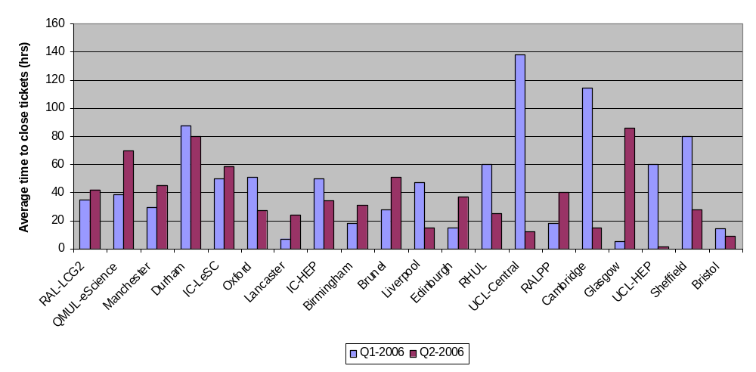
Average time to close tickets
Tickets are usually from grid operator on duty. We need to look at factors behind these times. Note that just a few tickets staying open for a long time can distort the conclusions. We need better defined targets. The MoU talks about time to response of 12hrs (prime time) and 72 hrs (not prime time).

Slide 23
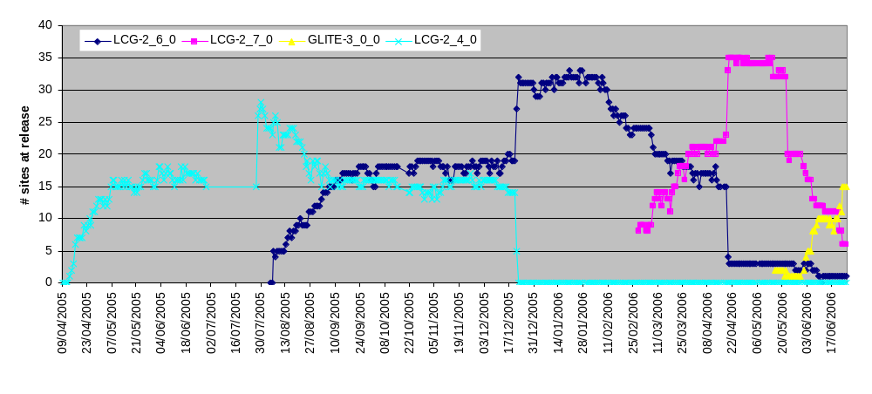
Middleware upgrade profiles remain similar
gLite 3.0.0 was deployed late but released on time raising questions about project wide communications. Our target remains 1 month from agreed start date.
EGEE wants to move to “rolling updates” but there are still issues around tracking (publishing) component versions installed.

Slide 24
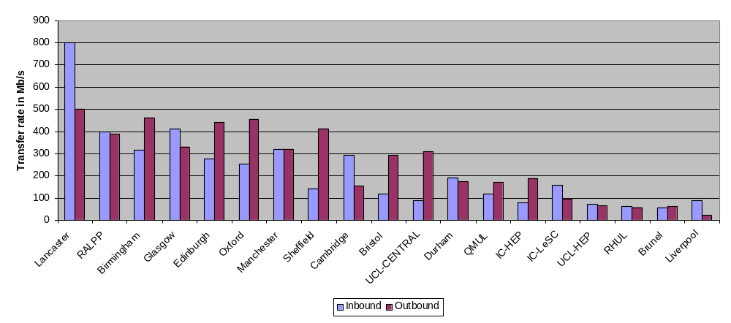
Disk to disk transfer rates
The testing went well (thanks to Graeme) but we have a lot to do to improve rates.
Suspected/actual problems and possible solutions are listed in the SC wiki:
http://www.gridpp.ac.uk/wiki/Service_Challenge_Transfer_Test_Summary

Slide 25
Some key work areas for Q3 and Q4 2006
Improving site availability/monitoring (e.g. Nagios scripts with alarms)
Getting the transfer rates higher
Understanding external connectivity data transfer needs
Understand performance differences across the sites
Adapt to rolling update of middleware model
Implement storage accounting
Improve cross-site support
Understand WLCG MoU mapping to UK Tier-2 structure (and how we meet it)
Take part in LCG experiment challenges (SC4 and beyond)
Streamlining of the support structure (helpdesk)
SRM upgrades (SRM v2.2)
New resources integration (start to address the CPU:disk imbalance vs requirements)
Security: incident response
Exploiting SuperJanet upgrades
Improved alignment with UK National Grid Service
The usual: documentation and communication

Slide 26
Workshop outputs
Tier-2 workshop/tutorials already covered – next planned for January 2007
OSG/EGEE operations workshop
  RELEASE AND DEPLOYMENT PROCESS
  Why do sites need to schedule downtime for upgrades?
  Release: Is local certification needed? sites required for testing against batch systems
  Links to deployment timetable and progress area
  USER SUPPORT
  How to improve communications (role of TCG was even debated!)
  Experiment/VO experience. Improving error messaging!
  SITE VALIDATION
  Site Availability Monitoring (SFTs for critical services – will remove some of the general SFT problems that end up logged against sites)
  VULNERABILITY & RISK ANALYSIS
  New in EGEE-II = SA3.
  Move to a new policy for going public with vulnerabilities
  RATS (risk analysis teams)
Service Challenge technical workshop
  Review of individual Tier-1 rates and problems
  Experiments plans are getting clearer and were reviewed
  Commitment to use GGUS for problem tickets

Slide 27
Identified experiment interactions (please give feedback!)
ScotGrid (Signed up to ATLAS SC4)
Durham
Edinburgh
Glasgow – PPS site involved with work for ATLAS
NorthGrid (Signed up to ATLAS SC4)
Lancaster – Involved with ATLAS SC4
Liverpool
Manchester – Already working with ATLAS but not SC4 specific
Sheffield
SouthGrid
Birmingham
Bristol
Cambridge
Oxford – ATLAS?
RAL-PPD – Will get involved with CMS
London Tier-2
Brunel – Offer to contribute to ATLAS MC production.
Imperial – Working with CMS
QMUL – ATLAS? (manpower concerns)
RHUL – Bandwidth concern. ATLAS MC?
UCL

Slide 28
Summary
1 There is a lot of data but not in a consistent format
2 Within EGEE and WLCG our contribution remains strong
3 Some issues with SFTs and scheduled downtime
4 Workshops over last 2 weeks have been useful
5 Some clear tasks for next 6 months
6 We need more sites to be involved with experiment challenges

